Slide 1
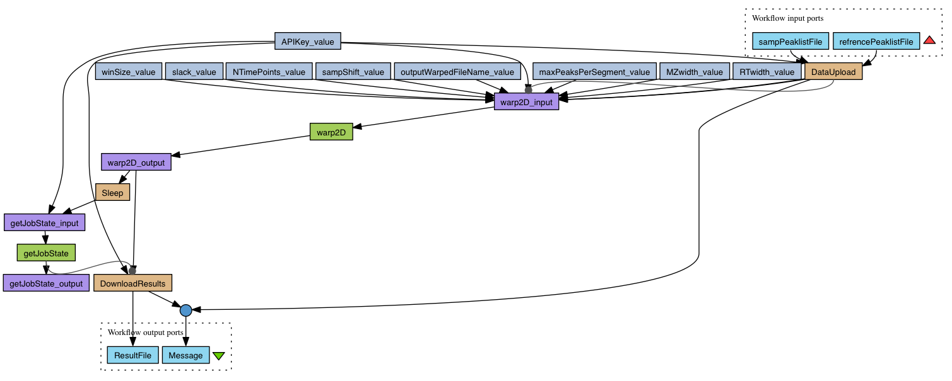

Slide 2
Stateful Invocation
Input Augmentation
Data Analysis
Data Moving
Output Extraction

Slide 3
wfdesc:Process
rdf:type
wfm:InputAugmentation
rdf:type
:processor/warp2D_input/
wfm:hasDataOperationMotif
_:mtf1
rdf:type
wfm:hasDataOperationMotif
_:mtf2
rdf:type
wfm:DataAnalysis
:processor/warp2D/
rdf:type
wfm:hasDataOperationMotif
_:mtf3
rdf:type
:processor/warp2D_output/
wfm:OutputExtraction
wfm:hasWorkflowMotif
rdf:type
_:mtf4
rdf:type
wfm:AsynchronousInvocation
:processor/getJobState/
wfm:hasWorkflowMotif
Class
:fragment
_:bnode
Property

Slide 4
wfdesc:Process :processor/warp2D_input/
wfm:hasDataOperationMotif
wfm:InputAugmentation _:mtf1
wfdesc:Process :processor/warp2D/
wfm:hasDataOperationMotif
wfm:DataAnalysis
_:mtf2
wfm:hasWorkflowMotif
wfdesc:Process :processor/getJobState/
wfm:AsynchronousInvocation
_:mtf4
wfm:hasWorkflowMotif
wfdesc:Process :processor/warp2D_output/
wfm:hasDataOperationMotif
wfm:OutputExtraction _:mtf3
: workflow fragment
_:blank node
Notes:
Previous figure modified by Dani to fit better in paper /html

Slide 5
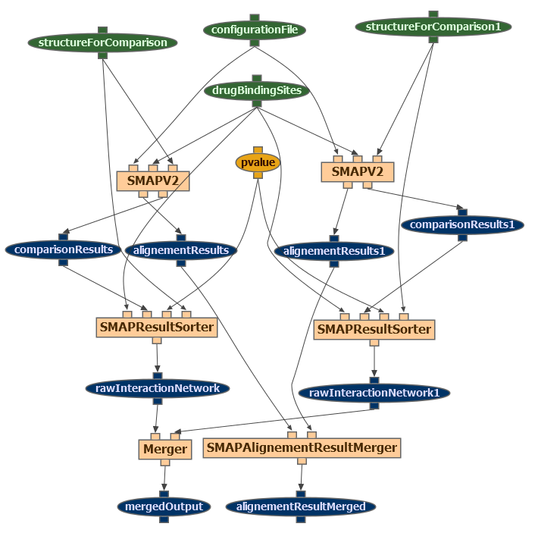
Data Analysis
Sort
Sort
Internal Macro
Sort
Merge
Merge
Notes:
Annotation of a Wings Workflow

Slide 6
opmw:WorkflowTemplateProcess :SMAPV2_1
wfm:hasDataOperationMotif
wfm:DataAnalysis _:mtf1
opmw:WorkflowTemplateProcess :SMAPResultSorter_1
wfm:hasDataOperationMotif
wfm:Sort
_:mtf2
:namedGraph1
wfm:hasWorkflowMotif
wfm:InternalMacro _:mtf3
wfdesc:WorkflowTemplateProcess :Merger
wfm:Combine
_:mtf4
wfm:hasDataOperationMotif
: workflow fragment
_:blank node

