Slide 1
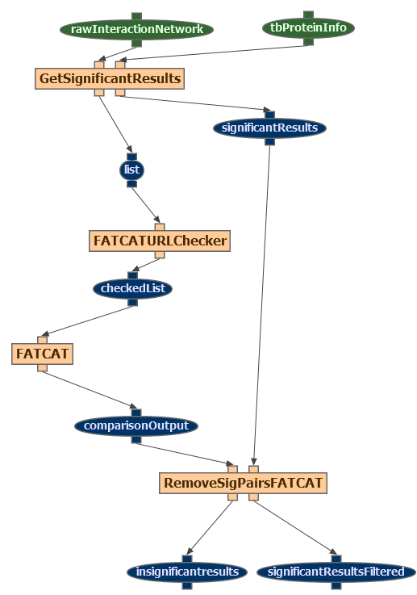
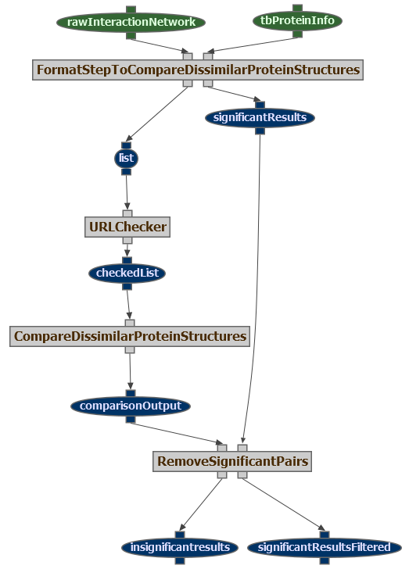
Executable and Abstract Workflow

Slide 2
OPM Representation (OLD)
Red: OPM model
Black: OPM profile (extension)
Artifact
hasArtifactTemplate
account
Artifact
Artifact
Artifact
Input artifact1
Input artifact2
hasArtifactTemplate
Execution Input1
Execution Input2
OPM Graph
user
used
account
hasArtifact
used
used
Account
used
Process
wasControlledBy
account
Workflow
template
Abstract template Node
Agent
Execution Node
Execution account
hasProcessTemplate
account
hasProcess
hasAbstractComponent
hasSpecificComponent
Process
hasArtifact
wasGeneratedBy
subClassOf
Abstract
component
Specific
component
wasGeneratedBy
account
Output
artifact1
hasArtifactTemplate
Execution result
Artifact
Artifact
hasWorkflowTemplate
Workflow Template
Execution Results

Slide 3




High Level Architecture
WINGS on local laptop
Core
Workflow
Template
OPM
export
Other
workflow
environments
Portal
Workflow
Instance
Programatic access
(external applications)
WINGS on shared host
Linked
Data
Publication
Core
Workflow
Template
OPM
export
Portal
Workflow
Instance
Interactive
Browsing
(Pubby frontend)
WINGS on web server
Core
Workflow
Template
OPM
export
Users
Portal
Workflow
Instance
Wings workflow generation
OPM
conversion
Publication
Share
Reuse

Slide 4
High Level Architecture for Workflow Publication
Abstract Workflow
(OPM)
Linked Data publication
RDF Upload Interface
Wings
OPM
conversion
OPM
conversion
ExecutableWorkflow
(OPM)
Other workflow frameworks
RDF
Triple
store
Permanent
web-accessible
file
store
OPM
import
Workflow
Data, Components, etc.
SPARQL Endpoint
Web accessible
Web browser

Slide 5
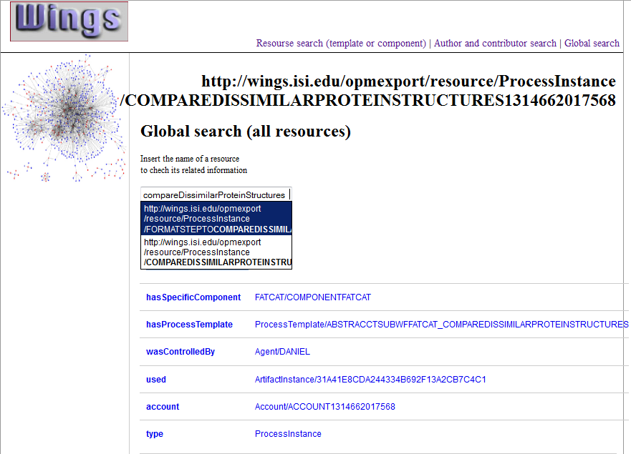
Types of
search
Resource URI
(Process instance)
Autocomplete search bar
Specific component used for this process instance
Resource Properties

Slide 6
OLD
opmv:Artifact
opmw:
WorkflowTemplateArtifact
artifact1
opmw:correspondsToTemplateArtifact
opmw:
ArtifactInstance
execInput1
opmv:
Agent
user1
opmo:account
opmw:uses
opmv:used
opmo:account
opmo:
Account
opmw:belongsToTemplate
opmv:wasControlledBy
opmv:Process
opmw:
WorkflowTemplate
template1
opmw:WorkflowTemplateProcess
templateNode1
opmw:ProcessInstanceexecutionNode1
opmo:
account
opmw:
ExecutionAccount
account1
opmw:
belongsToTemplate
opmw:correspondsToTemplateProcess
opmw:hasExecutableComponent
opmw:belongsToTemplate
opmv:wasGeneratedBy
opmo: account
opmw: isGeneratedBy
acwings:
ExecutableComponent
specComp1
opmw:
WorkflowTemplateArtifact
outputArtifact1
opmw:correspondsToTemplateArtifact
opmw:
ArtifactInstace
executionOutput1
opmv:Artifact
opmw:correspondsToTemplate
Abstract Workflow
Executable Workflow

Slide 7
opmv:Artifact
opmw:
WorkflowTemplateArtifact
artifact1
opmw:correspondsToTemplateArtifact
opmw:
ArtifactInstance
execInput1
opmv:
Agent
user1
opmo:account
opmw:uses
opmv:used
opmo:account
opmo:
Account
opmw:isVariableOfTemplate
opmv:wasControlledBy
opmv:Process
opmw:
WorkflowTemplate
template1
opmw:WorkflowTemplateProcess
templateNode1
opmw:ProcessInstanceexecutionNode1
opmo:
account
opmw:
ExecutionAccount
account1
opmw:
isStepOfTemplate
opmw:correspondsToTemplateProcess
opmw:hasExecutableComponent
opmw:isVariableOfTemplate
opmv:wasGeneratedBy
opmo: account
opmw: isGeneratedBy
acwings:
ExecutableComponent
specComp1
opmw:
WorkflowTemplateArtifact
outputArtifact1
opmw:correspondsToTemplateArtifact
opmw:
ArtifactInstace
executionOutput1
opmv:Artifact
opmw:correspondsToTemplate
Abstract Workflow
Executable Workflow

Slide 8
opmv:
Agent
WINGS
opmv:
Agent
Phil
dc:creator
opmv:
Agent
Daniel
opmw:createdInWorkflowSystem
dc:contributor
opmw:
WorkflowTemplate
template1
opmw:
hasDocumentation
“This is the documentation for template1….”
opmw:
versionNumber
“2”
dc:modified
dc:rights
“2011-09-29T15:54:56-07:00”
opmw:correspondsToTemplate
dc:rights
“http://creativecommons.org/licenses/by-sa/3.0/”
opmo:
Account
opmw:
ExecutionAccount
account1
opmw:executedInWorkflowSystem
opmv:
Agent
Pegasus
opmw:overallEndTime
opmv:
Agent
Condor
opmw:hasStatus
opmw:overallStartTime
“1317341784”
“1317342560”
“SUCCESS”

Slide 9
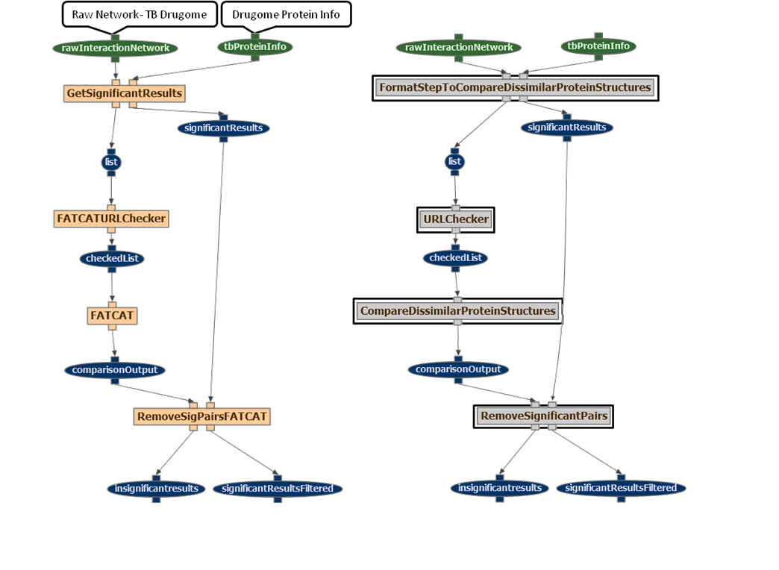
GetFATCATSignificantResults
GetSignificantResults
FATCATProteinIDChecker
ProteinIDChecker

Slide 10
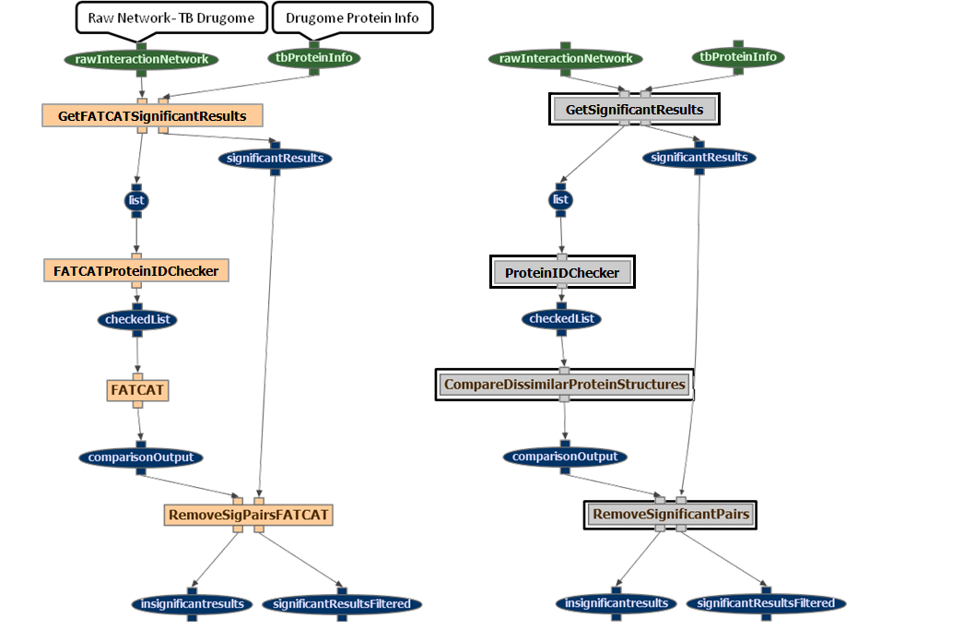

Slide 11
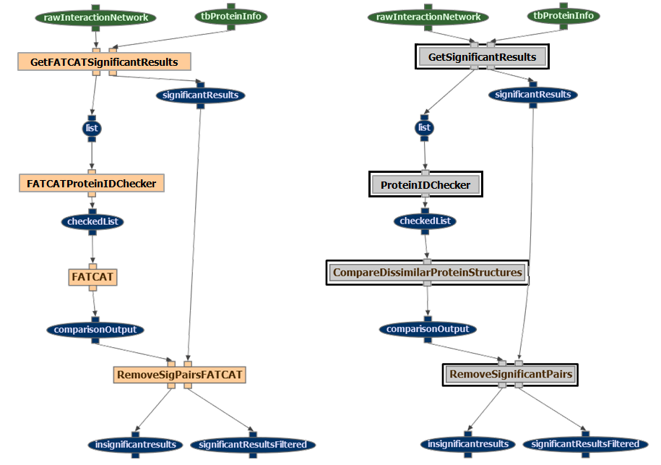
Figure 2a

Slide 12
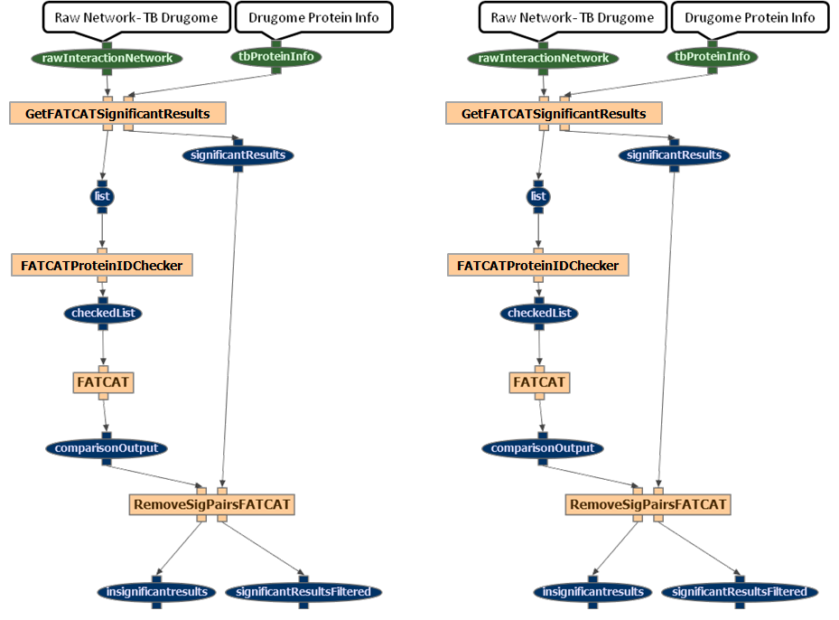
Figure 2b
SigR110293
FList100283
ChList1288
cOutPut09
NonSigResults1
SigResults1

Slide 13
Figure 2b
RawNetwork-TB1
DurgomeProtInfo1
RawNetwork-TB1
DurgomeProtInfo1
SigR110293
FList100283
ChList1288
cOutPut09
NonSigResults1
SigResults1

Slide 14
Figure 2b
RawNetwork-TBDrugome
Drugome
ProteinInfo
WorkflowRun123
NonSigResults1
SigResults1

