Slide 1
The NAF Automation Framework
Your Logo Here
A Modular Reference Architecture
Ryan Shaw, Christian Adell, Wim Hendrix, Damien Garros, Claudia de Luna, Dinesh Dutt

Slide 2
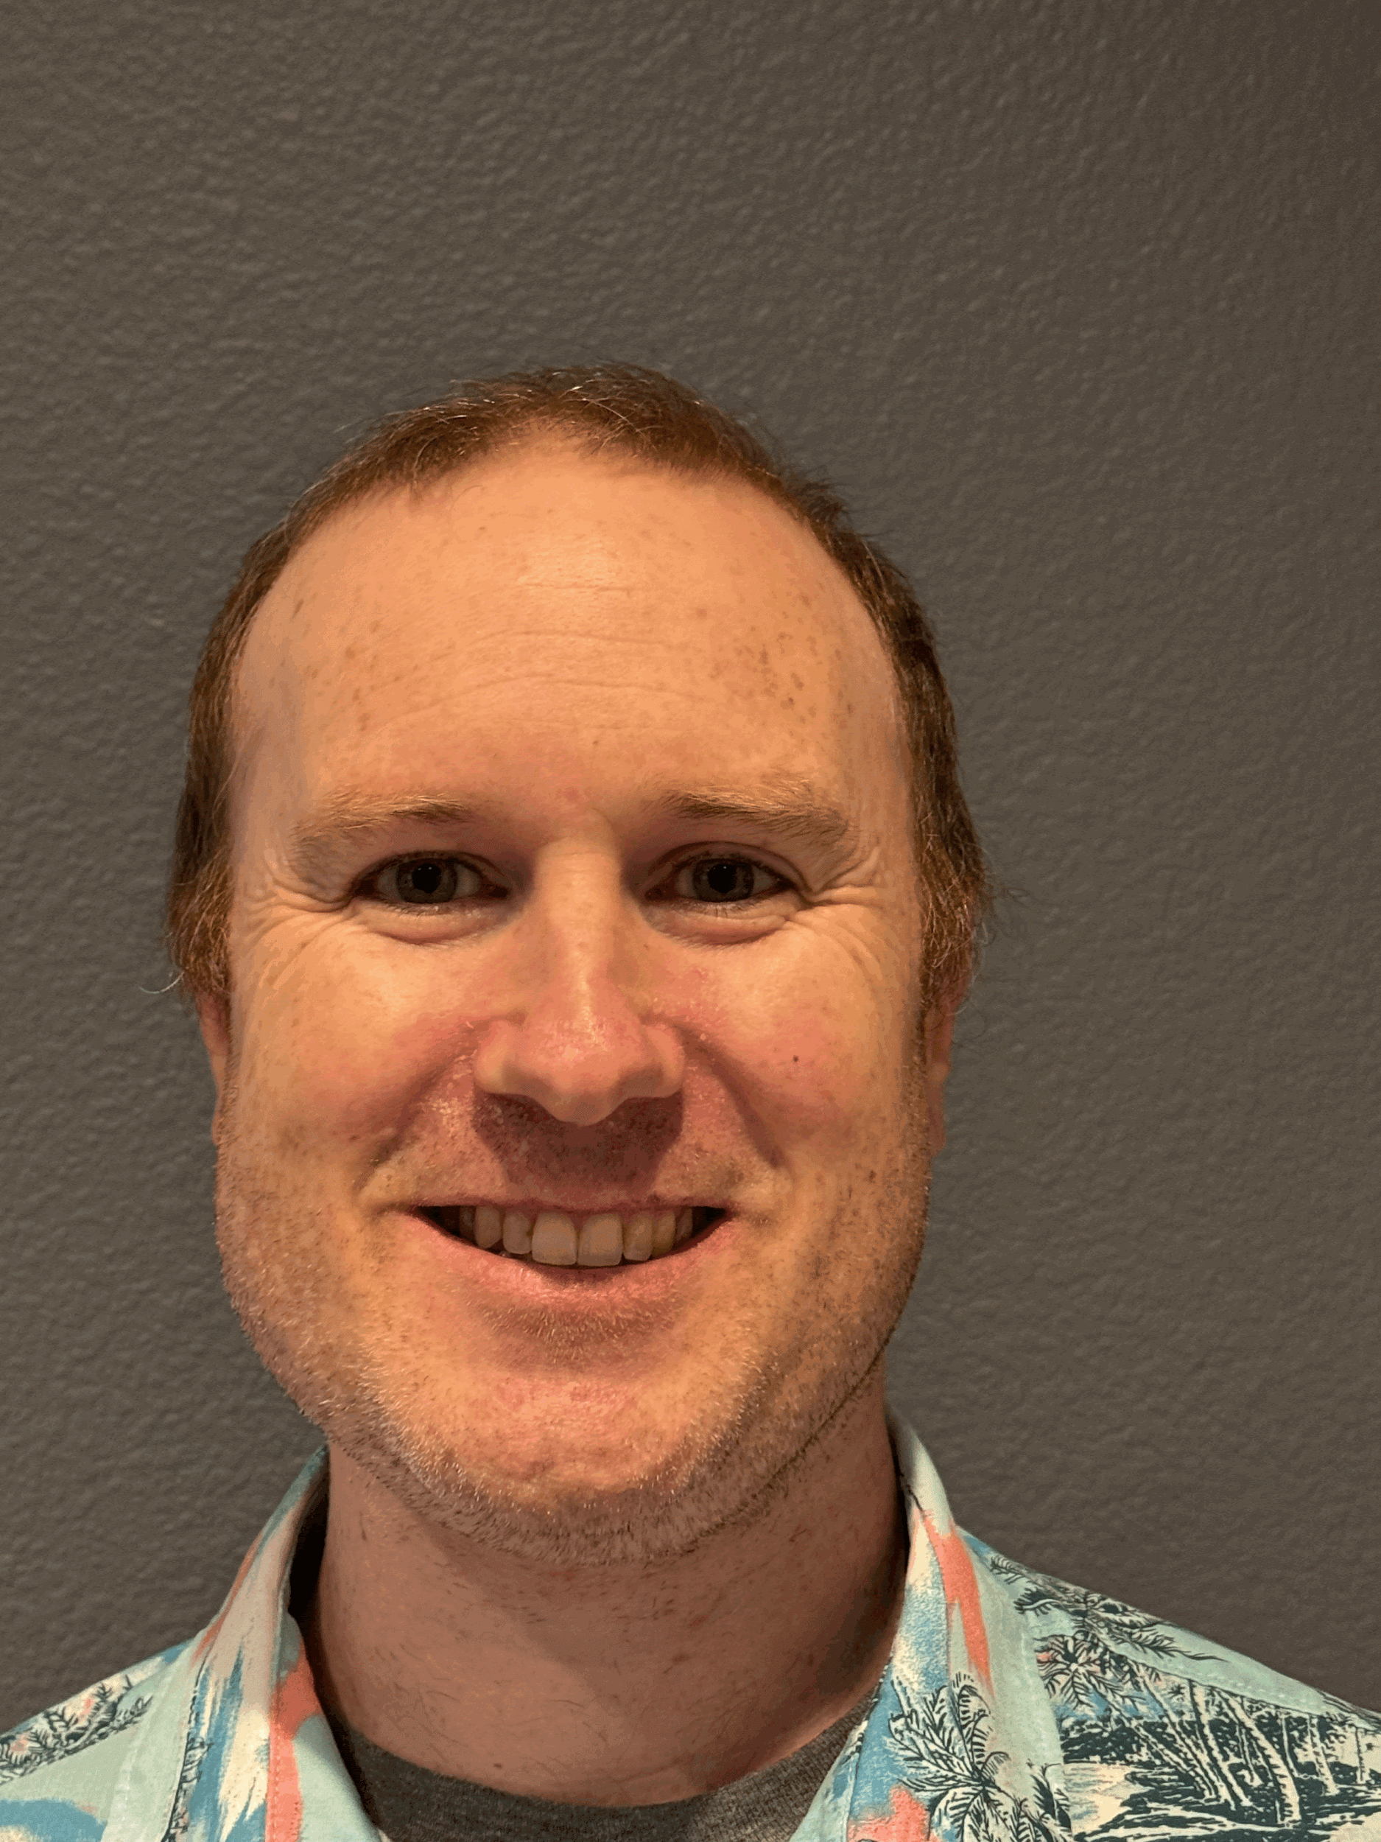
Is There a Real Ryan Shaw?

Slide 3
TL;DS
Simple building blocks that underpin any network automation framework
Terminology and a couple of key points

Slide 4
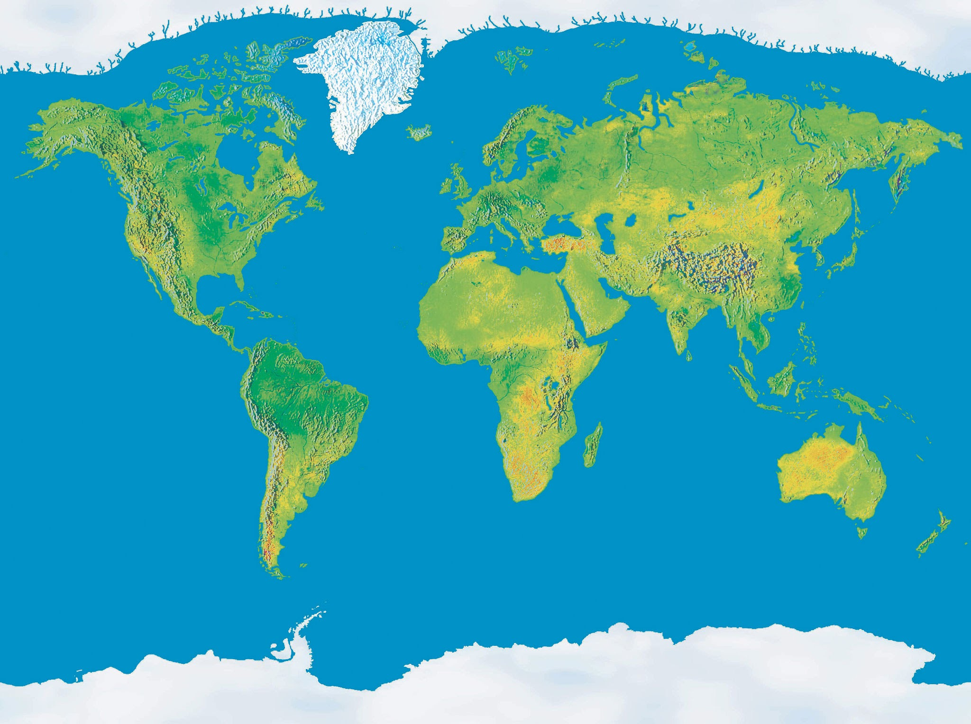
What It Is
Notes:
Grounded in network engineer best practices

Slide 5

What Problem Is It Meant to Solve?

Slide 6

Audience
Notes:
Apologies if your tribe is not in the picture, you most assuredly are in our minds

Slide 7
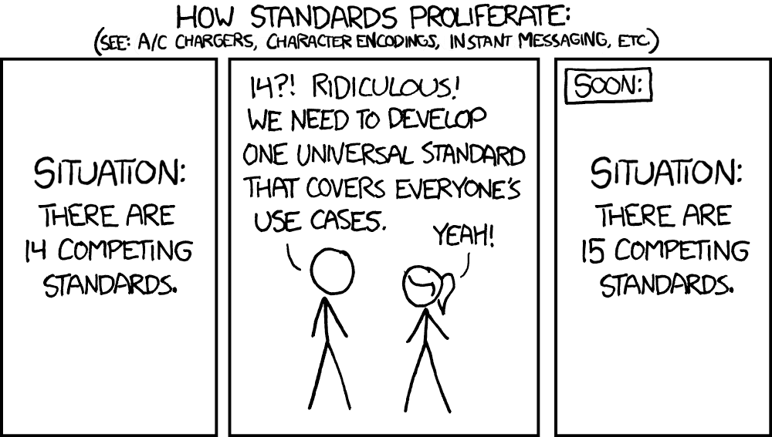
xkcd cartoon?
https://imgs.xkcd.com/comics/standards.png

Slide 8
What Else Is This Not?
Not recommending protocols or tools
Talk about characteristics and why they matter
Be inclusive, not exclusive

Slide 9
Multiple Perspectives
People who championed the current state
Operators (Ryan, Claudia)
Vendors (Wim, Srividya)
Automation engineers (Christian, Claudia, Ryan)
Management Vendors (Damien, Dinesh)
Community (NAF Slack and meetings)

Slide 10
Architecture
Presentation
Orchestrator
Observability
Intent
Collector
Executor
Network Devices

Slide 11
Why These Blocks?
Blocks are:
Functional
Simple
Composable
Framework handles growth in:
User sophistication
Network scale

Slide 12
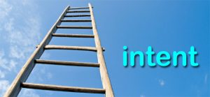
Intent
Captures expected outcomes
SHOULD be:
Versioned
Extensible
Normalized
Declarative

Slide 13

Observability
Captures Operational Truths
SHOULD be:
Timestamped
Queryable
https://p0.piqsels.com/preview/68/699/589/observe-monitoring-spy-search.jpg

Slide 14
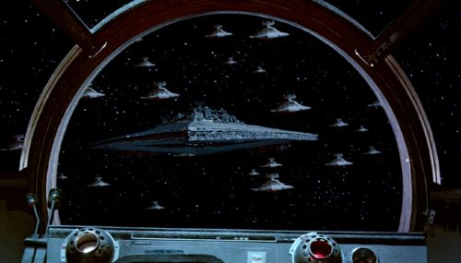
Executor
Pushes the configuration
SHOULD be:
Multi-protocol
Dry-runnable
Idempotent
https://www.starwars-universe.com/vehicule-253-super-destroyer-stellaire-de-classe-executor-executor.html

Slide 15

Collector
Gather data from network devices
SHOULD:
Support push/pull
Multi-vendor
Multi-protocol

Slide 16

Orchestrator
Allows sophisticated coordination and integration of the various blocks
SHOULD handle failure scenarios, recovery from failures

Slide 17

Presentation
How humans interact with the system
SHOULD be multi-modal
Does not imply a “a single pane of glass”, nor precludes it

Slide 18
What Else?
Srividya working on examples to buttress
Urs/Steinn working on redoing their toolkit picture to fit these categories
Implementation docs

Slide 19
Next Steps
Seek community input
Use that to decide how to expand and make this document more useful
Iterative but fast (measurable progress presented each AC)

Slide 20
Links
Github - https://github.com/Network-Automation-Forum/reference/blob/main/docs/Framework/Framework.md

Slide 21
Questions?

