Slide 1

The Network Automation Map
Navigate Your Journey with the
NAF Automation Framework
Pete Crocker
OpsMill
ESNOG 35

Slide 2

About Me
Pete Crocker
Director of Solution Architecture
OpsMill

Slide 3
Introduction

Slide 4

Modern networks demand automation that teams can trust, understand, and safely evolve.
Notes:
Before talking about NAF, let’s talk about state of network automation in the industry
What were seeing:
Need for automation that people can trust
it’s understandable
and can evolve
Why haven’t we seen more network automation?
Not a lot of mature solutions
A lot of scripting

Slide 5

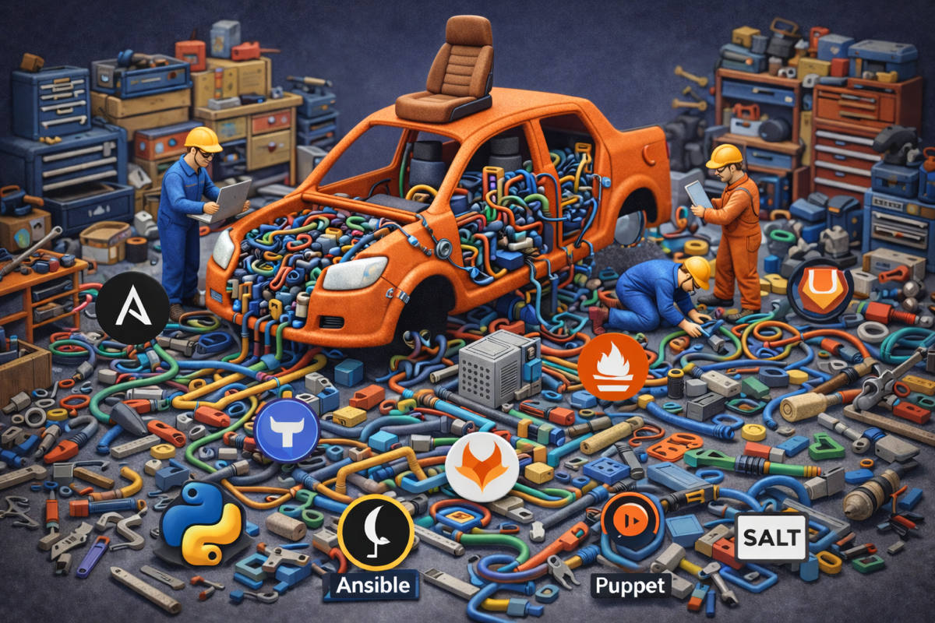
Yet, it’s still overly complicated for most organizations Building it is hard, maintaining it is almost impossible

Slide 6
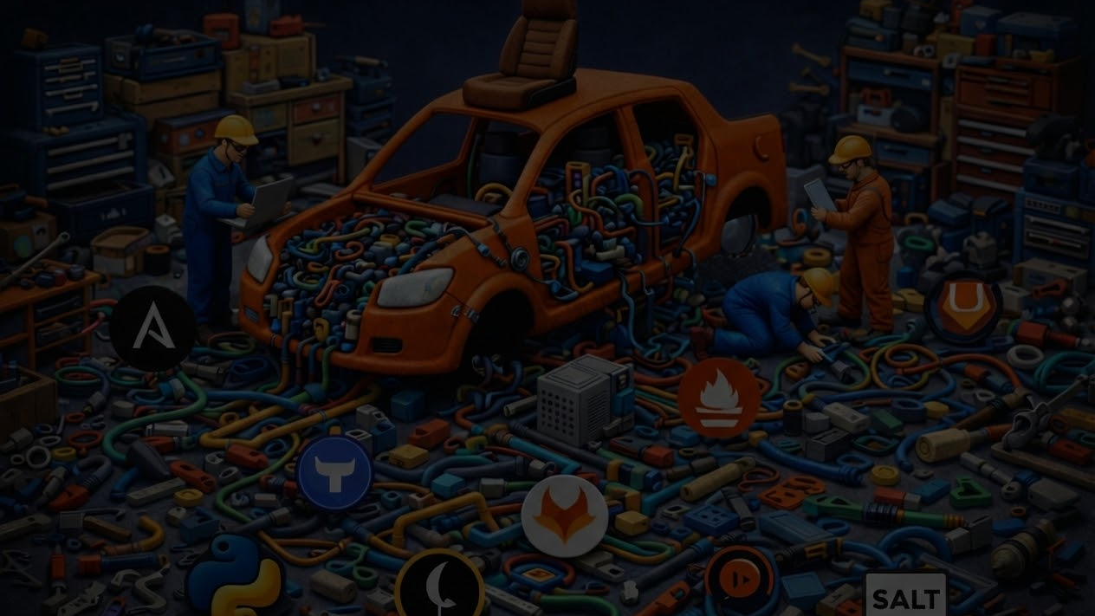
The pattern we keep seeing
Rebuild from scratch
Learn the hard way
No shared blueprint for what ‘good’ looks like
Teams keep recreating the same building blocks—data models, pipelines, integrations
Most “best practices” are discovered through outages, drift, and painful rewrites instead of repeatable patterns.
Without a common map, it’s hard to assess maturity, compare architectures, or even agree on what problem to solve first.

Slide 7


Multiple people from the NAF community got together to find a solution
It quickly turned into a working group with weekly meetings

Slide 8

It was hard at first
Everyone was biased by their own tools and habits
Ironically, we were missing a shared lexicon

Slide 9
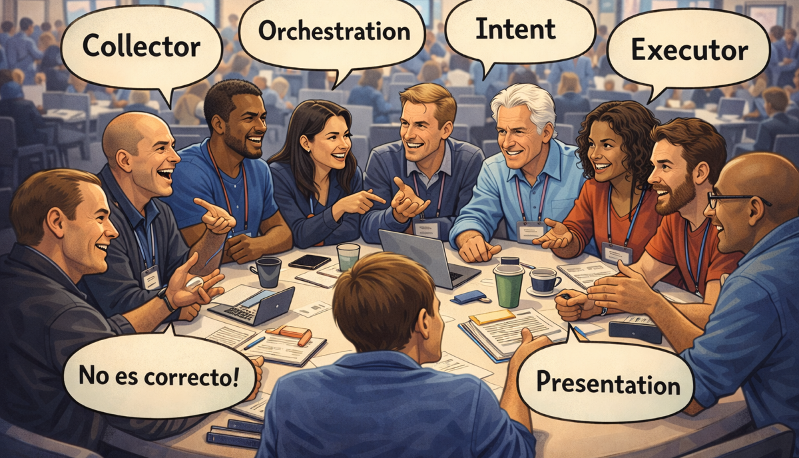
The solution was to stop focusing on tools and focus on functional building blocks
Quickly, everyone started talking the same language

Slide 10
Simple building blocks that
underpin any network
automation framework
NAF
Automation
Framework
Not a reference architecture
— it’s a shared vocabulary +
responsibilities.

Slide 11







Ryan Shaw
Dinesh Dutt
Dinesh Dutt
Christian Adell
Christian Adell
Claudia de Luna
Claudia de Luna
Srividya Iyer
Wim Henderickx
The NAF Community
Wim Henderickx
Damien Garros
The Team behind the Working Group

Slide 12
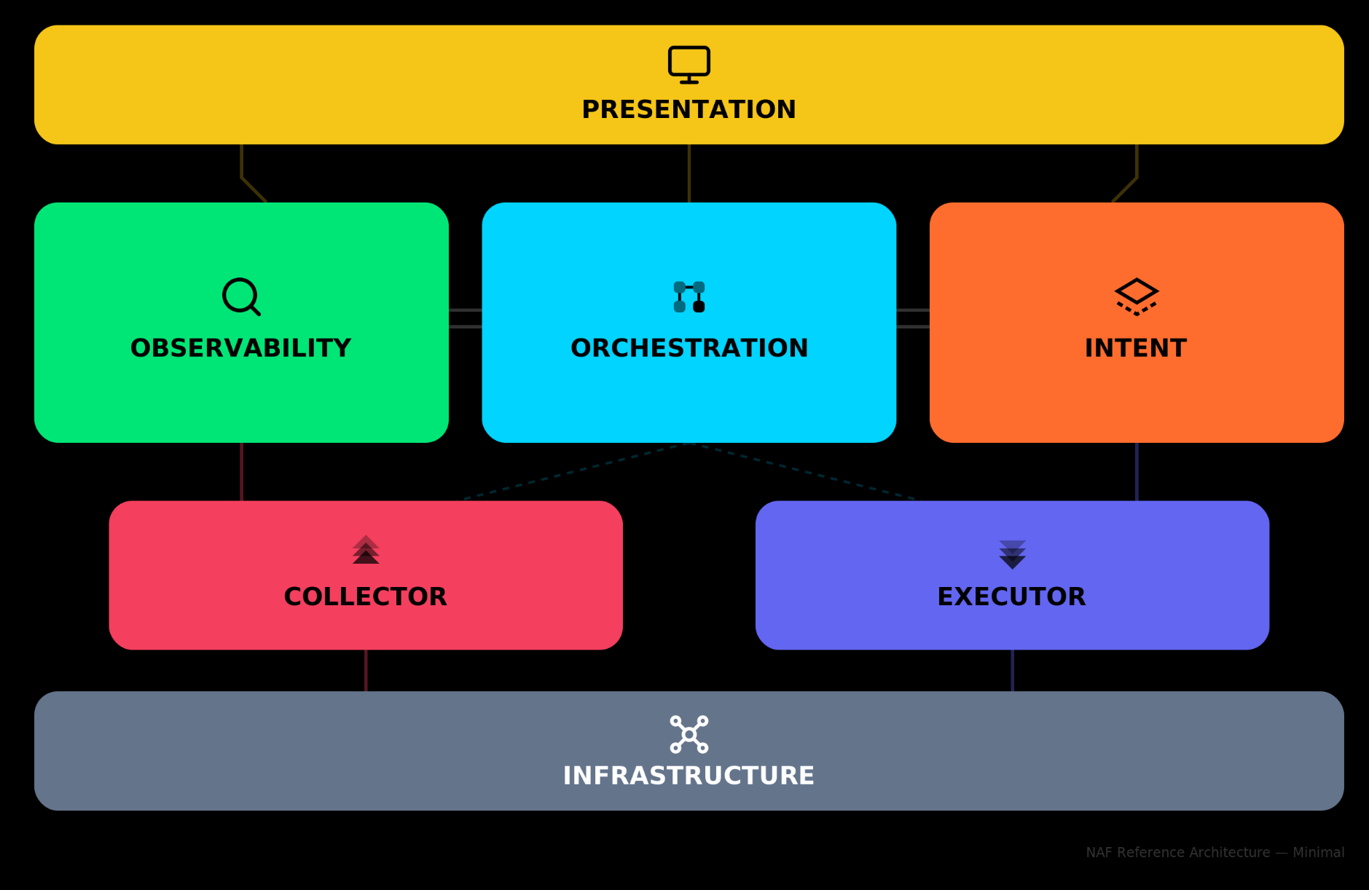
NAF Automation Framework
Notes:
Intent: desired state of the network, including both configuration and operational expectations.
Observability: It persists the actual network state, and defines the logic to process it.
Orchestrator: Defines how the automation tasks are coordinated and executed in response to events.
Executor: Encompasses the actual tasks applied to the network to drive changes (e.g., updating configuration) as guided by the intended state.
Collector: In contrast to Executor, this component focuses on retrieving (i.e., reading) the actual state of the network.
Presentation: Provides the interfaces through which users interact with the system, including dashboards, graphical user interfaces (e.g., ITSM), and CLI tools.

Slide 13

NAF Automation Framework Fundamentals
Functional Building Blocks
Living Document
Not a Protocol
Both for Beginners and Experts
The NAF automation framework is meant to be tool agnostic to avoid comparing apple and orange.
Each functional building block can be mapped to one or more tools and each tool can map to multiple functional blocks.
The NAF automation framework is meant to evolve over time.
It’s not a strict implementation that imposes a specific way of doing things and in many cases, not all components are required to get started.
The NAF automation framework initiative is focusing initially on laying out the main building blocks to lay the foundation.
In the future the goal is to go deeper into each block.

Slide 14
A map to help navigate the terminology and understand how things are related to each other
Presentation
Observability
Orchestration
Intent
Collector
Executor
Infrastructure

Slide 15
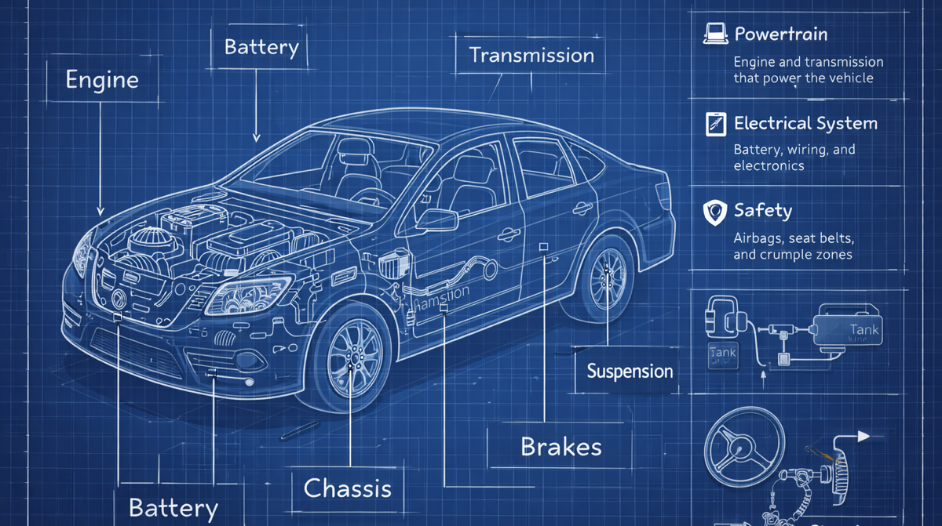
A functional blueprint to help everyone understand and build Network Automation Stack (system thinking)
Notes:
Need to explain the need to think about it as a system (system thinking)

Slide 16
Target Audience
Builders
Users
Network Automation Engineer
Network Engineer
Automation Architect
Network Ops
Software Engineer
Network Architect
Network Reliability Engineer
Engineering Manager

Slide 17

Wait, what about my tools ? Are they gone ?

Slide 18
Mapping between functional blocks and tools
Observability
Collector
Presentation
gNMIc
Each tool / product / project can map
Completely or Partially to
One or Multiple blocks
Prometheus
Grafana
SuzieQ
Kentik

Slide 19
Where do I start?
Do I need to implement all blocks to get started?
No, you should only implement what is required for your use case(s)
Is there a specific order to get started?
No, it really depends on your use case(s).

Slide 20
Main functional
Building blocks

Slide 21
What defines a functional building block
A tool-agnostic function in the automation system —
A chunk of responsibilities with clear goals, inputs/outputs, and capabilities
Purpose / Goals
Capabilities
Boundaries
what outcome it exists to deliver
expressed as MUST / SHOULD / MAY (requirements, not products)
what it does and what it does not do (inputs → outputs)

Slide 22
Intent

Slide 23
Defines the logic to handle and the persistence layer to store the desired state of the network, including both configuration and operational expectations.
Intent

Slide 24
Source of Truth ✘
Intent ✔
Source of Truth has been the root cause of many misunderstandings within our industry.
Intent is meant to provide a more accurate definition

Slide 25
Intent - Introduction
Inventory
Cabling / Topology
DCIM
Circuit
IPAM
Roles/Statuses
Configuration
Templates
Routing
Information
Services
What do you need to rebuild it
if the network was completely lost?

Slide 26

Why do we need the Intent

Slide 27
Declarative vs Imperative
configure terminal
interface GigabitEthernet0/1
switchport access vlan 10
exit
Exit
write memory
interface:
name: GigabitEthernet0/1
vlan: 10
Imperative - HOW
Declarative - WHAT
- Manually describe the step-by-step recipe.
- If something goes wrong halfway, state may be inconsistent.
- You describe the desired end state, not the steps to get there.
- Easier to make idempotent and retry safely.
- Vendor neutral

Slide 28
Differences between Cloud and Networking
Cloud
Networking
Declarative
Git
Git, Netbox, Nautobot, Infrahub
Imperative
Optional
Optional

Slide 29
Intent - Requirements
MUST be capable of representing, in a structured form, any network-related aspect.
SHOULD use a neutral representation that will be derived into vendor-specific configuration artifacts
MUST support create, read, update, and delete operations
SHOULD include metadata that supports effective data governance
MUST be exposed through a standardized, well-documented API
SHOULD be transactional, and provide a versioned access to data.
SHOULD provide a consistent and unified view of the desired state
MAY include all the logic related to intended state management

Slide 30
Executor

Slide 31
Executor
Encompasses the actual tasks applied to the network to drive changes (e.g., updating configuration) as guided by the intended state.

Slide 32
Executor - Requirements
MUST be capable of interacting with any of the supported network write interfaces
SHOULD provide a dry-run operation to check the expected result of the execution
SHOULD come from the intended state or be derived from it
SHOULD support transactional execution of the changes
SHOULD support any network operation that alters the network state
MAY support both imperative and declarative approaches

Slide 33
Observability
Collector

Slide 34
Observability
Stores the actual network state, and defines the logic to process the observed data.
Collector
Focuses on retrieving (i.e., reading) the actual state of the network.

Slide 35
Observability Sources
Logs
Metrics
Traces
Flows
Packet Captures
State
Config
Probes

Slide 36
Observability Stack: some questions to ask
Query / Event / Insights Logic
Storage
Which Data retention Policy?
Enrichment
Provide Context to the data
Normalization
Make the data vendor neutral (Optional)
Push, Pull or both?
Which protocol to use?
Collector
What to collect? Static or dynamic?
Network Infrastructure

Slide 37
Observability - Requirements
MUST support historical data persistence
SHOULD automatically generate events when discrepancies are detected
MUST offer programmatic access to this data
data SHOULD be normalized into vendor agnostic data model
SHOULD offer a capable query language to extract the data.
events MAY be processed by humans or connected to the Orchestration
SHOULD expose relevant insights into the current network state
MAY be enriched with contextual information from the intended state

Slide 38
Collector - Requirements
MUST include capabilities for retrieving live data from the network using read interfaces (push, pull)

Slide 39
Orchestrator

Slide 40
Orchestrator
Coordinates activities across various building blocks

Slide 41


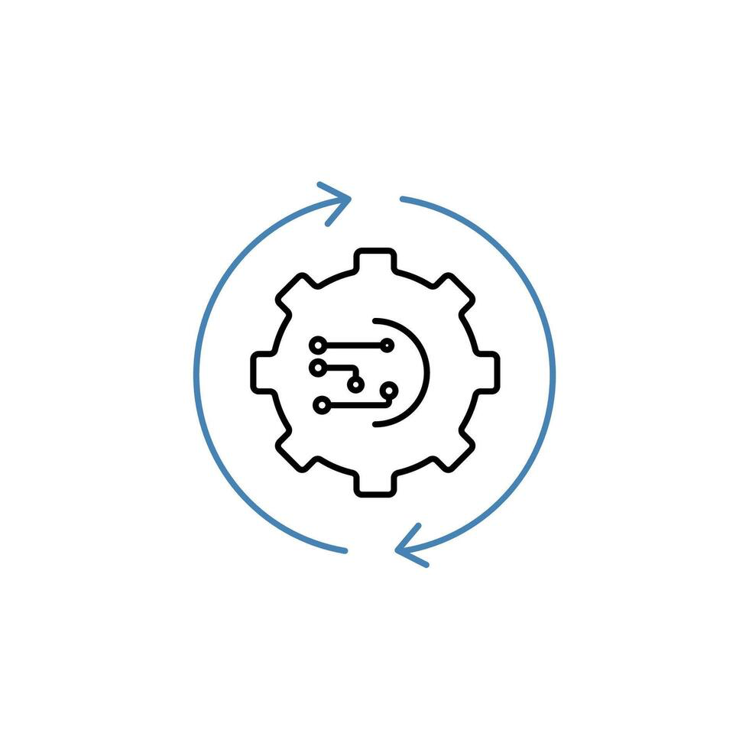
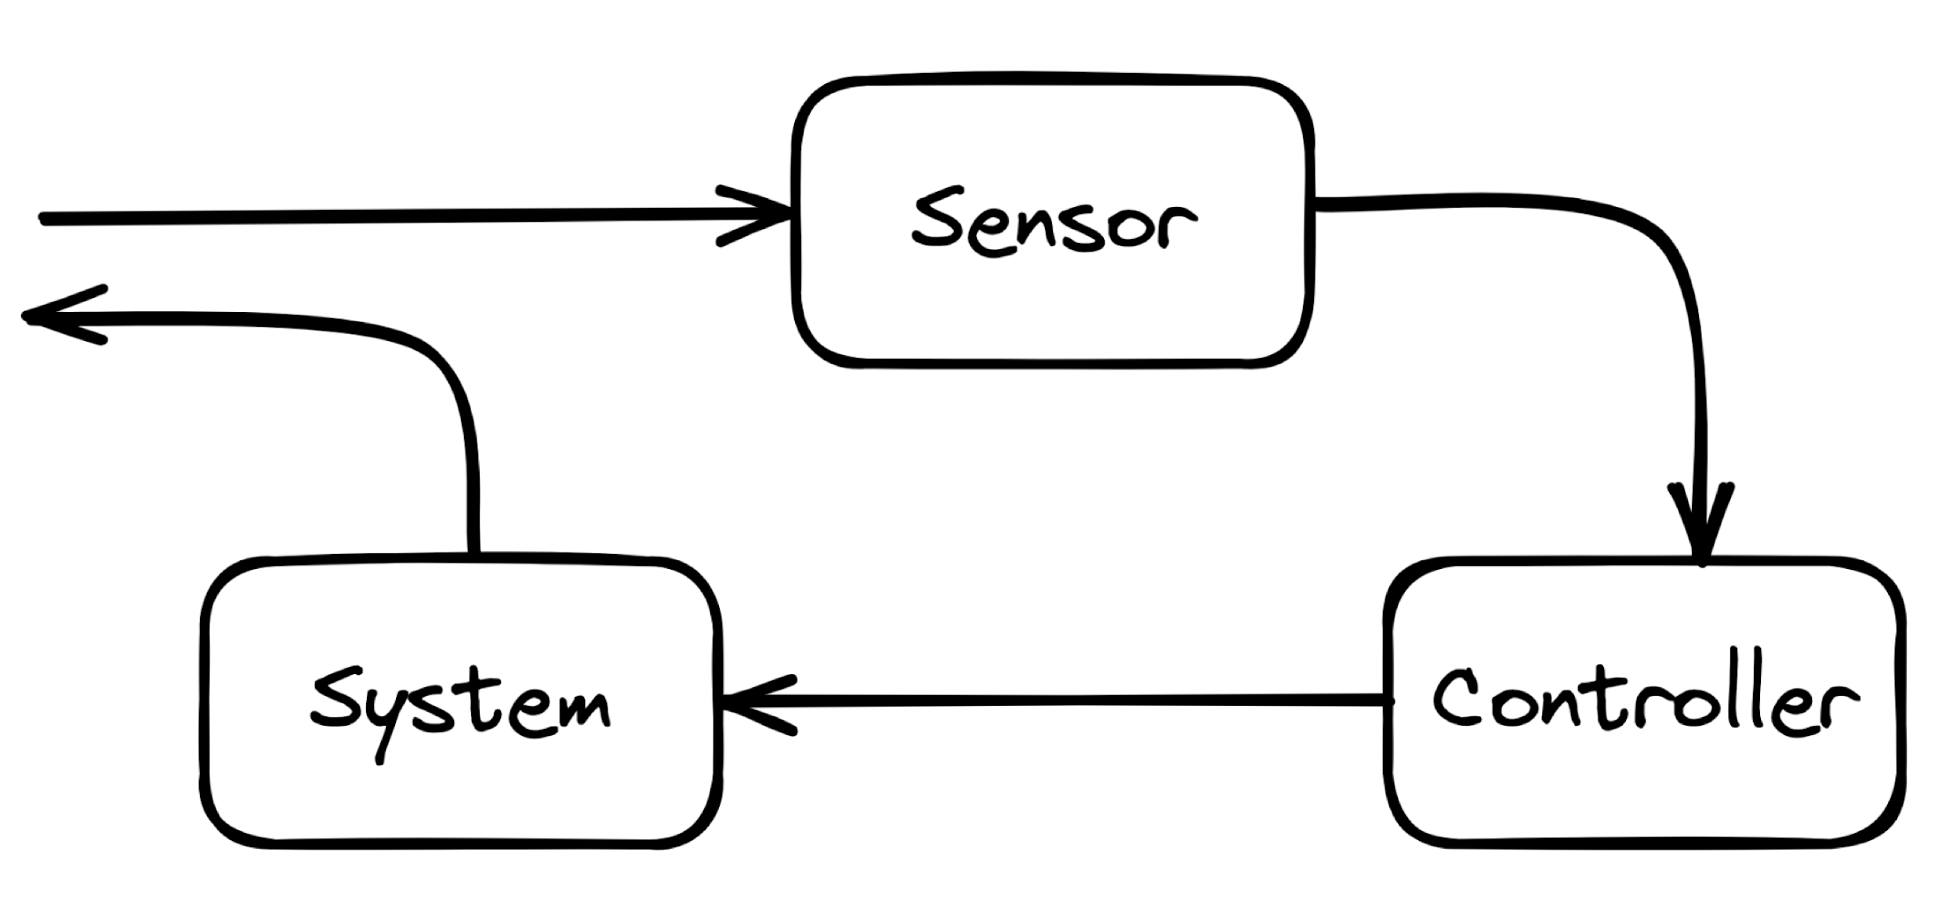
Event Driven Control Loop: Sense - Logic (Reason) - Act
Sense
Logic
Act
Runtime

Slide 42
Orchestration implementation approaches
Monolith
Workflow
Choreography
Agentic
fn
1
task
1
task
1
tool
1
fn
2
fn
3
task
2
graph
task
3
task
2
Pub Sub
task
3
tool
2
tool
3
fn
4
task
4
task
4
tool
4
E.g. a python program
Ansible (predefined workflow)
Event driven and distributed
Agentic

Slide 43
Orchestration: Trust
TRUSTED
- controller style
NOT TRUSTED
- change log/approval style
- Dry-run
- Diff (before/after)
- Rollback

Slide 44
Gaining Trust: Dry Run - Rollback - Diff
Diff:
- What changed?
- Review the changes before applying to the network
DRY-RUN
BEFORE
AFTER
Try the workflow without applying it to the network
Rollback:
- Something bad happened, move back to a well known good state

Slide 45
Orchestrator - Requirements
MUST enable to coordinate processes across the various building blocks
SHOULD provide a dry-run operation to check the expected result of the workflow
Process execution SHOULD follow an event-driven approach
SHOULD provide logging and traceability of past and current workflows
Execution logic SHOULD allow for reverse/compensating actions
MAY include logic to correlate multiple events, infer relationships
SHOULD provide the ability to schedule the execution of a workflow

Slide 46
Presentation

Slide 47
Presentation
Provides the interfaces through which users interact with the system, including dashboards, graphical user interfaces

Slide 48
It is designed to interface with any of the other building blocks as required, serving as the primary point of contact between humans and the automation system, but this does not imply the need for a single pane of glass.
Presentation
It's important to separate the presentation layer to avoid building workflows that are specific to one tool / interface

Slide 49
Presentation - Requirements
MUST provide robust authentication and authorization capabilities.
MAY take various forms depending on the needs of the end user
MAY support both read and write interactions

Slide 50
Practical Example

Slide 51

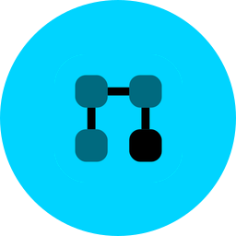




Example
Roll Out a New Subnet Across 50 Sites
A practical example showing how the NAF building blocks work together to deploy, validate, and remediate a network change at scale.
THE PROBLEM
Deploy a new subnet (10.100.0.0/24) across 50 branch sites, validate that it's working on every device, and automatically alert and remediate if any site falls out of compliance.
HIGH-LEVEL WORKFLOW
→
→
→
→
→
Define
Intent
Orchestrate
Deploy
50 devices
Collect
Actual state
Validate
Desired vs Actual
Dashboard
□ / □ per site
Infrahub
AWX
Ansible
gNMIc
Prometheus
Grafana

Slide 52

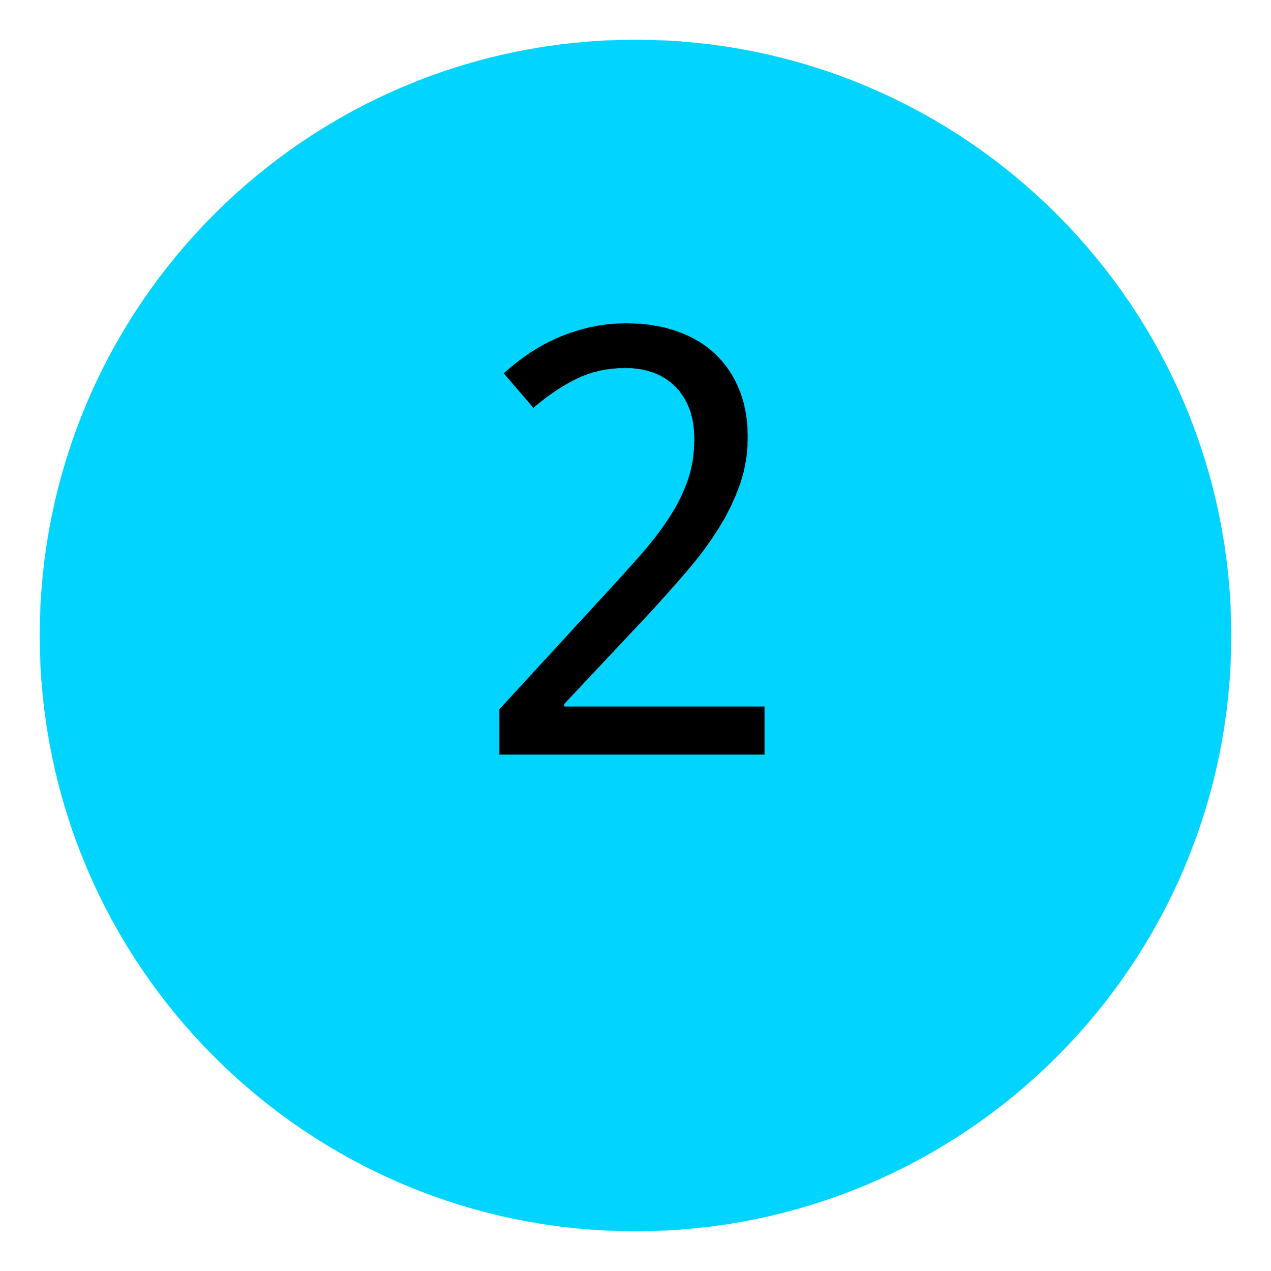







Example - Step-by-Step Workflow
INTENT — SOURCE OF TRUTH
ORCHESTRATOR — TRIGGER
Engineer enters the desired config: subnet, VLAN, routing. This is stored as the Desired State.
Receives a webhook about the change and triggers the Executor to begin deployment.
Infrahub
AWX
EXECUTOR — DEPLOY
COLLECTOR — GATHER STATE
Reads from the Intent API, generates device-specific configs, and pushes them via NETCONF to all 50 routers.
Connects to each device and retrieves actual interface configs, IP addresses, and routing tables.
Ansible
gNMIc
OBSERVABILITY — VALIDATE
↻ REMEDIATION LOOP
ORCHESTRATOR — REMEDIATE
Compares Desired State against Actual State. Mismatches are exposed as metrics and trigger alerts.
When an alert fires, automatically re-runs the Executor on the failing site, re-collects, and validates.
Prometheus
AWX
PRESENTATION — VISIBILITY
NETWORK — FOUNDATION
Dashboard shows all 50 sites: compliant ✓ or drifted ✗. Non-technical users can trigger manual remediations.
Success depends on device capabilities (e.g. NETCONF support). Limitations here affect the entire flow.
Grafana
50 routers
NETWORK AUTOMATION FRAMEWORK · USE CASE TEMPLATE

Slide 53
Example - Mapping to the Framework
SLIDE 3 OF 3
STEP 1 → INTENT · INFRAHUB
Engineer defines desired config — the single source of truth for what the network should look like.
STEPS 2, 6 → ORCHESTRATION · AWX
Coordinates the workflow: triggers deployment, handles alerts, and runs remediation loops.
STEP 3 → EXECUTOR · ANSIBLE
Generates and pushes device configs via NETCONF to all 50 sites.
STEP 4 → COLLECTOR · GNMIC
Reads the actual state from each device after deployment.
STEP 5 → OBSERVABILITY · PROMETHEUS
Compares desired vs. actual, exposes drift as metrics, triggers alerts.
STEP 7 → PRESENTATION · GRAFANA
Dashboard shows compliance status per site with drill-down.

Slide 54
Additional Resources

Slide 55
Additional Resources
Designing Network
Automation at Scale
NAF Network Automation
Solution Wizard
A comprehensive guide to designing scalable, reliable, and maintainable network automation systems
This application helps you apply the Network Automation Forum's NAF to your automation projects.
https://designingnetworkautomation.com/
By Christian Adell
https://naf-naf-wizard.streamlit.app/
By Claudia de Luna

Slide 56
Summary
• Not a standard, it’s a guide
• You don’t need everything to get started
• Think Automation as a system
• Focus on functional first, tools later
• Each tool can map to multiple building blocks
• Don’t reinvent the wheel
• Map your existing workflow toward the framework
• Give us some honest feedback good and bad

Slide 57
How can you help
Use case document Github:
https://github.com/Network-Automation-Forum/reference/blob/main/docs/Framework/Framework.md
Tool mapping
Expand details per building block
NAF Slack channel:
https://networkautomationfrm.slack.com/archives/C082G6VGZHP

Slide 58

Observability
Collector

Slide 59
Observability
Stores the actual network state, and defines the logic to process the observed data.
Collector
Focuses on retrieving (i.e., reading) the actual state of the network.

Slide 60
Observability Sources
Logs
Metrics
Traces
Flows
Packet
Captures
State
Config
Probes

Slide 61
Observability Stack: some questions to ask
Query | Event | Insights logic
Storage
Which Data retention Policy?
Enrichment
Provide Context to the data
Normalization
Make the data vendor neutral (Optional)
- Push, Pull or both?
- Which protocol to use and what is
supported by the vendor?
Collector
What to collect?
Network infrastructure

Slide 62
Observability - Requirements
MUST support historical data persistence
SHOULD automatically generate events when discrepancies are detected
MUST offer programmatic access to this data
data SHOULD be normalized into vendor agnostic data model
SHOULD offer a capable query language to extract the data.
events MAY be processed by humans or connected to the Orchestration
SHOULD expose relevant insights into the current network state
MAY be enriched with contextual information from the intended state

Slide 63
Collector - Requirements
MUST includes capabilities for retrieving live data from the network using read interfaces (push, pull)

Slide 64
Orchestrator

Slide 65
Coordinates activities across various building blocks
Orchestrator

Slide 66
Event Driven Control Loop: Sense - Logic (Reason) - Act
Sense
→
Logic
→
Act
Runtime
Sensor → Controller → System (feedback loop)

Slide 67
Orchestration implementation approaches
Monolith
Workflow
Choreography
Agentic
fn
1
task
1
task
1
tool
1
fn
2
fn
3
task
2
graph
task
3
task
2
Pub Sub
task
3
tool
2
tool
3
fn
4
task
4
task
4
tool
4
E.g. a python program
Ansible (predefined workflow)
Event driven and distributed
Agentic

Slide 68
Orchestration: Trust
TRUSTED
- controller style
NOT TRUSTED
- change log/approval style
- Dry-run
- Diff (before/after)
- Rollback

Slide 69
Gaining Trust: Dry Run - Rollback - Diff
Diff:
- What changed?
- Review the changes before
applying to the network
DRY-RUN
BEFORE
AFTER
Try the workflow without
applying it to the network
Rollback:
- Something bad happened,
move back to a well known good state

Slide 70
Orchestrator - Requirements
MUST enable to coordinate processes across the various building blocks
SHOULD provide a dry-run operation to check the expected result of the workflow
Process execution SHOULD follow an event-driven approach
SHOULD provide logging and traceability of past and current workflows
Execution logic SHOULD allow for reverse/compensating actions
MAY include logic to correlate multiple events, infer relationships
SHOULD provide the ability to schedule the execution of a workflow

