Slide 1

The Network Automation Map
Navigate Your Journey with the
NAF Automation Framework
Christian Adell
Coreweave
Damien Garros
OpsMill
ITNOG10

Slide 2


About Us
Christian Adell
Damien Garros
Staff Engineer
Coreweave
Co-founder and CEO
OpsMill

Slide 3
Introduction

Slide 4

Modern networks demand automation that teams can trust, understand, and safely evolve.

Slide 5


Yet, it’s still overly complicated for most organizations Building it is hard, maintaining it is almost impossible

Slide 6
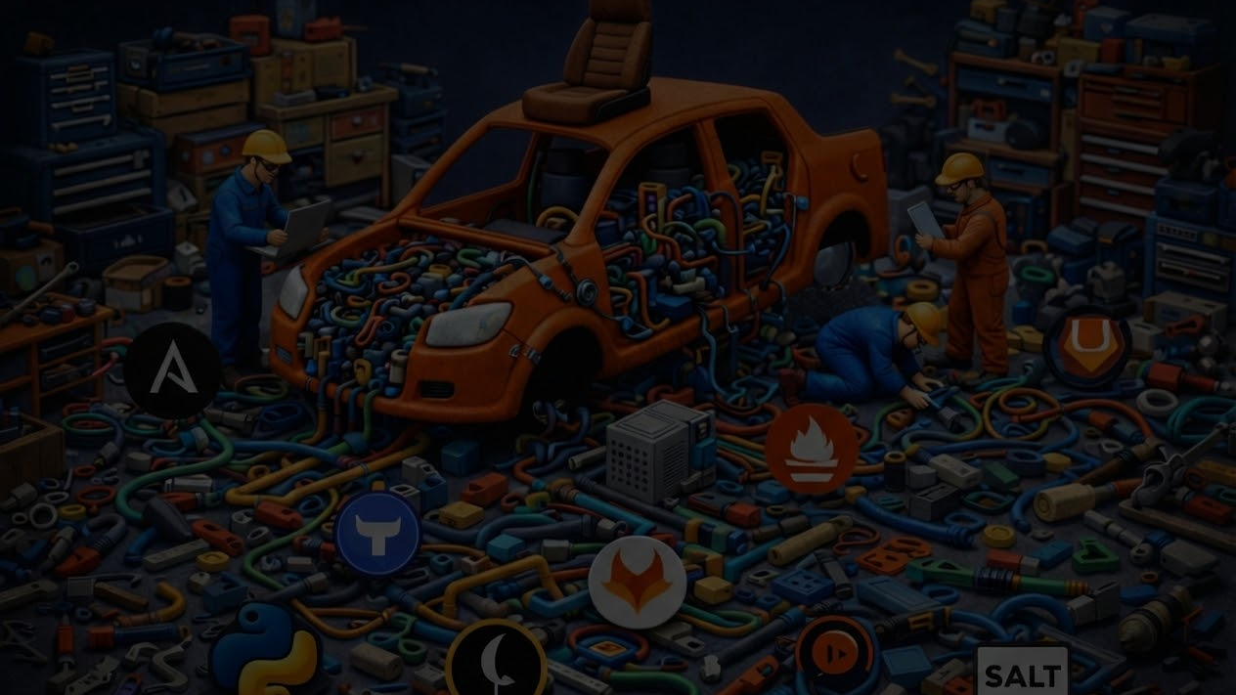
The pattern we keep seeing
Rebuild from scratch
Learn the hard way
No shared blueprint for what ‘good’ looks like
Teams keep recreating the same building blocks—data models, pipelines, integrations
Most “best practices” are discovered through outages, drift, and painful rewrites instead of repeatable patterns.
Without a common map, it’s hard to assess maturity, compare architectures, or even agree on what problem to solve first.

Slide 7


Multiple people from the NAF community got together to find a solution
It quickly turned into a working group with weekly meetings

Slide 8

It was hard at first
Everyone was biased by their own tools and habits
Ironically, we were missing a shared lexicon

Slide 9
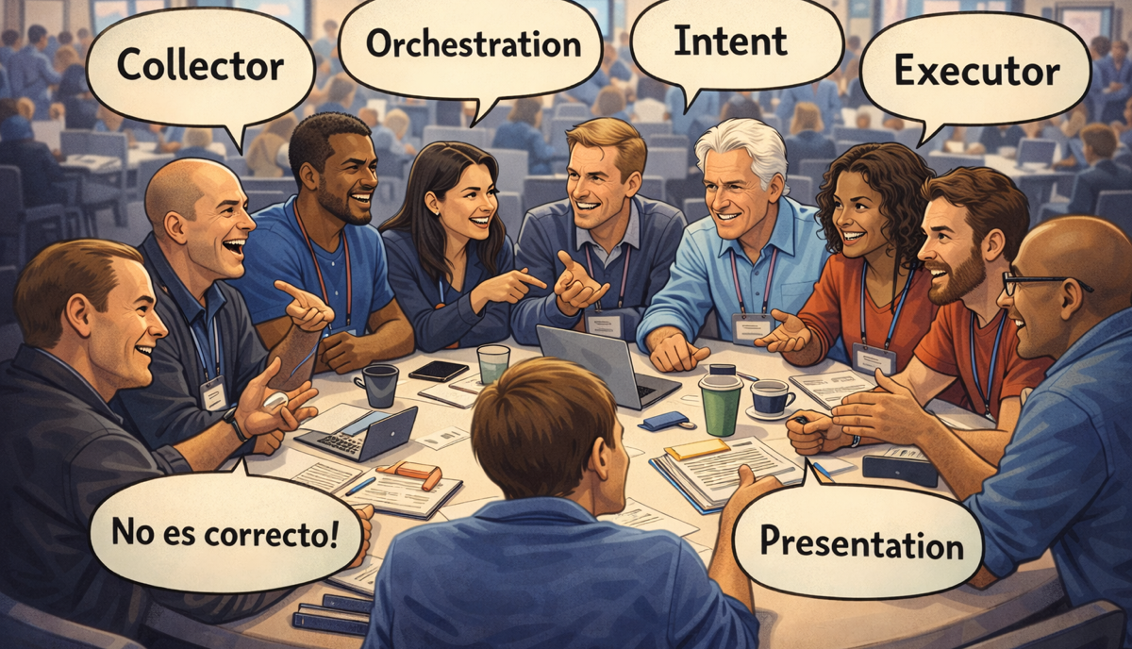
The solution was to stop focusing on tools and focus on functional building blocks
Quickly, everyone started talking the same language

Slide 10
Simple building blocks that
underpin any network
automation framework
NAF
Automation
Framework
Not a reference architecture
— it’s a shared vocabulary +
responsibilities.

Slide 11
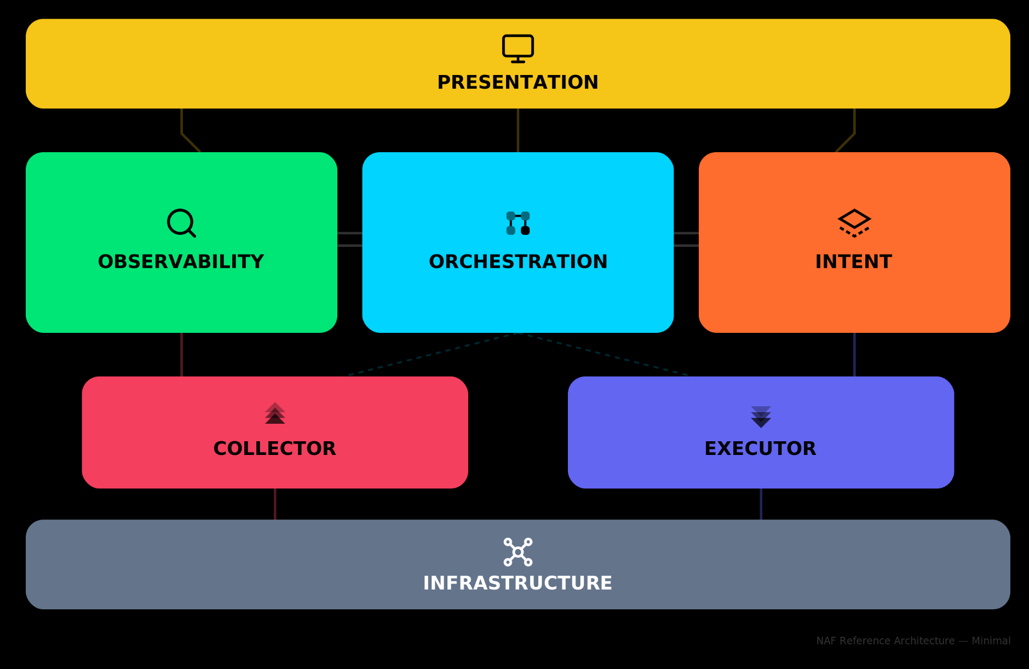
NAF Automation Framework

Slide 12

NAF Automation Framework Fundamentals
Functional Building Blocks
Living Document
Not a Protocol
Both for Beginners and Experts
The NAF automation framework is meant to be tool agnostic to avoid comparing apple and orange.
Each functional building block can be mapped to one or more tools and each tool can map to multiple functional blocks.
The NAF automation framework is meant to evolve over time.
It’s not a strict implementation that imposes a specific way of doing things and in many cases, not all components are required to get started.
The NAF automation framework initiative is focusing initially on laying out the main building blocks to lay the foundation.
In the future the goal is to go deeper into each block.

Slide 13
A map to help navigate the terminology and understand how things are related to each other
Presentation
Observability
Orchestration
Intent
Collector
Executor
Infrastructure

Slide 14
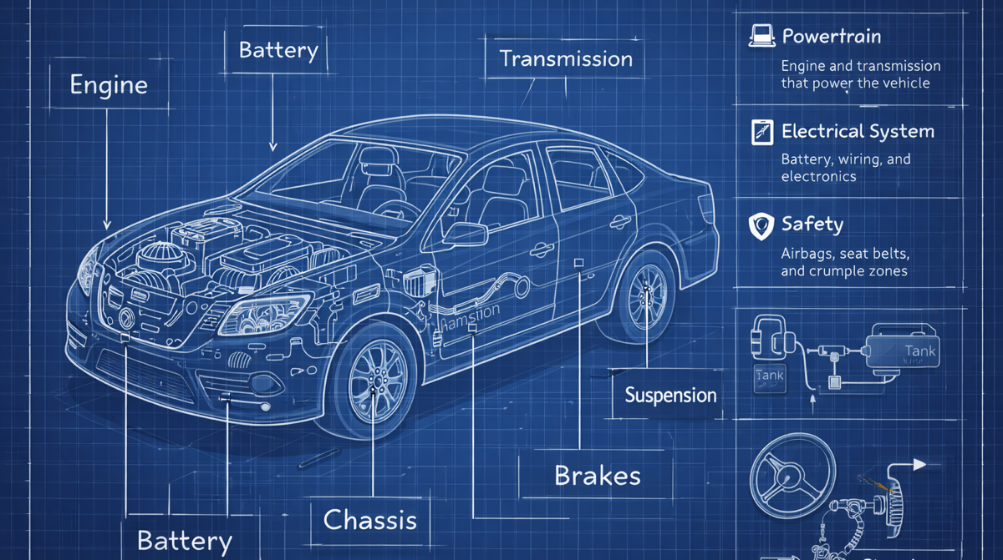
A functional blueprint to help everyone understand and build Network Automation Stack (system thinking)
Notes:
Need to explain the need to think about it as a system (system thinking)

Slide 15
Target Audience
Builders
Users
Network Automation Engineer
Network Engineer
Automation Architect
Network Ops
Software Engineer
Network Architect
Network Reliability Engineer
Engineering Manager

Slide 16

Wait, what about my tools ? Are they gone ?

Slide 17
Mapping between functional blocks and tools
Observability
Collector
Presentation
gNMIc
Each tool / product / project can map
Completely or Partially to
One or Multiple blocks
Prometheus
Grafana
SuzieQ
Kentik

Slide 18
Where do I start?
Do I need to implement all blocks to get started?
No, you should only implement what is required for your use case(s)
Is there a specific order to get started?
No, it really depends on your use case(s).

Slide 19





Ryan Shaw
Dinesh Dutt
Dinesh Dutt
Christian Adell
Christian Adell
Claudia de Luna
Claudia de Luna
Srividya Iyer
Wim Henderickx
The NAF Community
Wim Henderickx
Damien Garros
The Team behind the Working Group

Slide 20
Practical Example

Slide 21

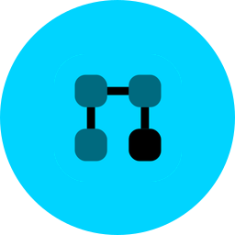




Example
Roll Out a New Subnet Across 50 Sites
A practical example showing how the NAF building blocks work together to deploy, validate, and remediate a network change at scale.
THE PROBLEM
Deploy a new subnet (10.100.0.0/24) across 50 branch sites, validate that it's working on every device, and automatically alert and remediate if any site falls out of compliance.
HIGH-LEVEL WORKFLOW
→
→
→
→
→
Define
Intent
Orchestrate
Deploy
50 devices
Collect
Actual state
Validate
Desired vs Actual
Dashboard
□ / □ per site
Infrahub
AWX
Ansible
gNMIc
Prometheus
Grafana

Slide 22

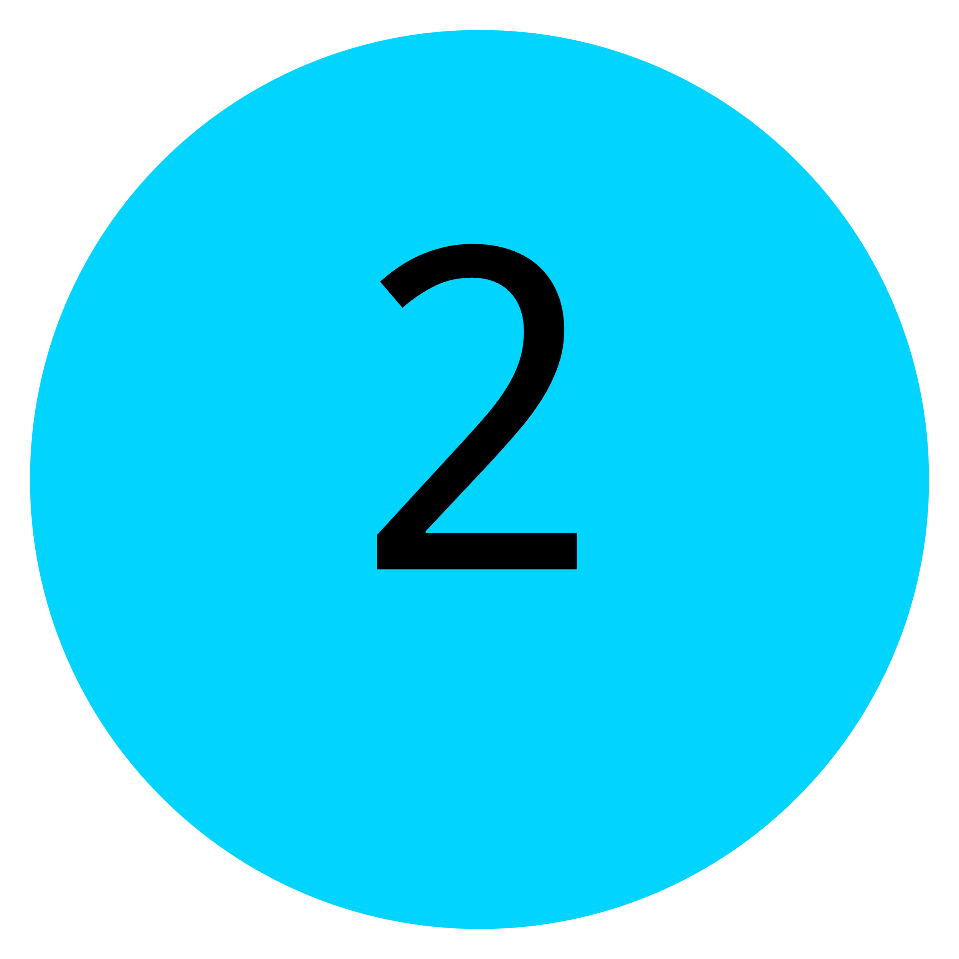
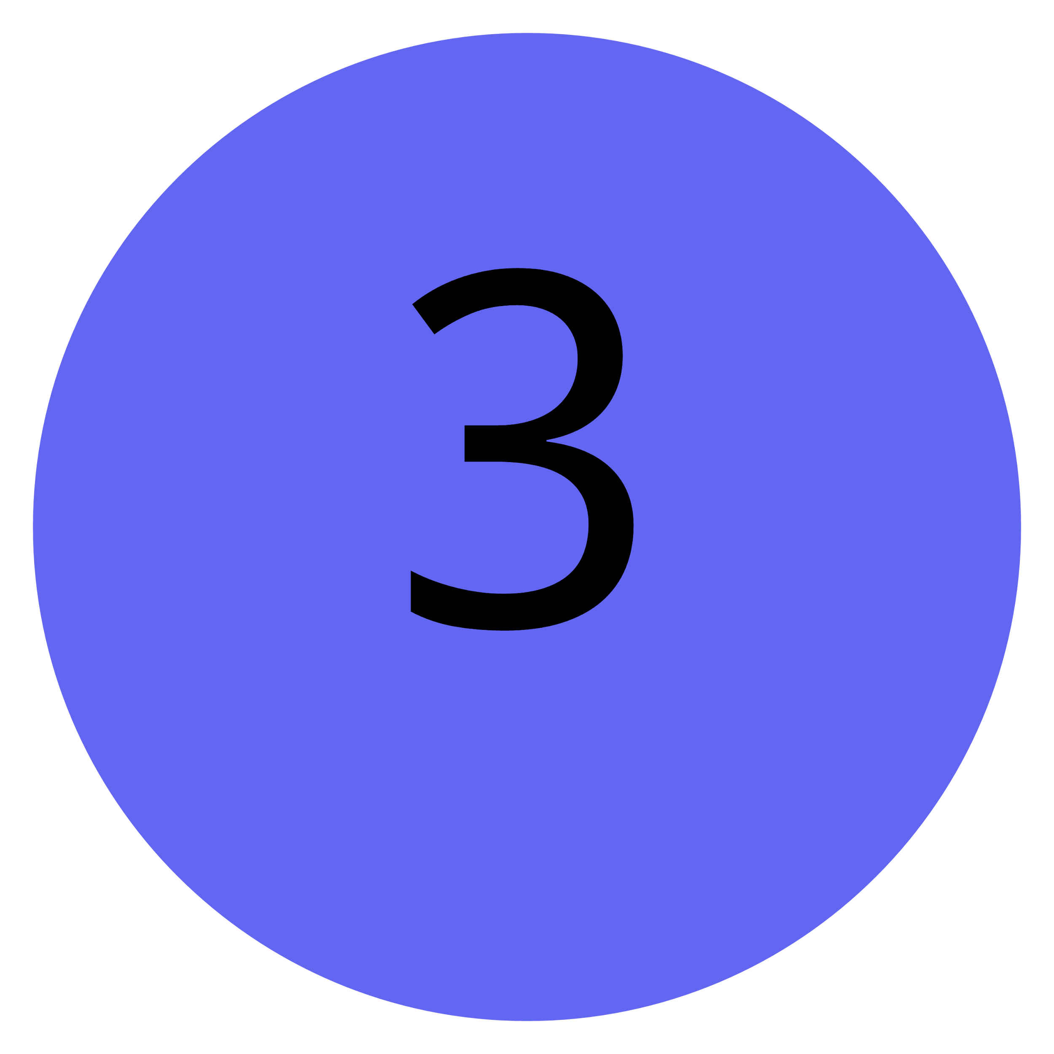
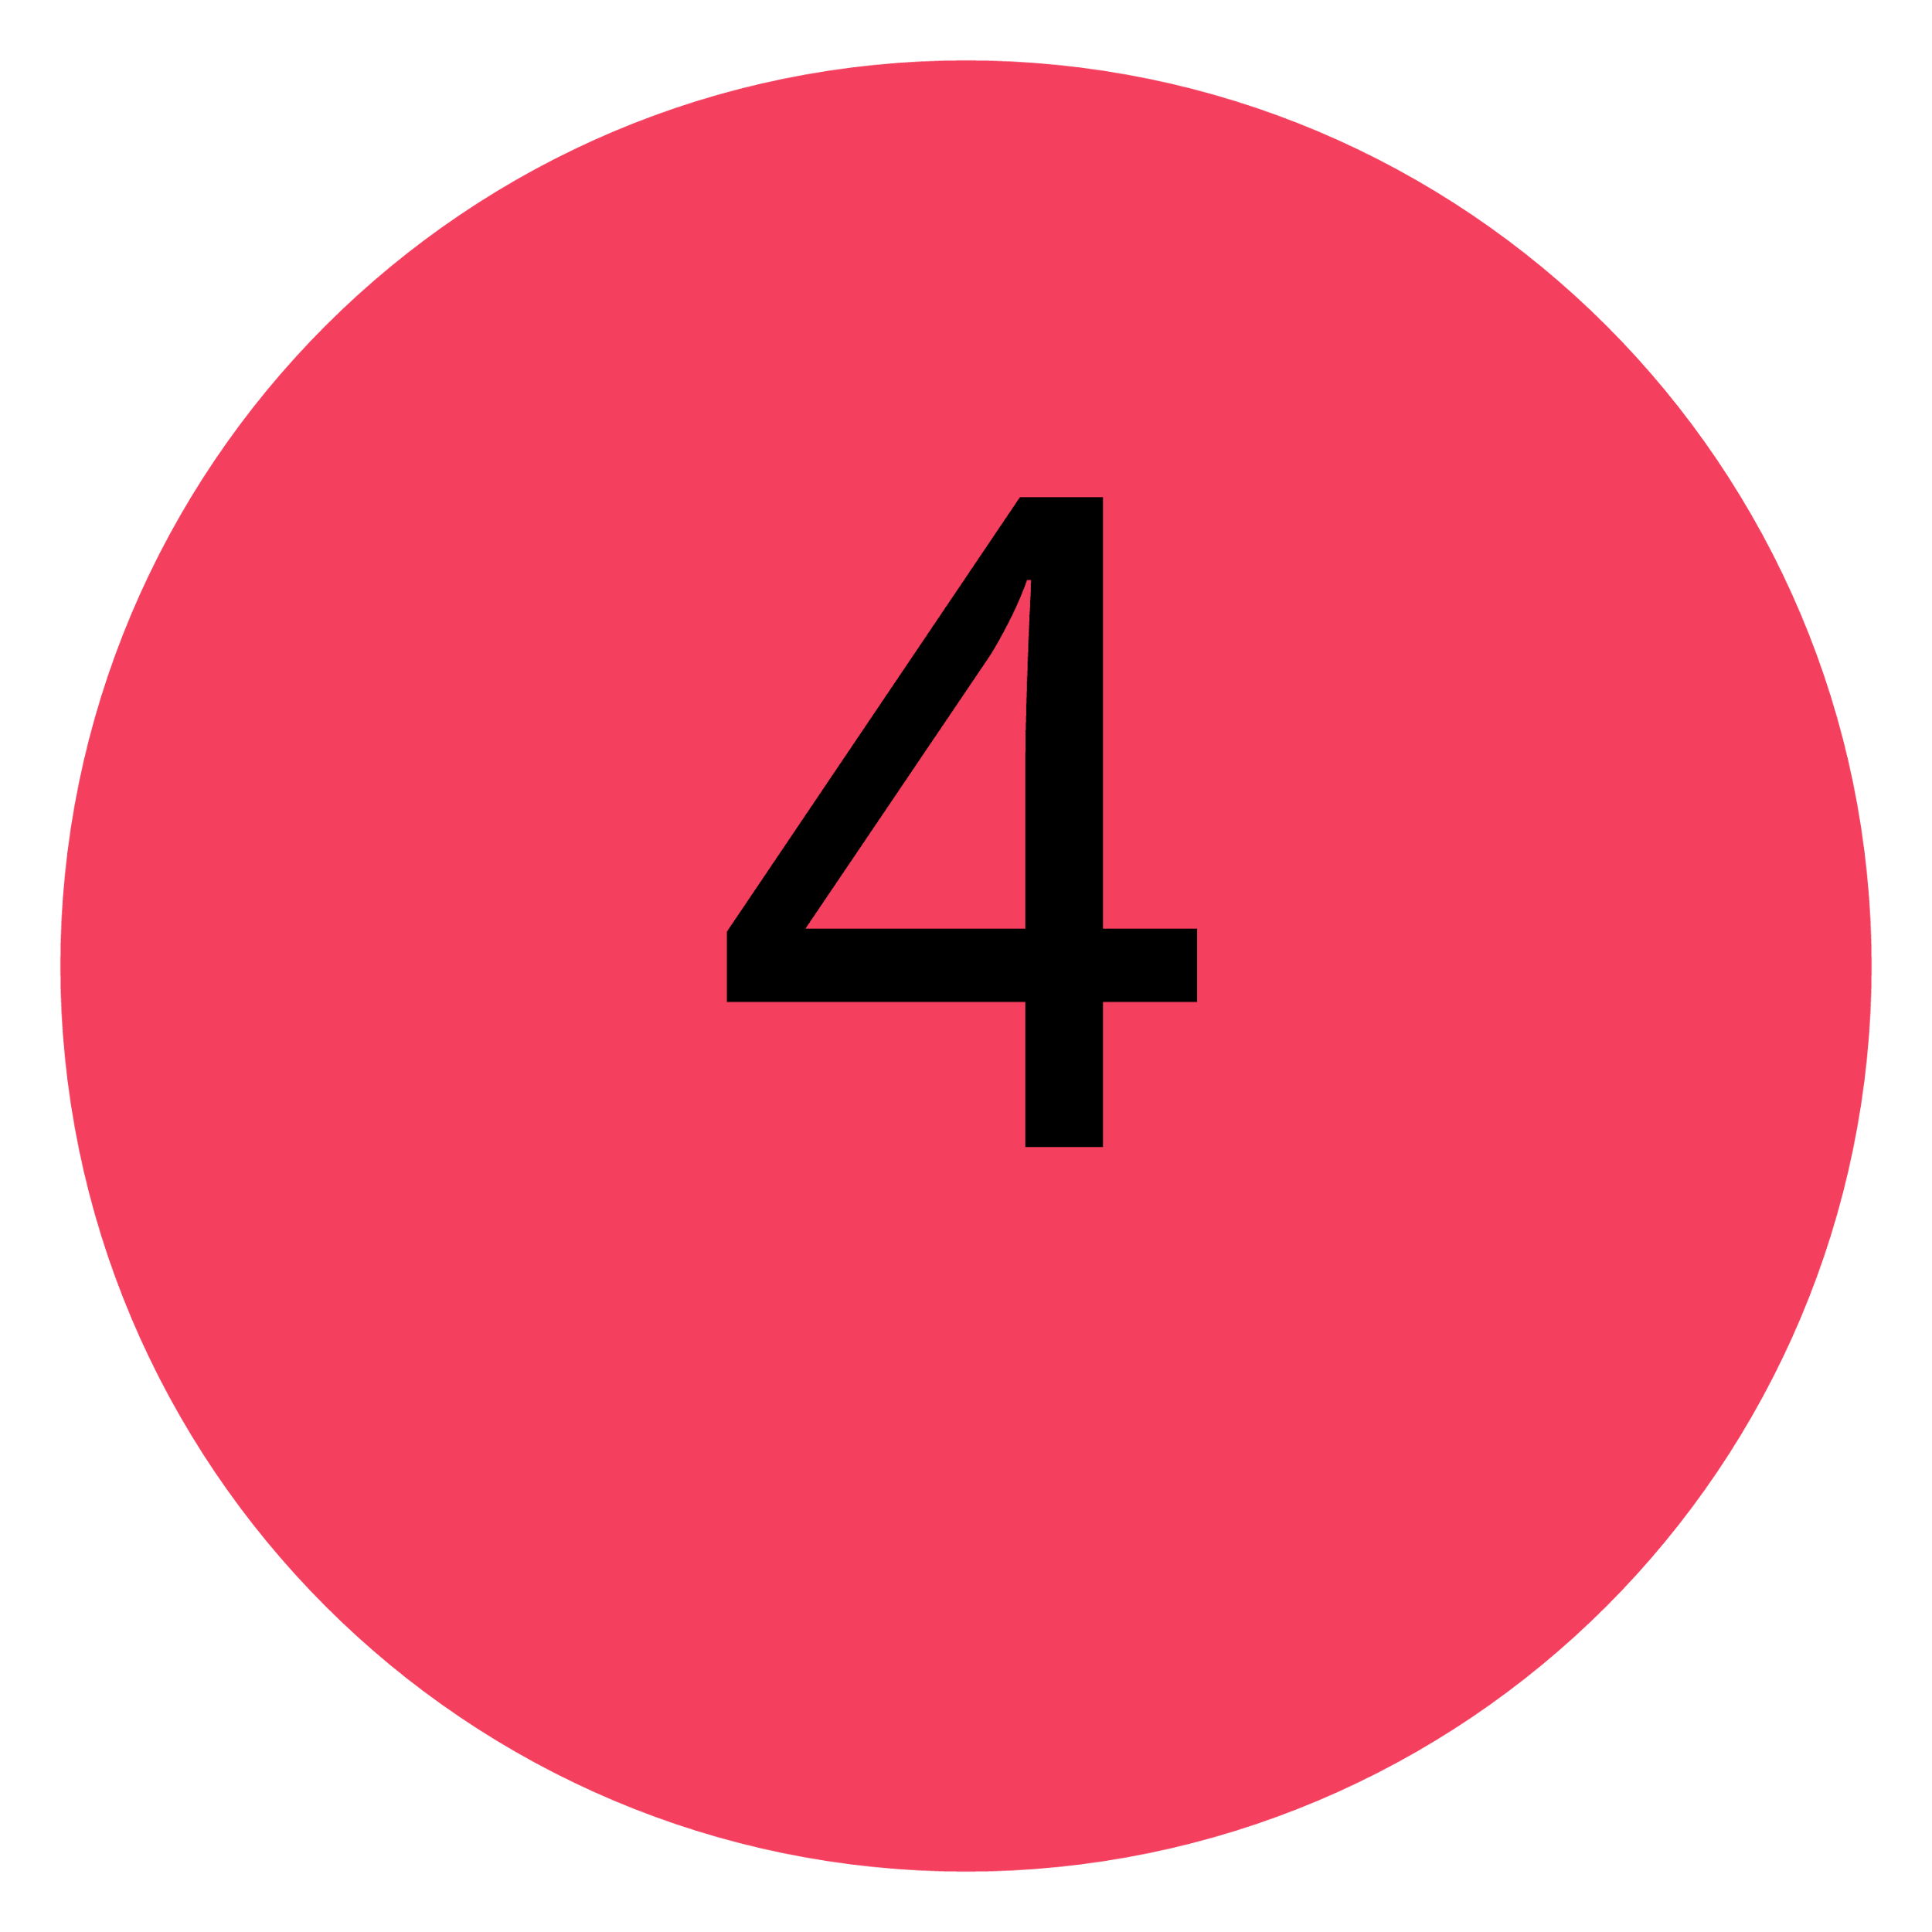





Example - Step-by-Step Workflow
INTENT — SOURCE OF TRUTH
ORCHESTRATOR — TRIGGER
Engineer enters the desired config: subnet, VLAN, routing. This is stored as the Desired State.
Receives a webhook about the change and triggers the Executor to begin deployment.
Infrahub
AWX
EXECUTOR — DEPLOY
COLLECTOR — GATHER STATE
Reads from the Intent API, generates device-specific configs, and pushes them via NETCONF to all 50 routers.
Connects to each device and retrieves actual interface configs, IP addresses, and routing tables.
Ansible
gNMIc
OBSERVABILITY — VALIDATE
↻ REMEDIATION LOOP
ORCHESTRATOR — REMEDIATE
Compares Desired State against Actual State. Mismatches are exposed as metrics and trigger alerts.
When an alert fires, automatically re-runs the Executor on the failing site, re-collects, and validates.
Prometheus
AWX
PRESENTATION — VISIBILITY
NETWORK — FOUNDATION
Dashboard shows all 50 sites: compliant ✓ or drifted ✗. Non-technical users can trigger manual remediations.
Success depends on device capabilities (e.g. NETCONF support). Limitations here affect the entire flow.
Grafana
50 routers
NETWORK AUTOMATION FRAMEWORK · USE CASE TEMPLATE

Slide 23
Example - Mapping to the Framework
SLIDE 3 OF 3
STEP 1 → INTENT · INFRAHUB
Engineer defines desired config — the single source of truth for what the network should look like.
STEPS 2, 6 → ORCHESTRATION · AWX
Coordinates the workflow: triggers deployment, handles alerts, and runs remediation loops.
STEP 3 → EXECUTOR · ANSIBLE
Generates and pushes device configs via NETCONF to all 50 sites.
STEP 4 → COLLECTOR · GNMIC
Reads the actual state from each device after deployment.
STEP 5 → OBSERVABILITY · PROMETHEUS
Compares desired vs. actual, exposes drift as metrics, triggers alerts.
STEP 7 → PRESENTATION · GRAFANA
Dashboard shows compliance status per site with drill-down.

Slide 24
Additional Resources

Slide 25
Additional Resources
Designing Network
Automation at Scale
NAF Network Automation
Solution Wizard
A comprehensive guide to designing scalable, reliable, and maintainable network automation systems
This application helps you apply the Network Automation Forum's NAF to your automation projects.
https://designingnetworkautomation.com/
By Christian Adell
https://naf-naf-wizard.streamlit.app/
By Claudia de Luna

Slide 26
Summary
• Not a standard, it’s a guide
• You don’t need everything to get started
• Think Automation as a system
• Focus on functional first, tools later
• Each tool can map to multiple building blocks
• Don’t reinvent the wheel
• Map your existing workflow toward the framework
• Give us some honest feedback good and bad

Slide 27
How can you help
Use case document Github:
https://github.com/Network-Automation-Forum/reference/blob/main/docs/Framework/Framework.md
Tool mapping
Expand details per building block
NAF Slack channel:
https://networkautomationfrm.slack.com/archives/C082G6VGZHP

Slide 28
Questions ?

Slide 29
Thank You

