Slide 1

C:\directory-genoveffa\pannello.csv
Carica
Elenco parametri
Pannello 3D
Run
Show Panel
Show Stat
Open GnuPlot

Slide 2
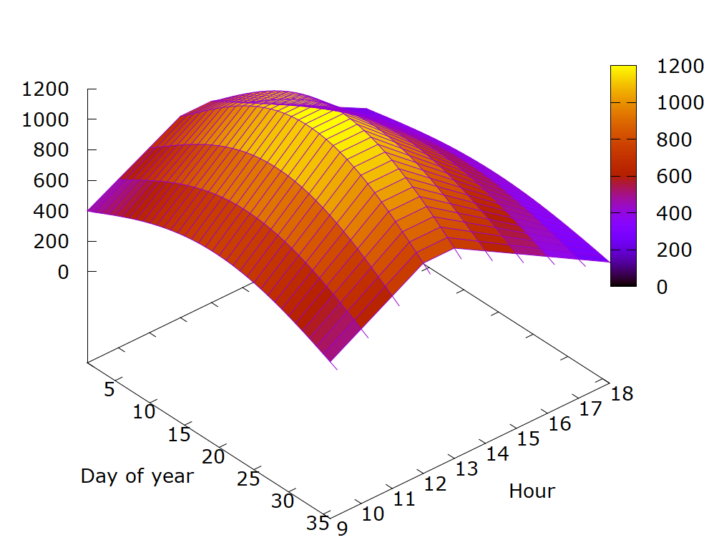
C:\directory-genoveffa\pannello.csv
Carica
Elenco parametri
Run
Show Panel
Show Stat
Open GnuPlot

