Slide 1



iMessageStatistics
View in Power BI
Last data refresh:
4/21/2018 5:27:11 PM Eastern Standard Time
Downloaded at:
5/8/2018 9:25:09 AM Eastern Standard Time

Slide 2
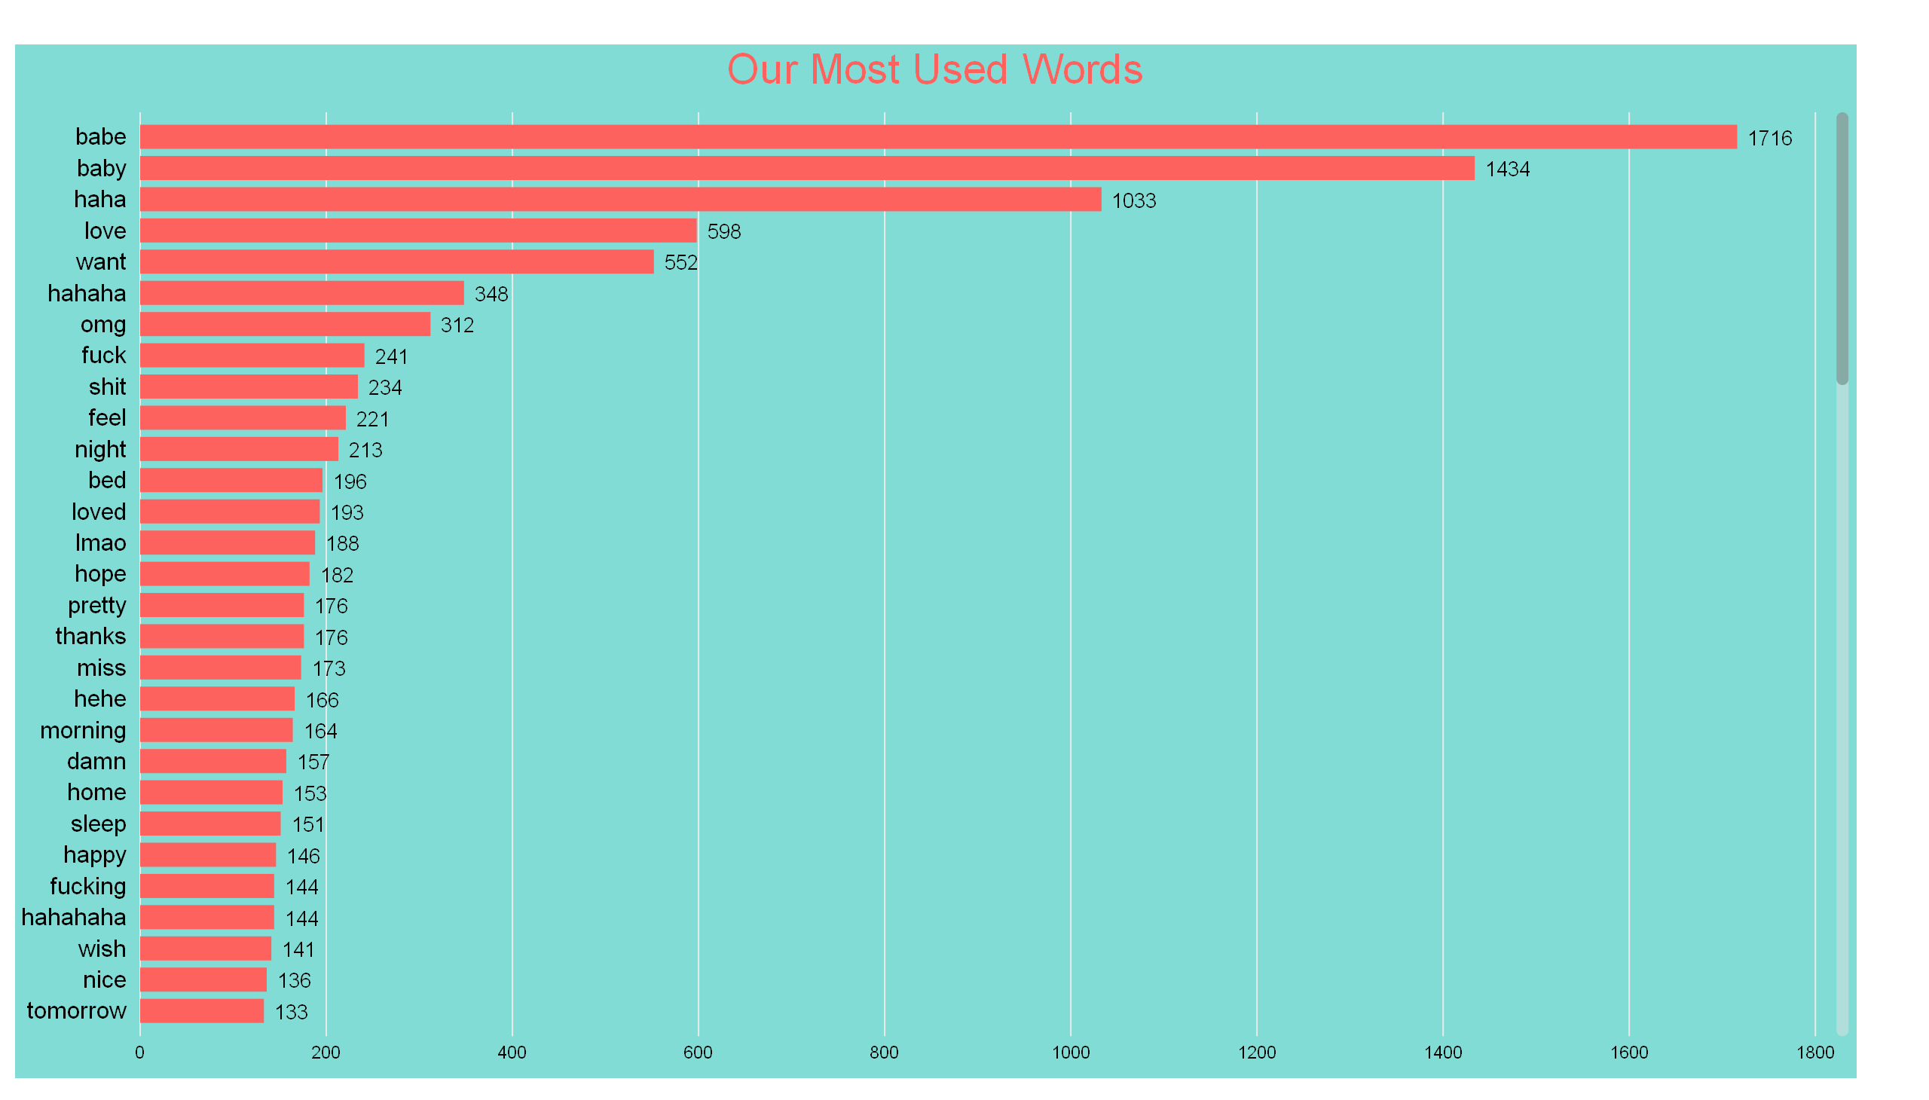

Slide 3
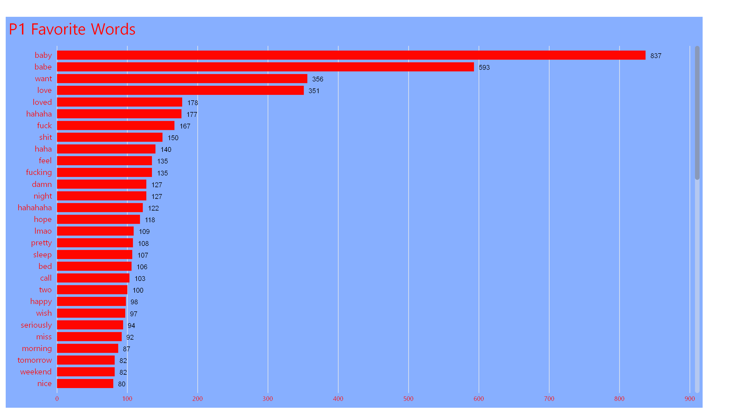

Slide 4
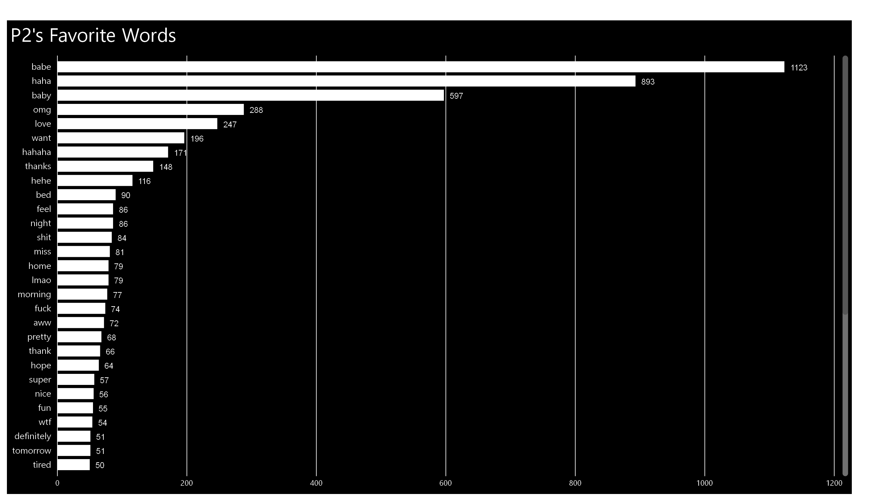

Slide 5
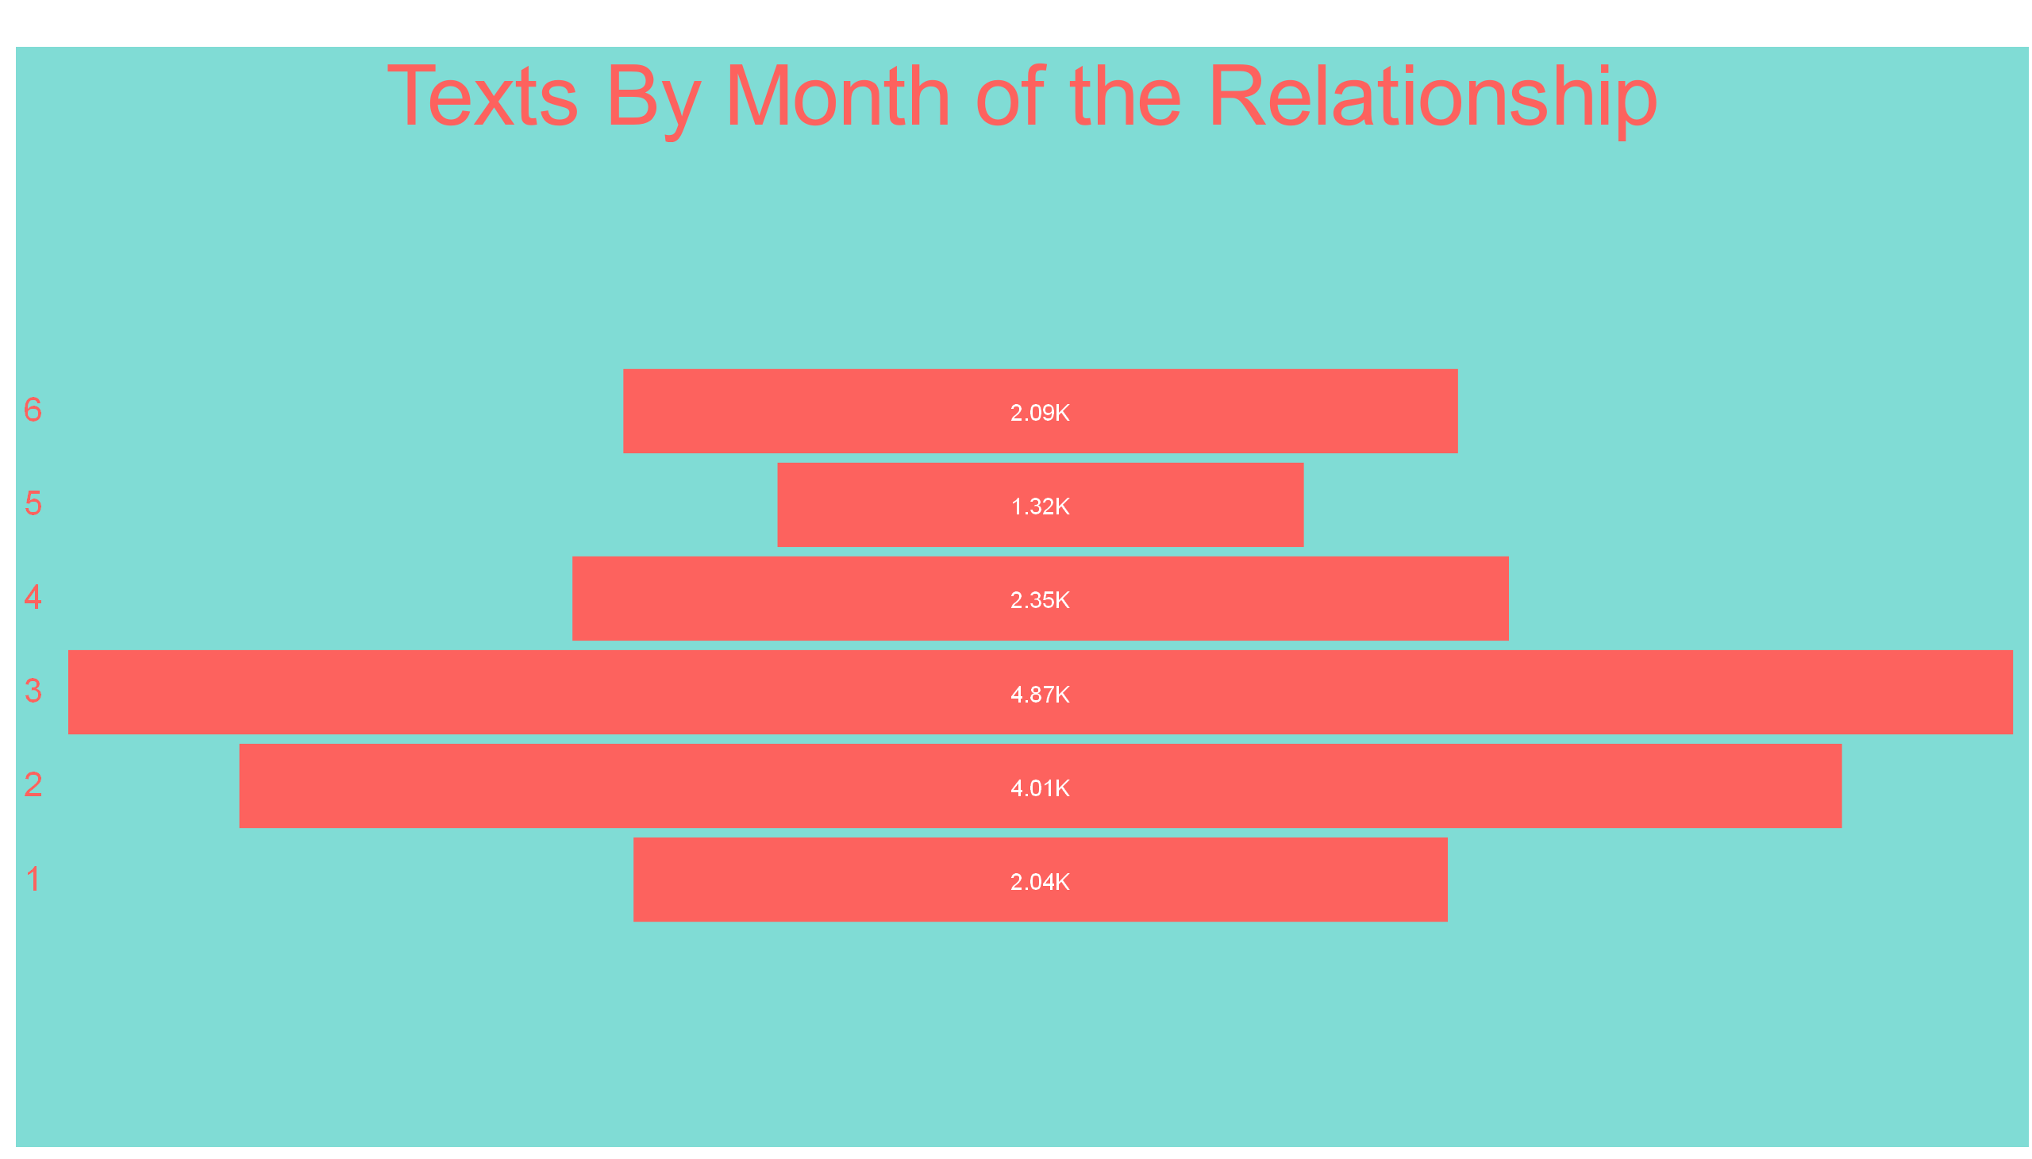

Slide 6
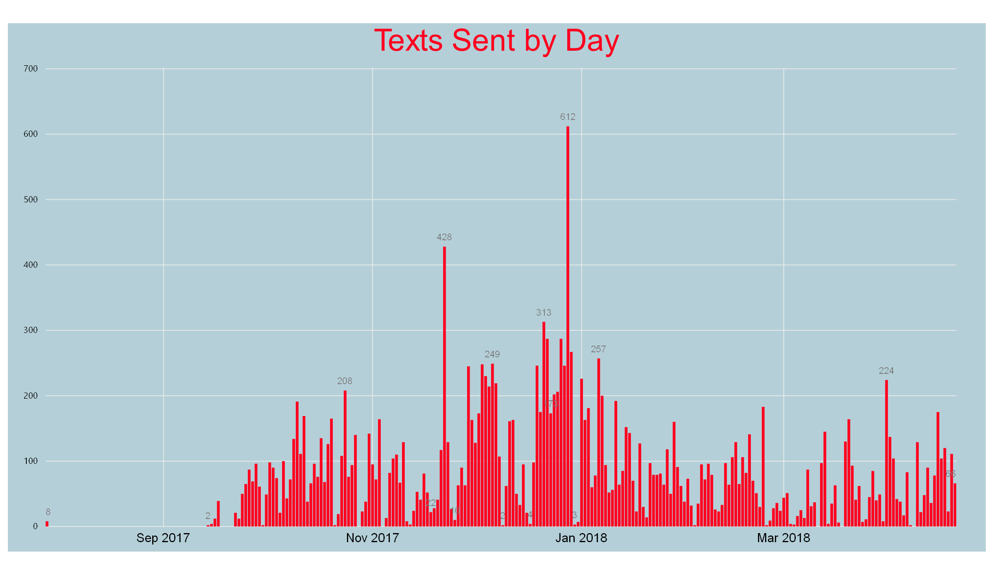

Slide 7
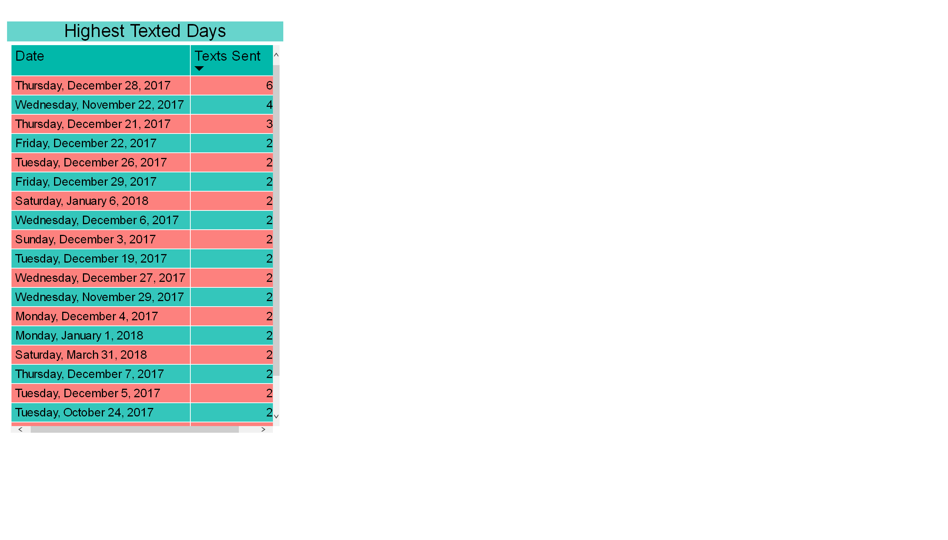

Slide 8
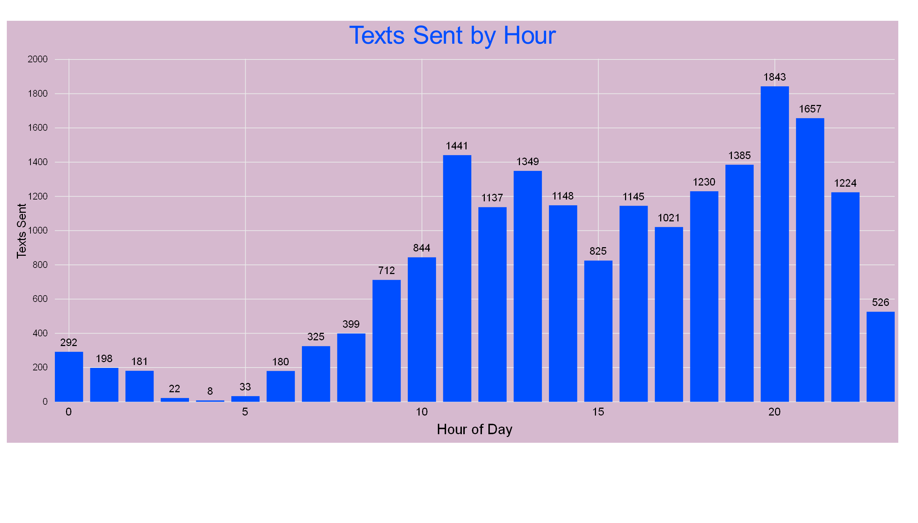

Slide 9
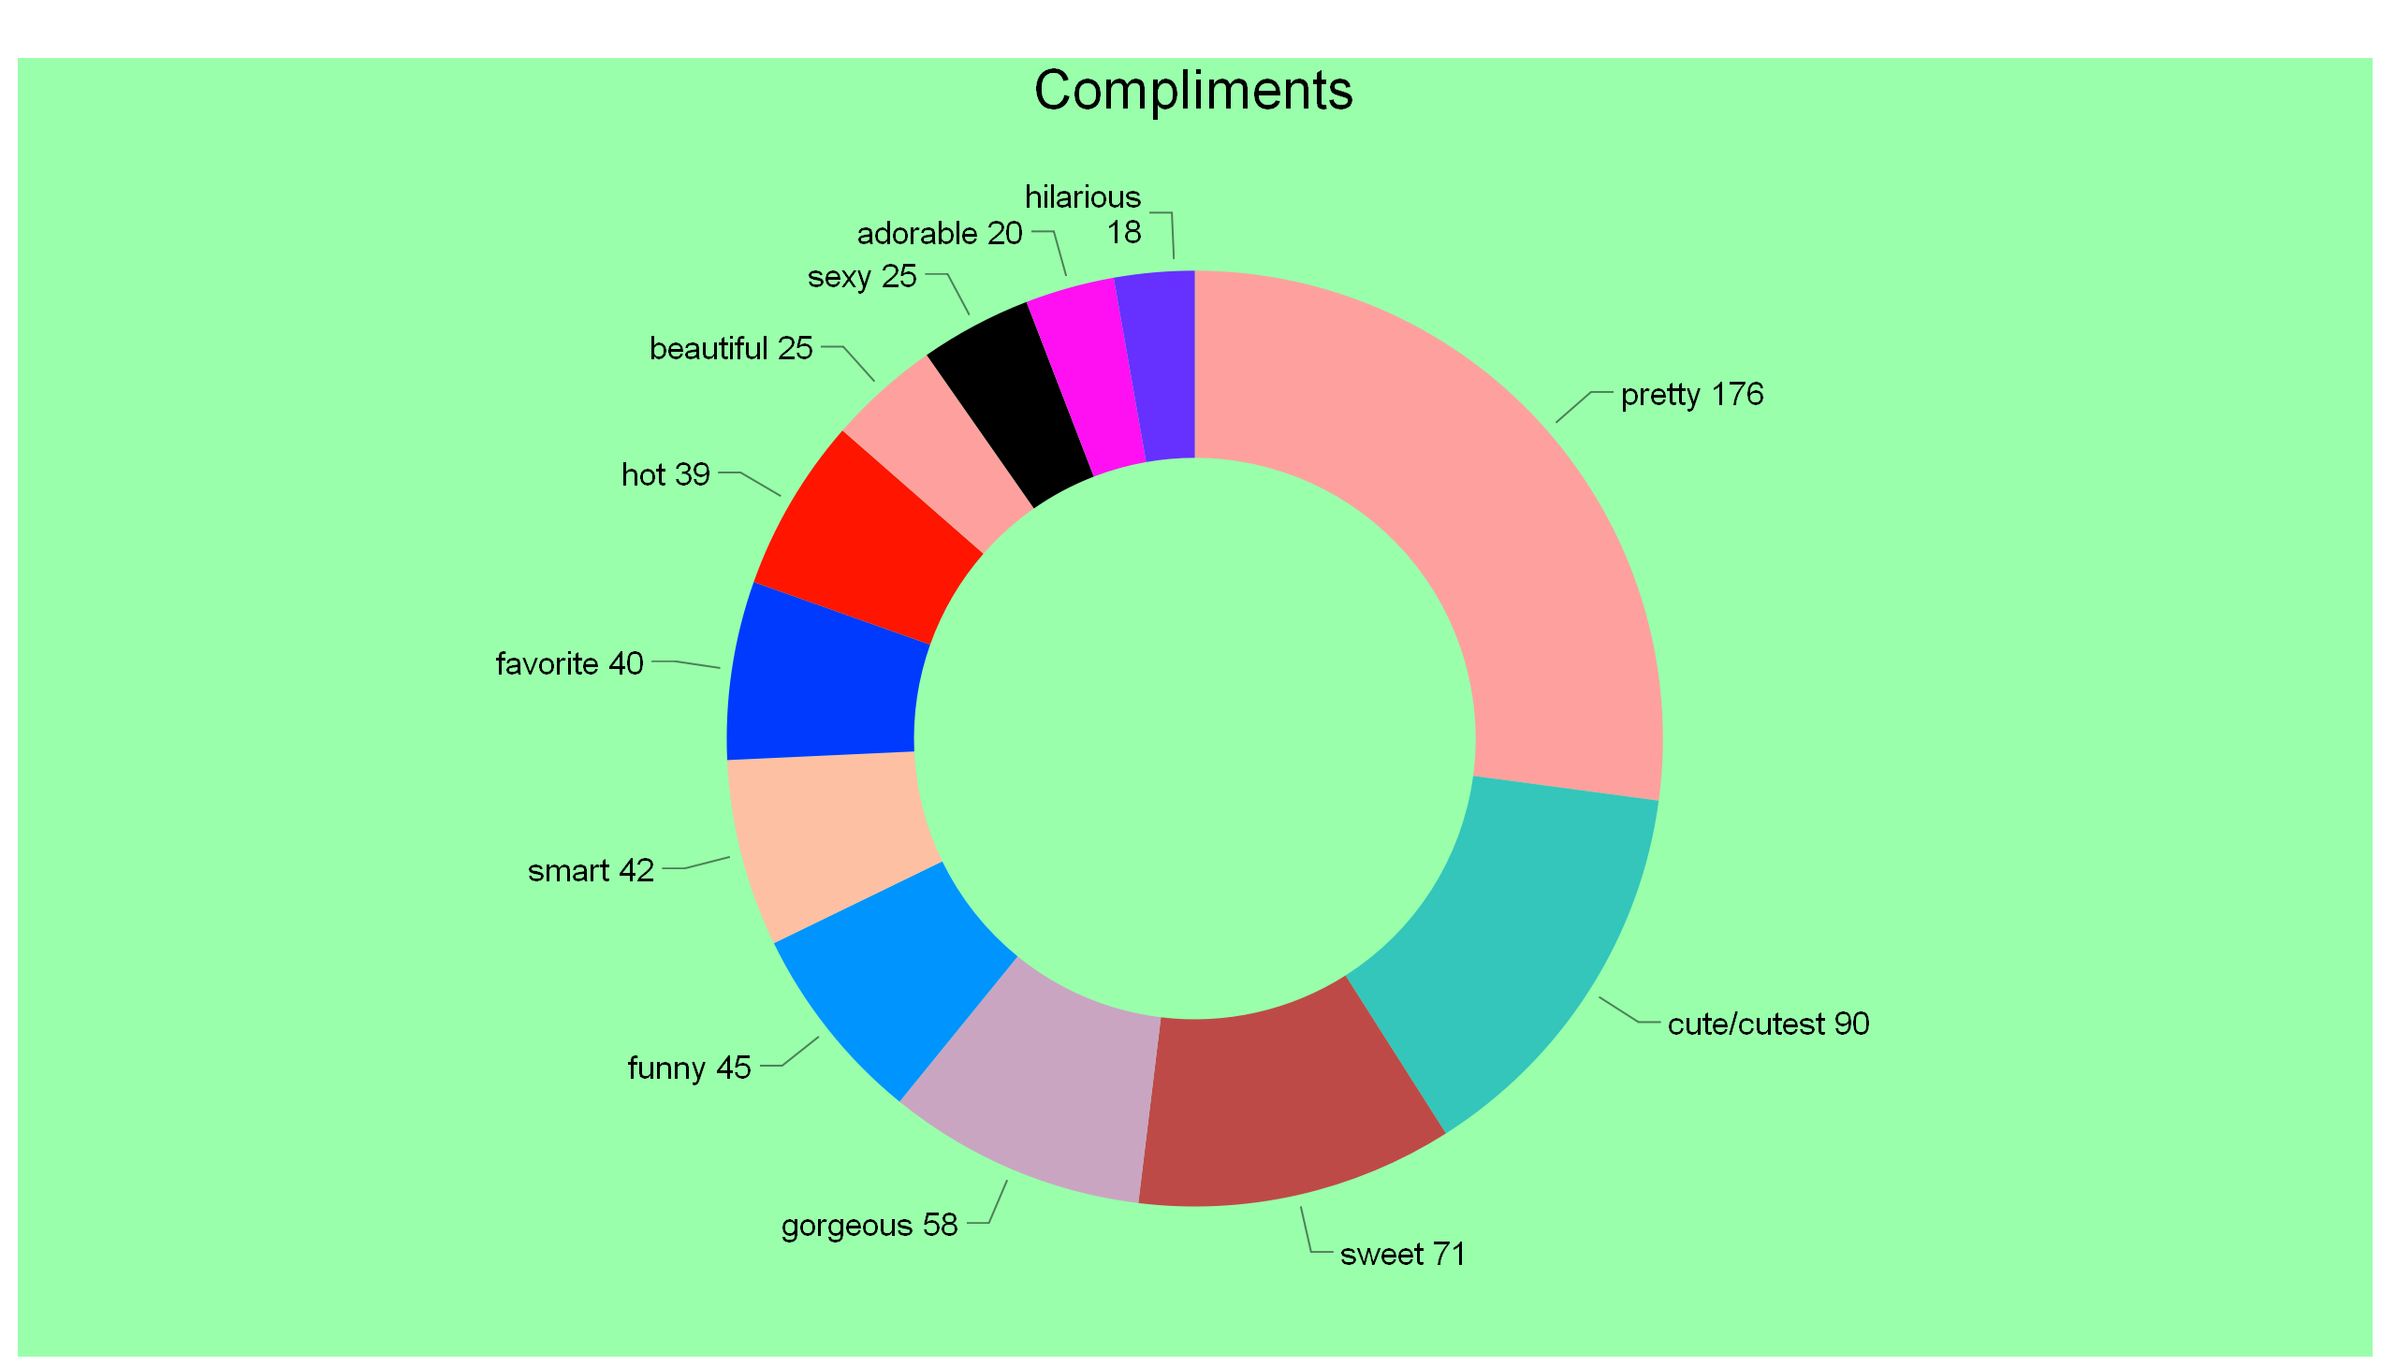

Slide 10
