Slide 1
Gradebook

Slide 2
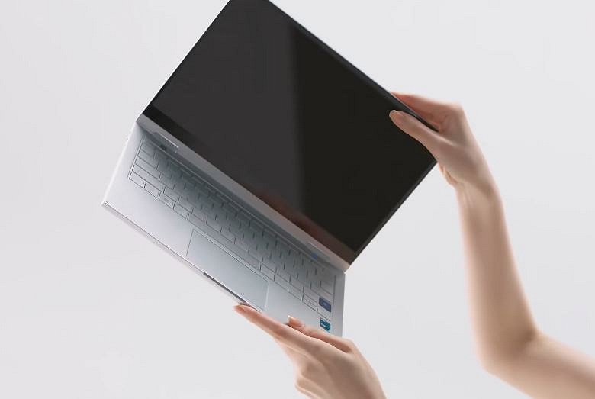
Goal: Development of a console program, which is an electronic gradebook
Objects of subject development:
person, teacher, student, exam, gradebook
After analyzing the subject area, it was decided to create entities:

Slide 3
The main entities are:
Person
Teacher
Student
Exam
Gradebook
Person — stores common for every person data, like surname.
Teacher — inherits from Person and also have additional field post.
Student — inherits from Person and also have own field group.
Exam — inherits from Teacher and Student, so it has theirs fields, also it have own fields like subject name, date, mark, etc.
Gradebook — stores an array of exams and has an iterator for easy data access.

Slide 4
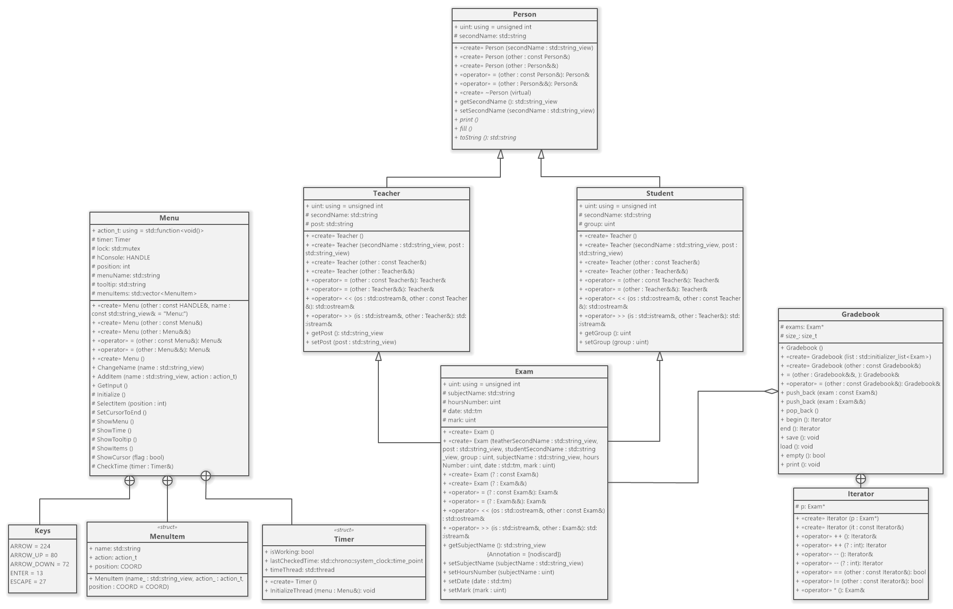

Slide 5
Features of created program:
simple user interface;
exception handling;
working with an array of objects using iterator;
writing to file;
reading from the file;
using of multithreading and other features from C++11/14/17 standard
polymorphic cluster to use our program comfortably.

Slide 6
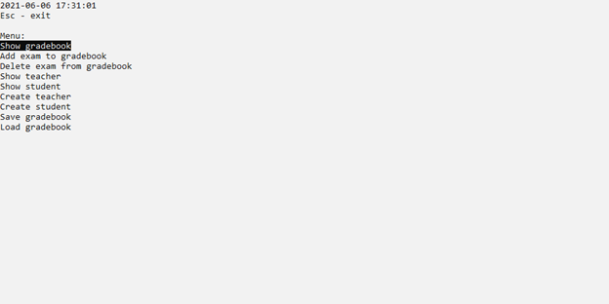
User interface
Implementation using custom Menu class using WinAPI console handler

Slide 7
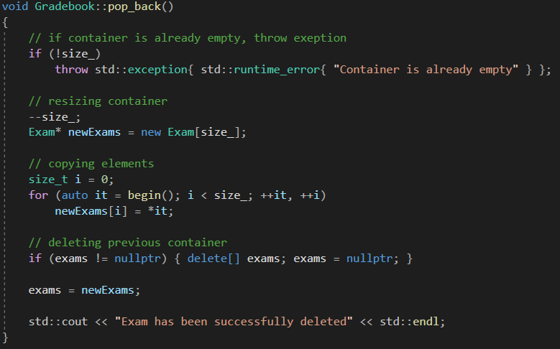
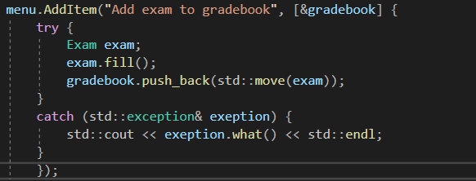
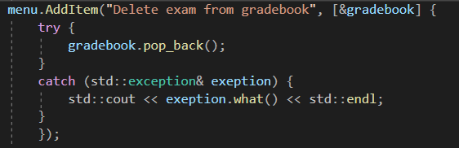
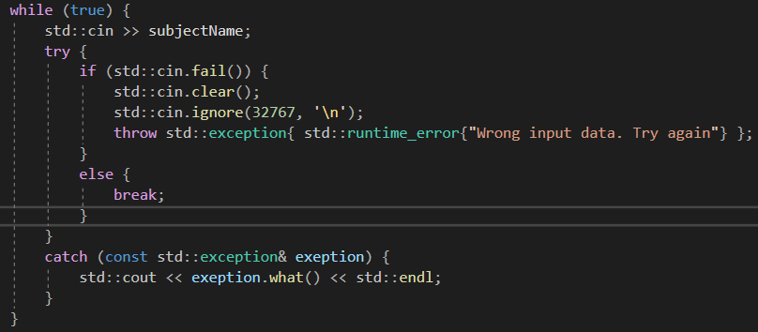
Exception handling

Slide 8
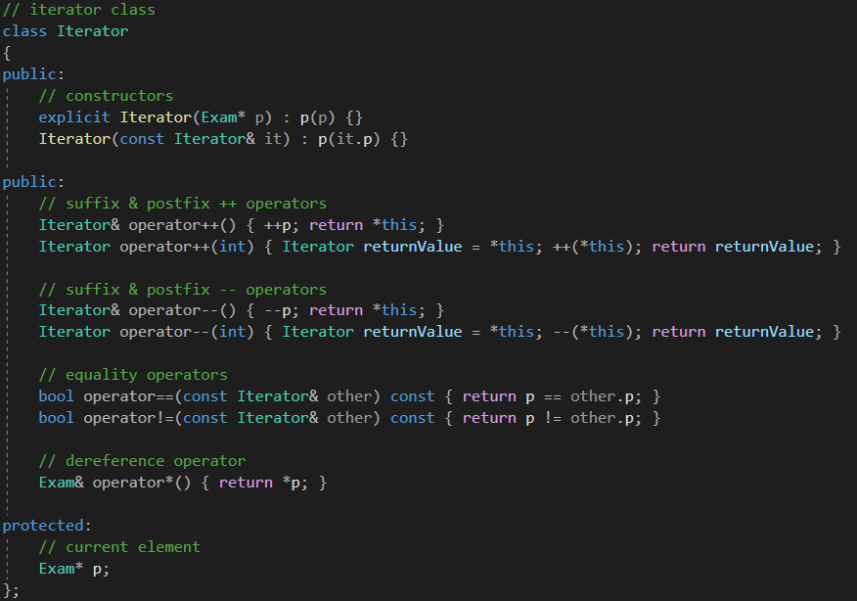
Iterator class

Slide 9
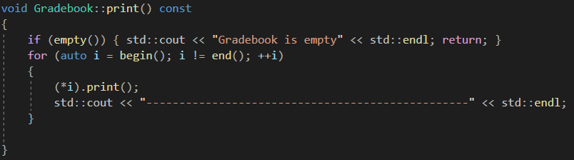


Work with iterator

Slide 10
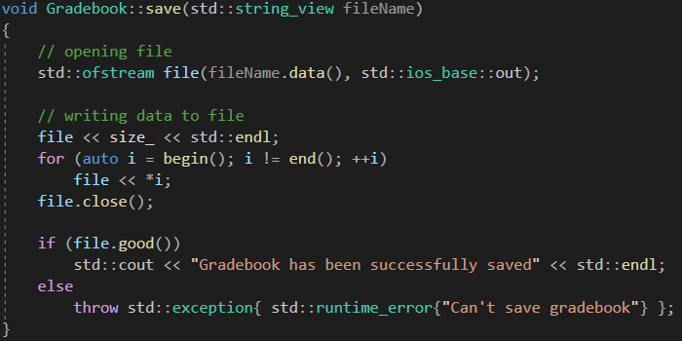
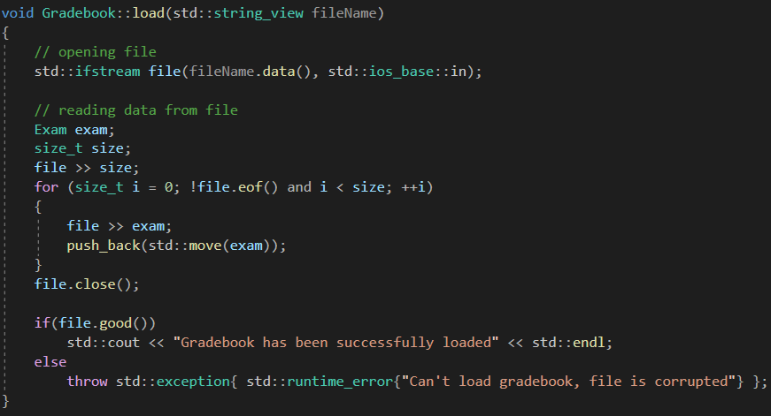
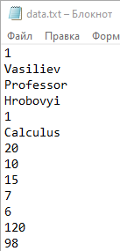
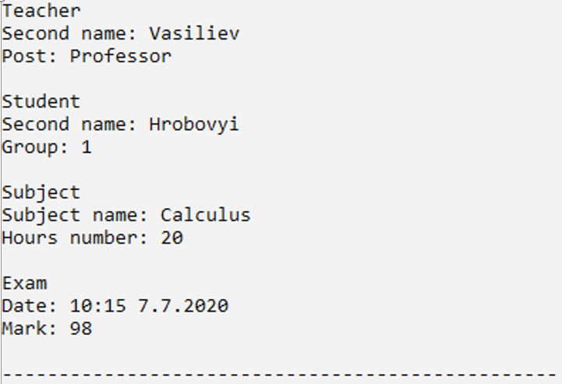
File handling (exams data from gradebook)

Slide 11
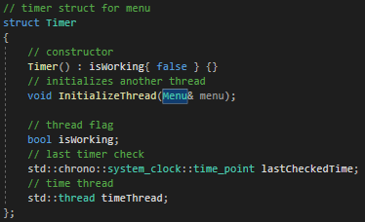
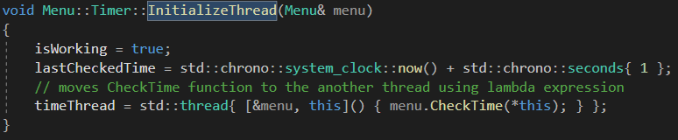
Multithreading
Timer — was created and integrated as a subclass of the Menu class. It has an InitializeThread method, which starts timer in another thread.

Slide 12
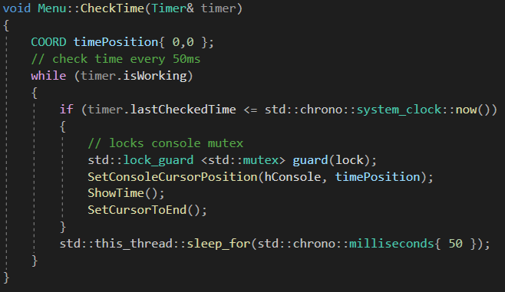

Slide 13
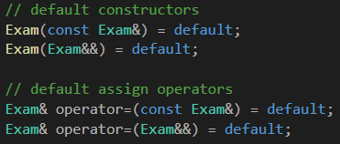
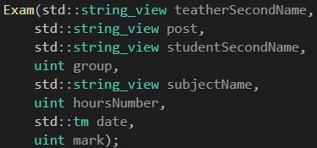

Other features from C++11/14/17 standards
The main features are:
move semantics;
using string_view instead of string;
lamda expressions ;
smart-pointers.

Slide 14








Polymorphic cluster

Slide 15
Conclusions
Was created object-oriented system "Gradebook", using C++ programming language, which can display various information about current exams in gradebook.
Were studied the features of the object-oriented programming paradigm in practice and improved knowledge of modern C++ standards.
The program can be used in institutions of higher education for storage student’s gradebooks and data about exams.

Slide 16
Thank you for your attention!

