Slide 1
Conformity Assessment:
Trade Documentation Services
Achieving Reliability and Interoperability for
Services replacing Paper in Trade
Pamela Mar, Hans J. Huber

Slide 2
Conformity Assessment: Trade Documentation Services
Introduction: Tim and Hans
Tim Bouma,
Digital Governance Council | Conseil de Gouvernance Numerique, Canada
Hans J. Huber
id4.trade GmbH, Germany

Slide 3
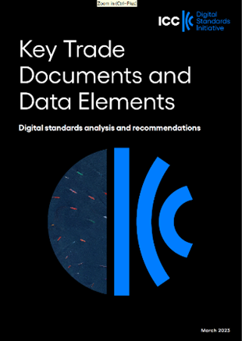
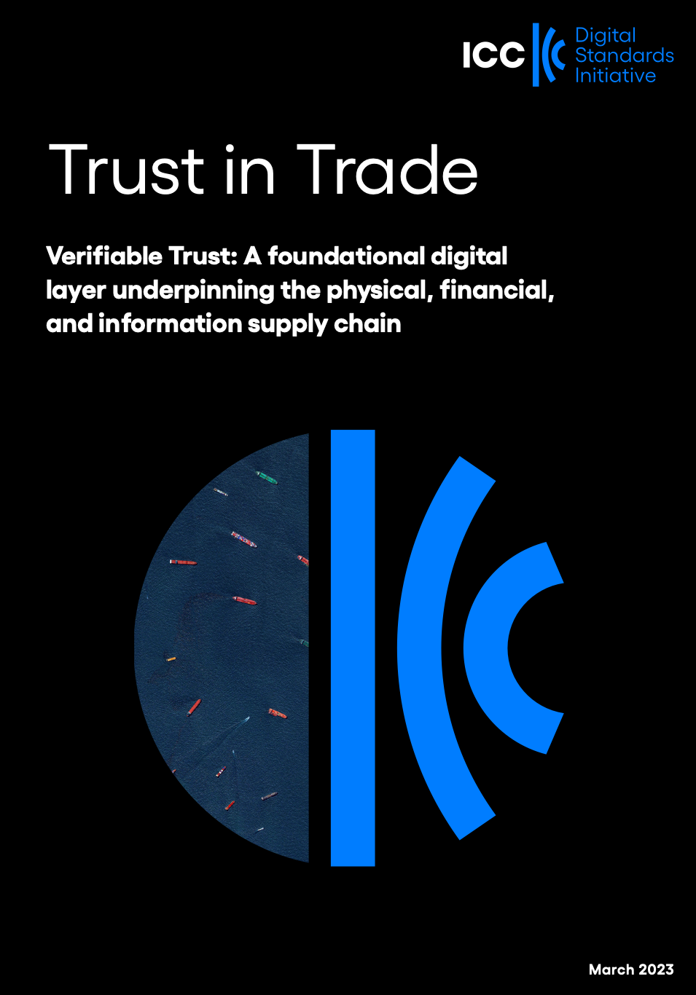
Conformity Assessment: Trade Documentation Services
Our approach
Key Trade Documents and Data Elements (KTDDE)
Defining a global baseline standard for the global trade documents and data
Trusted Trade Environment
Defining the pillars of a trusted trade data space
Conformity Assessment
Defining standardized digital trade documentation services

Slide 4

Conformity Assessment: Trade Documentation Services
The scope of the assessment
Subject of the CAS
Objects of conformity
Master conformity dimensions
=> Trade data services replacing paper documentation
=> The trade documentations in the KTDDE scope
interoperability, a technical angle
reliability, a legal and technical angle
Sub dimensions for reliability and interoperability should be defined to determine service properties.
Example Reliability: System uptime 99,99% (equals 8,76 hours downtime p.a.) Example Interoperability: Date information transfer done according to ISO 8601

Slide 5
Conformity Assessment: Trade Documentation Services
The maturity model
How will the trajectory for Assessment candidates look like?
2 elements: Pass / Fail
3 elements: Starters, Qualified, Gold
5 elements: …
Your views please!

Slide 6
Conformity Assessment: Trade Documentation Services
Risks?
Are there any risks we should see and monitor?
Your views please!

Slide 7
Conformity Assessment: Trade Documentation Services
The Process
Idea
Market Research
CAS Definition
CAS Elaboration
Test / Focus Group
Formalizing the CAS
June
July
August
September
October -November
December
Standards adoption
Supply chain credential for differentiation
Guidance on digitalization
Market convergence rather than fragmentation
Supply chain certifications landscape: what else is out there?
Potential users – buyers, suppliers, shippers, financial institutions. What do they want? What do they need?
Auditors and Assessors: qualifications and operating models
Maturity Model: self assessment, baseline, what does Gold look like
Conformity assessment scheme brief scope
Technical needs analysis
Elaborate technical requirements for scheme pillars
Test with focus groups including certification working group, assurance companies, digital platforms and others
Establish pilot pathways with UK and Germany ETDA implementation
Focus group feedbacks: Bangkok UN/CEFACT
WG members
Prep for submission to ISO.
Explore how to bring CAS to market (e.g. standards bodies)
Prep for Bringing the CAS to Market
Complete Scheme overview

