Slide 1
Summary / Comparison
 | Components | Steps/Options | Benefits | Challenges
BICC (recommended) | BI View Objects. BICC Scheduled Job Storage (UCM, Object Storage, Classic Storage). Optional data integration tooling. | Schedule and run BICC extract jobs to Storage. Load extract to target database. | Pre-Built / Easy to configure. High volumes. Scheduling available. Manages incremental updates. | (Small) Gaps in Content. Some transformation nuances.
 | Tooling Options | Scripts: Required to load data from storage to the target database. | No additional technology, no future licensing considerations. Must separately manage BICC jobs. | Hand crafted code generally not recommended due to manageability issues.
 |  | ODI: Manages entire end to end orchestration of BICC extraction and loading into the target data store. | End to end solution. Handles complex transformations. Recommended. | May have down stream licensing implications. Requires use of additional compute resource and tooling.
 |  | OAC: Manages entire end to end orchestration of BICC extraction and loading into the target data store. | End to end solution. Simplest to setup and run. | Replication only with no transformations. Significantly slower and is not suitable for large tables or data volumes. No ability to control the flow steps.

Slide 2
Summary / Comparison Con’t
 | Components | Steps/Options | Benefits | Challenges | Payload
Web Services (SOAP/REST) (not recommended) | Supported REST end points. | Build and run scripts to extract data to files (JSON). Build and run scripts to load data from extracted files to target database | No additional tooling required. | Smaller Payloads. Complex to code. Not suitable for large scale extraction. Need to code everything (extraction, transformation, loads) | JSON
BI Publisher (not recommended) | Production . Direct table access. | Create, schedule, and run extract jobs to UCM. Download files from UCM and load into database target. Use Scripts or ODI to download data from UCM and load into target database. | Highly Configurable (you write your own SQL). Scheduling Available. Can access some limited content that may not be available in the View Objects used by BICC. | Not intended for huge extracts. Limit on extract record or size. Requires scripting or ODI to load data from storage to the target database. | Multiple formats (CSV, XML, XLS, etc.)

Slide 3


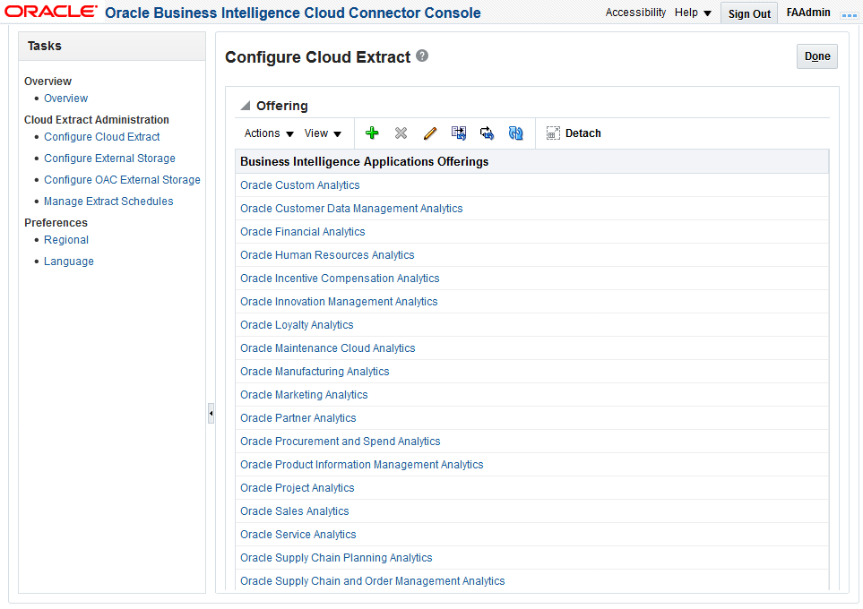
Data Extract using BI Cloud Connector (BICC)
With ODI
Fusion Cloud
OCI
ERP Tables
ODI
Execute BICC Jobs
Load data from storage to targets
BI View Objects
Gzip/CSV
ADW
BI Cloud Connector
Object Storage
BI Cloud Connector Console
Configure Cloud Extract
Configure Target Storage
Manage Extract Schedule

Slide 4
Data Extract using BI Cloud Connector (BICC)
With OAC
Fusion Cloud
OCI
OAC
Create replication connections
Create replication
Run replication (creates and runs BICC extract and loads data from Object Storage)
ERP Tables
BI View Objects
Gzip/CSV
ADW
BI Cloud Connector
Object Storage
BI Cloud Connector Console
Configure Cloud Extract
Configure Target Storage
Manage Extract Schedule

