Slide 1
Summary / Comparison
 | Components | Steps/Options | Benefits | Challenges
BICC (recommended) | BI View Objects. BICC Scheduled Job Storage (UCM, Object Storage, Classic Storage). Optional data integration tooling. | Schedule and run BICC extract jobs to Storage. Load extract to target database. | Pre-Built / Easy to configure. High volumes. Scheduling available. Manages incremental updates. | (Small) Gaps in Content. Some transformation nuances.
 | Tooling Options | Scripts: Required to load data from storage to the target database. | No additional technology, no future licensing considerations. Must separately manage BICC jobs. | Hand crafted code generally not recommended due to manageability issues.
 |  | ODI: Manages entire end to end orchestration of BICC extraction and loading into the target data store. | End to end solution. Handles complex transformations. Recommended. | May have down stream licensing implications. Requires use of additional compute resource and tooling.
 |  | OAC: Manages entire end to end orchestration of BICC extraction and loading into the target data store. | End to end solution. Simplest to setup and run. | Replication only with no transformations. Not suitable for large data volumes. No ability to control the flow steps.

Slide 2
Summary / Comparison Con’t
 | Components | Steps/Options | Benefits | Challenges | Payload
Web Services (SOAP/REST) (not recommended) | Supported REST end points. | Build and run scripts to extract data to files (JSON). Build and run scripts to load data from extracted files to target database | No additional tooling required. | Smaller Payloads. Complex to code. Not suitable for large scale extraction. Need to code everything (extraction, transformation, loads) | JSON
BI Publisher (not recommended) | Production . Direct table access. | Create, schedule, and run extract jobs to UCM. Download files from UCM and load into database target. Use Scripts or ODI to download data from UCM and load into target database. | Highly Configurable (you write your own SQL). Scheduling Available. Can access some limited content that may not be available in the View Objects used by BICC. | Not intended for huge extracts. Limit on extract record or size. Requires scripting or ODI to load data from storage to the target database. | Multiple formats (CSV, XML, XLS, etc.)

Slide 3


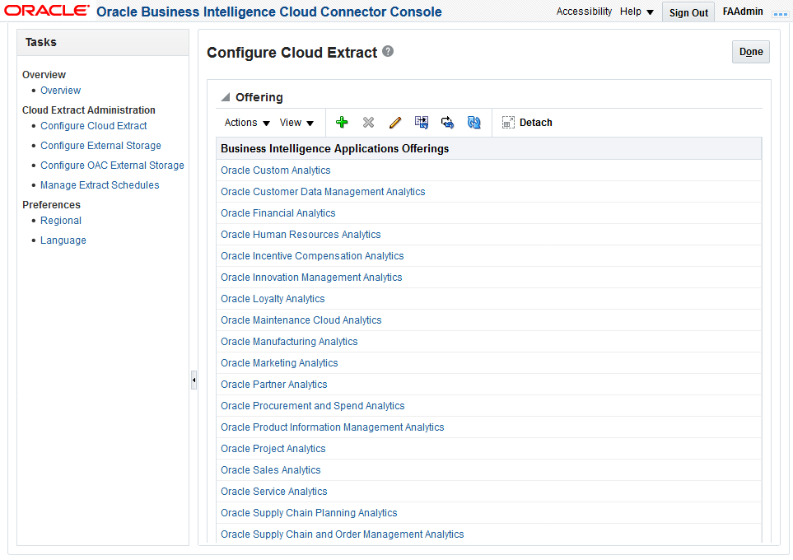
Data Extract using BI Cloud Connector (BICC)
With ODI
Fusion Cloud
OCI
ERP Tables
ODI
Execute BICC Jobs
Load data from storage to targets
BI View Objects
Gzip/CSV
ADW
BI Cloud Connector
Object Storage
BI Cloud Connector Console
Configure Cloud Extract
Configure Target Storage
Manage Extract Schedule

