Slide 1
Opalescence
Be on the same wavelength.
By Aidan Sensiba and Vincent Miller

Slide 2
Target Audience
Puzzle enthusiasts
Ages 9-99
People who like puzzles but don’t have many hours of free time to complete huge puzzle games.

Slide 3
Overall Concept
Use a laser to destroy blocks of the same color, and mirrors to redirect it and change the color.

Slide 4
Key Emotional Goals and Peak Moments
Satisfaction when the laser destroys blocks
The player should feel smart for solving the puzzles
Should not feel very frustrated when they lose, since each try only takes about a minute or two.

Slide 5
Measurable Experience Goals
No level takes more than five minutes to complete
Encourage player to use minimum number of moves
Players will continue to play more than one level if they have time

Slide 6
Key Features
There is at least one laser of a certain color in each level
Lasers can destroy the blocks that match their same color
Mirror blocks redirect the laser and change its color
Touch two adjacent objects to swap them in order to create the laser’s path
Clear all blocks, or certain number of blocks to win level

Slide 7
Additional Block Types
Bomb - destroys nearby blocks
Puppy - if you hit it you lose (the level restarts)
Splitter - split laser into two

Slide 8
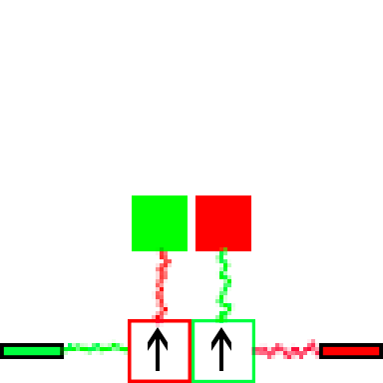
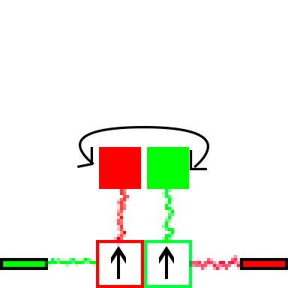
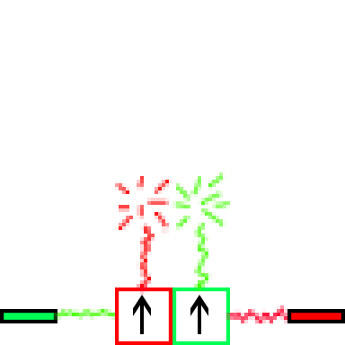
Play Description
Green laser fires into red mirror, laser turns red.
Red laser fires onto green mirror, laser turns green.
Switch the red and green solid blocks.
Red laser hits red block, green laser hits green block. Both match and are destroyed.

Slide 9
THE END.

