Slide 1
What the Moon Takes
Light reveals darkness.
Vincent Miller and Aidan Sensiba

Slide 2
Story Summary
“What the Moon Takes” by H.P. Lovecraft
Character is in a moonlit, dreamlike garden following a stream
Lotus flowers drifting by
Stream leads to ocean
Ancient underwater city revealed

Slide 3
Overall Concept
A bullet-hell where you dodge lotus flowers to avoid gaining forbidden knowledge.

Slide 4
Target Audience
Ages 12+
People with some experience playing action games

Slide 5
Experience Goals
Qualitative
Quantitative
Curiosity
Being unsettled
Regret
At least 50% of players complete the game normally the first time
The game takes five minutes to complete the game normally
Most players get hit at least once
To record, we’ll use an in-game timer and hit counters with DB functions

Slide 6
Features
Top-down player controls with WASD
Many projectile patterns to avoid, hits lower health
“Health” indicated by the size of the moon
Two endings, depending on if you avoid projectiles
Unsettling sound FX

Slide 7
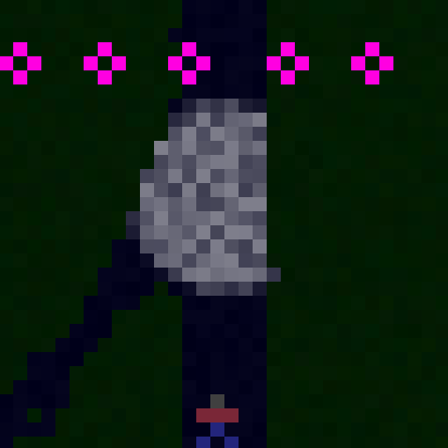
Play Description
Do not touch the lotus flowers.

Slide 8
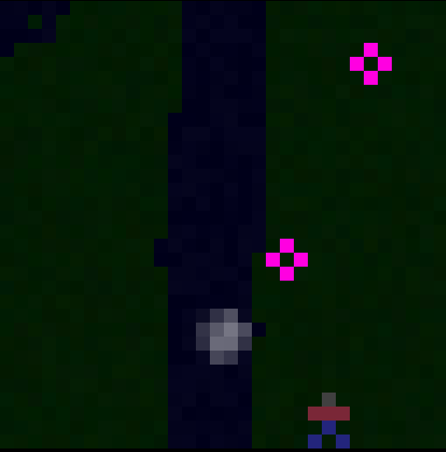
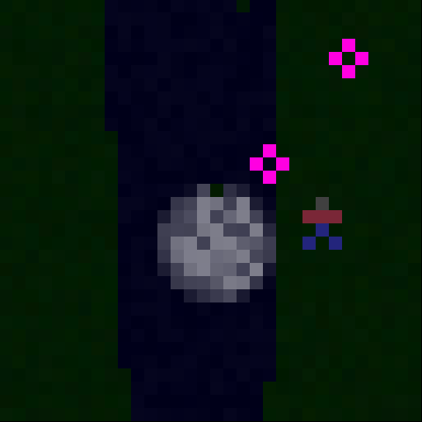
Play Description
The moon grows along with your wisdom.

Slide 9

Ending 1: You succeed in avoiding the flowers.
However, you may feel unsatisfied with a happy ending...

Slide 10
Thanks for watching.

