Slide 1
What the Moon Takes
Beware the whispers in the dark.
Vincent Miller and Aidan Sensiba

Slide 2
Story Summary
“What the Moon Brings” by H.P. Lovecraft
Character is in a moonlit, dreamlike garden following a stream
Lotus flowers drifting by
Stream leads to ocean
Ancient underwater city revealed

Slide 3
Overall Concept
A bullet-hell where you dodge lotus flowers to avoid gaining forbidden knowledge.

Slide 4
Target Audience
Ages 12+
People with some experience playing action games
Fans of cosmic horror

Slide 5
Experience Goals
Qualitative
Quantitative
Curiosity
Being unsettled
Regret
At least 50% of players complete the game normally the first time
The game takes five minutes to complete normally
Most players get hit at least once
To record, we used an in-game timer and hit counters with DB functions

Slide 6
Features
Top-down player controls with WASD and arrows
Many projectile patterns to avoid, hits increase “forbidden knowledge”
Knowledge indicated by the size of the moon
Two endings, depending on if you avoid projectiles
Unsettling sound FX

Slide 7
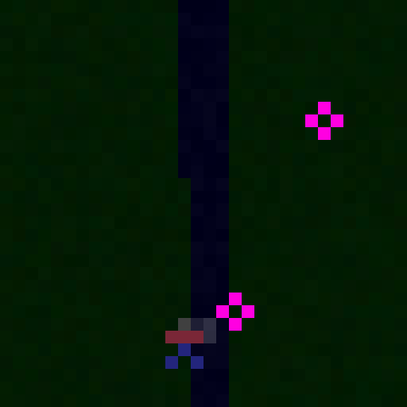
Play Description
Do not touch the lotus flowers.

Slide 8
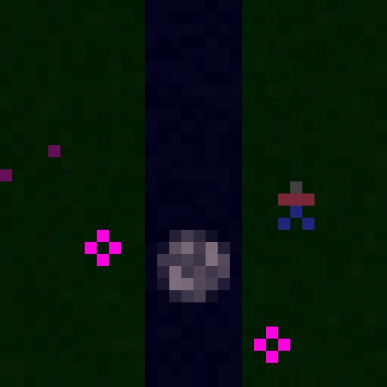
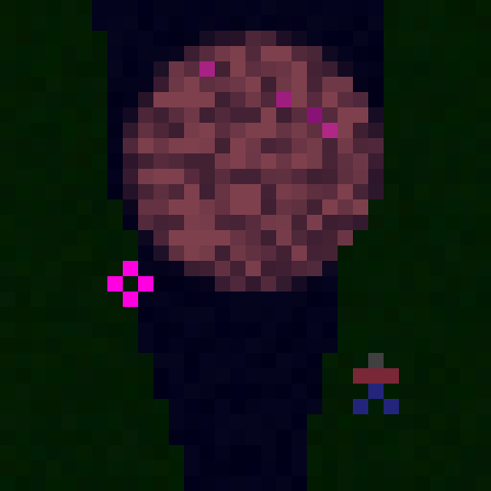
Play Description
If you do, the moon grows along with your wisdom.

Slide 9
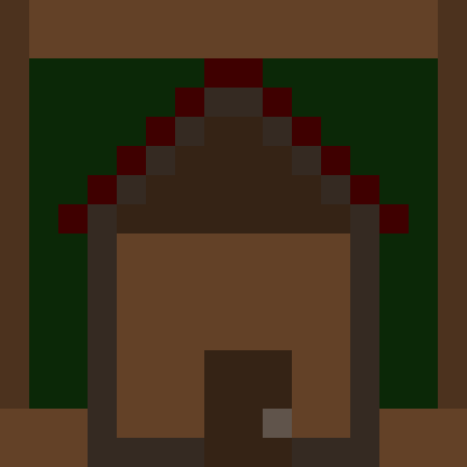
Ending 1: You succeed in avoiding the flowers, and return home

Slide 10
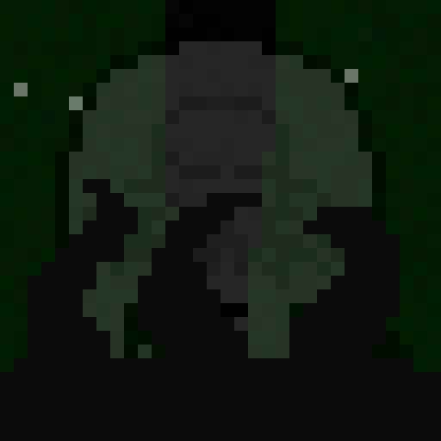
Ending 2: Your curiosity brings you a dark fate...

Slide 11
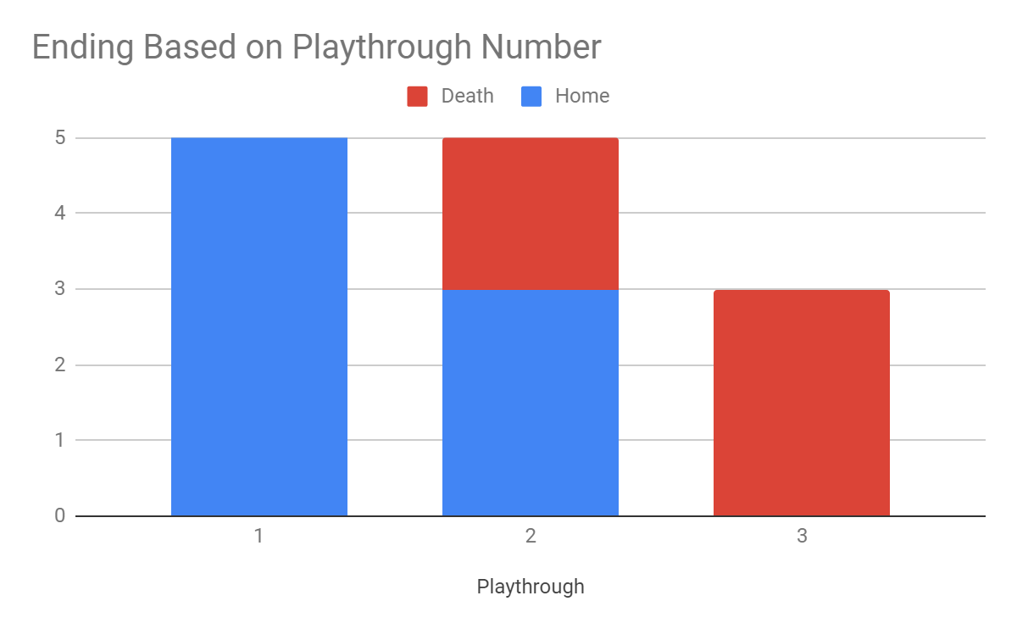
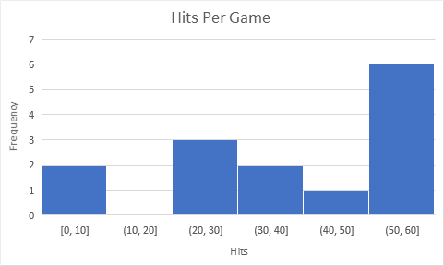
Analytics
Also, every game was completed within a minute or less.

Slide 12
Survey Questions
Could you tell what each visual element was?
Did the game convey a sense of dread?
What was your initial reaction to the flowers?
How difficult was it to move where you wanted to go?
How difficult was it to avoid getting hit?
Did the status messages discourage you from continuing to get hit?
Did you feel curious about what would happen if you kept getting hit?
Did the difficulty curve of avoiding getting hit seem smooth?

Slide 13
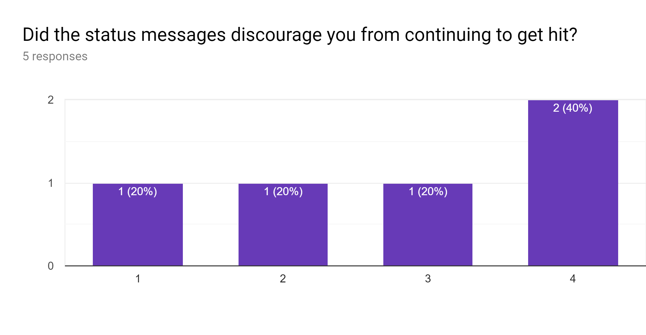
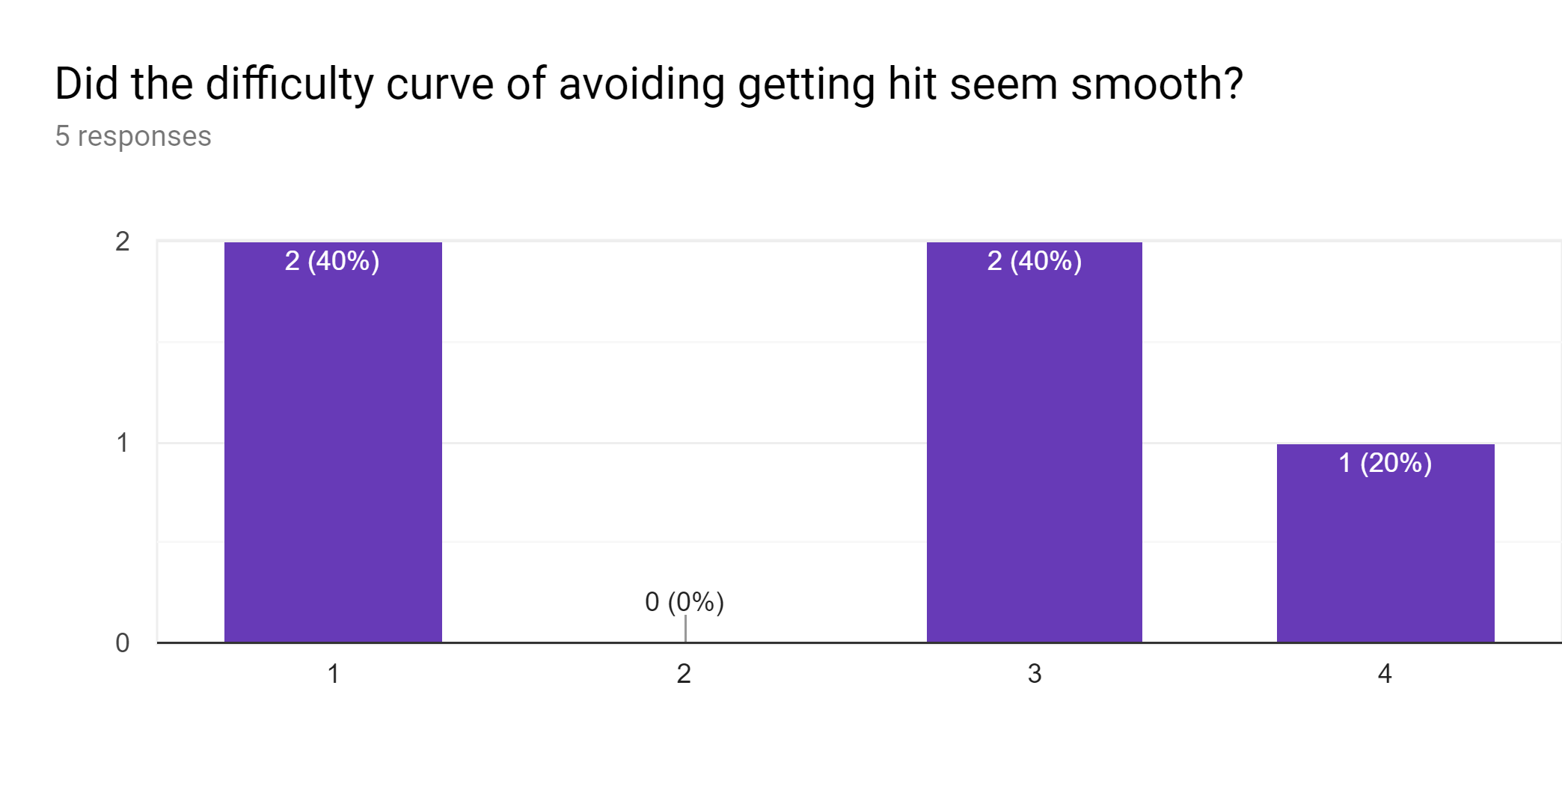
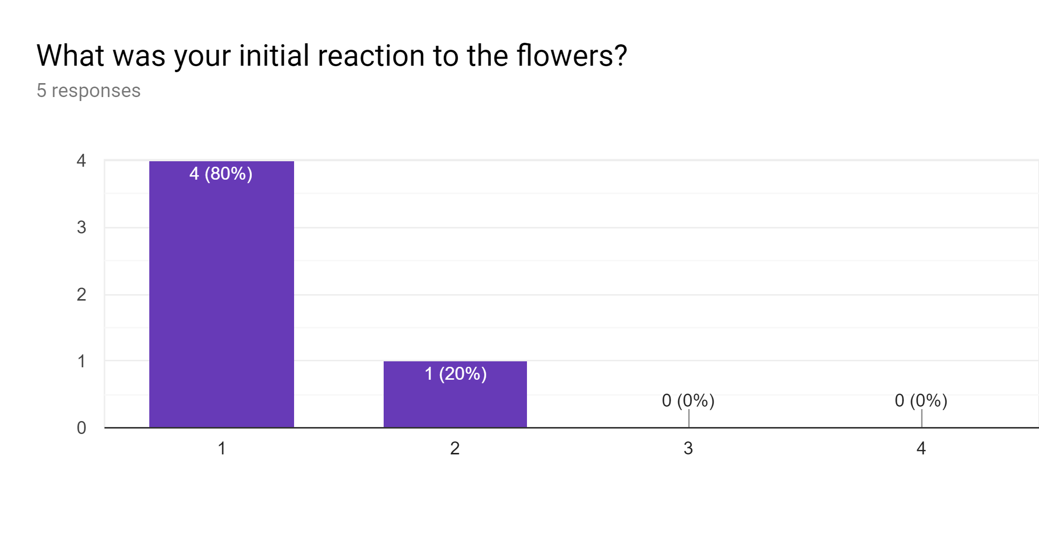
Survey Insights
1 = Avoided
4 = Collected

Slide 14
Playtesting Observations
Status text didn’t intrigue players to touch flowers
It was hard to read where flowers would spawn
Both endings were ambiguous
Flowers need to disappear at the endings
Moon grows too much

Slide 15
Critique
Player sprite looked weird
For some it was unclear whether they should collect or avoid the flowers
Monster should be more mysterious
Bell sound effect not discouraging enough

Slide 16
