Slide 1
OPALESCENCE
Be on the Same Wavelength
By Vincent Miller and Aidan Sensiba
AV Club

Slide 2
Overall Concept
Use lasers to destroy blocks of the same color, and mirrors to redirect them and change the color.

Slide 3
Target Audience
Puzzle enthusiasts
Ages 9-99
People who like puzzles but don’t have much free time

Slide 4
Experience Goals
Qualitative
Satisfaction destroying blocks
Feeling smart after solving
Low frustration
Quantitative
Each puzzle can be realistically solved in under 5 minutes
Minimize number of level skips
Maximize “smoothness” of trendline of player moves per level

Slide 5
Original Design

Slide 6
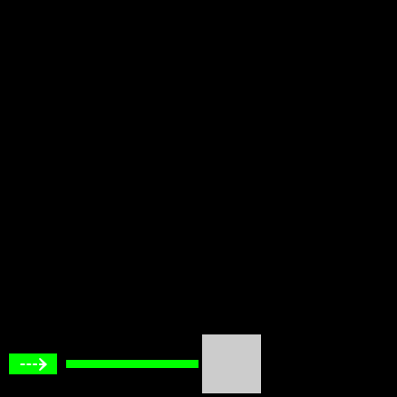
Original Design
Destroy blocks with lasers to win

Slide 7
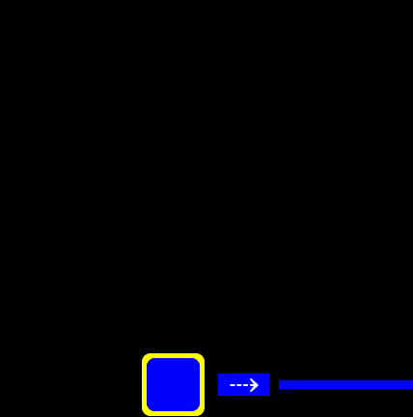
Original Design
Swap two blocks by clicking on them

Slide 8
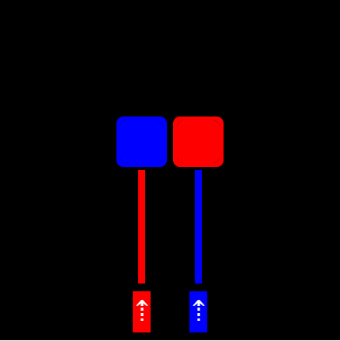
Original Design
Blocks must be hit by the correct color

Slide 9
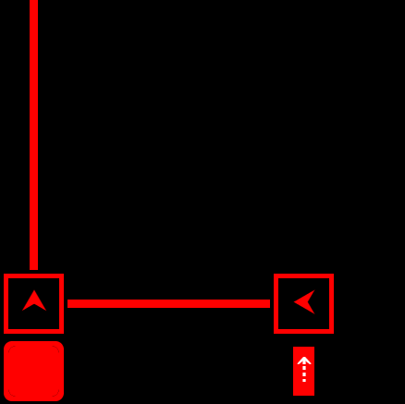
Original Design
Mirrors redirect and recolor lasers

Slide 10
Original Additional Features
Puppies (don’t hit with laser)
Bombs (destroy all nearby when hit)
Non-interactable blocks

Slide 11
Feedback and Data

Slide 12
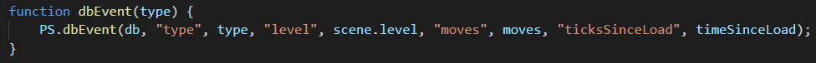
Analytics: Instrumentation
Events recorded: win, skip, back, reset
Variables for each event
Event type
Level index
Time since level load
Moves since level load

Slide 13
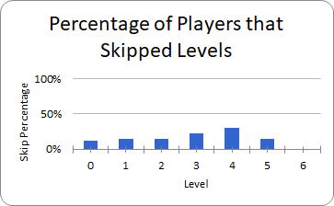
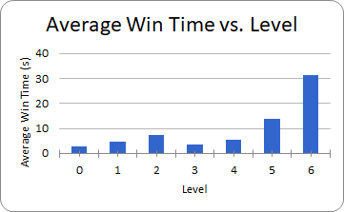
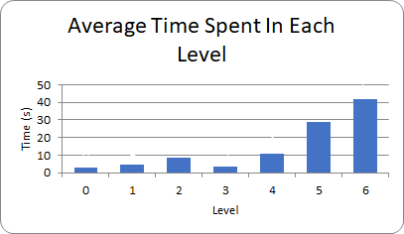
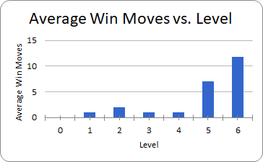
Analytics

Slide 14
Playtesting
Difficulty curve had a big bump
Players used skip button, just to see what it does
Somewhat difficult to tell what moves would make a level unwinnable
Repeated laser sound was annoying

Slide 15
Survey
How clearly did you understand the basic objectives of each level?
Median: 4/5
Was it easy to tell which beads represented which objects?
Median: 4/5
Was the object-switching mechanic easy to understand?
Median: 3/5
How clear was the audiovisual feedback for events?
Median: 3/5

Slide 16
Survey
How pleasing was the visual aesthetic?
Median: 4/5
Did you use the "skip level" buttons much?
Median: 1/5
After logging in, did you understand what happened in the first five seconds of the game?
Median: 4/5
How would you rate the overall increase in difficulty?
Median: 3/5

Slide 17
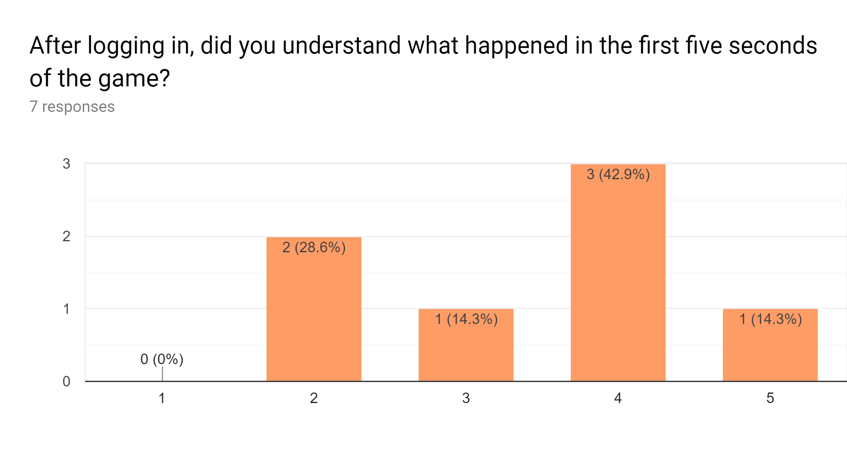
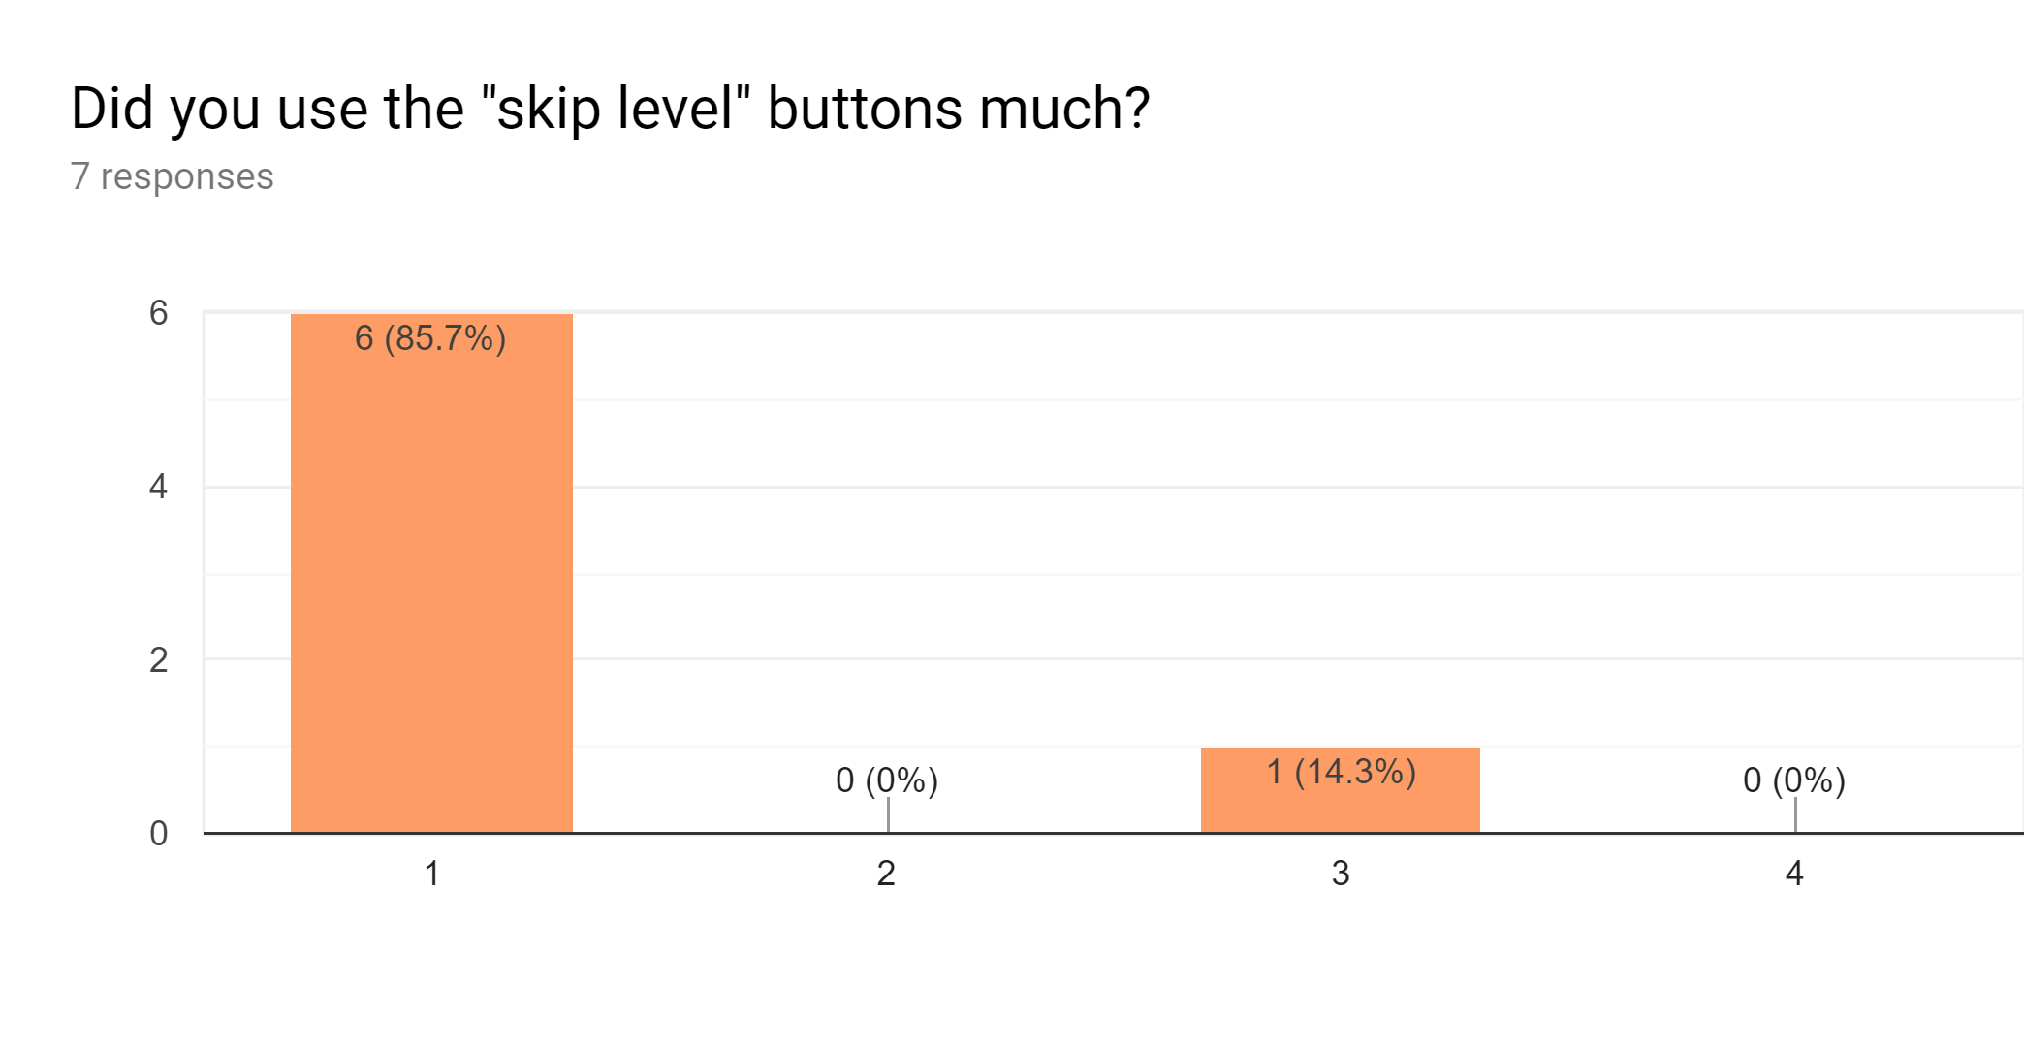
Survey Graphs

Slide 18
Critique
Negatives
Lasers were a bit flashy, maybe add a toggle
Hard to see color of mirrors when selected
Positives
Difficulty curve was smooth
Satisfying to destroy blocks

Slide 19
Final Version: Gameplay
Removed puppy and bomb object types
Added more intermediate levels to smooth difficulty
Added more advanced levels at the end
Added a non-interactable object type (boulders)

Slide 20
Final Version: Aesthetic
Changed to a neon color scheme to be more interesting than primary RGB
Added flashing animation on lasers and charged mirrors to convey energy
Added option to disable flashing animation
First level presents this option and shows skip button
Made mirrors show their color when selected

Slide 21
THE END

