Slide 1
Performance Measures
5 GA’s x 5 test functions x 30 runs = 750 total runs
Metrics
Average number of Evaluations on Success (AES)
Average number of evaluations to find the optimum
Success Rate (SR)
Mean Best Fitness (MBF)
For GA’s with SR < 30

Slide 2
Experimental Results
Algorithms
Traditional Genetic Algorithm (TGA)
GA with self-adaptive mutation rate only (SAMGA)
GA with self-adaptive crossover rate only (SAXGA)
GA with adaptive population size only (APGA)
GA with all extensions (SAMXPGA)

Slide 3
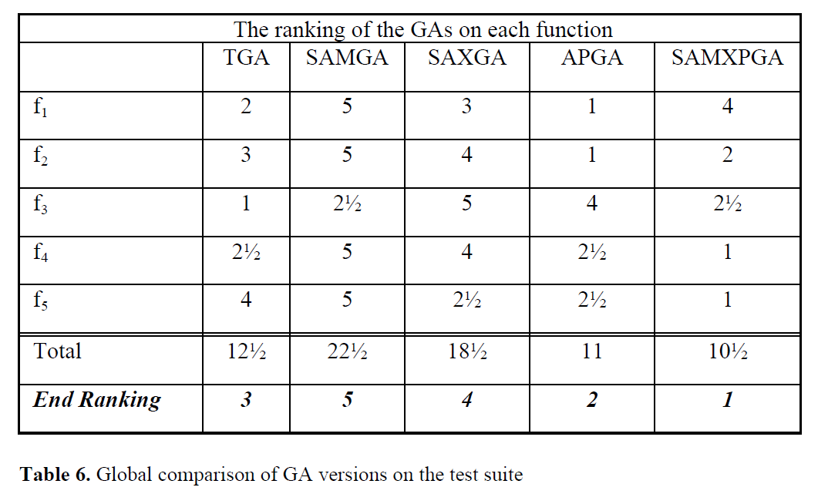
Experimental Results Cont.
Table 6 ranks the performance of the GA’s for each function. The fastest GA or the GA closest to the minimum is given 1 point and the worst GA is given 5 points. If two GA’s have similar performance, they are awarded equal points.

Slide 4
Conclusions
When self-adaptive mutation and self-adaptive crossover are incorporated on their own, results are disappointing
Time spend searching for good parameters is taken away from time spent finding the optimum
Adapting the population size is effective, however
Having a maximum lifetime keeps the population small and sets high pressure on survival

Slide 5
Conclusions Cont.
With SAMXPGA as number one and APGA number two, adaptive population size was the key to improving on the TGA
The authors note that self-adjusting mutation and crossover where important in SAMXPGA, though
This study shows that a GA without parameters can perform very well and that more attention should be devoted to control mechanisms for variable population sizes

