Slide 1
SOLID :
OO Design Principles
With Code Samples
Darryl Gebert
Solutions Architect and Clean Coder

Slide 2
Agenda
Introduction
SOLID and best OO Practices
Single Responsibility Principle
Open / Closed Principle
Liskov Substitution Principle
Interface Segregation Principle
Dependency Inversion Principle
Ioc, Dependency Injection
Unit Testing

Slide 3

Why Are We Here
You are a good developer.
You want to be a better developer.
Building quality
Software systems are often large and complex
Construction requires best Agile / OO Development skills and practices
Stakeholders , Product Owners => customers, features, schedule
Our job => Build and Defend the Code

Slide 4

The Foundation of Good Software Design
Majority of principles, patterns, and practices are based on this:
Coupling
Cohesion
Coupling
To what extent are objects dependent on other objects?
Ripple effects of a change?
Cohesion
What is size of the class (LOC) ?
Does it do more than one thing?

Slide 5
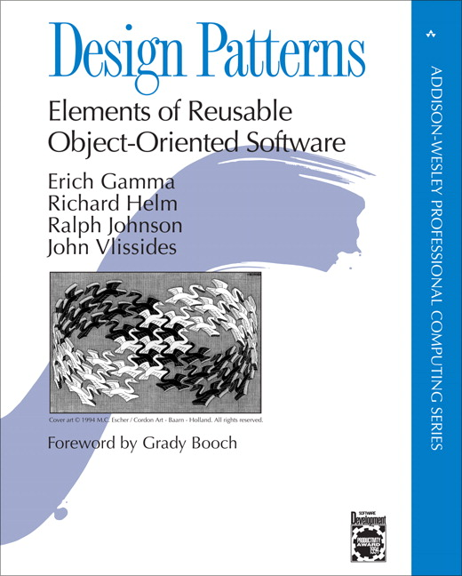
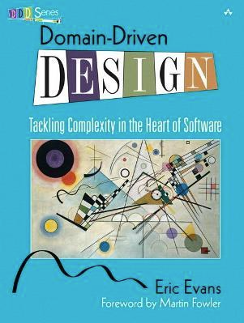


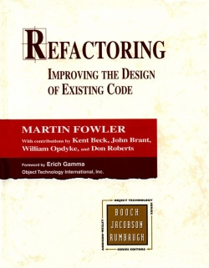
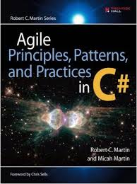


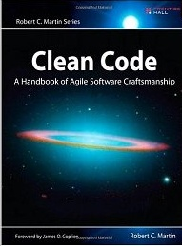
Best OO and Agile Development Practices
OO Principles
Encapsulation
Polymorphism
Abstraction
Inheritance
Design Patterns
Domain Driven Design
Code Smells
Refactoring Patterns
Automated Testing

Slide 6
SOLID - Principles of Maintainable OO Programming
Introduced by Robert C. Martin (“Uncle Bob”)
Core of Agile software development
Maintainable testable code
Avoid code smells
Easily refactor code
SOLID
Single Responsibility Principle (SRP)
Open/Closed Principle (OCP)
Liskov Substitution Principle (LSP)
Interface Segregation Principle (ISP)
Dependency Inversion Principle (DIP)

Slide 7
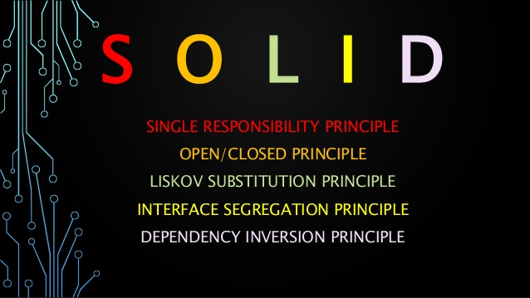
SOLID - Summary
SRP | A class should have one, and only one, reason to change.
OCP | You should be able to extend a classes behavior, without modifying it.
LSP | Derived classes must be substitutable for their base classes.
ISP | Make fine grained interfaces that are client specific.
DIP | Depend on abstractions, not on concretions.

Slide 8
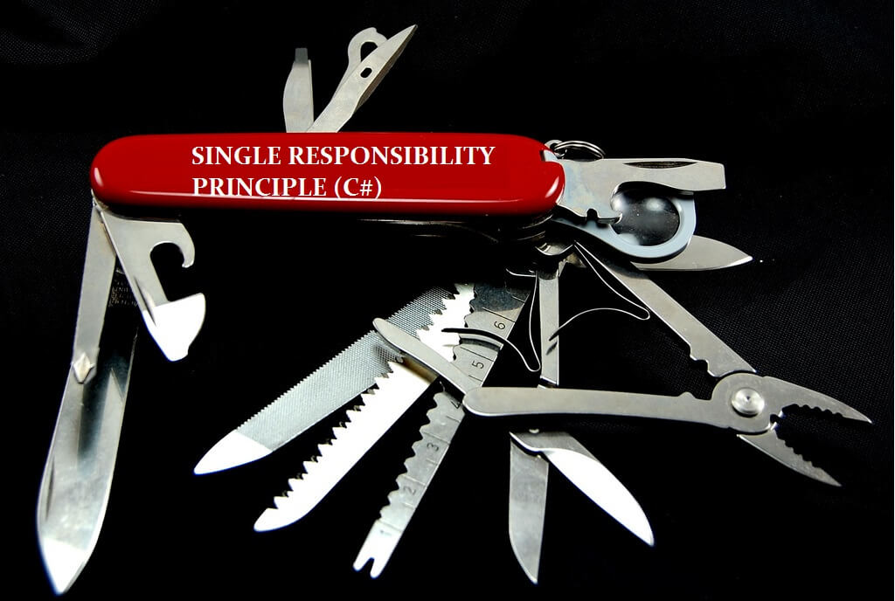
Single Responsibility Principle

Slide 9
SOLID
"There should never be more than one reason for a class to change."
Every class should have a single responsibility – ie. it does ONE thing
aka. Cohesion
Responsibility should be entirely encapsulated by the class.
Should only be a single reason for making the change to a class.
Good way of identifying classes at design phase
The size of the classes become shorter.
This makes code easier to understand and maintain

Slide 10
SOLID - Code Sample: CsvContactsFileProcessor
public class CsvContactsFileProcessor
{
public int Process(string filename)
{
// Read file
TextReader textReader = new StreamReader(filename);
textReader.ReadToEnd();
textReader.Close();
// Parse lines
var splitOptions = CStringSplitOptions.RemoveEmptyEntries;
string[] allLines
= textReader.ToString().Split(new string[] { @"\r\l" }, splitOptions);
string[][] linesArray
= allLines.Select(e => e.Split(new string[] { "," }, splitOptions))
.ToArray();
// . . . continued on next slide . . .

Slide 11
SOLID - Code Sample (con’t)
// Take each line from file and insert a People record
// In reality, EntityFramework is a preferred implementation
var connString = "server=(local);integrated security=sspi;database=CRM";
using (var conn = new SqlConnection(connString))
{
conn.Open();
foreach (string[] columns in linesArray)
{
using (var command = conn.CreateCommand())
{
command.CommandText
= @INSERT INTO Contacts (FirstName, LastName, Email)
VALUES (@FirstName, @LastName, @Email)";
command.Parameters.AddWithValue("@FirstName", columns[0]);
command.Parameters.AddWithValue("@LastName", columns[1]);
command.Parameters.AddWithValue("@Email", columns[2]);
command.ExecuteNonQuery();
}
}
}
return allLines.Length;
}

Slide 12
SOLID – Code review: CsvContactsFileProcessor
This class does 3 distinct things:
Read CSV file
Parse CSV file
Insert record in Contacts DB table
Problems:
Many responsibilities in one method, hard to unit test
If code change in Parse introduces bug, then Reading and Storing functionality are also broken.
If no unit tests or complex unit tests, takes longer to troubleshoot and fix.
Complexity hinders comprehension
costs Organization time and $$
like $$ interest, compounds as new developer works with this code base.

Slide 13
SOLID - Some refactoring - Better
public class CsvContactsFileProcessor {
public void Process(string fileName) {
string csvData = ReadCsv(fileName);
string[] parsedData = ParseCsv(csvData);
StoreCsvData(parsedData);
}
public string ReadCsv(string filename) {
// …
}
public string[] ParseCsv(string csvData) {
// …
}
public void StoreCsvData(string[] parsedData) {
// …
}
}

Slide 14
SOLID - Refactor into SRP Classes

Slide 15

SOLID – Processor using refactored classes
// Implementation details moved to each responsible class
public class CsvContactProcessor
{
public int Process(string filename)
{
string csvData = new CsvContactsDataProvider().Read(fileName);
IEnumerable<Contact> contacts = new CsvContactsParser().Parse(csvData);
int result = new AdoContactsWriter().Write(contacts);
return result;
}
}
There is still a Better way to improve this with ISP and DIP.

Slide 16
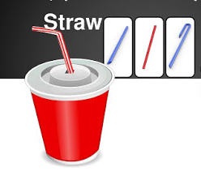
Open / Closed Principle

Slide 17
SOLID
"Software entities (classes, modules, functions, etc.) should be open for extension, but closed for modification.."
Ability to extend behavior of system without having to modify that system.
Open for extension
Do not change class unless absolutely necessary (new requirements)
Derived classes rely on implementation to function properly.
Closed for modification
Class is developed, unit tested, and in use
Class should not be altered unless bugs found or requirements change.
Strategies
Inheritance
Delegation - Favor composition over inheritance.
C# extension methods

Slide 18
SOLID – Simple Shopping Cart example
public class ShoppingCart
{
private readonly List<OrderItem> _orderItems = new List<OrderItem>();
public IEnumerable<OrderItem> OrderItems => _orderItems;
public void Add(OrderItem orderItem) {
_orderItems.Add(orderItem);
}
public decimal CalculateTotalAmount()
{
decimal total = 0m;
foreach (var orderItem in OrderItems)
{
total += CalculateItemTotal(orderItem);
}
return total;
}
// . . . Continued . . .
}

Slide 19
SOLID – Simple Shopping Cart example (con’t)
private decimal CalculateItemTotal(OrderItem orderItem)
{
if (orderItem.Identifier.StartsWith("Each"))
{
return orderItem.Quantity * 4m; // price per unit
}
if (orderItem.Identifier.StartsWith("Weight"))
{
return orderItem.Quantity * 3m / 1000; // price per kilogram
}
if (orderItem.Identifier.StartsWith("Spec"))
{
total += orderItem.Quantity * .3m;
int setsOfFour = orderItem.Quantity / 4;
return setsOfFour * .15m; // discount on groups of 4 items
}
return 0m;
}
}

Slide 20
SOLID – Simple Shopping Cart - Problem
Problem
If new pricing strategy, have to add to more “if” logic to existing class.
Potential to introduce bugs and/or break existing code
In general, repeated if-else logic s an opportunity to think polymorphism and apply a GoF design pattern.
Next we’ll show re-design with patterns application to achieve OCP.

Slide 21
SOLID – Price Calculator with Pricing Strategies

Slide 22
SOLID – Shopping Cart w/ IPriceCalculator
public class ShoppingCart
{
private readonly IPriceCalculator _priceCalculator;
// . . .
public ShoppingCart(IPriceCalculator priceCalculator)
{
_priceCalculator = priceCalculator;
}
public decimal CalculateTotalAmount()
{
decimal total = 0m;
foreach (var orderItem in OrderItems)
{
total += _priceCalculator.CalculatePrice(orderItem);
}
return total;
}
}
Delegate to IPriceCalculator. This class/method is now closed for modification

Slide 23
SOLID – Introduce IPricingStrategy Implementations
public class PricePerKilogramStrategy : IPriceStrategy
{
public bool IsMatch(OrderItem item) {
return item.Identifier.StartsWith("Weight");
}
public decimal CalculatePrice(OrderItem item) {
return item.Quantity * 3m / 1000;
}
}
public class PricePerUnitStrategy : IPriceStrategy {
// implementation of price per unit strategy
}
public class SpecialPriceStrategy : IPriceStrategy {
// implementation of special price strategy
}

Slide 24
SOLID – IPriceCalculator w/ Pricing Strategies
public class DefaultPriceCalculator : IPriceCalculator
{
private readonly IList<IPriceStrategy> _pricingRules;
public DefaultPriceCalculator()
{
_pricingRules = new List<IPriceStrategy>();
_pricingRules.Add(new PricePerKilogramStrategy());
_pricingRules.Add(new PricePerUnitStrategy());
_pricingRules.Add(new SpecialPriceStrategy());
}
public decimal CalculatePrice(OrderItem item)
{
// First matching strategy clculates price
return _pricingRules.First(r => r.IsMatch(item))
.CalculatePrice(item);
}
}
This is open for extension. Plug in new pricing strategies as they evolve.

Slide 25
SOLID – But Wait, There’s More…
New Pricing Strategy: Buy 3 Get 1 Free
Define and plug into PriceCalculator list of strategies
public class BuyThreeGetOneFree : IPriceStrategy
{
public bool IsMatch(OrderItem item)
{
return item.Identifier.StartsWith("Buy3OneFree");
}
// n-1+[n/3+1]
public decimal CalculatePrice(OrderItem item)
{
decimal price = total - 1m + (total / 3m + 1m);
return price;
}
}

Slide 26
SOLID – Final Thoughts on OCP
Do not interpret this rule as: "don't change already implemented classes, ever."
Nothing can ever be 100% closed
Scenarios will always arise that will force or require you to change classes that are already implemented.
However, use discretion when attempting to make modifications
Since closure cannot be complete, it must be strategic
Experienced designer hopefully knows users and industry well enough to judge probability of different kinds of changes.
Designer ensures that OCP applied for most probable changes.

Slide 27
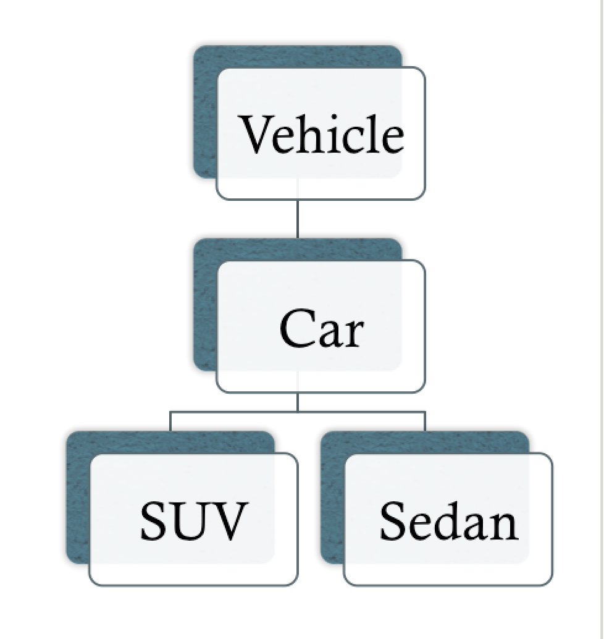
Liskov Substitution Principle

Slide 28
SOLID
“Objects in a program should be replaceable with instances of their sub types without altering the correctness of that program”
Translation:
Subclass extends base class without changing behavior
Subclass should be perfectly substitutable for its base class.
If class B is subclass of A, then B should be substitutable for A.

Slide 29
SOLID – Inheritance Enables Substitution
A potential subclass should conform to the
100% Rule (definition conformance)
“Is-a” Rule (set membership conformance)
100% rule
100% of superclass definition should be applicable to subclass.
Subclass must conform to 100% of superclass’s attributes + associations
“Is-a” rule
Subclass is a Superclass
All the members of Subclass B must be members of Superclass A superclass set.
Eg. CreditPayment is a Payment

Slide 30


SOLID - Inheritance
Apply “Is-a” and 100% rule to these:

Slide 31
SOLID – Code Sample: Use Abstraction
public abstract class MusicalInstrument {
public abstract void PlayNote();
}
public class Piano : MusicalInstrument {
public override void PlayNote() {
PressKey();
}
private void PressKey() {
// Press a piano key.
}
}
public class Saxophone : MusicalInstrument {
public override void PlayNote() {
Blow();
}
private void Blow() {
// Blow air into the instrument.
}
}

Slide 32
SOLID - Strategies
Create a subclass of a superclass when:
Subclass has additional attributes of interest.
Subclass has additional associations of interest.
Subclass concept is operated on, handled, reacted to, or manipulated differently than superclass or other subclasses, in ways that are of interest.
Subclass concept represents an animate thing (for example, animal, robot) that behaves differently than superclass or other subclasses, in ways that are of interest.

Slide 33

Interface Segregation Principle

Slide 34
SOLID
" Clients should not be forced to depend upon
interfaces that they do not use"
Translation:
Client should not be forced to use an interface or interface operations that are irrelevant to its needs
Keep interfaces small and cohesive
Similar to SRP
A bloated interface imposes a huge implementation burden
Favor many small cohesive client-specific interfaces over one general-purpose large interface
Large interface - tendency for class to provide partial implementation
Diminishes the advantages of having an interface
Partial implementations violate the LSP
Beware of method implementations with NotSupportedException

Slide 35
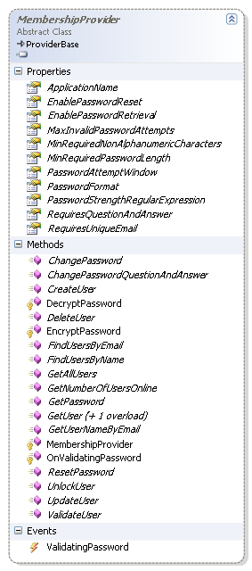
SOLID – Original ASP.NET Membership Provider
Required implementation of:
abstract MembershipProvider
Difficult to reuse just the parts needed when customizing membership solution for an application.
MembershipProvider entangled a number of responsibilities and required a relational database
Big violator of ISP

Slide 36
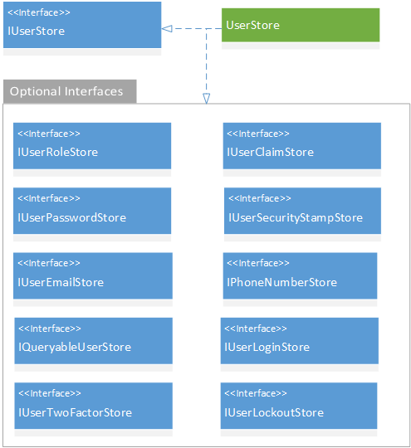
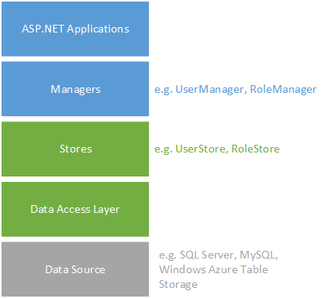
SOLID – ASP.NET Identity 2.x
UserStore, RoleStore

Slide 37
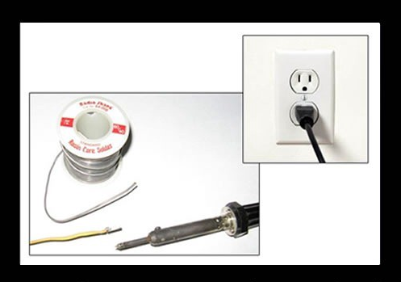
Dependency Inversion Principle

Slide 38
SOLID
“High level modules should not depend on low level modules rather both should depend on abstraction. Abstraction should not depend on details; rather detail should depend on abstraction.”
Translation:
If a class has dependencies on other classes, it should rely on the dependencies’ interfaces, NOT their concrete types
Reduces coupling between classes and modules
USE a DI (Dependency Injection) Container
NEW is GLUE

Slide 39
SOLID – Remember this from SRP discussion?

Slide 40
SOLID – CvsContactProcessor w/ interfaces

Slide 41
SOLID – Change processor to use abstractions
public class CsvContactProcessor
{
private readonly IContactDataProvider _contactDataProvider;
private readonly IContactParser _contactParser;
private readonly IContactWriter _contactWriter;
public CsvContactProcessor()
{
_contactDataProvider = new CsvContactDataProvider();
_contactParser = new CsvContactParser();
_contactWriter = new AdoContactDataWriter();
}
public void Process(string filename)
{
string csvData = _contactDataProvider.Read(fileName);
IEnumerable < Contact> contacts = _contactParser.Parse(csvData);
_contactWriter.Write(contacts);
}
}

Slide 42
SOLID – IoC, Dependency Injection
Where DIP starts to become really useful is with IoC or Dependency Injection.
IoC – Inversion of Control
Dependency Injection pattern - specialization of IoC
Delegate selection of a concrete implementation type for a class’s dependencies to an external component or source.
About getting other code to inject dependency instances into a class
Client class does NOT new-up an of its concrete dependent instances.
Completely isolates class
Makes change and reuse much easier.

Slide 43
SOLID – Change processor to depend on interfaces
public class CsvContactProcessor : IContactProcessor
{
private readonly IContactDataProvider _contactDataProvider;
private readonly IContactParser _contactParser;
private readonly IContactWriter _contactWriter;
public CsvContactProcessor(IContactDataProvider dataProvider,
IContactParser contactParser,
IContactWriter contactWriter)
{
_contactDataProvider = dataProvider;
_contactParser = contactParser;
_contactWriter = contactWriter;
}
public void Process(string filename)
{
string csvData = _contactDataProvider.Read(fileName);
IEnumerable < Contact> contacts = _contactParser.Parse(csvData);
_contactWriter.Write(contacts);
}
}
Dependencies are “injected” into constructor

Slide 44
SOLID – Dependency Injection Container
Who creates instances of:
IContactsDataProvider ?
IContactsParser ?
IContactsWriter ?
How does CvsContactsProcessor receive these dependencies?
Answer: Dependency Injection Container

Slide 45
SOLID – DI Container: How it works

Slide 46
SOLID – Register Interface/Class bindings
Note:
This sample uses Ninject for DI container
.NET Core comes with its on DI framework: Microsoft.Extensions.DependencyInjection
using Ninject.Modules;
public class Bindings : NinjectModule
{
// Register and bind concrete classes to interfaces
public override void Load()
{
Bind<IContactProcessor>().To<CsvContactProcessor>();
Bind<IContactDataProvider>().To<CsvContactDataProvider>();
Bind<IContactParser>().To<CsvContactParser>();
Bind<IContactWriter>().To<AdoContactWriter>();
}
}

Slide 47
SOLID – Putting it all together
using Ninject;
using System;
using System.Reflection;
class Program
{
// Using Ninject for Dependency Injection container
static void Main(string[] args)
{
// Init container
var kernel = new StandardKernel();
kernel.Load(Assembly.GetExecutingAssembly());
// Get instance of processor (all its dependencies are
// resolved and instantiated
var processor = kernel.Get<IContactProcessor>();
processor.Process("Contacts.csv");
}
}

Slide 48
SOLID - Unit Testing w/ Mocks of Interfaces
using System.Collections.Generic;
using FluentAssertions;
using NSubstitute;
using Xunit;
namespace gwn.solid.test
{
public class CsvContactProcessorTest
{
[Fact]
public void ProcessTest()
{
// Arrange, Act, Assert – next slide ...
}
}
}
3 essential packages for Unit Testing

Slide 49
SOLID - XUnit Testing - AAA (Arrange-Act-Assert)
[Fact]
public void ProcessTest()
{
// Arrange – mocks via NSubstitute
var dataProvider = Substitute.For<IContactDataProvider>();
dataProvider.Read(Arg.Any<string>()).Returns(string.Empty);
var contacts = new List<Contact> {
new Contact("Bill", "Smith", "bill.smith@gmail.com")
};
var contactParser = Substitute.For<IContactParser>();
contactParser.Parse(Arg.Any<string>()).Returns(contacts);
var contactWriter = Substitute.For<IContactWriter>();
contactWriter.Write(contacts).Returns(contacts.Count);
// Act
var processor = new CsvContactProcessor(dataProvider, contactParser, contactWriter)
var result = processor.Process("NA");
// Assert - FluentAssertions
result.Should().Be(contacts.Count);
}

Slide 50
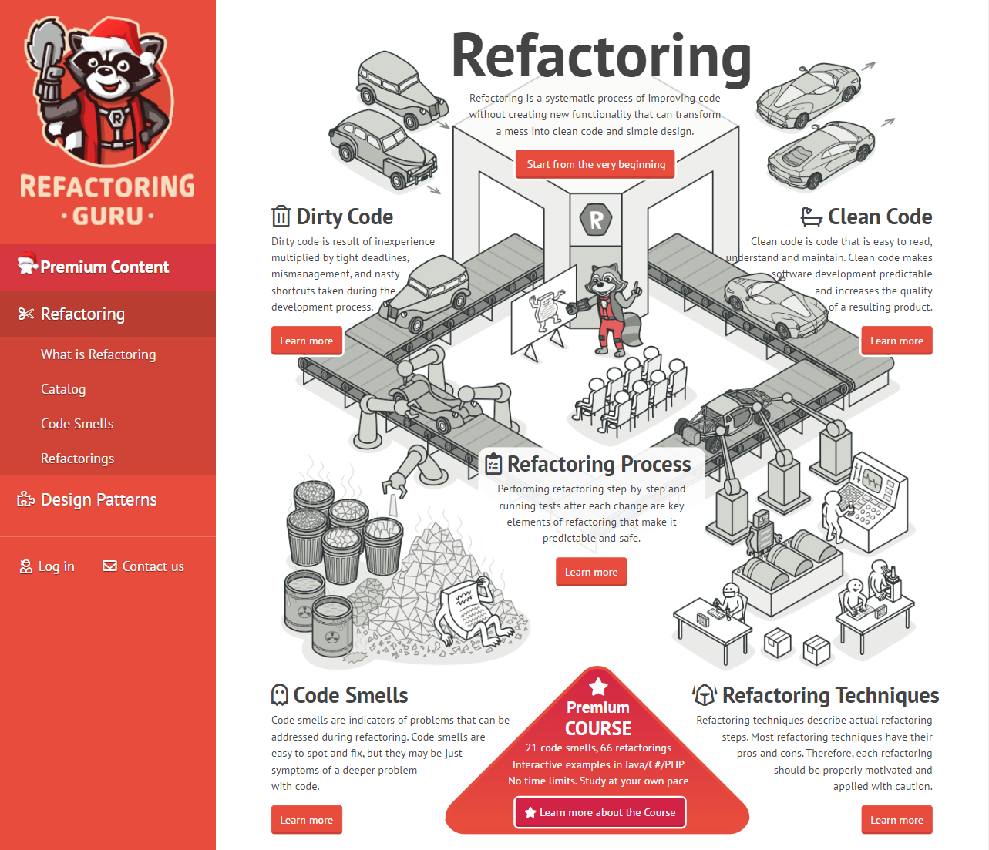
Want to Learn More? - https://refactoring.guru/refactoring

