Slide 1


Dimitriana Georgiou
University of Cyprus – 27th May 2025
Thesis Supervisor: Dr. Chris Christodoulou
Co-Supervisor: Marios Pafitis
Examiner : Dr. Costas Pattichis

Slide 2

Leveraging Vision Transformers for Early Breast Cancer Detection
A study on Thermal Infrared Imaging with the use of DINOv2

Slide 3

Presentation contents
01
02
05
12
04
Why this Matters
Research Question
Performance
Metrics
Past Attempts and
Limitations
05
06
07
08
Evaluation Setup
Classifiers Implemented
Why use ViTs &
DINOv2?
Dataset and
Preprocessing
for DINOv2
09
10
11
Linear Classifier&
Results
MLP v.2 Classifier
&Results
Comparison: Linear
VS MLP
MLP v.1 Classifier
&Results
13
14
15
13
MLPv.1 MLPv.2
Comparison
Conclusion
Cases of
Suitability
Teachable
Machine Model

Slide 4
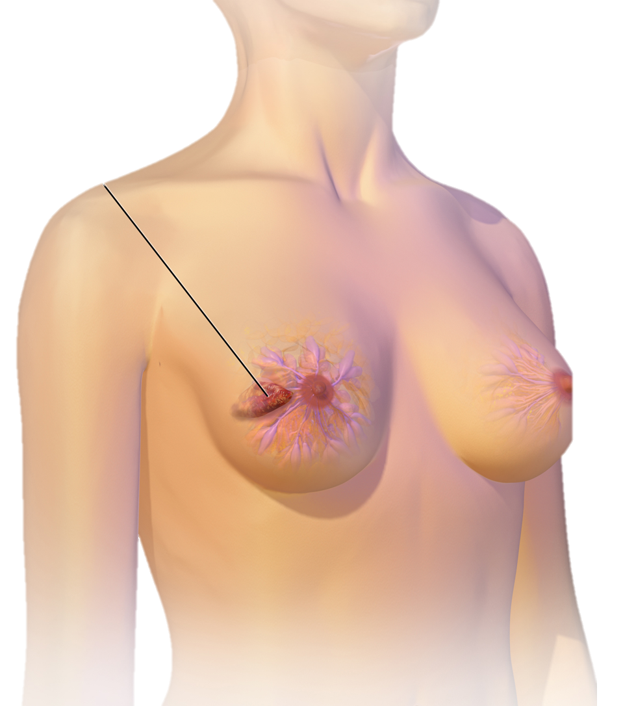
WHY this matters
Breast Cancer is responsible for 1 in 6 cancer deaths globally.
It is a malignant tumor that originates in the breast cells.
30% of all new female cancer cases annually are breast cancer.
Early detection = higher survival, less aggressive treatment.
Mammography: effective but painful, uses radiation.
Thermography: Non-invasive, no contact or compression.
TUMOR
Early Detection is KEY!

Slide 5
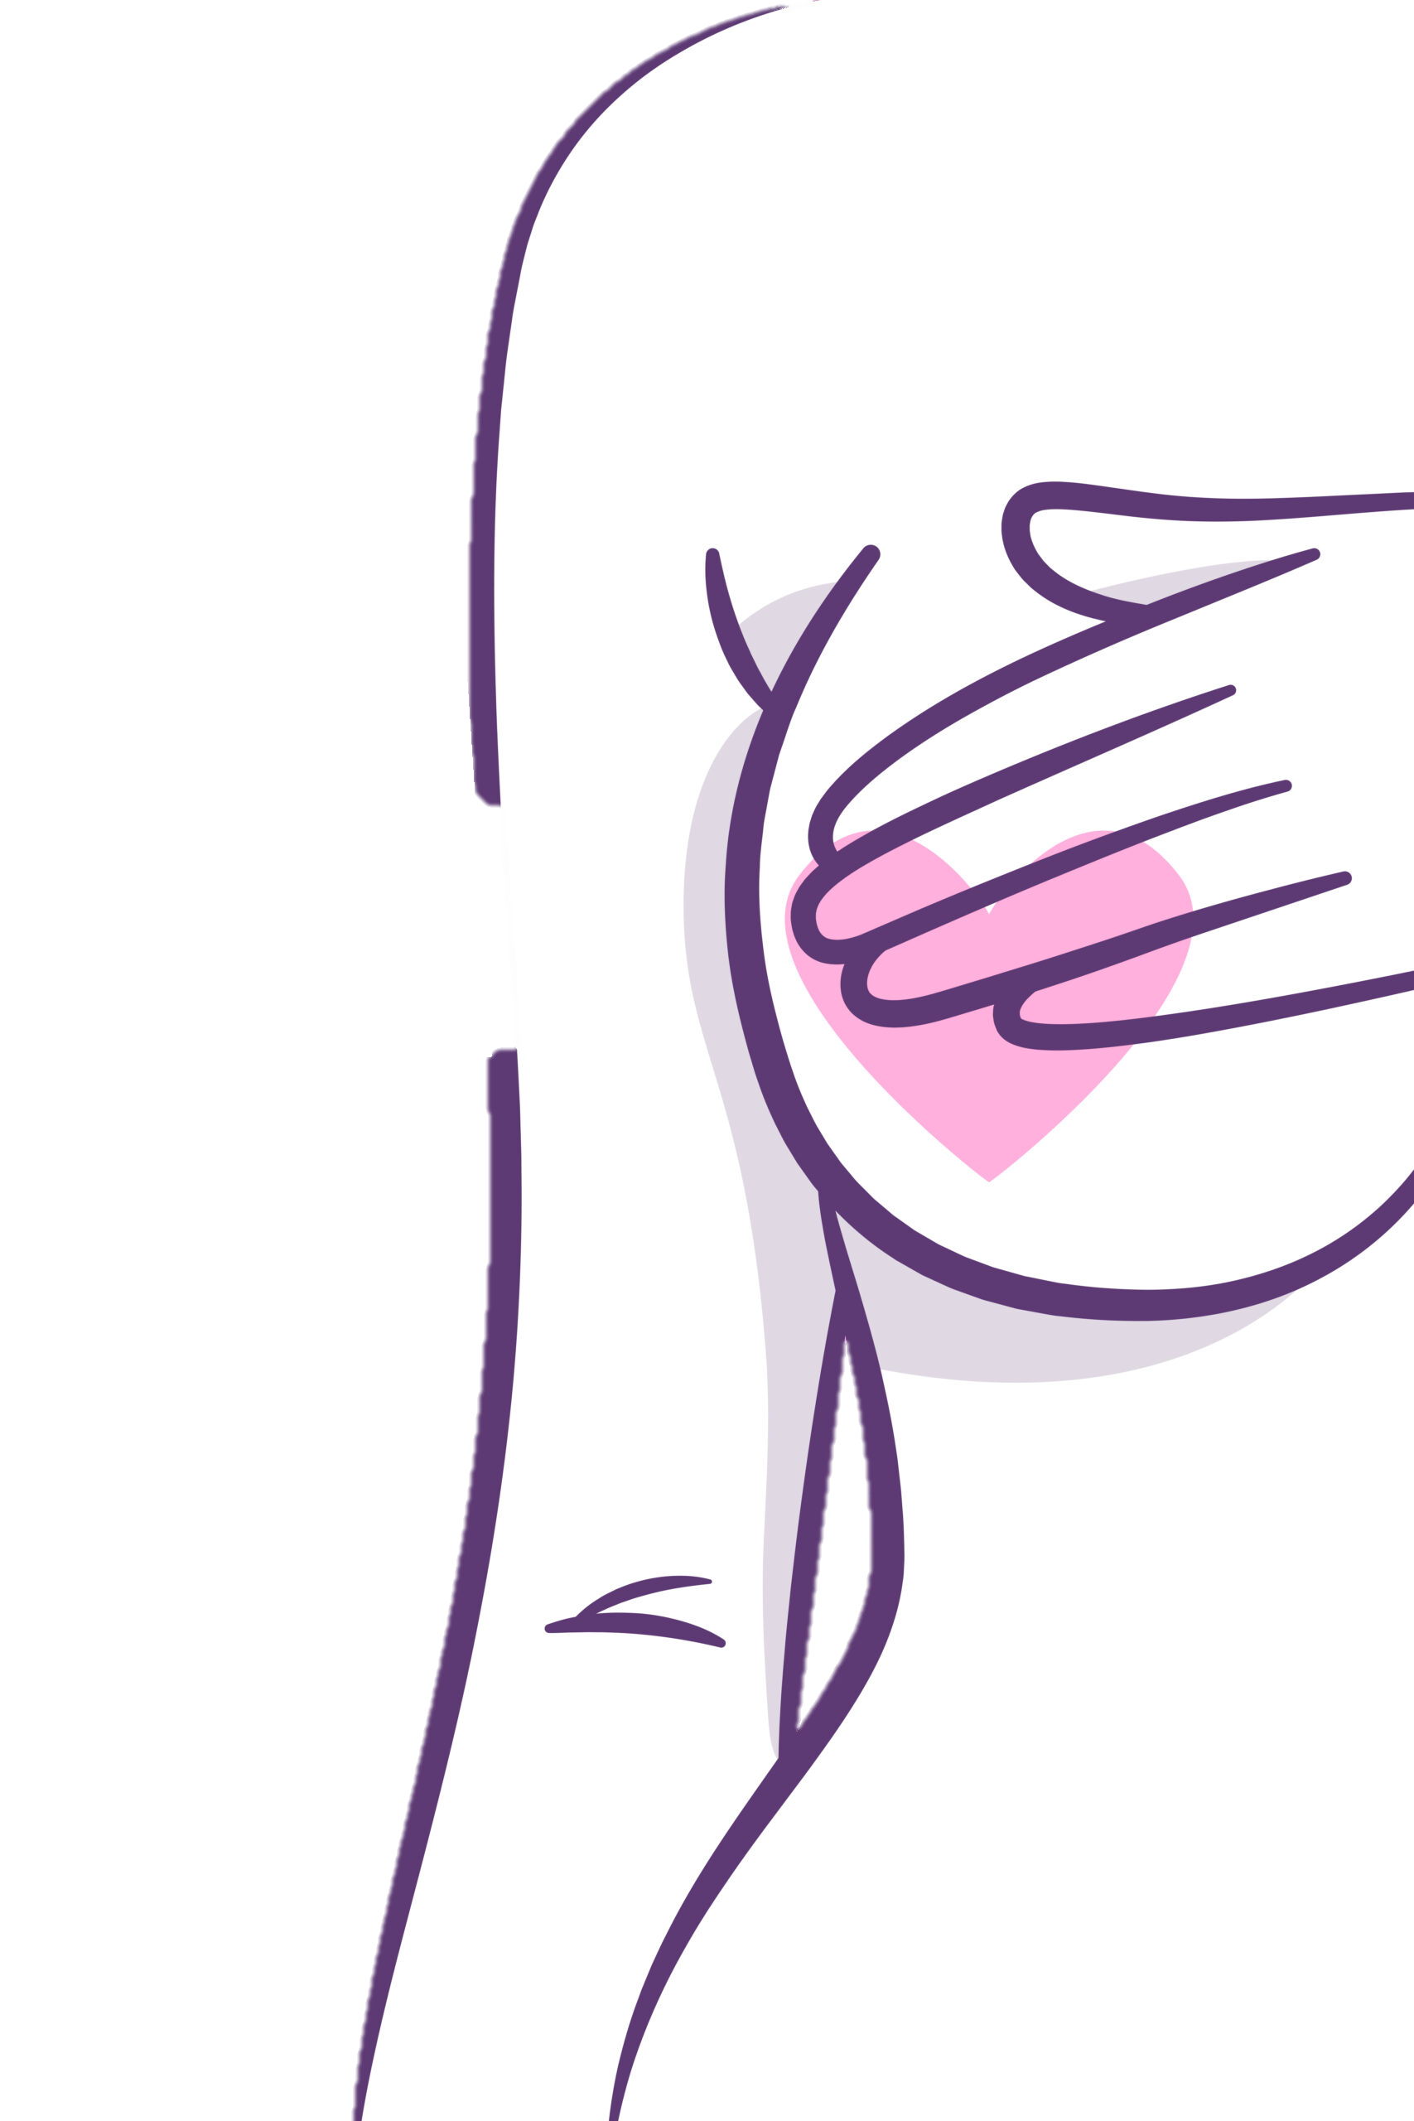
01
Can ViTs classify thermal breast images?
And if so, which classifier works best on top of DINOv2?

Slide 6



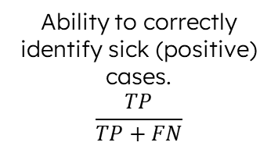
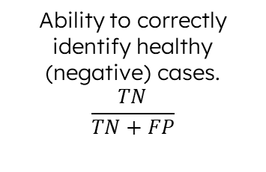
Performance Metrics Used
Measures model error during training
Binary Cross Entropy Loss
Ability to correctly identify sick (positive) cases.
$$\frac{TP}{TP+FN}$$
Accuracy
Overall proportion of correctly classified cases.
Sensitivity (recall)
Specificity
Ability to correctly identify healthy (negative) cases.
$$\frac{TN}{TN+FP}$$
F1-Score
Balance between
precision and sensitivity

Slide 7
Performance Metrics Used
TP : True Positive ( Unhealthy ) Cases
TN : True Negative ( Healthy ) Cases
FN : Unhealthy Images Classified as Healthy
FP : Healthy Images Classified as Unhealthy

Slide 8
CNNs – Why They Fall Short
What are CNNs?
Deep Learning Models, widely used in image analysis.
They automatically extract hierarchical features.
Custom CNNs (e.g., BCCNN) reached 98.28% F1-score using data balancing.
What are their Limitations?
Sensitive to class imbalance.
Patch-based approach = lose global context-> FPs.
Poor Generalization across datasets.
Rely on Large Datasets.
They struggle with image quality and noise.

Slide 9
WHY use Vision Transformers?
Vision Transformers overcome CNN Limitations as they are not biased toward local features, they’re more robust to imaging variations, and they model global structure from the start
STEP 1 | Divide Image Into Patches ( usually 16x16 or 32x32)
STEP 2 | Flatten, embed, and add positional info
STEP 3 | Use Transformer Encoder with Self-Attention
STEP 4 | [CLS] token encodes whole-image understanding

Slide 10
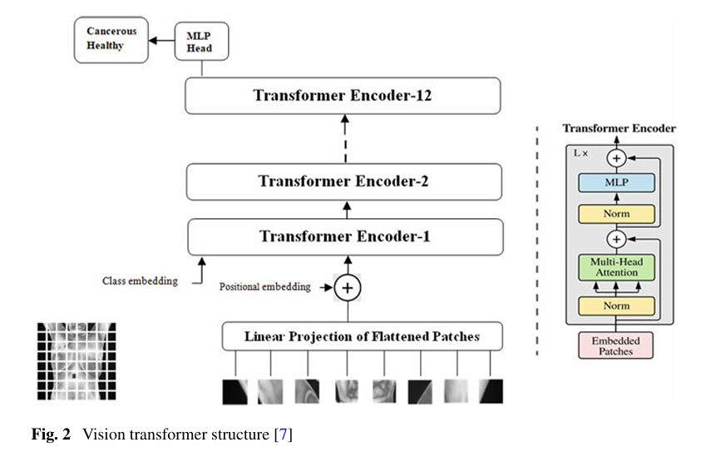
ViT Architecture Diagram
STEP 1 | Divide Image Into Patches ( usually 16x16 or 32x32)
STEP 2 | Flatten, embed, and add positional info
STEP 3 | Use Transformer Encoder with Self-Attention
STEP 4 | [CLS] token encodes whole-image understanding
IMAGE SOURCE:
L. S. Garia and M. Hariharan, "Vision Transformers for Breast Cancer Classification from Thermal Images," in Robotics, Control and Computer Vision: Select Proceedings of ICRCCV 2022, H. Muthusamy, J. Botzheim, and R. Nayak, Eds., Lecture Notes in Electrical Engineering, vol. 1009, Singapore: Springer, 2023, pp. 177–186. [Online]. Available: https://dokumen.pub/qdownload/robotics-control-and-computer-vision-select-proceedings-of-icrccv-2022-9819902355-9789819902354.html

Slide 11
DINOv2
DINOv2 is a self supervised learning framework built on the DINOv2 architecture.
It learns from images, without using labels.
Student model learns to match a teacher model.
Learns semantically rich features through view consistency.
Combines global and local training objectives.
Produces robust, transferable features from large unlabelled datasets.
Model Variant Used
Used ViT-S/14 variant (21M parameters) trained on LVD-142M.
Αpplied to thermal breast images using transfer learning.
Outputs frozen features → passed into custom Linear/MLP classifiers.
Enhanced with Neighbour Consistency Optimization (Neco) for better spatial consistency.

Slide 12
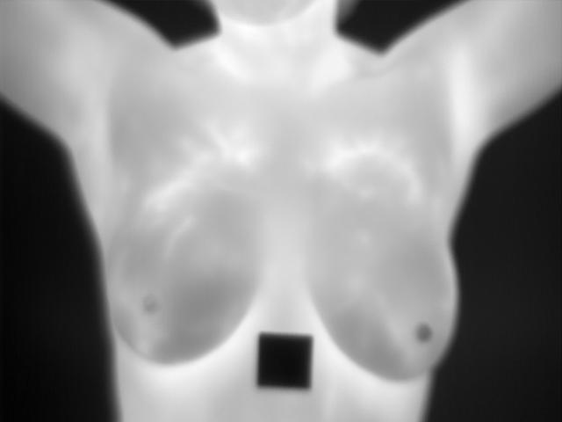
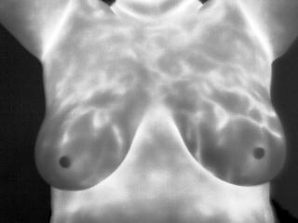
Dataset- Combination of two public Datasets
DMR-IR
TIBSDB
323
Both Filtered for Frontal Images Only.
NO Duplicate Images.
Final Dataset Size
HEALTHY
HEALTHY
252 HEALTHY
71 UNHEALTHY

Slide 13
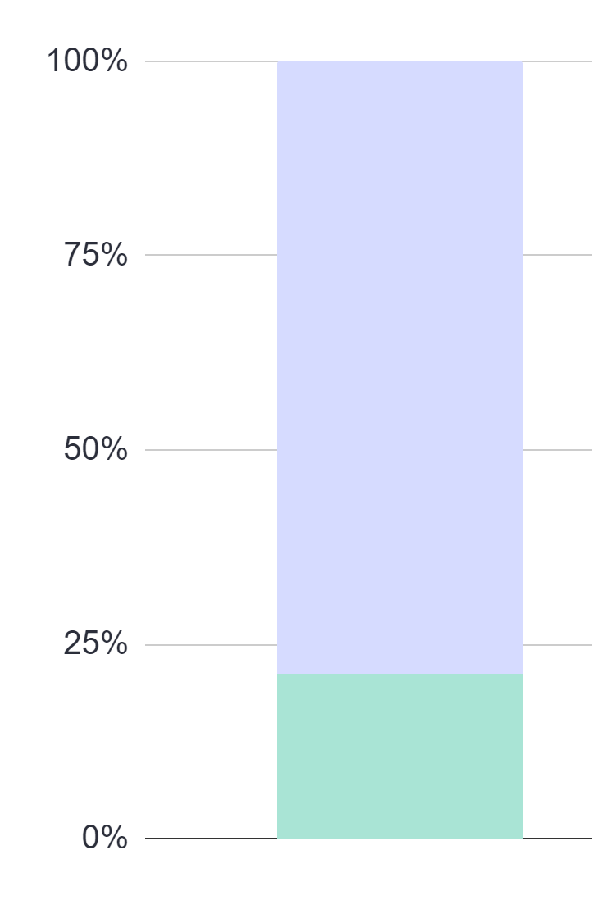
Dataset Imbalance
Healthy Images
Majority (78%) of the Images are Healthy
Unhealthy Images
Minority (22%) of the Images are Sick/Unhealthy

Slide 14
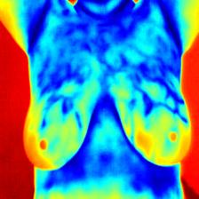
Preprocessing for DINOv2
1
2
3
Normalization
Resize Images to 224×224
Image Colorization with JET colormap
4
DINOv2 Compatibility
DINOv2 (ViTs) expects Images of 224x224 Input Size
Converted grayscale thermograms to 3-channel RGB for visual representation enhancement.
Images were normalized using ImageNet statistics to match DINOv2 pretraining condition.
Mean: [0.485, 0.456, 0.406] Std: [0.229, 0.224, 0.225]
Preprocessing aligned
with ViT expectations.
Visual Alignment with Natural RGB.

Slide 15

Evaluation Setup
Stratified-5-Folds Cross Validation
Same 20% final Test Set across All 5 Folds.
Training, Validation % Testing
Metrics tracked: Accuracy, Sensitivity, Specificity, F1-Score, TP / FP / FN / TN
Thresholds:
Linear: sensitivity ≥ 0.90
MLP v.1 : maximize Youden’s Index
MLP v.2 : sensitivity ≥ 0.90
Three Epoch Experiments: 30,50,150.
Final Epoch Setting(&Optimal): 50
All trained, evaluated and tested using 50 epochs.
TESTING: 20%- Final Test Set

Slide 16
Class Distribution Per Fold
Fold | Subset | Total Images | Healthy Images | Unhealthy Images
1 | Train | 206 | 160 | 46
 | Validate | 52 | 41 | 11
 | Test | 65 | 51 | 14
2 | Train | 206 | 161 | 45
 | Validate | 52 | 40 | 12
 | Test | 65 | 51 | 14
3 | Train | 206 | 161 | 45
 | Validate | 52 | 40 | 12
 | Test | 65 | 51 | 14
4 | Train | 206 | 161 | 46
 | Validate | 52 | 40 | 11
 | Test | 65 | 51 | 14
5 | Train | 206 | 161 | 46
 | Validate | 52 | 40 | 11
 | Test | 65 | 51 | 14
A portion of 20% was held out of every fold and used as the testing set.

Slide 17
Classification Heads
Linear
MLP Frozen Backbone
MLP with Partial Fine-Tuning
Single fully connected layer
Trained on frozen DINOv2 [CLS] features
Lightweight & fast — baseline for feature quality
Threshold optimized per epoch for sensitivity ≥ 0.90
Hidden layer with ReLU, BatchNorm, Dropout
Threshold strategy matched to Linear Head
Ensures fair comparison of architecture only
Hidden layer with ReLU, BatchNorm, Dropout
Final DINOv2 block (block 11) unfrozen for limited tuning
Explores non-linear decision boundaries
Used Youden’s J for threshold selection
(Sensitivity + Specificity - 1 )
ReLu: Rectified Linear Unit

Slide 18
LINEAR HEAD RESULTS
Fold | Test Accuracy | Test Sensitivity | Test Specificity | Test Loss | Test F1-score
1 | 0.6154 | 0.9286 | 0.5686 | 1.4299 | 0.4906
2 | 0.6769 | 0.8571 | 0.7451 | 1.3453 | 0.4878
3 | 0.6769 | 0.9286 | 0.7461 | 1.191 | 0.4583
4 | 0.7846 | 0.6429 | 0.8824 | 1.2732 | 0.4848
5 | 0.7692 | 0.5714 | 0.9216 | 1.3588 | 0.4571

Slide 19
MLP(with frozen backbone) HEAD RESULTS
Fold | Test Accuracy | Test Sensitivity | Test Specificity | Test Loss | Test F1-score
1 | 0.4308 | 1 | 0.3137 | 3.0356 | 0.4062
2 | 0.6615 | 0.9286 | 0.6275 | 2.2156 | 0.5417
3 | 0.4 | 1 | 0.2549 | 2.0561 | 0.4179
4 | 0.6923 | 0.9286 | 0.6863 | 1.9088 | 0.5333
5 | 0.5231 | 1 | 0.3922 | 2.5078 | 0.4746

Slide 20
LINEAR CLASSIFICATION vs MLP(frozen backbone) CLASSIFICATION
Fold | Test Accuracy | Test Sensitivity | Test Specificity | Test Loss | Test F1-score
1 | 0.6154 | 0.9286 | 0.5686 | 1.4299 | 0.4906
2 | 0.6769 | 0.8571 | 0.7451 | 1.3453 | 0.4878
3 | 0.6769 | 0.9286 | 0.7461 | 1.191 | 0.4583
4 | 0.7846 | 0.6429 | 0.8824 | 1.2732 | 0.4848
5 | 0.7692 | 0.5714 | 0.9216 | 1.3588 | 0.4571
Fold | Test Accuracy | Test Sensitivity | Test Specificity | Test Loss | Test F1-score
1 | 0.4308 | 1 | 0.3137 | 3.0356 | 0.4062
2 | 0.6615 | 0.9286 | 0.6275 | 2.2156 | 0.5417
3 | 0.4 | 1 | 0.2549 | 2.0561 | 0.4179
4 | 0.6923 | 0.9286 | 0.6863 | 1.9088 | 0.5333
5 | 0.5231 | 1 | 0.3922 | 2.5078 | 0.4746
The MLP Head achieved higher sensitivity values

Slide 21
LINEAR CLASSIFICATION vs MLP(frozen backbone) CLASSIFICATION
Fold | Test Accuracy | Test Sensitivity | Test Specificity | Test Loss | Test F1-score
1 | 0.6154 | 0.9286 | 0.5686 | 1.4299 | 0.4906
2 | 0.6769 | 0.8571 | 0.7451 | 1.3453 | 0.4878
3 | 0.6769 | 0.9286 | 0.7461 | 1.191 | 0.4583
4 | 0.7846 | 0.6429 | 0.8824 | 1.2732 | 0.4848
5 | 0.7692 | 0.5714 | 0.9216 | 1.3588 | 0.4571
Fold | Test Accuracy | Test Sensitivity | Test Specificity | Test Loss | Test F1-score
1 | 0.4308 | 1 | 0.3137 | 3.0356 | 0.4062
2 | 0.6615 | 0.9286 | 0.6275 | 2.2156 | 0.5417
3 | 0.4 | 1 | 0.2549 | 2.0561 | 0.4179
4 | 0.6923 | 0.9286 | 0.6863 | 1.9088 | 0.5333
5 | 0.5231 | 1 | 0.3922 | 2.5078 | 0.4746
The Linear Head, although achieved lower sensitivity, achieved much higher specificity values

Slide 22
LINEAR CLASSIFICATION vs MLP(frozen backbone) CLASSIFICATION
Folds | Linear TP | MLP TP | Real TP
1 | 13 | 14 | 14
2 | 12 | 13 | 14
3 | 13 | 14 | 14
4 | 9 | 13 | 14
5 | 8 | 14 | 14
The MLP Head achieved near perfect classification of cancerous cases (True Positives)

Slide 23
LINEAR CLASSIFICATION vs MLP(frozen backbone) CLASSIFICATION
Folds | Linear TN | MLP TN | Real TN
1 | 29 | 16 | 51
2 | 38 | 32 | 51
3 | 38 | 13 | 51
4 | 45 | 35 | 51
5 | 47 | 20 | 51
The MLP Head severely struggled to correctly classify healthy cases (True Negatives). Many healthy images were misclassified as Sick (trade-off)!
The Linear Head showed better classification in terms of TN cases, especially in Fold 4 and 5.

Slide 24

Could the MLP Head be improved in terms of Specificity?
Why is this important?
False Positives Lead to :
Unnecessary stress for patients
Additional Tests (biopsies, imaging)
Increased Healthcare Costs
Risk of Overtreatment or Anxiety

Slide 25
MLP(with partial fine-tuning) HEAD RESULTS
Fold | Test Accuracy | Test Sensitivity | Test Specificity | Test Loss | Test F1-score
1 | 0.8 | 0.9286 | 1 | 2.2616 | 0.4444
2 | 0.7846 | 0.9286 | 0.9804 | 1.8563 | 0.5714
3 | 0.8 | 0.8571 | 0.9804 | 1.7295 | 0.5263
4 | 0.8154 | 0.7143 | 0.9804 | 1.9845 | 0.5263
5 | 0.8308 | 0.5 | 0.9804 | 2.3136 | 0.5

Slide 26
MLP with frozen backbone vs MLP with partial fine-tuning CLASSIFICATION
Folds | Test Accuracy | Test Accuracy | Test Sensitivity | Test Sensitivity | Test Specificity | Test Specificity | Test Loss | Test Loss | F1-Score | F1-Score
1 | 0.8 | 0.4308 | 0.9286 | 1 | 1 | 0.3137 | 2.2616 | 3.0356 | 0.4444 | 0.4062
2 | 0.7846 | 0.6615 | 0.9286 | 0.9286 | 0.9804 | 0.6275 | 1.8563 | 2.2156 | 0.5714 | 0.5417
3 | 0.8 | 0.4 | 0.8571 | 1 | 0.9804 | 0.2549 | 1.7295 | 2.0561 | 0.5263 | 0.4179
4 | 0.8154 | 0.6923 | 0.7143 | 0.9286 | 0.9804 | 0.6863 | 1.9845 | 1.9088 | 0.5263 | 0.5333
5 | 0.8308 | 0.5231 | 0.5 | 1 | 0.9804 | 0.3922 | 2.3136 | 2.5078 | 0.5 | 0.4746
MLP with partial fine-tuning
MLP with frozen backbone

Slide 27
MLP with frozen backbone vs MLP with partial fine-tuning CLASSIFICATION
Folds | Test Accuracy | Test Accuracy | Test Sensitivity | Test Sensitivity | Test Specificity | Test Specificity | Test Loss | Test Loss | F1-Score | F1-Score
1 | 0.8 | 0.4308 | 0.9286 | 1 | 1 | 0.3137 | 2.2616 | 3.0356 | 0.4444 | 0.4062
2 | 0.7846 | 0.6615 | 0.9286 | 0.9286 | 0.9804 | 0.6275 | 1.8563 | 2.2156 | 0.5714 | 0.5417
3 | 0.8 | 0.4 | 0.8571 | 1 | 0.9804 | 0.2549 | 1.7295 | 2.0561 | 0.5263 | 0.4179
4 | 0.8154 | 0.6923 | 0.7143 | 0.9286 | 0.9804 | 0.6863 | 1.9845 | 1.9088 | 0.5263 | 0.5333
5 | 0.8308 | 0.5231 | 0.5 | 1 | 0.9804 | 0.3922 | 2.3136 | 2.5078 | 0.5 | 0.4746
MLP with partial fine-tuning
The MLP Head with the frozen backbone, achieves higher sensitivity values, even though the MLP Head with partial-fine tuning achieves relatively high values as well.
MLP with frozen backbone

Slide 28
MLP with frozen backbone vs MLP with partial fine-tuning CLASSIFICATION
Folds | Test Accuracy | Test Accuracy | Test Sensitivity | Test Sensitivity | Test Specificity | Test Specificity | Test Loss | Test Loss | F1-Score | F1-Score
1 | 0.8 | 0.4308 | 0.9286 | 1 | 1 | 0.3137 | 2.2616 | 3.0356 | 0.4444 | 0.4062
2 | 0.7846 | 0.6615 | 0.9286 | 0.9286 | 0.9804 | 0.6275 | 1.8563 | 2.2156 | 0.5714 | 0.5417
3 | 0.8 | 0.4 | 0.8571 | 1 | 0.9804 | 0.2549 | 1.7295 | 2.0561 | 0.5263 | 0.4179
4 | 0.8154 | 0.6923 | 0.7143 | 0.9286 | 0.9804 | 0.6863 | 1.9845 | 1.9088 | 0.5263 | 0.5333
5 | 0.8308 | 0.5231 | 0.5 | 1 | 0.9804 | 0.3922 | 2.3136 | 2.5078 | 0.5 | 0.4746
MLP with partial fine-tuning
The MLP Head with partial fine-tuning, achieves higher specificity values in comparison to the fully frozen one, especially in Folds 3 and 5.
MLP with frozen backbone

Slide 29
What is causing the difference in specificity of the two MLP Classifiers?
Fully Frozen MLP
MLP with partial fine-tuning
Prioritizes general, learned features from DINOv2
No adaptation to specific thermal dataset
Focuses on detecting any potential cancer signals
Tends to flag more positives, even if uncertain → high sensitivity
Leads to more false positives → low specificity
Conservative behaviour: avoids false negatives at the cost of over-alerting
Partially adapts DINOv2 features to the target domain
Learns task-specific patterns in breast thermograms
Can better distinguish between cancerous and healthy patterns
Tends to be more confident in negative predictions → better specificity
May slightly reduce sensitivity if fine-tuning overfits or loses generality
Overall, more balanced and better suited for clinical use

Slide 30
Which Classification Head is more suitable for early breast cancer detection between the three?
MLP Frozen Backbone
Linear
MLP with Partial Fine-Tuning
Lightweight & efficient, but lacked generalization
High variability, often confidently wrong
Less suited for standalone clinical use
May be useful in ensemble setups or resource-limited environments
Achieved perfect or near-perfect sensitivity.
Best choice when missing a cancer case is unacceptable.
But very low specificity → high FP rate
Suitable for early screening, not final diagnosis
Best overall balance between sensitivity and specificity.
High recall and near-perfect specificity.
Most stable across folds with fewer prediction errors
Clinically reliable for deployment

Slide 31
Which Classification Head is more suitable for early breast cancer detection between the three?
MLP with Partial Fine-Tuning
MLP Frozen Backbone
Linear
GOAL: Prioritizing Sensitivity (Minimize False Negatives)
Suitable for Early Detection

Slide 32
Which Classification Head is more suitable for early breast cancer detection between the three?
MLP with Partial Fine-Tuning
MLP Frozen Backbone
Linear
GOAL: Balanced Screening (Sensitivity + Specificity)
Most Clinically Balanced Model

Slide 33
Which Classification Head is more suitable for early breast cancer detection between the three?
MLP with Partial Fine-Tuning
MLP Frozen Backbone
Linear
GOAL: Resource-Limited Environments (Speed + Simplicity)

Slide 34
Teachable Machine Model
1
2
3
Web-based tool that enables rapid creation of machine learning models without requiring in-depth programming knowledge.
4
Epochs=50
Batch Size=32
LR= 0.0012
Epochs=50
Batch Size=32
LR= 0.0001
Epochs=50
Batch Size=32
LR= 0.0005
Epochs=100
Batch Size=32
LR= 0.0005

Slide 35
Setup of Teachable Machine Model
1st Class: Healthy
2nd Class: Unhealthy
Training:
145 Images
Training:
30 Images
Testing:
107 Images
Testing:
41 Images

Slide 36
Results of Teachable Machine Model
Configuration | Accuracy | Sensitivity | Specificity | TP | TN | FP | FN
1 | 0.7230 | 0.000 | 1.000 | 0 | 107 | 0 | 41
2 | 0.7230 | 0.000 | 1.000 | 0 | 107 | 0 | 41
3 | 0.7162 | 0.000 | 0.9907 | 0 | 106 | 1 | 41
4 | 0.7230 | 0.000 | 1.000 | 0 | 107 | 0 | 41
Expected Results:
The model is highly biased toward the Healthy class
Completely fails to detect Unhealthy samples
Not suitable for critical classification tasks (e.g. health detection)
TP: 41
TN: 107

Slide 37

Conclusion
Vision Transformers (DINOv2) significantly improves classification performance.
DINOv2 embeddings enabled even simpler classifiers (Linear, MLP v.2 ) to outperform Teachable Machine.
Best model: Fine-Tuned MLP with Youden’s Index (v.1). Balanced sensitivity and specificity.
Despite promising results, misclassifications remain too high for clinical deployment.
Suitable for research and development, but not yet for real-world diagnosis.

Slide 38
References
[1]. G. Ayana, K. Dese, N. Husen, Y. Dereje, Y. Kebede, H. Barki, F. Mulugeta, D. Amdissa, B. Habtamu, and S.-W. Choe, "Vision-Transformer-Based Transfer Learning for Mammogram Classification." Diagnostics, 13(2), 178, 2023.
[2]. Europa Donna Cyprus, "Breast Cancer Facts," Europa Donna Cyprus, 2024. [Online]. Available: https://europadonna.com.cy/en/breast-and-gynaecological-cancers/breast-cancer/breast-cancer-facts/. Accessed: Mar. 18, 2025.
[3]. Breastcancer.org, "Breast Cancer Facts and Statistics," Breastcancer.org, 2024. [Online]. Available: https://www.breastcancer.org/facts-statistics. Accessed: Mar. 18, 2025.
[4]. Ezra, "Why Is Early Detection of Breast Cancer Important?," Ezra, 2024. [Online]. Available: https://ezra.com/blog/why-is-early-detection-of-breast-cancer-important. Accessed: Mar. 18, 2025.
[5]. L. S. Garia and M. Hariharan, "Vision Transformers for Breast Cancer Classification from Thermal Images," in Robotics, Control and Computer Vision: Select Proceedings of ICRCCV 2022, H. Muthusamy, J. Botzheim, and R. Nayak, Eds., Lecture Notes in Electrical Engineering, vol. 1009, Singapore: Springer, 2023, pp. 177–186. [Online]. Available: https://dokumen.pub/qdownload/robotics-control-and-computer-vision-select-proceedings-of-icrccv-2022-9819902355-9789819902354.html
[6]. A. Dosovitskiy, L. Beyer, A. Kolesnikov, D. Weissenborn, X. Zhai, T. Unterthiner, M. Dehghani, M. Minderer, G. Heigold, S. Gelly, J. Uszkoreit, and N. Houlsby, "An Image Is Worth 16x16 Words: Transformers for Image Recognition at Scale," arXiv:2010.11929, 2020.
[7]. A. Abunasser, M. L. L. Toledo, F. J. P. Lopes, and R. S. Oliveira, "BCCNN: A Custom CNN Architecture for Breast Cancer Detection and Classification in Histopathological Images," Diagnostics, vol. 13, no. 5, 2023. [Online]. Available: https://pmc.ncbi.nlm.nih.gov/articles/PMC10162639/.
[8]. Yan, J. (2023). Study for Performance of MobileNetV1 and MobileNetV2 based on Breast Cancer. Highlights in Science, Engineering and Technology, 39, 10-14.
[9]. M. Oquab, T. Darcet, T. Moutakanni, H. V. Vo, M. Szafraniec, V. Khalidov, P. Fernandez, D. Haziza, F. Massa, A. El-Nouby, M. Assran, N. Ballas, W. Galuba, R. Howes, P.-Y. Huang, S.-W. Li, I. Misra, M. Rabbat, V. Sharma, G. Synnaeve, H. Xu, H. Jegou, J. Mairal, P. Labatut, A. Joulin, and P. Bojanowski, "DINOv2: Learning Robust Visual Features without Supervision," arXiv:2304.07193, 2024.
[10]. X. Lu, H. Wang, and D. Fischer, “DINO-Mix: Enhancing Visual Place Recognition with Foundational Vision Model and Feature Mixing,” ResearchGate, 2023. [Online]. Available: https://www.researchgate.net/publication/377064388_DINO-Mix_Enhancing_Visual_Place_Recognition_with_Foundational_Vision_Model_and_Feature_Mixing. Accessed: May 5, 2025.
[11]. T. Darcet, M. Oquab, J. Mairal, and P. Bojanowski, "Vision Transformers Need Registers,"arXiv:2309.16588, 2023.
[12]. Pan, S. J., & Yang, Q. (2010). A Survey on Transfer Learning. IEEE Transactions on Knowledge and Data Engineering, 22(10), 1345–1359.
[13]. Facebook Research, "DINOv2: Learning Visual Features without Supervision," GitHub, 2024. [Online]. Available: https://github.com/facebookresearch/dinov2?tab=readme-ov-file. Accessed: Sept. 09, 2024.
[14]. D. Hendrycks and K. Gimpel, “Gaussian Error Linear Units (GELUs),” 2016. [Online]. Available: https://arxiv.org/pdf/1606.08415. Accessed: May 5, 2025.
[15]. J. Ba, J. Kiros, and G. Hinton, “Layer Normalization,” 2016. [Online]. Available: https://arxiv.org/pdf/1607.06450. Accessed: May 5, 2025.
[16]. V. Pariza, "NeCo: A New SSL Post-Training Approach for Improving DINOv2’s Spatial Representations in 19 GPU Hours with Patch Neighbor Consistency," GitHub, 2024. [Online]. Available: https://github.com/vpariza/NeCo. Accessed: Jan. 20, 2025.
[17]. IBM Corp., "Area under the Curve," IBM Documentation, 2024. [Online]. Available: https://www.ibm.com/docs/en/spss-statistics/30.0.0?topic=schemes-area-under-curve. Accessed: Mar. 4, 2025.
[18]. N. Rogge, "Train a Linear Classifier on Top of DINOv2 for Semantic Segmentation," GitHub, 2024. [Online]. Available: https://github.com/NielsRogge/Transformers-Tutorials/blob/master/DINOv2/Train_a_linear_classifier_on_top_of_DINOv2_for_semantic_segmentation.ipynb. Accessed: Feb. 20, 2025.
[19]. I. Goodfellow, Y. Bengio, and A. Courville, Deep Learning. MIT Press, 2016. [Online]. Available: https://www.deeplearningbook.org/. Accessed: Mar. 07, 2025.
[20]. T. Chen, S. Kornblith, M. Norouzi, and G. Hinton, "A simple framework for contrastive learning of visual representations," arXiv, Feb. 13, 2020. [Online]. Available: https://arxiv.org/abs/2002.05709. Accessed: Mar. 09, 2025.
[21]. "Database for Mastology Research," Visual Lab, Universidade Federal Fluminense, 2024. [Online]. Available: https://visual.ic.uff.br/en/proeng/thiagoelias/. Accessed: Nov. 01, 2024.
[22]. S. Rodriguez-Guerrero, H. Loaiza Correa, A.-D. Restrepo-Girón, L. A. Reyes, L. A. Olave, S. Diaz, and R. Pacheco, "Breast Thermography," Mendeley Data, Version 3, Feb. 5, 2024. [Online]. Available: https://data.mendeley.com/datasets/mhrt4svjxc/3. Accessed: Jan. 01, 2025.
[23]. "Scikit-Learn Cross-Validation Module," Scikit-learn.org, 2024. [Online]. Available: https://scikit-learn.org/1.5/modules/cross_validation.html. Accessed: Nov. 11 ,2024.
[24]. A. Luque, A. Carrasco, A. Martín, and A. de las Heras, “The impact of class imbalance in classification performance metrics based on the binary confusion matrix,” Pattern Recognition, vol. 91, pp. 216–231, 2019. [Online]. Available: https://www.sciencedirect.com/science/article/pii/S0031320319300950.
[25]. D. M. Berrar, “ROC curves – Practical Stats in Medical Research,” [Online]. Available: https://practical-stats-med-r.netlify.app/roc . Accessed: Feb. 27, 2025.
[26]. F. Pedregosa, G. Varoquaux, A. Gramfort, et al., “Scikit-learn: Machine Learning in Python,” Journal of Machine Learning Research, vol. 12, pp. 2825–2830, 2011. [Online]. Available: https://scikit-learn.org/stable/modules/generated/sklearn.metrics.roc_curve.html
[27]. "A New Database for Breast Research with Infrared Image," ResearchGate, 2015. [Online]. Available:https://www.researchgate.net/publication/272274878_A_New_Database_for_Breast_Research_with_Infrared_Image. Accessed: Nov. 01 , 2024
[28]. Google, "Teachable Machine," Google, [Online]. Available: https://teachablemachine.withgoogle.com/.

Slide 39
Acknowledgements
I am deeply grateful to my advisor, Dr. Chris Christodoulou, for his guidance and invaluable feedback throughout this thesis.
Special thanks to Marios Pafitis and Valentinos Pariza, for their continuous support, data provision, insightful collaboration and for patiently replying to my endless stream of messages at times where I was on the verge of smashing my laptop.
I also extend my appreciation to Dr. Costas Pattichis for taking the time to attend this presentation!

Slide 40
THANK YOU FOR YOUR ATTENTION
FEEL FREE TO ASK ANY QUESTIONS
(which I hopefully can answer!! )

