Slide 1
SGB-TW:
A tool to write Software Guidebook using ‘diagrams as code’ approach

Slide 2
What is a SGB?
A Software Guide-book (SGB) is a document that describes the software architecture and high-level design of a system.
In addition to that, the document contains maps, sight and itineraries, history and culture and practical information about the software; it describes what the code does not. And it is an alive and evolve document.

Slide 3
SGB-TW – Functionality
What is?
  A python command line and a customized TiddlyWiki (TW).
  TW is the GUI used to write the SGB, while the python script is used to retrieve and store information in the DB.
  The DB is manage using git as all is plain text.
Main functionality
  Add notes to TW using wiki syntax and PlantUML.
  Notes could have tags so it is easy to search information using them.
  Generate reporst in PDF and more.

Slide 4
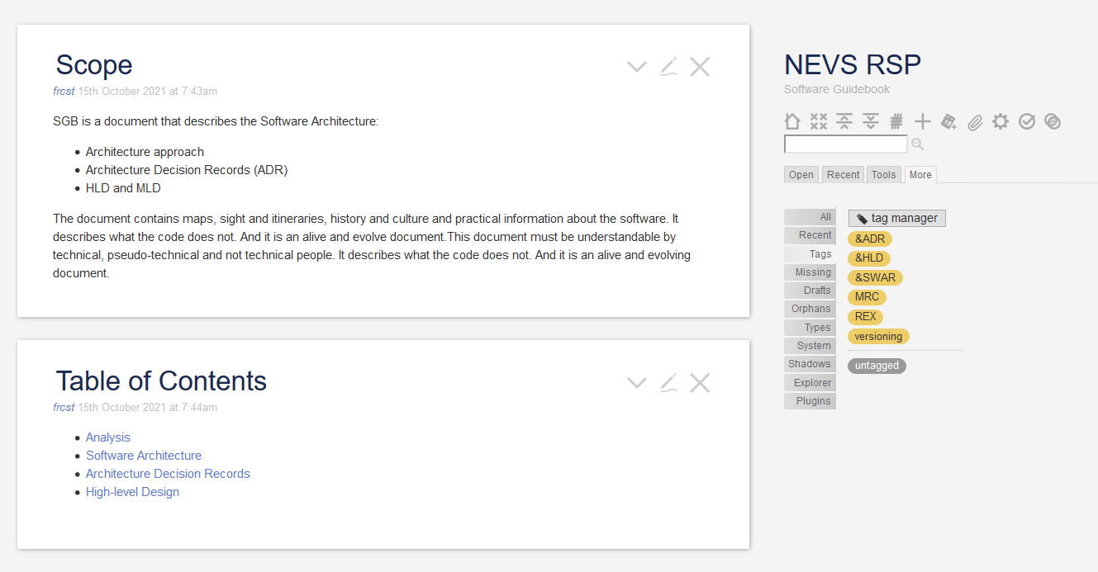

SGB-TW - Overview
TW/GUI
PDF
Others
reports
DB
your_sgb.html
git
sgb-cli.py

Slide 5
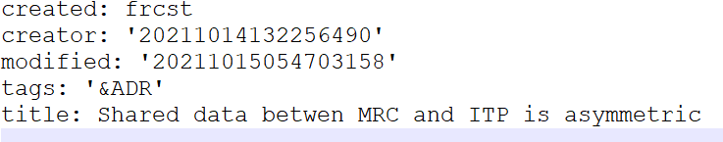
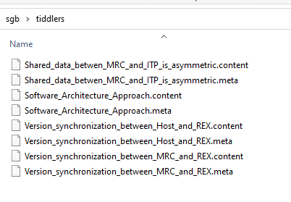
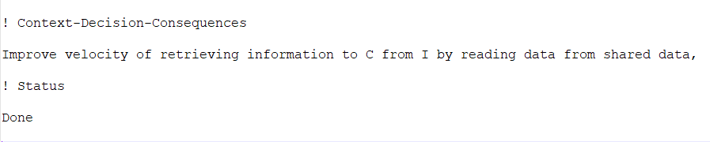
SGB-TW – DB Structure
sgb-cli.py
DB
(Files)
tiddlers
*.meta
git
*.content

Slide 6
SGB-TW – Synch DB and TW (1)
DB
add
tiddlers
retrieve
tiddlers
synch
git
sgb-cli.py
2) update TW
1) pull code
3) reload TW and use

Slide 7
SGB-TW – Synch DB and TW (2)
DB
extract
tiddlers
store
tiddlers
synch
git
sadac-cli.py
1) update DB
2) push code

Slide 8
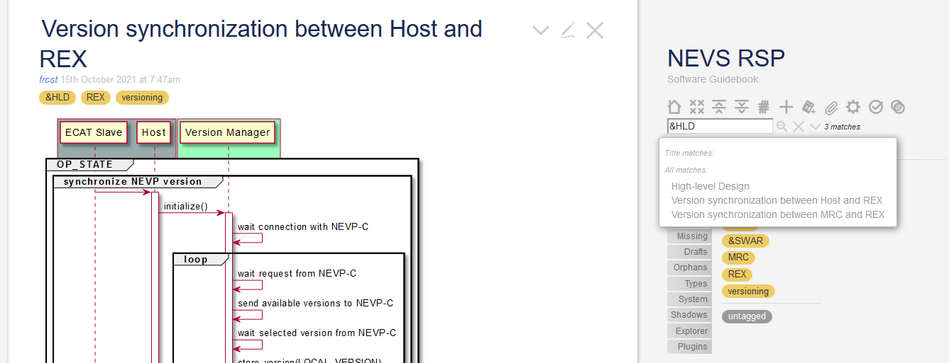
SGB-TW – Search using tags

Slide 9
SGB-TW – Generate reports
PDF
Other
reports
2) generate
sgb-cli.py
DB
1) retrieve

Slide 10
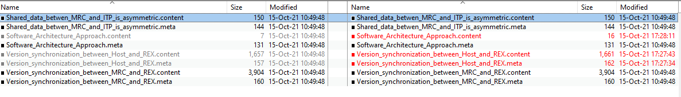
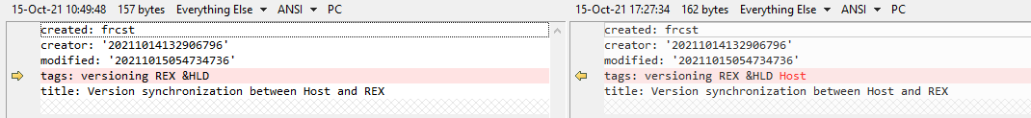
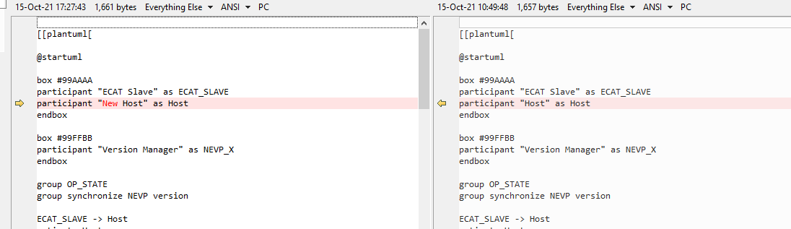
SGB-TW – Compare DB using git

