Slide 1

SRMS Drona Learning WebApp for Non-Teaching Staff
SRMS Internship Project
Presented by:
Anant Sharma
Ansh Gupta
Nafeha Aqueel
Syeda Raazia
Arsh Yar Khan
Deepak Gangwar
Riya Rastogi
Rajneesh Kumar Singh
Under the guidance of:
Ms. Sakshi Goel
Assistant Professor
Department of IT

Slide 2
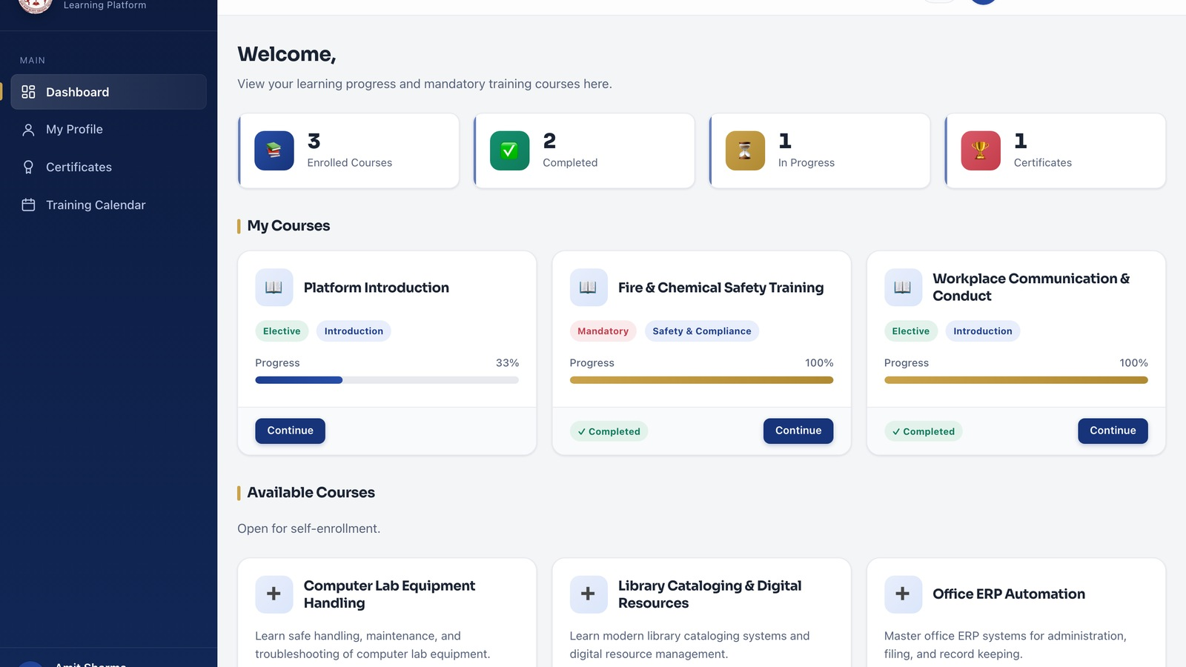
Problem & Real-World Need
Staff training resources need a simple,
centralized digital platform.
Institutional learning material should be
easy to access on mobile devices.
Courses and quizzes need a structured
digital delivery mechanism.
Learning progress and achievements need
proper completion.
Administrators need tools to manage content and monitor participation.

Slide 3
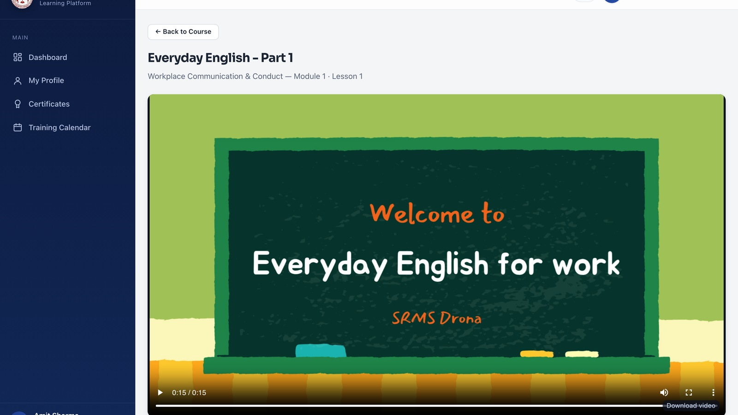
Our Proposed Solution
Staff Learning: Digital access to institutional learning resources.
Course Management: Structured courses
& learning modules.
Quiz Management: Digital quizzes & assessments.
Progress Tracking: Track learning progress
& achievements.
Certificate Generation: Certificates after successful
completion.
Notifications: Keep staff informed about their performance.
Role-Based Administration: Controlled management for administrators.

Slide 4
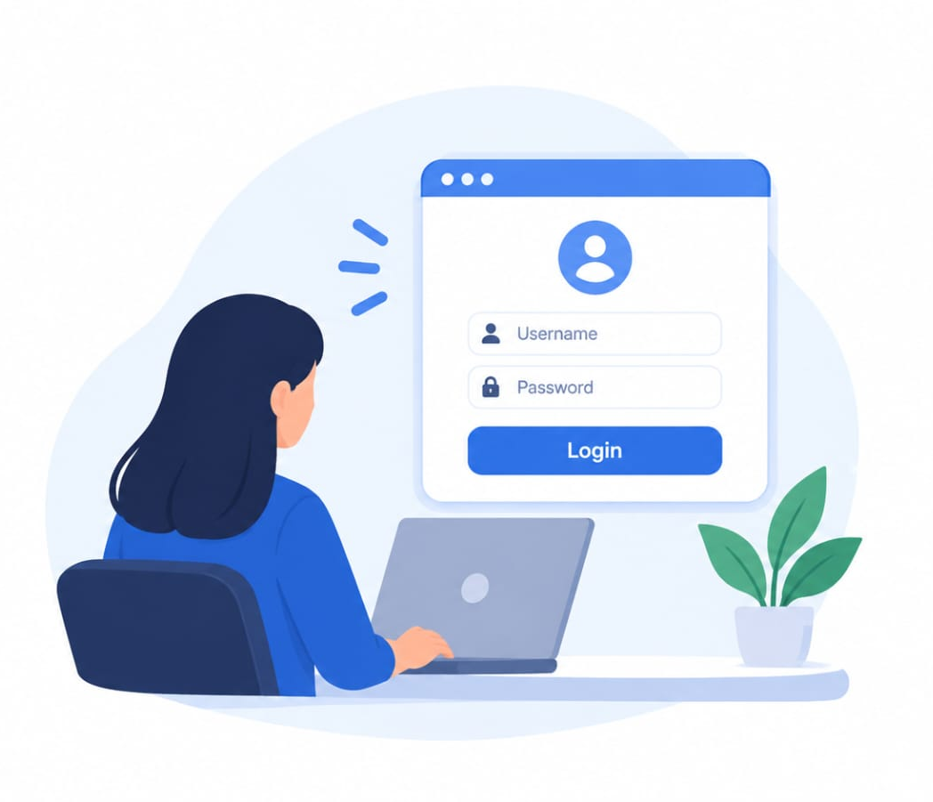

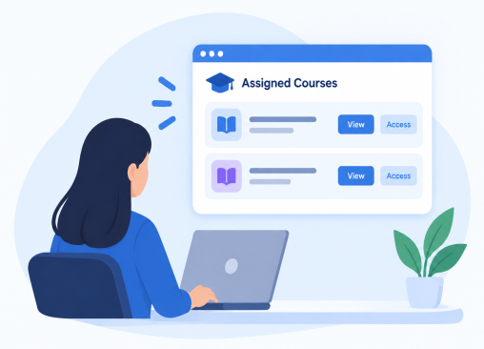
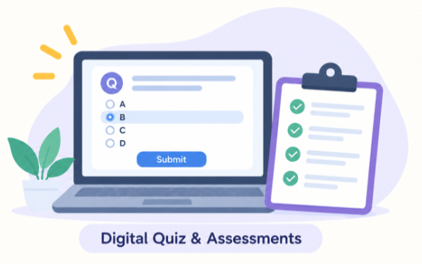
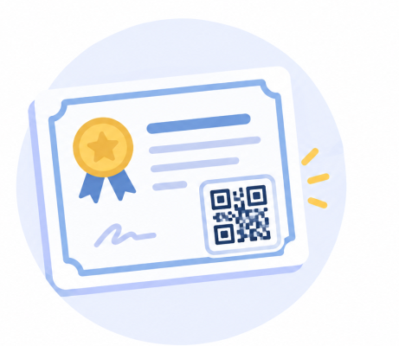

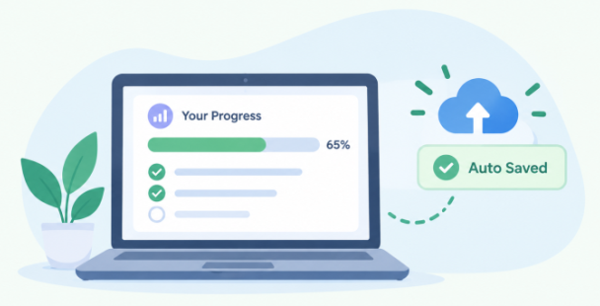
How Our Solution Works
Assigned Courses
Learning Content
Employee Login
Digital Quizzes
Progress Tracking & Auto-Saved
Certificates with QR
Successful Completion

Slide 5
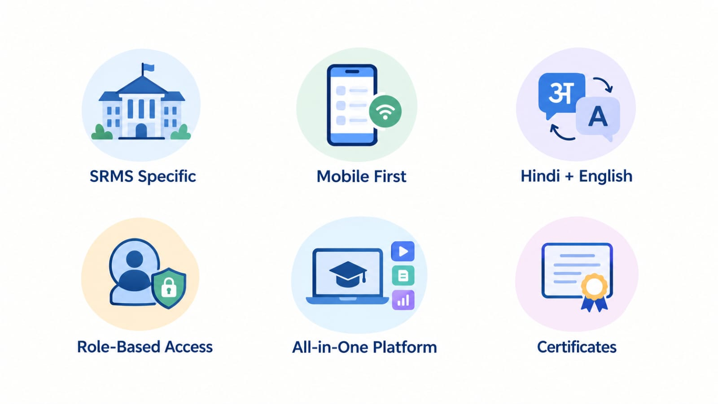
Key Innovations & USP
Access Control: Role based administration.
User Experience: Simple and intuitive.
Language Support:
Hindi + English
Institution Specific: Focused on internal organizational training
All-in-One Platform: Learning + Quizzes + Certificates with QR + Notifications

Slide 6
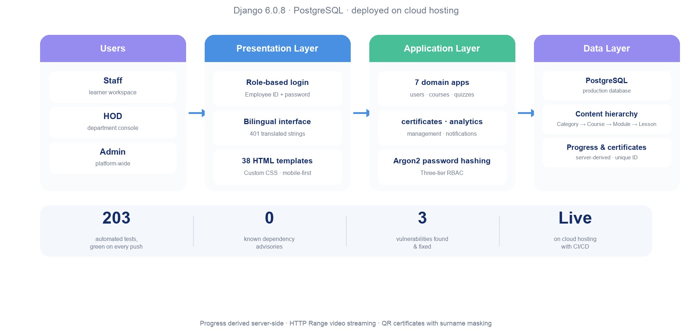
System Architecture

Slide 7
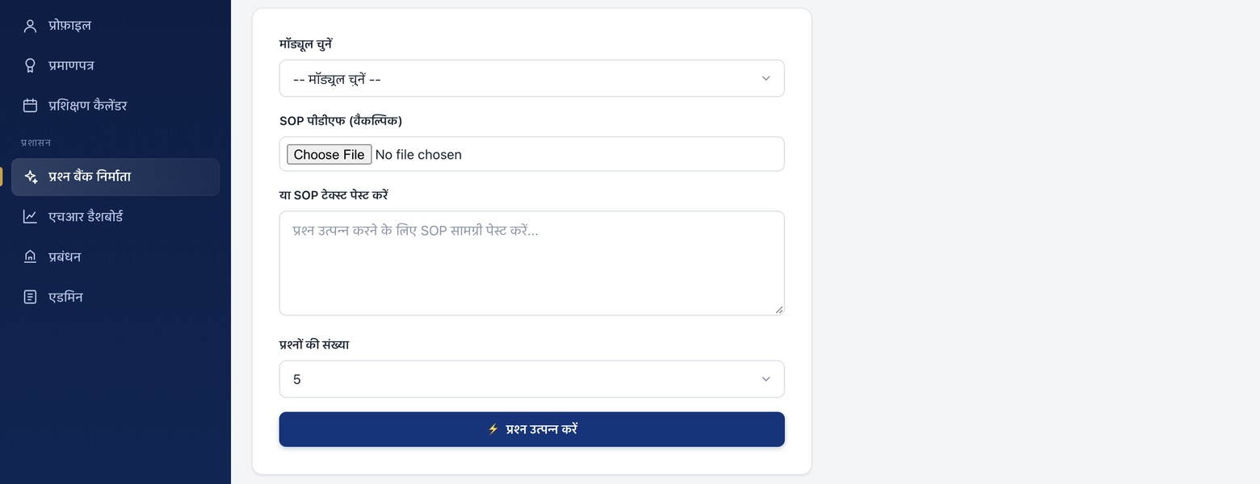
AI-Assisted Assessment Generation
SOP Document
Gemini Model
Generated MCQs
MODEL:
Google Gemini writes questions, answer keys and explanations.
INPUT:
Uploaded SOP PDF,
or pasted SOP text
from the institute
OUTPUT:
Generated administrator reviews and edits.

Slide 8
Feasibility, Impact & Deployment
Feasibility:
Impact:
Deployed & Verified:
Established, well-documented
technologies (Django,
PostgreSQL). Modular design.
Digital Staff Training.
Easy Resource Access.
Progress & Achievement Tracking.
Digital Certificates.
Live on cloud hosting
with CI/CD on every push
203 automated tests
0 known advisories
3 vulnerabilities found & fixed

Slide 9
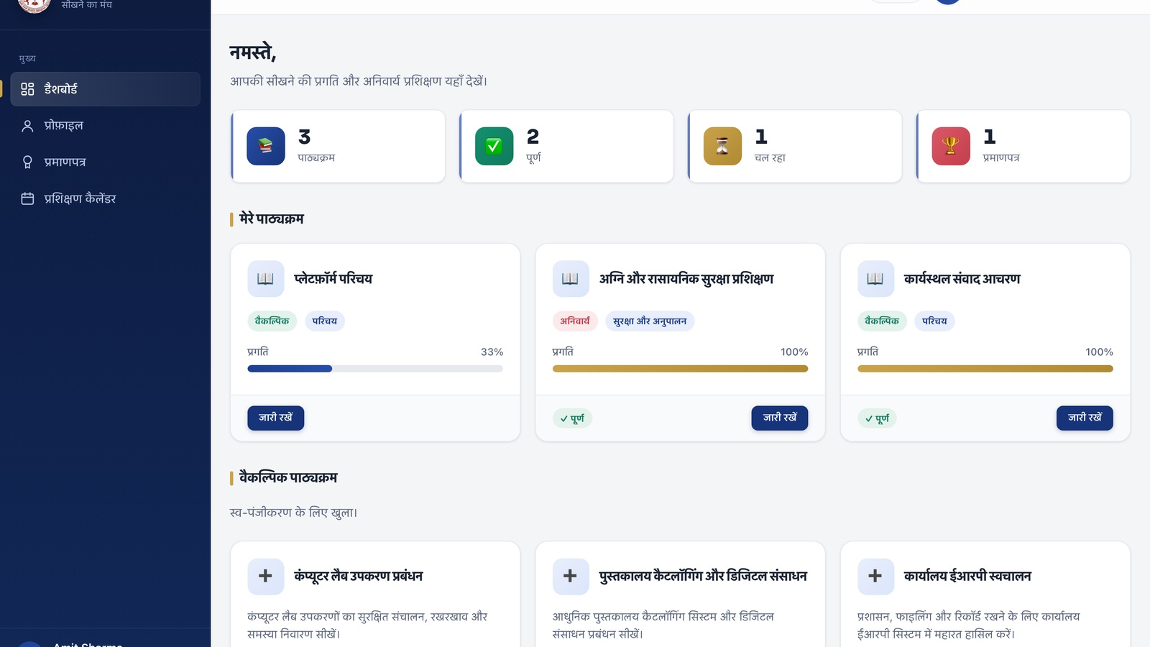
Why Our Solution?
Generic LMS:
SRMS Drona:
General audience.
Standard experience.
Usually single language.
Separate tools.
Generic administration.
SRMS specific.
Mobile first.
Hindi + English language.
All in one tools.
Role based administration.
Drona dashboard in हिन्दी — same tool, no separate build

Slide 10


