Slide 1

Project Plan & Progress
HUSTLRZZ
A planned AI mock interview coach with voice, posture feedback and candidate-owned RAG
Group 3 :
Arsh Yar Khan (2300140130013)
Deepak Gangwar (2300140130018)
Nikhil Singh (2300140130035)
Riya Rastogi (2300140130043)
Project Guide :
Er. Ashish Agrawal

Slide 2
Content
01
Motivation & Problem
02
Product workflow & live demo
03
Architecture
04
Tools & Technology
05
Current progress
06
Product screens — UI built
07
Next enhancements
08
Conclusion

Slide 3
Motivation
Feedback-free preparation
Single-dimension tools
No private interviewer
!
!
!
Candidates need an affordable, always-available space to practice under realistic pressure.
Static question banks rarely provide role-specific probing or evidence-based feedback.
Many tools focus only on answer content and miss delivery, posture and eye contact.

Slide 4
Problem Statement
Current automated preparation tools do not connect the candidate’s real context with a live, multi-dimensional evaluation.
Automated preparation today
Our plan
•
Static question banks — no resume or role adaptation
Generate role-specific questions from the candidate’s own context → conduct a real-time conversational interview → score answers → track posture in parallel.
Keyword matching — limited understanding of depth and structure
•
→
No live feedback on non-verbal cues
•

Slide 5
Literature Review
Literature | Key Finding | Gap Identified
Lewis et al. (2020) – RAG | Retrieval improves LLM grounding using external knowledge. | Not personalized for interview coaching.
BlazePose (2020) | Enables real-time on-device pose estimation. | Not interview-specific.
Yoodli (2026) | AI-based interview and communication coaching. | Focuses strongly on speech/communication coaching.
PolyInterview (2026) | CV/JD-based multimodal mock interviews with content, vocal and non-verbal assessment. | Leaves room for different privacy/RAG architecture and candidate-owned longitudinal context.

Slide 6
How It Works
1
2
3
4
Prepare
Interview
Feedback
Parallel
→
→
→
Resume (text/PDF) + job description → personalized questions, model answers and company-match analysis.
A WebSocket interviewer asks questions live; the candidate responds by typing or speaking.
The interviewer can follow up; the completed transcript becomes a structured scored report.
In-browser body-language tracking runs while the candidate answers.
In progress: candidate-owned documents and prior reports are retrieved as source-labelled context for relevant follow-ups.

Slide 7
Architecture — target design
Real-time interview coaching with private browser analysis, resilient AI, and candidate-owned retrieval.
Candidate browser · private device boundary
Next.js + TypeScript
Prepare · interview · report UI
On-device analysis
MediaPipe posture + Web Speech STT/TTS
Camera frames stay in browser
Supabase PostgreSQL
Auth · workflows · sessions · reports
Row-Level Security
REST + secure WebSocket
FastAPI application
REST: preparation, knowledge, coaching, history
WebSocket: live interviewer and report
Authenticated persistence
Candidate knowledge (RAG)
knowledge_documents + knowledge_chunks
pgvector similarity search · user-scoped
Index / retrieve
AI requests
AI gateway
Groq → Gemini, free tiers
BYOK for paid providers
Grounded interview context
Top 5 source-labelled chunks for relevant follow-ups
Non-blocking: core interview works without retrieval
Provider calls
Bounded source context
LLM providers
Generation · judge · Gemini embeddings
Privacy and reliability by design: video never leaves the browser; RAG is user-scoped; a retrieval failure never blocks practice.

Slide 8
Technology Stack
Frontend
Backend
AI
Free tiers only; BYOK for paid
Next.js 16, React 18, Tailwind
Python 3.14, FastAPI 0.141
Database
Speech
Body tracking
Supabase Postgres + pgvector
Browser Web Speech API - STT + TTS
MediaPipe tasks-vision — pose, face, hand, in-browser
Deployment
RAG
Vercel (front end) and Render (API), deployed independently
Candidate-owned, user-scoped

Slide 9
Demo — the working path today
Open the web app and sign in
Submit a resume and target Job Description
Start an interview; AI asks a role-specific question
1
2
3
Answer by voice; observe the follow-up
Show the live camera posture signal
End the session → report and history
4
5
6

Slide 10
Current Progress
1
2
3
4
Working
In progress
UI built
Not started
→
→
→
Prepare, Resume Analyzer, Interview and Coaching run end to end, from sign-in to a written result.
Indexing and search work; retrieval quality is still being validated on real documents.
Coaching workspaces, assessment, settings and data rights are designed; the behaviour behind them is still being wired.
Capacity planning, backup and recovery, and evaluation with real users.
About 40% of the plan is functional today; the remainder is complete at the interface level and is being integrated next.

Slide 11
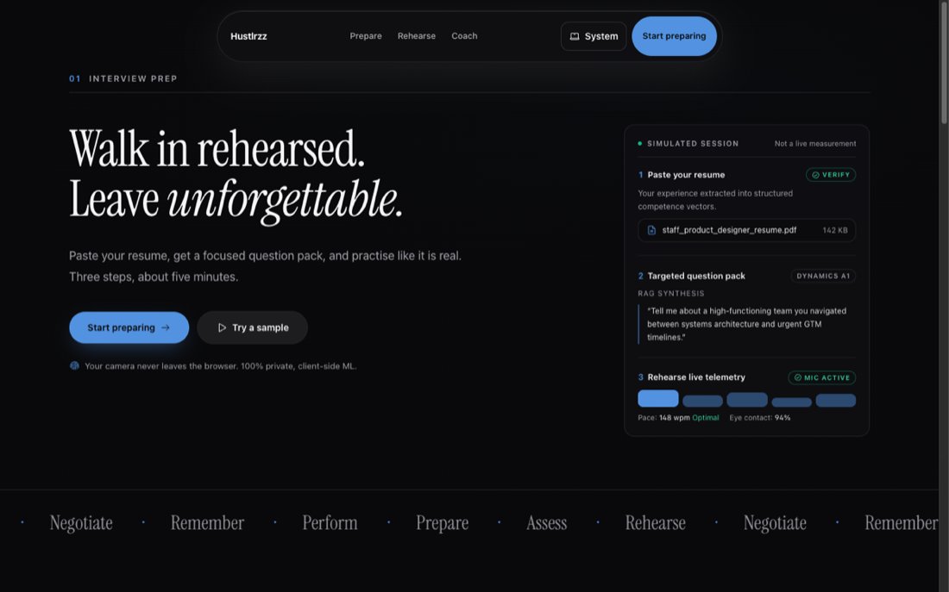
Product screens — current build

Slide 12
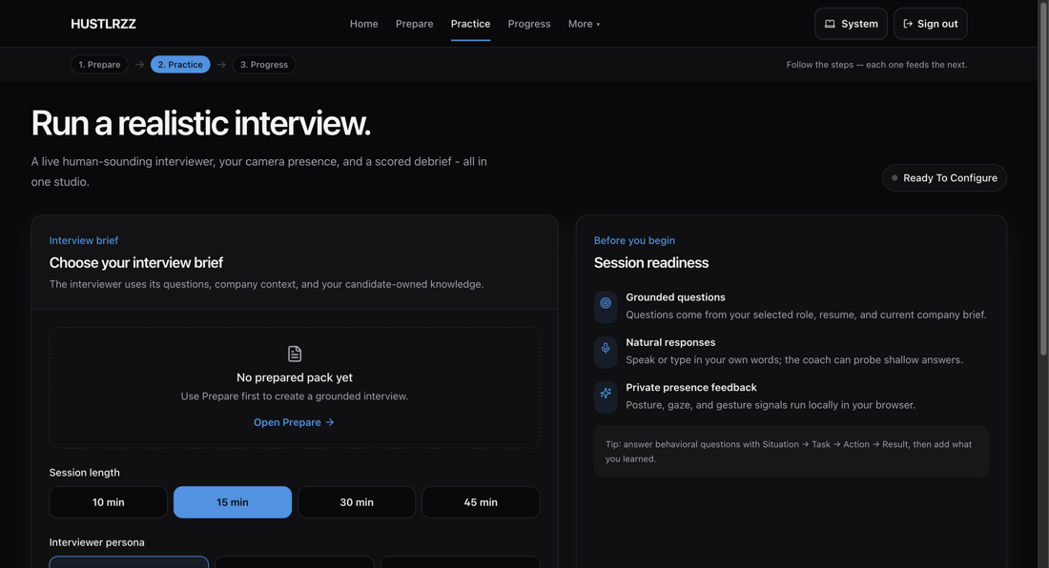
Practice — live interview
Working

Slide 13
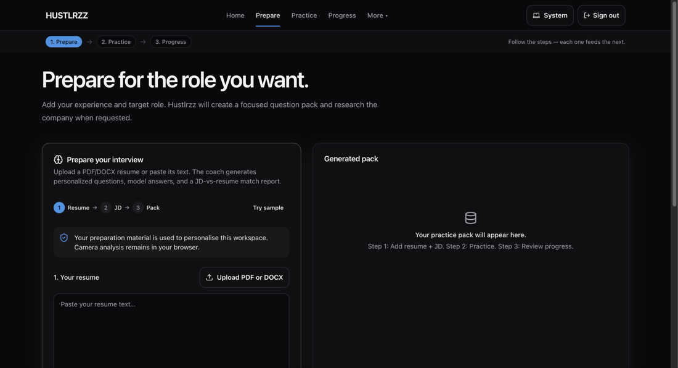
Prepare
Working

Slide 14
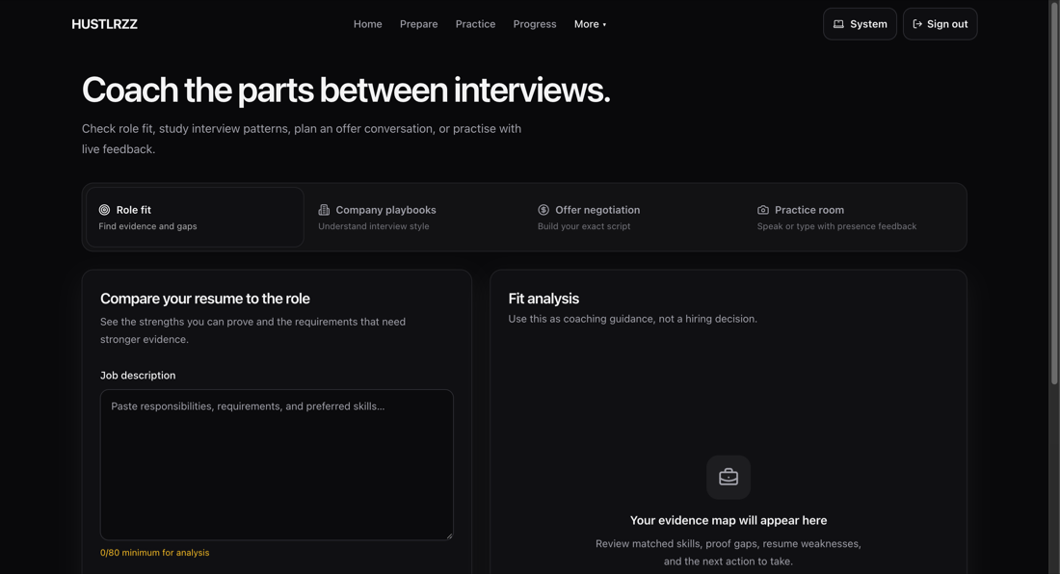
Coaching
UI built

Slide 15
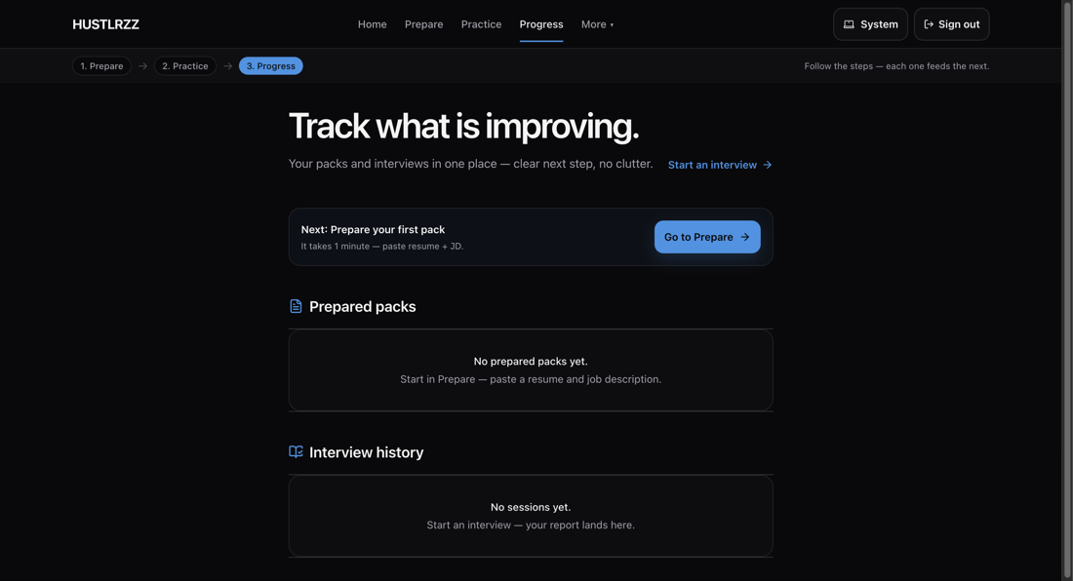
Progress
Working

Slide 16
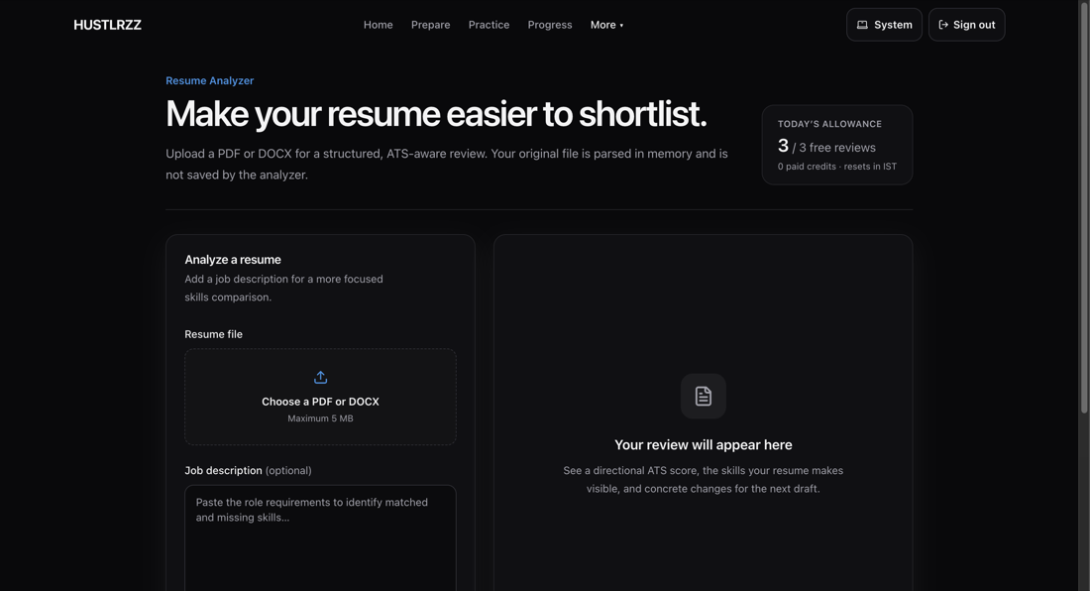
Resume Analyzer
Working

Slide 17
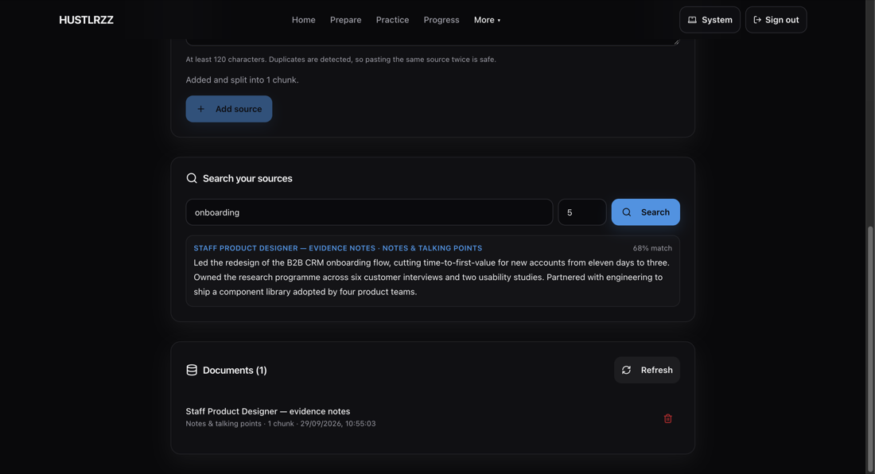
Knowledge base
In progress

Slide 18
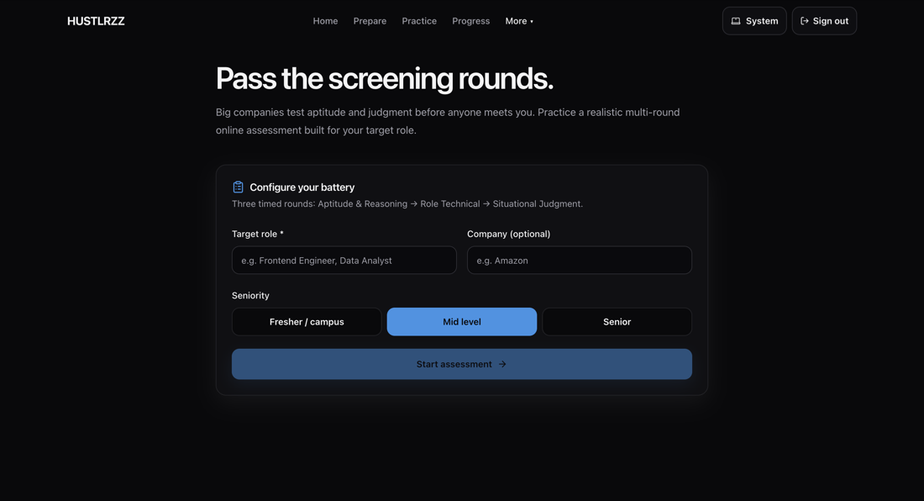
Assessment
UI built

Slide 19
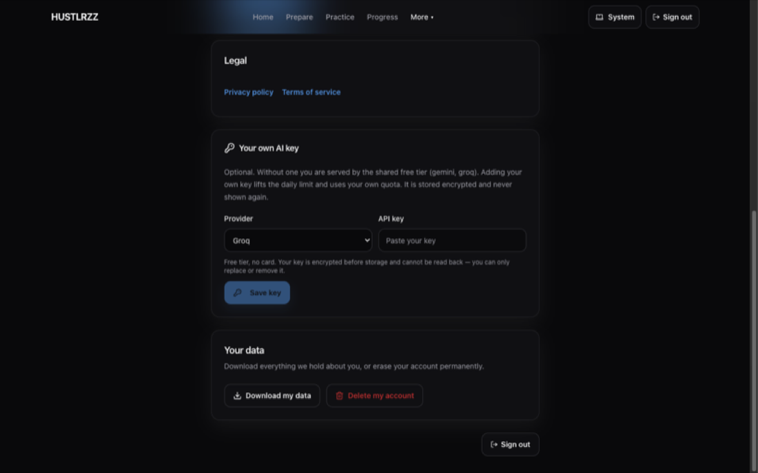
Settings and data rights
UI built

Slide 20
Enhancements
⌕
↗
◫
★
RAG quality & coverage
Cross-session coaching
Offline options
Richer rubrics
Expand approved sources, hybrid ranking and retrieval evaluation on the pgvector foundation.
→
→
→
Add more assessment dimensions and stronger behavioral scoring.
Compare current reports with prior feedback to show measurable improvement over time.
Explore smaller local models for lower-cost or offline practice.

Slide 21
Conclusion
✓
Role-specific questions from a real resume and job description
✓
Live voice or text conversation over Web Sockets
✓
In-browser body-language feedback
✓
Final structured scoring and coaching report
→
Planned next: coaching workspaces, assessment, settings and data rights
✓
The core journey works today; the remaining screens are built and are being integrated next.

Slide 22
References
Lewis et al. — Retrieval-Augmented Generation for Knowledge-Intensive NLP, NeurIPS 2020
01
Wei et al. — Chain-of-Thought Prompting Elicits Reasoning in Large Language Models, NeurIPS 2022
02
Bazarevsky et al. — BlazePose: On-device Real-time Body Pose Tracking, arXiv:2006.10204
03
04
Groq and Google Gemini developer documentation
05
Web Speech API documentation; MediaPipe Pose documentation

Slide 23
Thank You

Slide 24
Where to find it
Live application — hustlrzz.vercel.app
01
Backend health — hustlrzz-api.onrender.com/health
02
Source code — github.com/dgexplores/hustlrzz
03
04
Interface gallery — docs/images_project/ (16 screens, live deployment)
05
Verification — 249 backend tests and 141 frontend tests, all passing

