Slide 1
Capital planning office tool
By team shamrock
-kevin mooney
-Roger Escobedo
-Benjamin Benton
-david Gutierrez
-Jorge rangel

Slide 2

communication
-Slack was used as a quick means of constant communication
-Slack is available for apple & android devices and browsers

Slide 3

GitHub
-Github held our local and remote repositories
-Our collective code was held in the Github website
-A few team mates used the Github desktop version to push code and clone

Slide 4
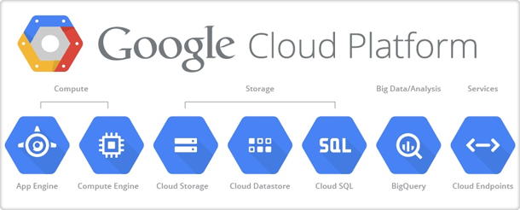
Hosting
-Google’s cloud platform was used to collect and run our code
-There was debate whether to use Cloud computing or a raspberry pi, ultimately the Cloud was chosen
Raspberry Pi
Control over hardware
Flexible
Free
Google CP
Always on
Tech Support
More power
“Safer choice”

Slide 5
organization
View
Controller
Tweet DB
Text-field
Model

Slide 6
Issues with burndown
Our burn-down representation was very strange.
It would only show the current date’s progress, only displaying hours remaining
A sketch for what our burn-down may have looked like is show below

