Slide 1
Chatbot
Daniel Ghazvini

Slide 2
Dataset: Cornell movie-dialogs corpus
220, 579 conversational exchanges between 10,292 pairs of movie characters
Other movie metadata (genres, release year, IMDB rating etc.)

Slide 3
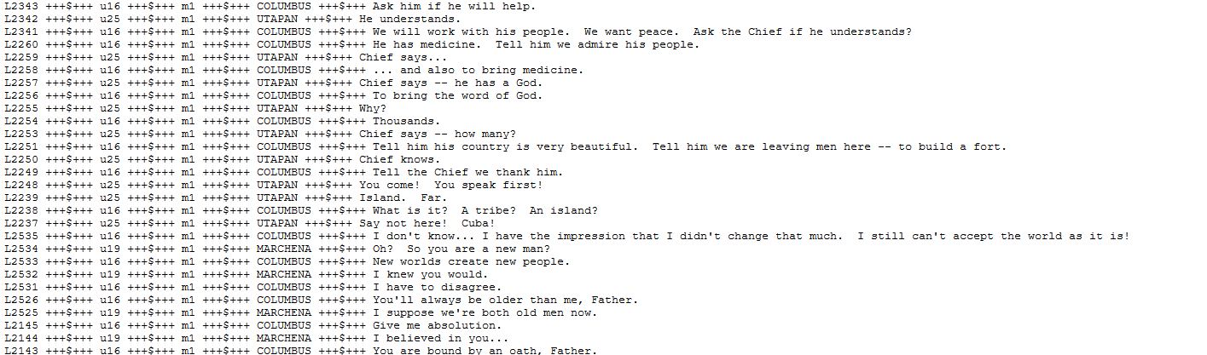
Question and response Pairs

Slide 4
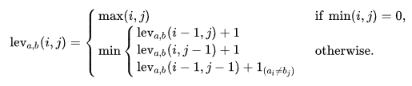
Methodology – Fuzzy matching
Levenshtein Distance
Measurement of number of edits between 2 strings
E.g. THURSDAY → TUESDAY = 2 LD (1 Deletion and 1 Change)
Hamming Distance
Similar but for strings with same length
Faster

Slide 5
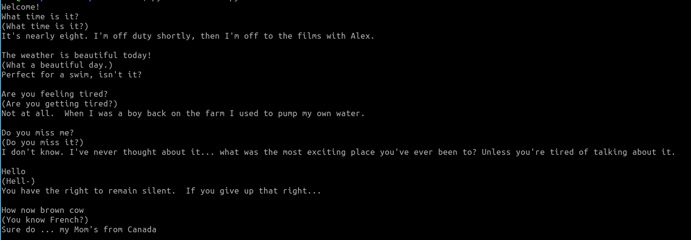
Output

