Slide 1
Trend in the number of Confirmed cases from 13th March 2020 and 10th March 2021

Slide 2
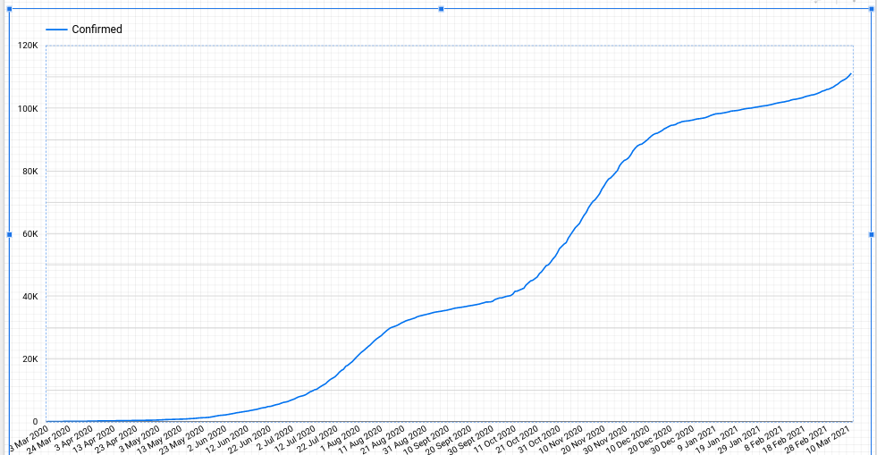

Slide 3
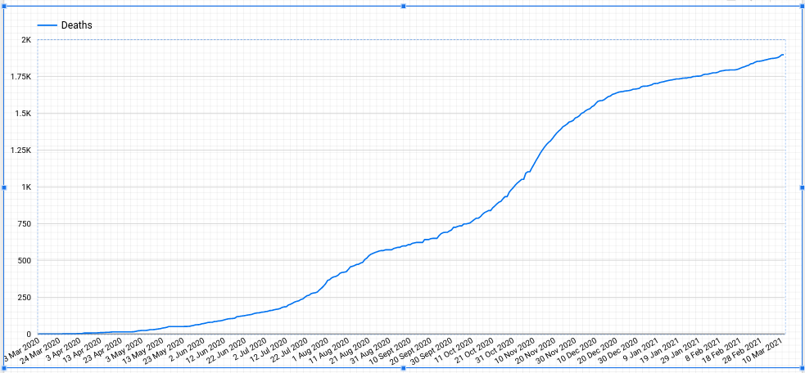
Trend in the number of Deaths between 13th March 2020 and 10th March 2021

Slide 4
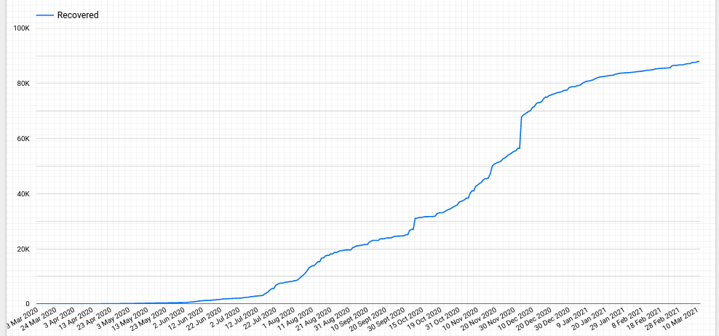
Trend in the number of Recoveries between 13th March 2020 and 10th March 2021

Slide 5
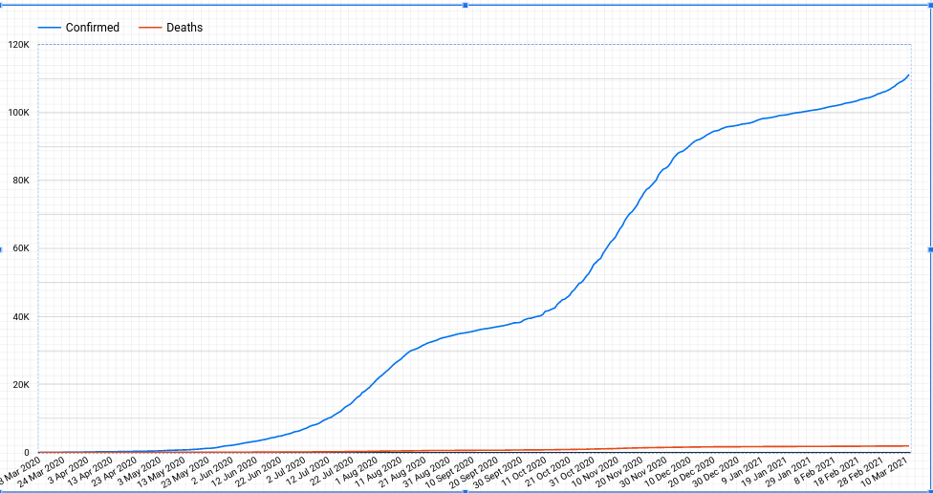
Confirmed Cases versus Death Cases

Slide 6
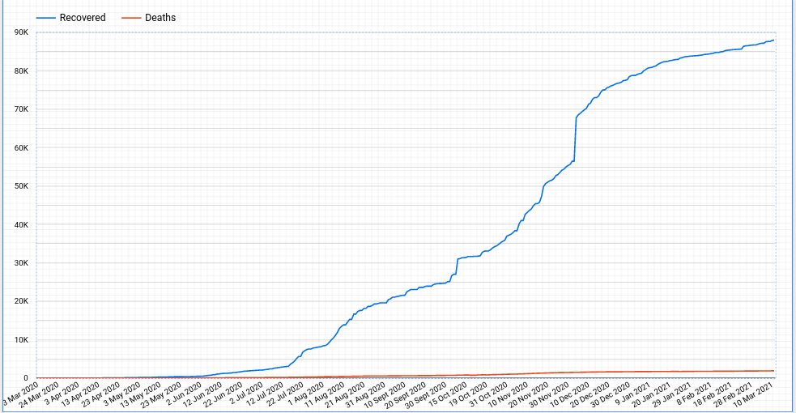
Recovery cases versus Death Cases

