Slide 1

Data, Information and Databases
Facilitator
Prof. Tarannum Bloch
Department of Information Technology

Slide 2
Session Outcomes
Upon successful completion of this session, you will be able to:
Describe the differences between data, information, and technology
Define the term database and identify the steps to creating one
Describe the role of a database management system
Use MySQL database management system
Learn basic SQL queries for CRUD operations

Slide 3
Data, Information, Knowledge
Data
Information
Knowledge
Wisdom
Data is raw bits and pieces of information
Quantitative – numeric
Qualitative – descriptive
Alone is not useful
Information is when data is given context and more specific
Knowledge is developed when information has been aggregated and analyzed to make decisions, set policies, and spark innovation
Wisdom is the combination of knowledge and experience May take years to develop

Slide 4
Database
Organized collection of related information to generate knowledge for decision making purposes
For example, a university transcript database may contain information on students, classes taken, and grades received
A separate university database would be created to maintain your financial information
Relational databases (such as Microsoft Access) where data in organized into one or more tables
Tables are a collection of fields
E.g., Student ID, Course ID, Grade Earned
Record is an instance in the table
E.g., your specific information in the table

Slide 5
Database

Slide 6
Database Design
There are several different types. They can be grouped into four basic categories:
Design is a critical first step in creating a database
Understand the goal of how the database will be used
Identify the data needed as part of accomplishing this goal
Identify how the data is related to each other
Identify tables and fields to organize the data
Each table needs a primary key of which field(s) is unique to each record and will not change
For example, our Bronco ID Normalization is performed to eliminate duplicated data

Slide 7
Database Design
Each field in the database has a data type to store information:
Text – non-numeric data less than 256 characters
Number – numeric data
Yes/No – stores 0 for No or False and 1 for Yes or True
Date/Time – number data type that can be interpreted as a number or a time
Currency – monetary data
Paragraph Text – stores text longer than 256 characters
Object – data that can’t be typed such as a picture or music file
Data types dictate what functions can be performed on the data
For example, 2 number fields can be used to perform calculations
Data types indicate the amount of storage needed for each field

Slide 8
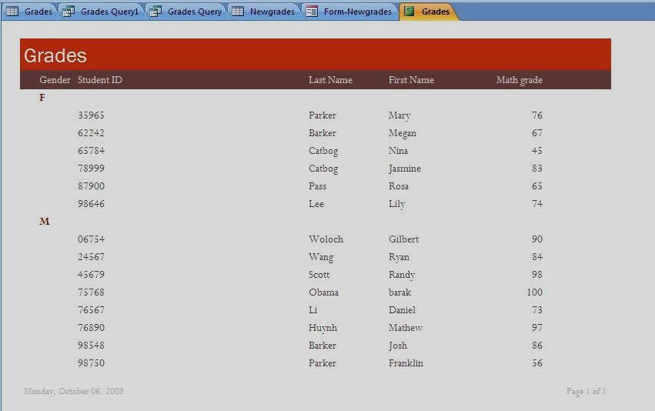
Database Reports
Structured Query Language (SQL) is a tool/language that helps extract information from the database for analysis purposes

Slide 9
Database Management System
Database Management Systems (DBMS) is an application that allows data to be:
Entered, Modified, and Deleted
Read
Reported
Has a user friendly interface to design the database
Relational databases use Microsoft Access installed on one machine with one user
access at a time
Enterprise Databases serve the entire organization

Slide 10
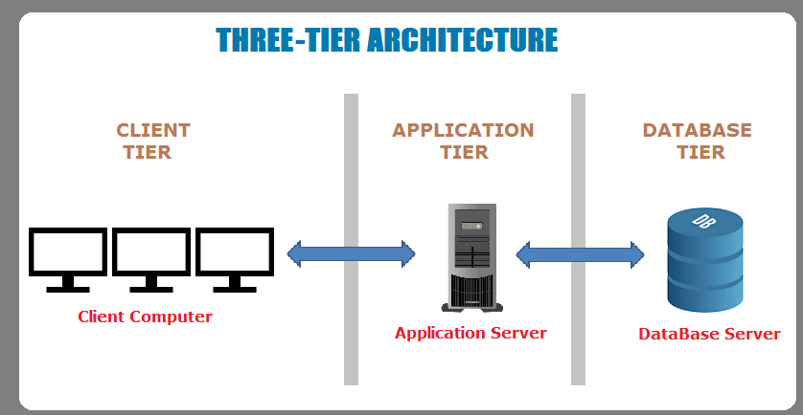
3-tier software Architecture

Slide 11
MySQL
Database Creation
Table Creation
CRUD on created table

Slide 12


Thank You.
05-06-201913

