Slide 1

Support Vector Machine - Machine Learning Research
Darrell Gerber, Ted Korby, Chris Nash, Greg Wagner
Notes:
ted

Slide 2
Introduction
Support Vector Machine
What it is? How it works?
Classification
Kernels
Comparison & Advantages
Advantages of SVMs
Disadvantages of SVMs
Comparison with Logistic Regression
Data Processing & Parameters
Data Processing
Tuning Hyperparameters
Hyperparameter C
Hyperparameter Degree and Coef0
Conclusion

Slide 3
Support Vector Machine

Slide 4
What is it? How does it work?
"Support Vector Machines (SVMs), are a set of supervised learning methods used for classification, regression and outlier detection." [1]
Supports multi-class classifications based on input data supplied to training models. These methods include SVC and LinearSVC.
SVC: A 'one-to-one' classifier or 'one-to-one' into 'one-to-rest' classifier in conjunction with modifying the decision_function_shape parameter, able to choose Kernel type.
LinearSVC: A 'one-to-rest' classifier, Kernel type is only Linear.
SVC logistic creates planes in reference to training data which can take multiple forms based on Kernel type, these are known as hyperplanes.
Linear, Polynomial, Radial Basis Function and Sigmoidal
In a similar fashion to Logistic Regression, data point classification is based on a data points position in the multi-dimensional space, separated or categorized by planes determined by the algorithm.
[1]: https://scikit-learn.org/stable/modules/svm.html#tips-on-practical-use
Notes:
ted

Slide 5
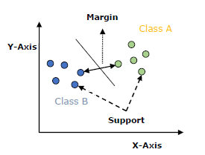
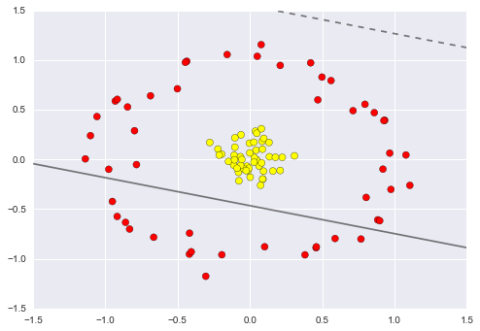
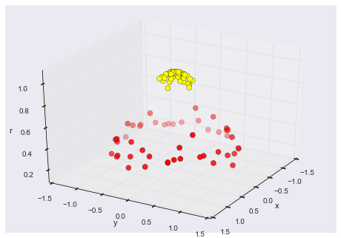
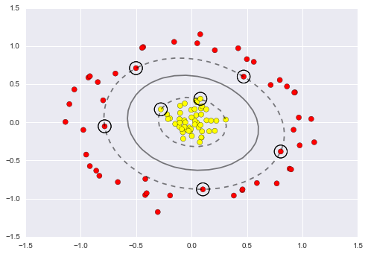
Classification
The objective of the support vector machine algorithm is to find a hyperplane in an N-dimensional space(N — the number of features) that distinctly classifies the data points.​
Our objective is to find a plane that has the maximum margin, i.e., the maximum distance between data points of both classes
Notes:
ted

Slide 6
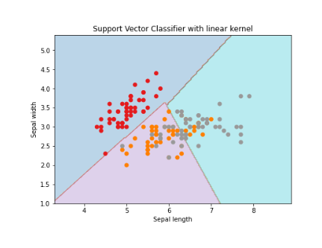
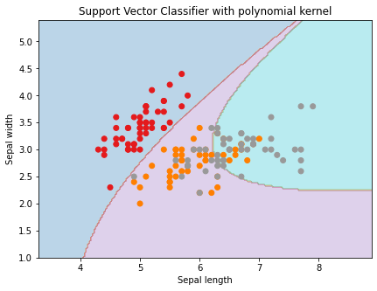
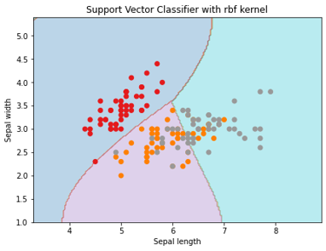
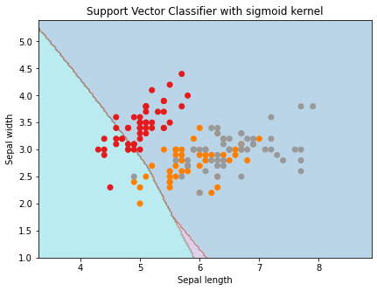
Kernels
Specify what type of hyperplane to use
Built in options: Linear, RBF, Polynomial, Sigmoid
Also, provide custom kernel
Radial Basis Function (RBF)
Linear
Polynomial
Sigmoid
⟨x,x′⟩
(γ⟨x,x′⟩+r)^{d}
exp⁡(−γ‖x−x′‖²)
tanh⁡(γ⟨x,x′⟩+r)
Notes:
ted

Slide 7
Comparison & Advantages
Notes:
chris

Slide 8
Advantages of Support Vector Machines
Their dependence on relatively few support vectors means that they are very compact models and take up very little memory.
Once the model is trained, the prediction phase is very fast.
Because they are affected only by points near the margin, they work well with high-dimensional data—even data with more dimensions than samples, which is a challenge for other algorithms like K-means.
Their integration with kernel methods makes them very versatile, able to adapt to many types of data.
Not necessary to specify the number of clusters beforehand.
Notes:
Chris

Slide 9
Disadvantages of Support Vector Machines
For large numbers of training samples, the computational cost can be prohibitive.
The results are strongly dependent on a suitable choice for the softening parameter C. Unlike other hyperparameters from Linear Regression or Logistic Regression, this must be carefully chosen via cross-validation, which can be expensive as datasets grow.
The results do not have a direct probabilistic interpretation. This can be estimated via an internal cross-validation, but this extra estimation can have a high computational cost.
Notes:
Chris

Slide 10
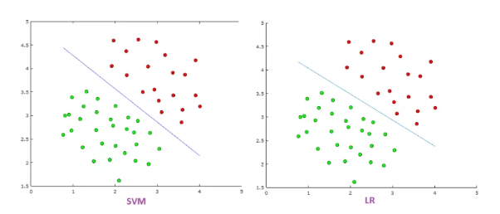
Comparison with Logistic Regression
SVM tries to finds the “best” margin (distance between the line and the support vectors) that separates the classes, and this reduces the risk of error on the data, while logistic regression does not, instead it can have different decision boundaries with different weights that are near the optimal point.
SVM works well with unstructured and semi-structured data like text and images while logistic regression works with already identified independent variables.
SVM is based on geometrical properties of the data while logistic regression is based on statistical approaches.
The risk of overfitting is less in SVM, while Logistic regression is vulnerable to overfitting.
Notes:
Greg

Slide 11
Data Processing & Parameters
Notes:
greg

Slide 12
Data Processing
Scaling or standardizing is highly recommended when using SVMs.
For example, scale each attribute on the input vector X to [0,1] or [-1,+1], or standardize it to have mean 0 and variance 1.
The same scaling must also be applied to the test vector.
Duplicate data should be dropped to improve performance
SVMs do not need any processing as far as missing values go. In fact, SVMs can act as a preprocessor for other classification algorithms when it comes to unbalanced data.
It also has a class (One-Class SVM) that can detect outliers, making it a good preprocessor for outliers as well
Notes:
greg

Slide 13
Tuning Hyperparameters
Use sklearn.model_selection.GridSearchCV to tune the hyperparameters
Setup the parameter grid
Perform cross-validation to find the best parameter combination
Tunable Hyperparameters
C
Gamma
Degree
Coef0
Notes:
darrell

Slide 14
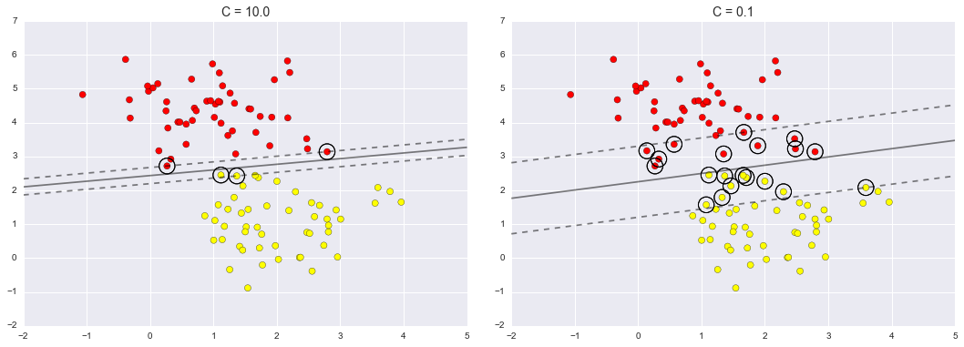
Hyperparameter C
SVM has a hyperparameter which softens the margin that dictates the placement of the classification line.
It allows some of the points to creep into the margin if that allows a better fit. The hardness of the margin is controlled by a tuning parameter, most often known as C.
For very large C, the margin is hard, and points cannot lie in it. For smaller C, the margin is softer, and can grow to encompass some points.
Notes:
darrell

Slide 15
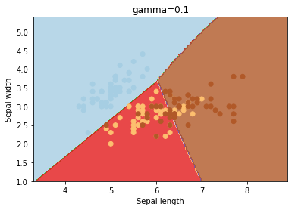
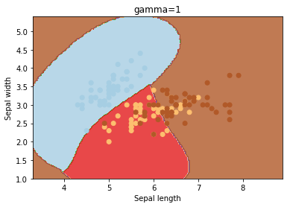
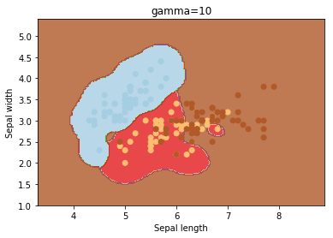
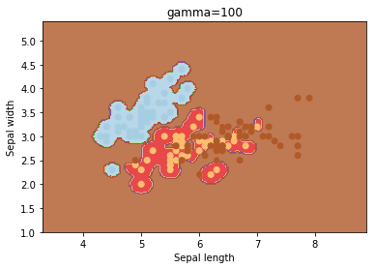
Hyperparameter Gamma
Gamma
The weighting coefficient for the nonlinear hyperplanes 'rbf', 'poly', and 'sigmoid'
Automated values:
Scale – gamma = 1/(number features*number of ??)
Auto – gamma = 1/number of features
Gamma Too High = Overfitting
Notes:
darrell

Slide 16
Hyperparameter Degree and Coef0
Degree
Degree is a parameter used when kernel is set to ‘poly’.
The degree parameter controls the flexibility of the decision boundary. Higher degree kernels yield a more flexible decision boundary
Can be an integer, default is 3
Coef0
Independent term in kernel function. It is only significant in ‘poly’ and ‘sigmoid’
When parameter approaches infinity, it more and more separates pairs of points
Because powers of values smaller than one gets closer and closer to 0, while the same power of value bigger than one grows to infinity, use coef0 to "scale" your data so there is no distinction
Typically kept equal to 0
Notes:
darrell

Slide 17
Conclusion
A set of supervised learning methods used for classification, regression and outlier detection.
Creates hyperplanes to split data into clusters that maximize the separation between clusters.
PROS
Memory efficient.
Prediction phase is very fast.
They work well with high-dimensional data—even data with more dimensions than samples.
Their integration with kernel methods makes them very versatile, able to adapt to many types of data.
Resilient to missing or unbalanced data
CONS
Can be slow for large sample sizes
The results are strongly dependent on parameter C selection. Must be carefully chosen via cross-validation, which can be expensive as datasets grow.
The results do not have a direct probabilistic interpretation and estimating has a high computational cost.
Notes:
darrell

Slide 18
Appendix

Slide 19
Sources
https://towardsdatascience.com/support-vector-machine-introduction-to-machine-learning-algorithms-934a444fca47
https://jakevdp.github.io/PythonDataScienceHandbook/05.07-support-vector-machines.html
https://www.tutorialspoint.com/machine_learning_with_python/machine_learning_with_python_classification_algorithms_support_vector_machine.htm#:~:text=ML%20-%20Support%20Vector%20Machine%20%28SVM%29%201%20Introduction,Implementing%20SVM%20in%20Python%204%20SVM%20Kernels.%20
https://www.geeksforgeeks.org/svm-hyperparameter-tuning-using-gridsearchcv-ml/
https://medium.com/axum-labs/logistic-regression-vs-support-vector-machines-svm-c335610a3d16
https://stats.stackexchange.com/questions/39243/how-does-one-interpret-svm-feature-weights

Slide 20
Tutorial Links & PDFs
Tutorial
https://www.datacamp.com/community/tutorials/svm-classification-scikit-learn-python
https://towardsdatascience.com/support-vector-machines-explained-with-python-examples-cb65e8172c85
PDF
https://www.csie.cyut.edu.tw/~shwu/PR_slide/SVM.pdf

Slide 21
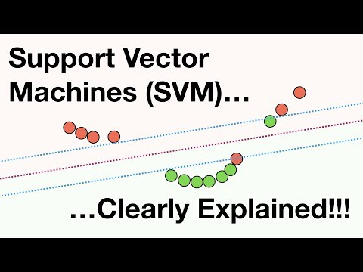
Support Vector Machines Clearly Explained
https://www.youtube.com/watch?v=efR1C6CvhmE&t=611s&ab_channel=StatQuestwithJoshStarmer

Slide 22
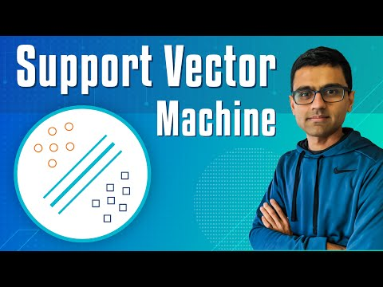
Machine Learning Tutorial - SVM
https://www.youtube.com/watch?v=FB5EdxAGxQg&t=102s&ab_channel=codebasics

Slide 23
Sample Code
https://github.com/dgitall/Exercise-DataProcessing/blob/main/Group_samplecode_SVM.ipynb
https://github.com/dgitall/Exercise-DataProcessing/blob/main/Group_samplecode_SVM.pdf
https://github.com/dgitall/Exercise-DataProcessing/blob/main/Linear%20SVM.ipynb
https://github.com/dgitall/Exercise-DataProcessing/blob/main/Non-Linear%20SVM.ipynb

