Slide 1
Guideline For the Testing the System of Real-Time Immersive Speech Programming

Slide 2
Server requirements
git clone https://github.com/dgiunchi/Real-Time-Immersive-Speech-Programming.git
Python: storytelling environment + ‘pip install openai’

Slide 3
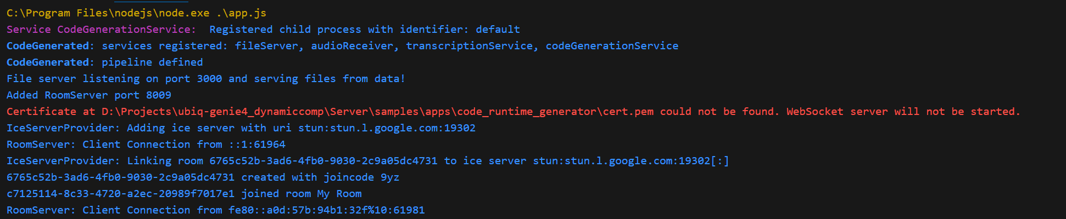
Run the server
node app.js in the folder ubiq-genie4_dynamiccomp\Server\samples\apps\code_runtime_generator

Slide 4
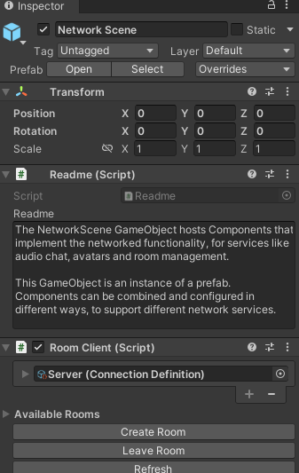
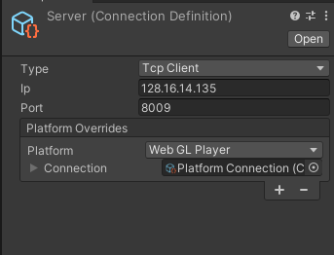
UNITY
Build the scene in Unity/Assets/Demos/DynamicCompiler
OR
Download this APK that point to RTX4090 in VR Lab
To change the server IP, open Unity and change the URL server:

Slide 5
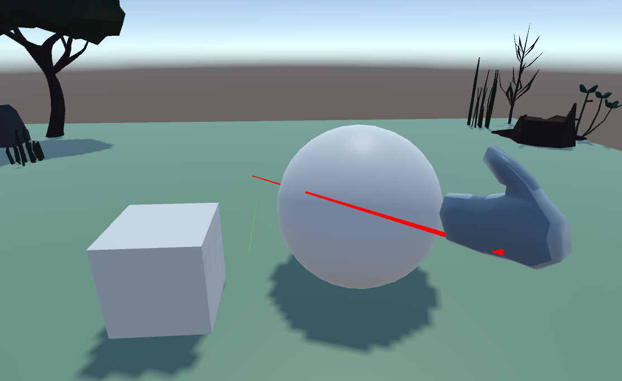
Familiarize with the SYSTEM
Click in the training section and practice
Select the object
Describe a behaviour you want
Wait (and keep the selection until the behaviour is attached)
Examples: move this object right, forward, up
color this object of red, blu
scale the object pulsing between 0 and 1
move in a circle

Slide 6
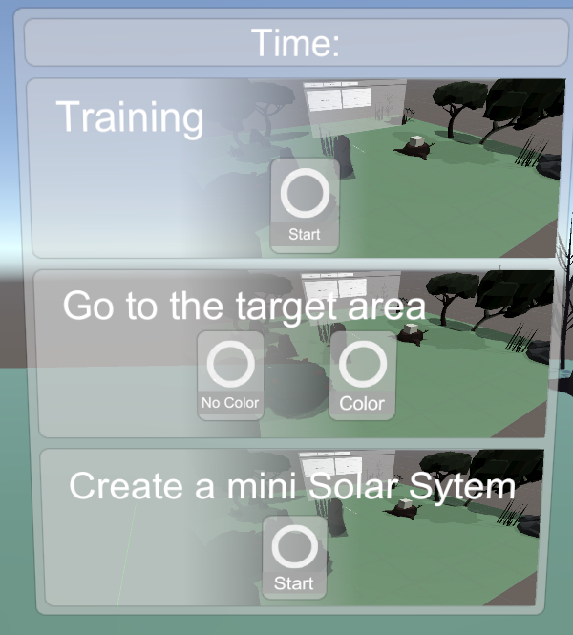
EXPERIMENT
SESSION 1
Program a Cube to move by Speech
3 SESSIONS
SESSION 2
Program a Cube to change to the right color and move by Speech
SESSION 1
Build a mini solar System (a star and two orbiting planets
The user clicks one of the sessions, and the menu disappears. To run another session the VR App needs to be restarted.

Slide 7
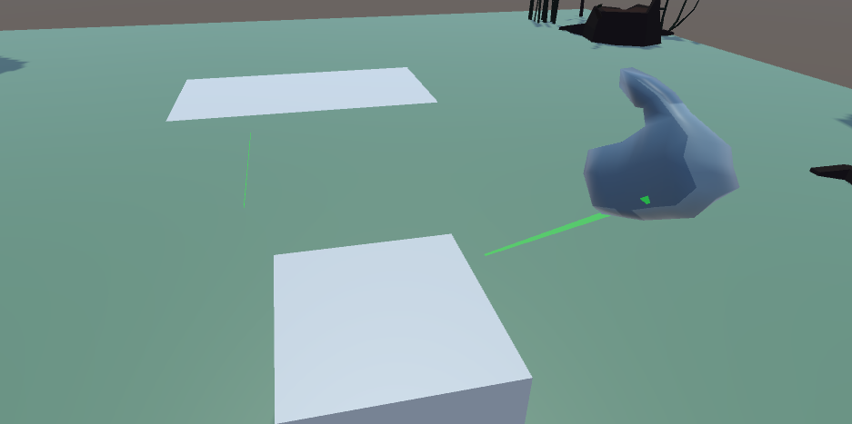
SESSION 1 – No Color
The user will be in front of a cube. He needs to move the cube by attaching on it a Behaviour described by voice.

Slide 8
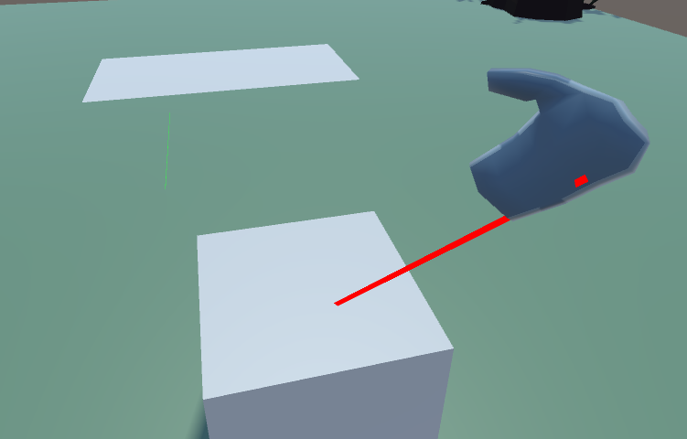
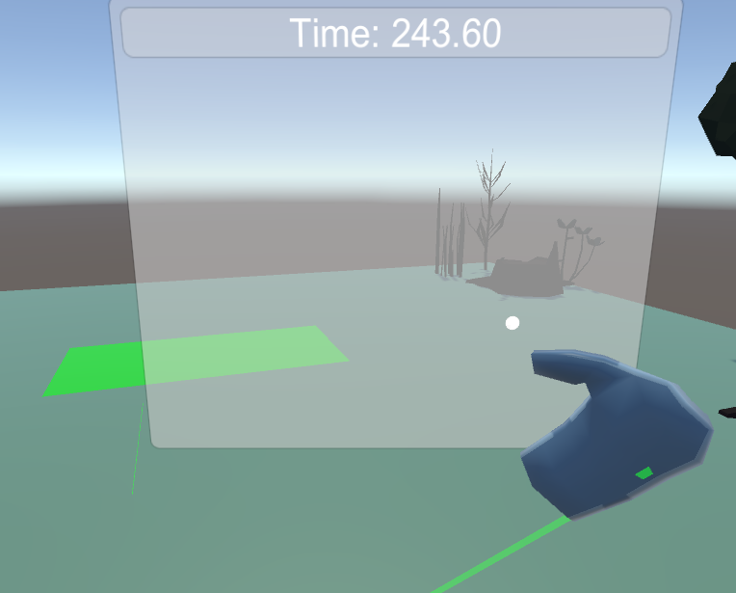
SESSION 1 - Solution
The user needs to select the object, the ray turn from green to red
And say move this object forward (or analogous behaviour)
When the object touch the target area, the area becomes green, and the time required to complete the task is displayed on the menu

Slide 9
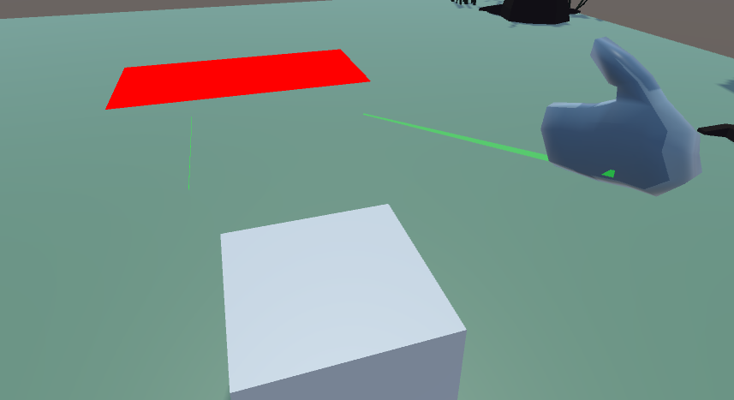
SESSION 2 – Color
The user will be in front of a cube. He needs firstly to change the color
Of the cube to the same color of the target area and then to move the cube by attaching on it a Behaviour described by voice.

Slide 10
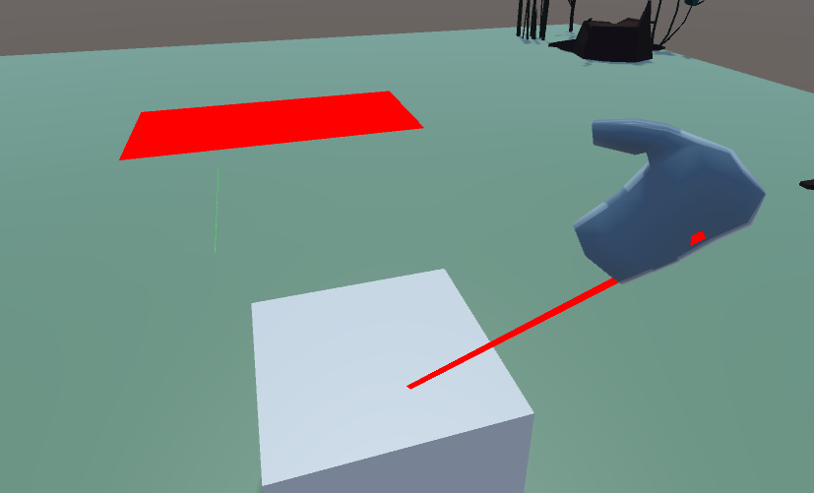
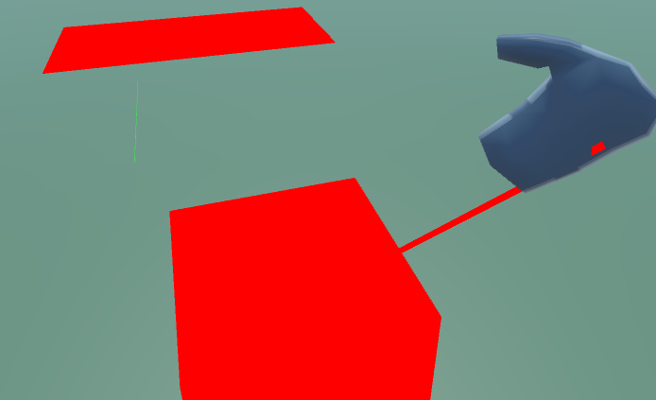
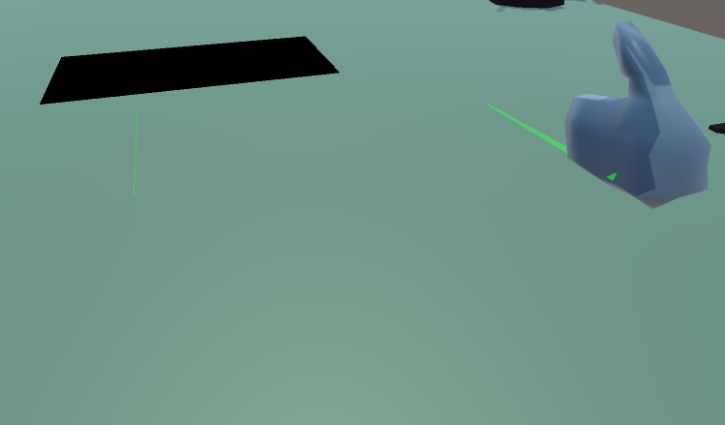
SESSION 2 - Solution
correct
The user needs to select the object
The users changes the color saying “turn this object into red” or analogous
And say “move this object forward“ (or analogous behaviour)
When the object touch the target area, the area becomes green, and the time required to complete the task is displayed on the menu. If the color is wrong, the target area becomes black and it means FAIL.
wrong

Slide 11
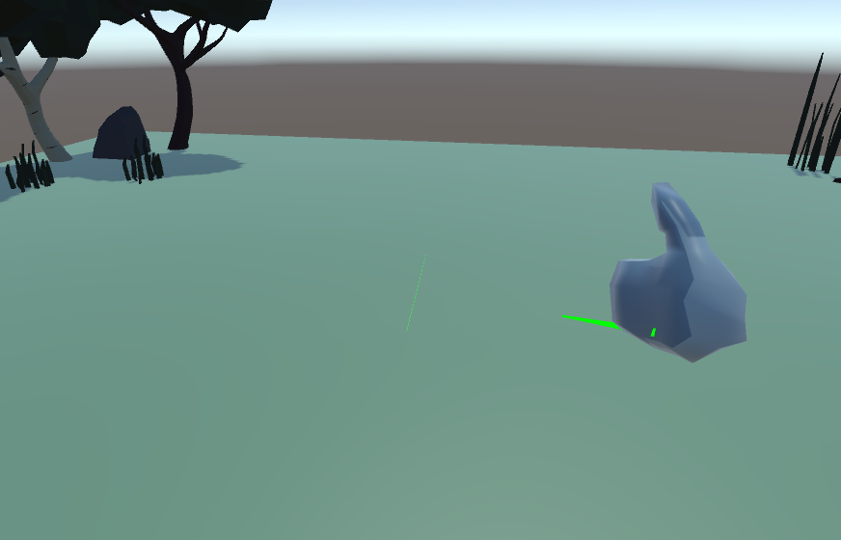
SESSION 3 – Build a Small Solar System
The user will be in the environment and will create a small planetary system with spheres orbiting.

Slide 12
SESSION 3 - Solution
The user does not select anything and say “create a yellow sphere of radius 0.5 and height 1”
Then select the yellow sphere (the ray should become red) and say “create a red sphere with x equal to 2 and radius 0.2”
Then select the red sphere and say “move this object circularly”
Repeat for the second planet point 2 and 3 with different values

Slide 13
