Slide 1
CLASH ROYALE - DECK BUILDER
DATA MINING AND MACHINE LEARNING
University of Pisa
Fabio Cognata, Luca Di Giacomo
Academic year: 2021/2022

Slide 2
INTRODUCTION
The application is a tool for clash-royale’s game community that allows decks building with the support of data analysis and machine learning algorithms to give an idea of the quality of the final deck analysing cards’ parameters such as Health Points, Damage, and other statistics concerning the game.
The application also gives suggestions to build a competitive deck proposing specific combinations adapting to already selected cards. It is thought of as a completely free to use application, without any user registration to make it as open as possible. It also offers information about each card retrieved by official sources such as the game’s wiki.

Slide 3
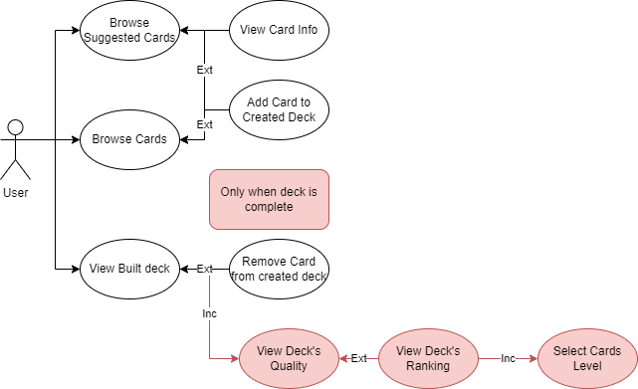

FUNCTIONAL REQUIREMENTS
CLASS DIAGRAM

Slide 4
REQUIREMENTS
FUNCTIONAL
Explore the cards viewing informations about them
Build decks by adding/removing specific cards.
View suggestions based on the actual state of the deck during the building phase
Receive a preview of the quality of the deck, once it is completely built
Receive a ranking of the deck, once levels for each card are selected
NON-FUNCTIONAL
The application should be easy to use.
The GUI should be intuitive and easy to use
The application should be responsive to changes

Slide 5
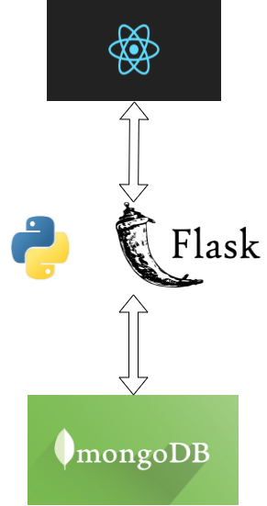
ARCHITECTURE

Slide 6
DATASET DESCRIPTION
The cards dataset has been built by official clash royale APIs at: https://developer.clashroyale.com/#/
Retrieving 106 cards, then integrated with informations retrieved from both the official wiki at:
https://clashroyale.fandom.com/it/wiki/Clash_Royale_Wiki
And the statistics of the updated APIs from github: https://royaleapi.github.io/cr-api-data/
For the decks dataset has been used a .csv file from kaggle, containing the full list of matches played during season 18 (2021) of Clash Royale:
https://www.kaggle.com/bwandowando/clash-royale-season-18-dec-0320-dataset
The final dataset resulted in a 1.05GB database containing both the cards and decks collection formatted as descripted above.
Volume: ~1GB
Variety: Multiple sources combined together in order to obtain the most possible informations about each deck and its performances in games

Slide 7
PRE-PROCESSING
Data Cleaning: necessity to remove unnecessary informations not concerning the decks and to fill missing values such as arrays of damage based on the level of the card
Data Integration: additional fields have been added, obtained by examining the existent features
Numerosity Reduction: Most of the games retrieved by Kaggle’s dataset were outdated, thus, games have been selected by removing the ones older then the last relevant patch of the game
Data Validation: An ulterior step has been added to validate informations and update older ones basing on the official github’s APIs at: https://royaleapi.github.io/cr-api-data/.
Decks Extraction: For decks building has been used the kaggle’s dataset combined with the cleaned and validated information about cards, using the Card ID parameter as identifier for the updates.

Slide 8
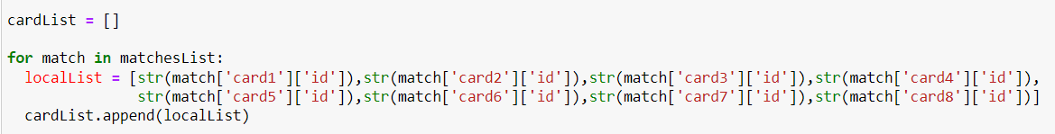
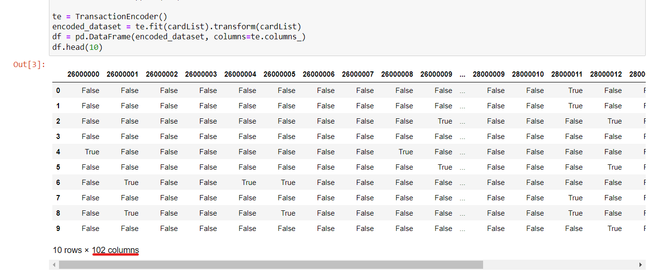
FREQUENT PATTERN ANALYSIS
FPA-Specific Pre-processing

Slide 9
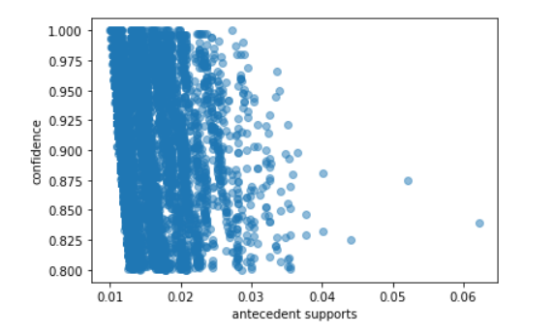
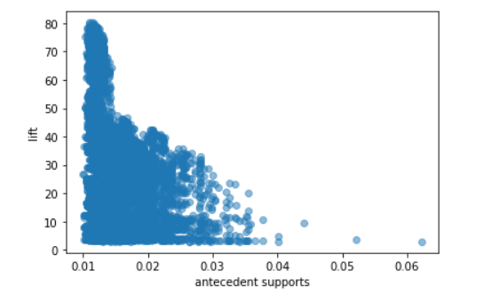
PATTERNS EVALUATION
metric: confidence
min_support: 0.01
suggestions: taken cards in antecedents, consequents with high confidence are suggested to the user.
Algorithm preference: Since performances between Apriori and FP-Growth have been almost the same, the chosen algorithm has been FP-Growth for his gain in speed

Slide 10
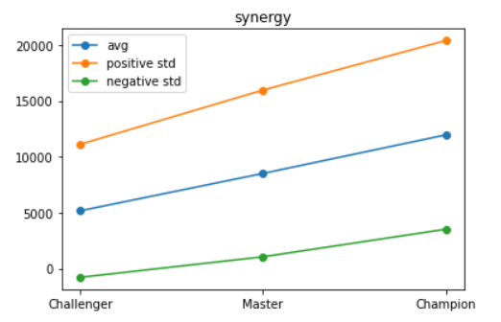
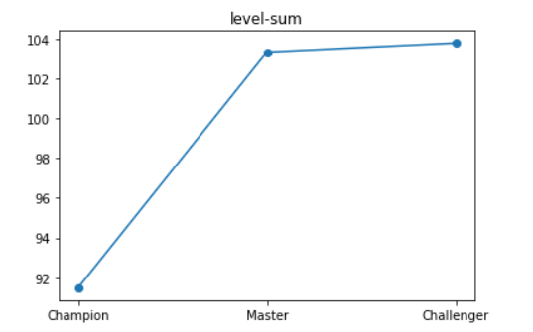
CLASSIFICATION ANALYSIS
Classification specific pre-processing
feature extraction: decks from Kaggle’s matches have been analyzed and integrated with card’s characteristics matching with their level(setted to the maximum for the un-leveled analysis).
behaviour analysis: to better analyze players’ behaviour in various ranks the confidence sum of the deck have been integrated with others statistics. Also levels of the cards have been splitted by rarity to analyze which cards have been most used in the various ranks.

Slide 11
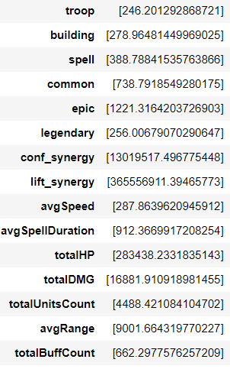
UN-LEVELED ANALYSIS (level setted to maximum for each card)
NO ATTRIBUTE SELECTION
Algorithm | Accuracy | Precision | Recall | F-Measure | fit-time | score-time
J48 | 79,62% | 77,59% | 77,20% | 77,36% | 0,09s | 0,01s
RF | 85,87% | 84,92% | 82,90% | 83,73% | 1,19s | 0,04s
KNN | 71,5% | 68,40% | 67,65% | 67,92% | 0s | 0,49s
NB | 53,12% | 67,24% | 63,59% | 53,07% | 0,02s | 0,01s
KBest+Chi^2 scores
SELECT K-BEST + Chi^2 Test(K=15)
Algorithm | Accuracy | Precision | Recall | F-Measure | fit-time | score-time
J48 | 79,40% | 77,26% | 77,20% | 77,22% | 0,13s | 0,02s
RF | 85,09% | 84,17% | 82,38% | 83,12% | 1,13s | 0,05s
KNN | 71,35% | 68,22% | 67,61% | 67,86% | 0,07s | 0,08s
NB | 52,81% | 66,86% | 73,73% | 52,93% | 0,03s | 0,02s
VARIANCE THRESHOLD (T=0.7) (17 selected)
Algorithm | Accuracy | Precision | Recall | F-Measure | fit-time | score-time
J48 | 79,21% | 77,07% | 76,99% | 77,02% | 0,09s | 0,01s
RF | 79,27% | 77,14% | 76,93% | 77,02% | 0,08s | 0,01s
KNN | 71,39% | 77,86% | 67,50% | 67,80% | 0,02s | 0,4s
NB | 52,95% | 66,96% | 62,85% | 52,07% | 0,03s | 0,02s

Slide 12
LEVELED ANALYSIS (1/3)
NO ATTRIBUTE SELECTION
Algorithm | Accuracy | Precision | Recall | F-Measure | fit-time | score-time
J48 | 70,18% | 69,74% | 70,18% | 69,56% | 0,1s | 0,01s
RF(100 estims) | 76,14% | 77,12% | 76,14% | 76,40% | 3,12s | 0,2s
KNN(N=4) | 55,48% | 54,25% | 55,48% | 53,88% | 0,01s | 1,4s
NB | 50,23% | 51,40% | 50,23% | 50,09% | 0,05s | 0,06s
K-BEST with Chi^2 (K=20)
Algorithm | Accuracy | Precision | Recall | F-Measure | fit-time | score-time
J48 | 69,98% | 69,45% | 69,89% | 69,32% | 0,12s | 0,01s
RF(100 estims) | 76,04% | 76,84% | 76,04% | 76,23% | 3,07s | 0,32s
KNN(N=4) | 55,44% | 54,22% | 55,44% | 53,88% | 0,07s | 0,09s
NB | 51,07% | 51,09% | 51,07% | 49,86% | 0,17s | 0,07s

Slide 13
LEVELED ANALYSIS (2/3)
K-BEST with Mutual Info Gain (K=20)
Algorithm | Accuracy | Precision | Recall | F-Measure | fit-time | score-time
J48 | 69,96% | 68,87% | 69,96% | 69,34% | 0,41s | 0,01s
RF(100 estims) | 76,21% | 77,14% | 76,21% | 76,43% | 3,90s | 0,15s
KNN(N=4) | 55,47% | 54,25% | 55,47% | 53,91% | 3,05s | 0,1s
NB | 50,87% | 51,01% | 50,87% | 49,51% | 4,72s | 0,03s
VARIANCE THRESHOLD (T=0.7)
Algorithm | Accuracy | Precision | Recall | F-Measure | fit-time | score-time
J48 | 69,88% | 69,48% | 69,88% | 69,24% | 0,08s | 0,01s
RF(100 estims) | 75,67% | 76,51% | 75,67% | 75,88% | 2,57s | 0,14s
KNN(N=4) | 55,38% | 54,14% | 55,38% | 53,78% | 0,03s | 1,1s
NB | 51,31% | 51,41% | 51,31% | 51,07% | 0,05s | 0,02s

Slide 14
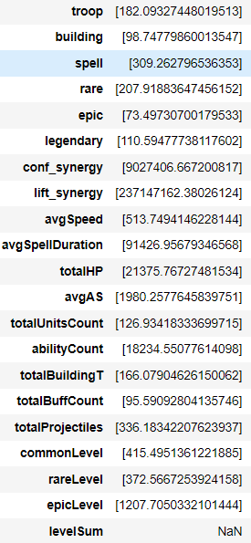
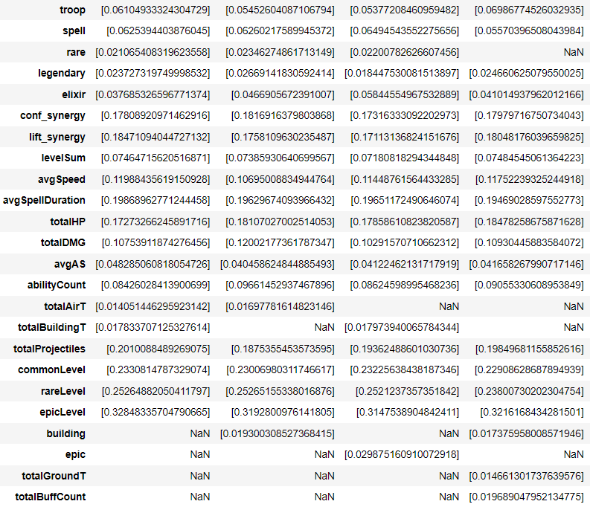
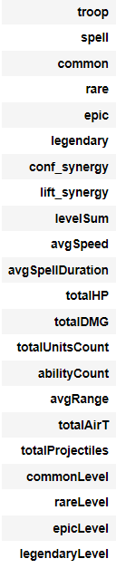
LEVELED ANALYSIS (3/3)
KBest + Chi^2 scores
KBest + Mutual Info scores
Variance Threshold selection

Slide 15
MODEL SELECTION AND FINAL CONSIDERATIONS
Selection: Since speed is not considered to be as important as in suggestions, the preference for model selection has been the accuracy, thus, selecting the Random Forest classifier for both levelled and unlevelled adding K-Best with mutual information attribute selector and k=15 for the levelled analysis.
Final Considerations
It’s noticeable that, from the analysis, all results are highly influenced by players’ skill, especially with the growth of the rank. In Fact in most of the cases players tend to follow the trend of higher level players copying their deck, resulting in few visible differences such as cards level and rarity of the owned cards indicating also the amount of time spent on the game with cards also having minimal properties’ differences for each level resulting in very near classes.
Other factor of interest is the high variance of each attribute causing a lot of sparsity in classes due to the possibility to buy cards and upgrades independently from the skill or rank of the players causing decks to be present in minor ranks as well as in the higher ones.

