Slide 2
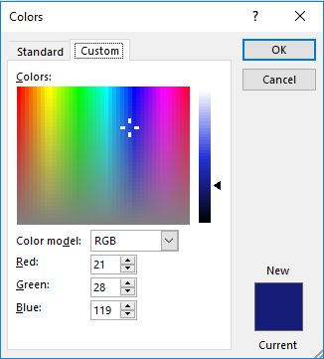
Title Slide Details
All slides will be in widescreen format (use this template to start new slide builds)
The title slide (see previous slide) should be in Arial, bold, 44 point and the standard blue
The AF standard blue is: Hue 167, Sat 179, Lum 70, Red 21, Green 28, and Blue 119
Aligned with the top of the AF symbol star should be
Rank, Name of briefer
Office symbol should be on the line below
Date the briefing is given
All will be black, bold, 20 point Arial, and right justified

Slide 3
Other Details
Slides should always be in narrative format and self-explanatory
Bullets and sub-bullets should not end in periods
An orphan is a single word on its own line
This sub-bullet is added here for the purpose of demonstrating what is meant by an orphan
Ensure slides do not have orphans
Limit abbreviations
Standardize dates (e.g. 11 Jul 19)
Page numbers should be displayed on all slides, after the Title slide, in the lower right-hand corner
Utilize this box for the slide’s main take-away

Slide 6

The Air Force’s Personnel Center

