Slide 1

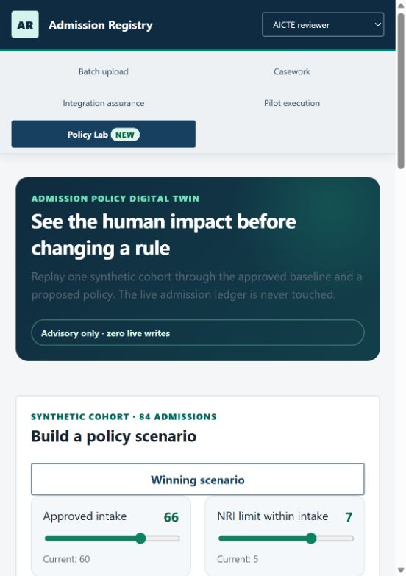
SMART INDIA HACKATHON 2026
ADMISSION REGISTRY
WORKING, TESTED, AUTHORITY-READY
Problem Statement ID 26263
APAAR ID-Based Student Data Management & Verification
Theme Smart Automation
Category Software
Team ID [TEAM ID]
Team Name [TEAM NAME]
Protect every legitimate seat before admission becomes an audit problem.

Slide 2
IDEA TITLE
[TEAM NAME]
FROM ANNUAL TOTALS TO A VERIFIABLE ADMISSION LEDGER
TODAY'S FAILURE CHAIN
1
Versioned upload
2
APAAR adapter
3
Policy decision
Fragmented files
Student identity gaps
Late intake reconciliation
Duplicate or excess enrolment discovered after the fact
4
Seat protected
5
Immutable receipt
6
AICTE oversight
THE DIFFERENCE
Last-seat concurrency protection • Every outcome has a rule code • Policy changes can be replayed before rollout
HERO FEATURE: ADMISSION POLICY DIGITAL TWIN

Slide 3
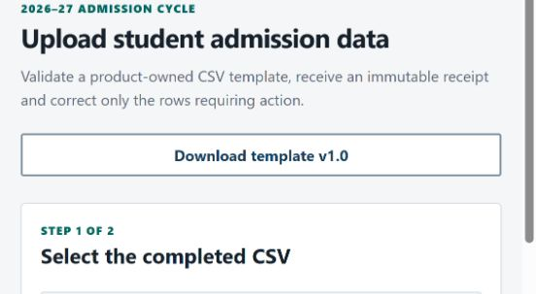
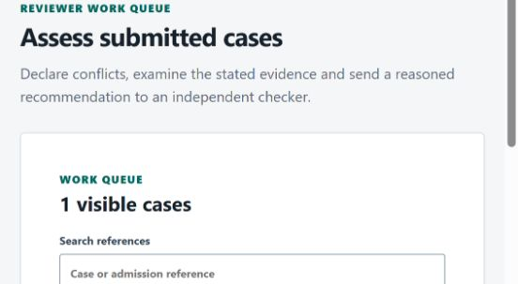
TECHNICAL APPROACH
[TEAM NAME]
ONE POLICY ENGINE. ONE TRANSACTION. ONE DEFENSIBLE RECORD.
7 ROLES
→
GATEWAY
→
DOMAIN
→
POSTGRESQL
→
ADAPTERS
Institution + AICTE
OIDC/RBAC boundary
Admission + batch + casework
Serializable seat lock
APAAR/SSO/signing
REAL POSTGRESQL CONCURRENCY
RESTART PERSISTENCE
7-ROLE ACCESS TESTING

Slide 4
FEASIBILITY AND VIABILITY
[TEAM NAME]
BUILT & TESTABLE NOW
AUTHORITY-CONTROLLED NEXT
Policy kernel + category capacity
Versioned CSV ingestion + correction
Transactional audit/outbox + idempotency
Governed casework + seven scoped roles
Containers, recovery, security and accessibility checks
Official APAAR/API Setu credentials
AICTE SSO, approval feed and signing service
Production hosting, keys, SLO/RTO/RPO
Privacy, legal and security approvals
Representative supervised pilot cohort
RISK → CONTROL
Policy ambiguity
→
Manual review; never invent authority
Provider outage
→
Explicit outage state + safe retry
Duplicate / final seat
→
Idempotency + serializable lock
Privacy leakage
→
Data minimisation + scoped audit

Slide 5
IMPACT AND BENEFITS
[TEAM NAME]
PREVENT HARM TODAY. IMPROVE POLICY BEFORE TOMORROW.
+9 policy-valid access
5 excess still blocked
Scenario evidence only — synthetic cohort, deterministic rules, zero live writes.
STUDENT
Explainable identity-linked record
INSTITUTION
Row correction + defensible receipt
AICTE
Intake integrity + policy foresight
VERIFIER
Purpose-limited audit trail

Slide 6
RESEARCH AND REFERENCES
[TEAM NAME]
AUTHORITATIVE RULES + EXECUTABLE PROOF
PRIMARY SOURCES
REPOSITORY EVIDENCE
1 AICTE Approval Process Handbook 2024–2027
aicte-india.org
2 APAAR About, Privacy Policy and Terms
apaar.education.gov.in
3 API Setu ABC / APAAR catalogue + consumer SOP
directory.apisetu.gov.in · apisetu.gov.in
4 SIH 2026 format and evaluation guidance
sih.gov.in
✓ Domain rule corpus + stable rule codes
✓ Real PostgreSQL migration/concurrency suites
✓ Batch, casework and integration contracts
✓ Full-system restart-persistence journey
✓ Seven-role accessibility checks
✓ Container, recovery, audit and secret scans
✓ SBOM and recursive licence inventory
✓ Synthetic identifiers only
JUDGE GUIDE + REPOSITORY QR WILL BE ADDED AFTER GITHUB URL IS SET

