Slide 1

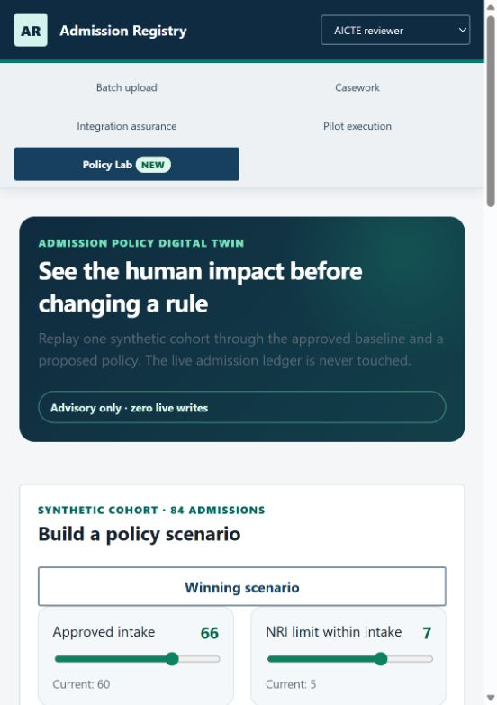
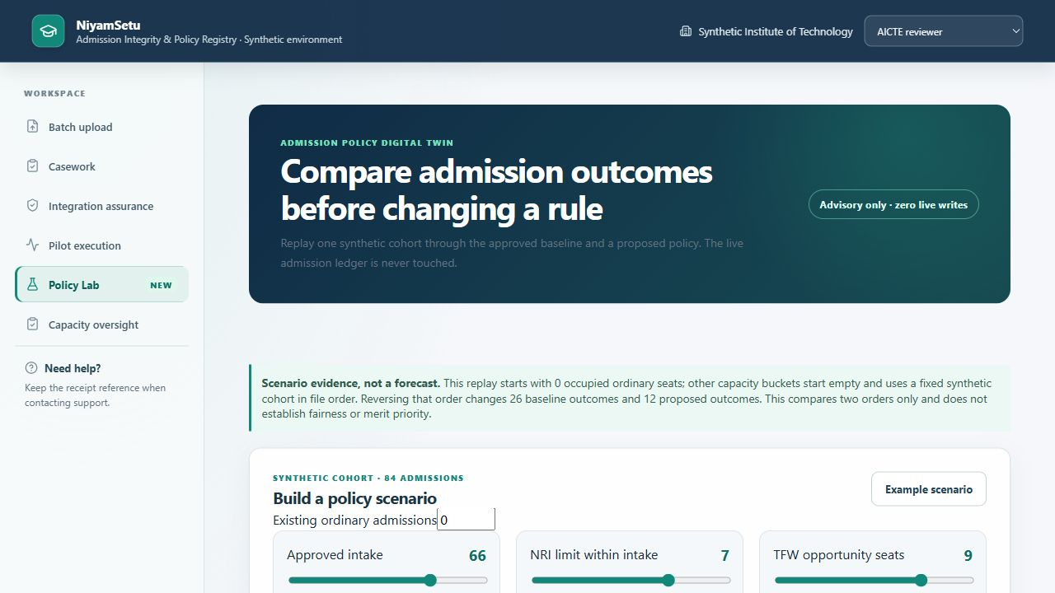
SMART INDIA HACKATHON 2026
NiyamSetu
Admission Integrity & Policy Registry
LOCALLY TESTED · SYNTHETIC RECORDS
Problem Statement 26263
Development of an APAAR ID-Based Student Data Management and Verification Platform for AICTE-Approved Institutions
Theme Smart Automation
Category Software
Team ASTRAL
Team ID Not yet assigned
Verify the record. Apply the rule. Protect the seat.

Slide 2
IDEA TITLE
ASTRAL
FROM ANNUAL TOTALS TO A VERIFIABLE ADMISSION LEDGER
TODAY'S FAILURE CHAIN
1
Versioned upload
2
APAAR adapter
3
Policy decision
Fragmented files
Student identity gaps
Late intake reconciliation
Duplicate or excess enrolment discovered after the fact
4
Seat protected
5
Immutable receipt
6
AICTE oversight
THE DIFFERENCE
Last-seat concurrency protection • Every outcome has a rule code • Policy changes can be replayed before rollout
HERO FEATURE: ADMISSION POLICY DIGITAL TWIN

Slide 3
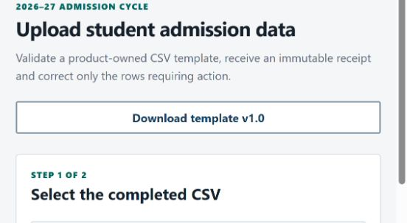
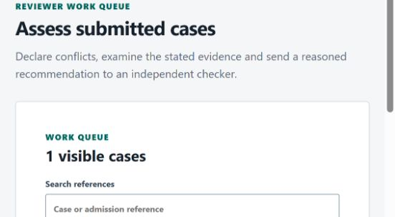
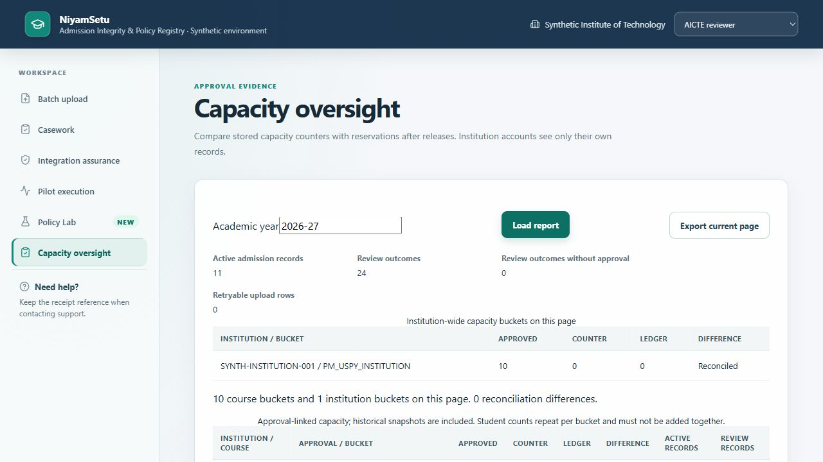
TECHNICAL APPROACH
ASTRAL
ONE POLICY ENGINE. ONE TRANSACTION. ONE DEFENSIBLE RECORD.
7 ROLES
→
GATEWAY
→
DOMAIN
→
POSTGRESQL
→
ADAPTERS
Institution + AICTE
OIDC/RBAC boundary
Admission + batch + casework
Serializable seat lock
APAAR/SSO/signing
REAL POSTGRESQL CONCURRENCY
RESTART PERSISTENCE
7-ROLE ACCESS TESTING

Slide 4
FEASIBILITY AND VIABILITY
ASTRAL
BUILT & TESTABLE NOW
NEXT VALIDATION AND INTEGRATION
Versioned upload and correction
Student conflict checks + seat transactions
Stored grant scope + atomic withdrawal
Independent Ed25519 receipt signing
Capacity reconciliation + restart evidence
Official APAAR, SSO and approval feeds
Real institution onboarding and user study
Production key custody and operational SLOs
Privacy and security review
Representative supervised pilot
RISK → CONTROL
Policy ambiguity
→
Manual review; never invent authority
Provider outage
→
Explicit outage state + safe retry
Duplicate / final seat
→
Identity conflict gate + seat transaction
Privacy leakage
→
Scoped grants + withdrawal + audit

Slide 5
IMPACT AND BENEFITS
ASTRAL
SCENARIO COMPARISON + MEASURED LOCAL SAFETY
+9 acceptances in this example
5 capacity rejections
Synthetic example: 84 records, zero occupied seats. Local PostgreSQL test: 40 students for 1 seat per run, at concurrency 1/2/4. No over-allocation observed.
STUDENT
Explainable identity-linked record
INSTITUTION
Row correction + defensible receipt
AICTE
Intake integrity + policy foresight
VERIFIER
Purpose-limited audit trail

Slide 6
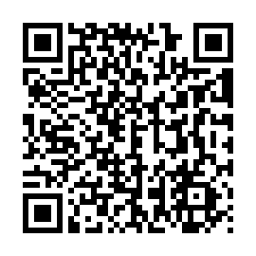
RESEARCH AND REFERENCES
ASTRAL
AUTHORITATIVE RULES + EXECUTABLE PROOF
PRIMARY SOURCES
REPOSITORY EVIDENCE
AICTE Approval Process Handbook 2024–2027
aicte-india.org
APAAR identity and API Setu documentation
apaar.education.gov.in · apisetu.gov.in
Public enrolment / PGDM workflow manuals
Current operator study: not yet conducted
Sourced rules + stable explanation codes
Fresh-key duplicates and overlap review
Grant scope and withdrawal concurrency
Public-key verification after restart
Capacity ledger/counter reconciliation
Pinned PostgreSQL contention evidence
Operator study prepared, not conducted
github.com/dglalithchandra/apaar-admission-platform

