Slide 1
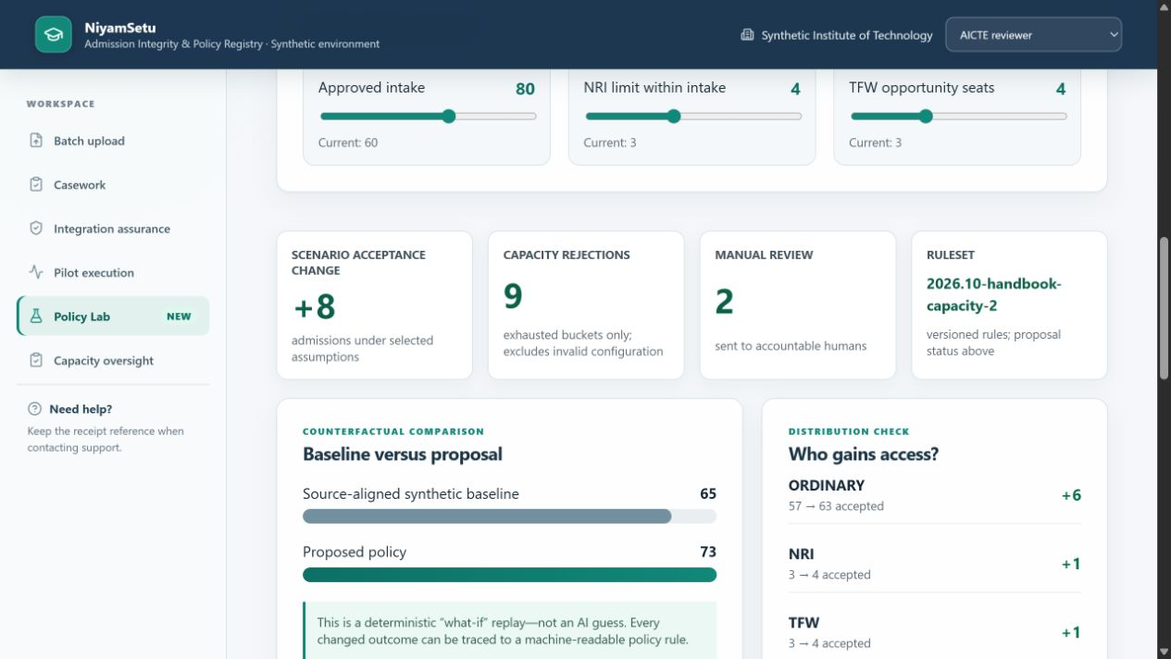
SMART INDIA HACKATHON 2026
NiyamSetu
Admission Integrity & Policy Registry
LOCALLY TESTED · SYNTHETIC RECORDS
Problem Statement 26263
Development of an APAAR ID-Based Student Data Management and Verification Platform for AICTE-Approved Institutions
Theme Smart Automation
Category Software
Team ASTRAL
Team ID Not yet assigned
Verify the record. Apply the rule. Protect the seat.
Notes:
Handbook reconciliation: source AICTE Approval Process Handbook 2024–27, https://www.aicte.gov.in/sites/default/files/APH%20Final.pdf, PDF pp. 34–35, 70–71, 75–76. Ruleset 2026.10-handbook-capacity-2. Baseline 60/3/3 and candidate 80/4/4, same 84 synthetic records and zero occupancy: 65 and 73 accepted. Category checks are synthetic fixture assessments, not external verification. Candidate remains unapproved. Full input record is available in Policy Lab; no ledger writes. See ADR-0024.

Slide 2
IDEA TITLE
ASTRAL
FROM ANNUAL TOTALS TO A VERIFIABLE ADMISSION LEDGER
TODAY'S FAILURE CHAIN
1
Versioned upload
2
APAAR adapter
3
Policy decision
Fragmented files
Student identity gaps
Late intake reconciliation
Duplicate or excess enrolment discovered after the fact
4
Seat protected
5
Immutable receipt
6
AICTE oversight
THE DIFFERENCE
Last-seat concurrency protection • Every outcome has a rule code • Policy changes can be replayed before rollout
HERO FEATURE: ADMISSION POLICY DIGITAL TWIN
Notes:
Handbook reconciliation: source AICTE Approval Process Handbook 2024–27, https://www.aicte.gov.in/sites/default/files/APH%20Final.pdf, PDF pp. 34–35, 70–71, 75–76. Ruleset 2026.10-handbook-capacity-2. Baseline 60/3/3 and candidate 80/4/4, same 84 synthetic records and zero occupancy: 65 and 73 accepted. Category checks are synthetic fixture assessments, not external verification. Candidate remains unapproved. Full input record is available in Policy Lab; no ledger writes. See ADR-0024.

Slide 3
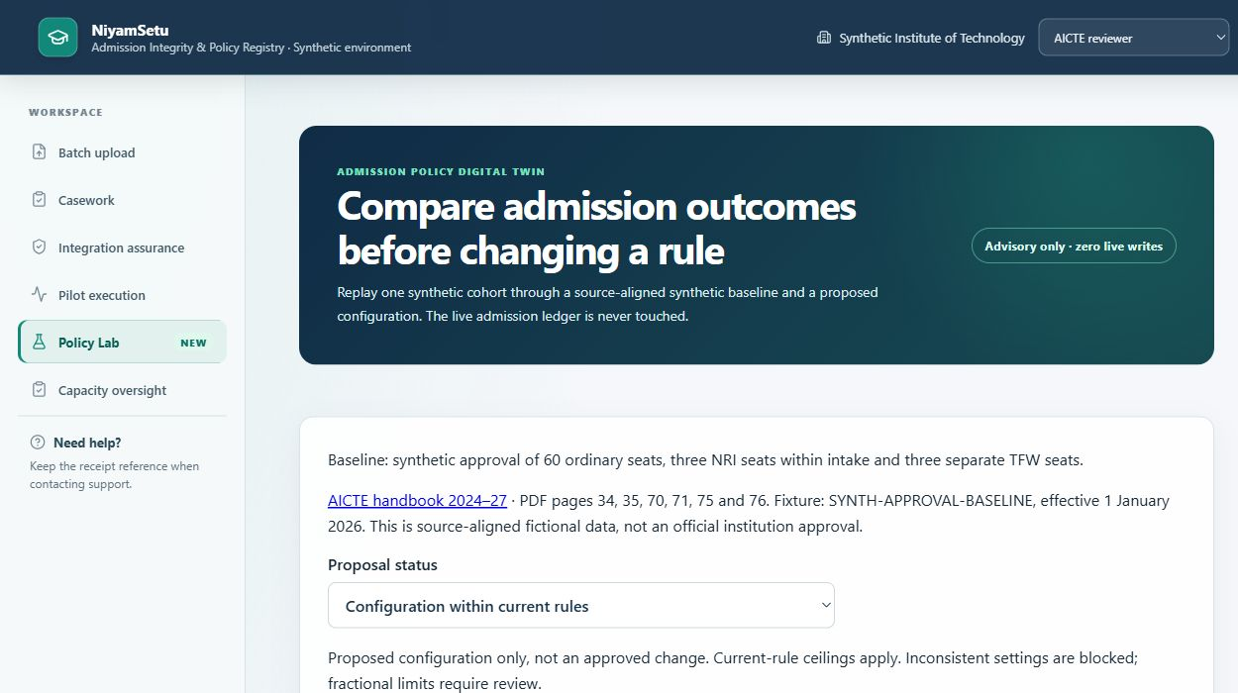
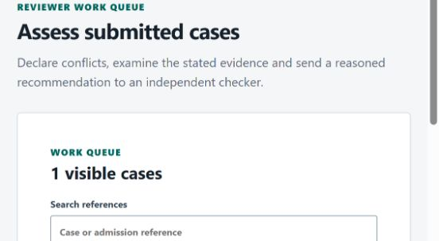
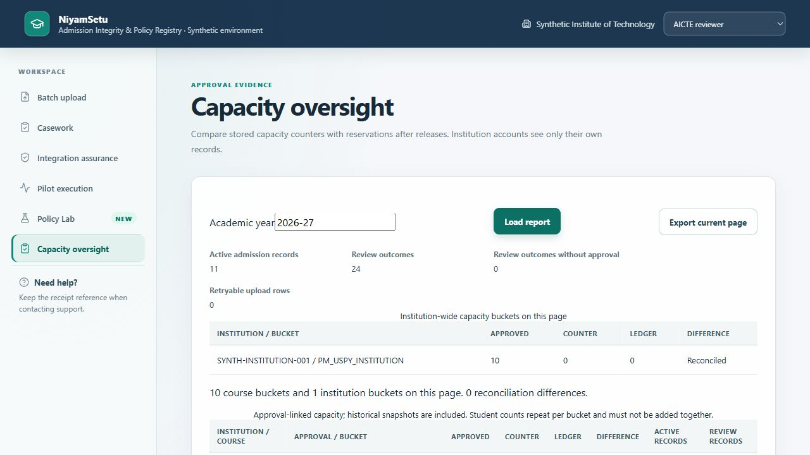
TECHNICAL APPROACH
ASTRAL
ONE POLICY ENGINE. ONE TRANSACTION. ONE DEFENSIBLE RECORD.
7 ROLES
→
GATEWAY
→
DOMAIN
→
POSTGRESQL
→
ADAPTERS
Institution + AICTE
OIDC/RBAC boundary
Admission + batch + casework
Serializable seat lock
APAAR/SSO/signing
REAL POSTGRESQL CONCURRENCY
RESTART PERSISTENCE
7-ROLE ACCESS TESTING
Notes:
Handbook reconciliation: source AICTE Approval Process Handbook 2024–27, https://www.aicte.gov.in/sites/default/files/APH%20Final.pdf, PDF pp. 34–35, 70–71, 75–76. Ruleset 2026.10-handbook-capacity-2. Baseline 60/3/3 and candidate 80/4/4, same 84 synthetic records and zero occupancy: 65 and 73 accepted. Category checks are synthetic fixture assessments, not external verification. Candidate remains unapproved. Full input record is available in Policy Lab; no ledger writes. See ADR-0024.

Slide 4
FEASIBILITY AND VIABILITY
ASTRAL
BUILT & TESTABLE NOW
NEXT VALIDATION AND INTEGRATION
Versioned upload and correction
Student conflict checks + seat transactions
Stored grant scope + atomic withdrawal
Independent Ed25519 receipt signing
Capacity reconciliation + restart evidence
Official APAAR, SSO and approval feeds
Real institution onboarding and user study
Production key custody and operational SLOs
Privacy and security review
Representative supervised pilot
RISK → CONTROL
Policy ambiguity
→
Manual review; never invent authority
Provider outage
→
Explicit outage state + safe retry
Duplicate / final seat
→
Identity conflict gate + seat transaction
Privacy leakage
→
Scoped grants + withdrawal + audit
Notes:
Handbook reconciliation: source AICTE Approval Process Handbook 2024–27, https://www.aicte.gov.in/sites/default/files/APH%20Final.pdf, PDF pp. 34–35, 70–71, 75–76. Ruleset 2026.10-handbook-capacity-2. Baseline 60/3/3 and candidate 80/4/4, same 84 synthetic records and zero occupancy: 65 and 73 accepted. Category checks are synthetic fixture assessments, not external verification. Candidate remains unapproved. Full input record is available in Policy Lab; no ledger writes. See ADR-0024.

Slide 5
IMPACT AND BENEFITS
ASTRAL
SCENARIO COMPARISON + MEASURED LOCAL SAFETY
+8 scenario acceptances
9 capacity rejections
84 synthetic records; zero occupied seats. Baseline: 60 intake / 3 NRI / 3 TFW. Proposal: 80 / 4 / 4 under current rules. Proposed, not officially approved.
STUDENT
Explainable identity-linked record
INSTITUTION
Row correction + defensible receipt
AICTE
Intake integrity + policy foresight
VERIFIER
Purpose-limited audit trail
Notes:
Handbook reconciliation: source AICTE Approval Process Handbook 2024–27, https://www.aicte.gov.in/sites/default/files/APH%20Final.pdf, PDF pp. 34–35, 70–71, 75–76. Ruleset 2026.10-handbook-capacity-2. Baseline 60/3/3 and candidate 80/4/4, same 84 synthetic records and zero occupancy: 65 and 73 accepted. Category checks are synthetic fixture assessments, not external verification. Candidate remains unapproved. Full input record is available in Policy Lab; no ledger writes. See ADR-0024.

Slide 6

RESEARCH AND REFERENCES
ASTRAL
AUTHORITATIVE RULES + EXECUTABLE PROOF
PRIMARY SOURCES
REPOSITORY EVIDENCE
AICTE Approval Process Handbook 2024–2027
aicte-india.org
APAAR identity and API Setu documentation
apaar.education.gov.in · apisetu.gov.in
Public enrolment / PGDM workflow manuals
Current operator study: not yet conducted
Sourced rules + stable explanation codes
Fresh-key duplicates and overlap review
Grant scope and withdrawal concurrency
Public-key verification after restart
Capacity ledger/counter reconciliation
Pinned PostgreSQL contention evidence
Operator study prepared, not conducted
github.com/dglalithchandra/apaar-admission-platform
Notes:
Handbook reconciliation: source AICTE Approval Process Handbook 2024–27, https://www.aicte.gov.in/sites/default/files/APH%20Final.pdf, PDF pp. 34–35, 70–71, 75–76. Ruleset 2026.10-handbook-capacity-2. Baseline 60/3/3 and candidate 80/4/4, same 84 synthetic records and zero occupancy: 65 and 73 accepted. Category checks are synthetic fixture assessments, not external verification. Candidate remains unapproved. Full input record is available in Policy Lab; no ledger writes. See ADR-0024.

