Slide 1
Lecture 16
Digital Video !

Slide 2
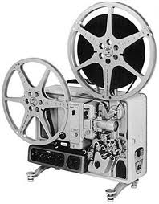
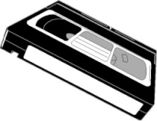





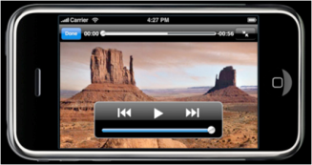
Digital Video
Introduction
Video Timeline
MPEG
‘60’s-70’s
’70’s-80’s
‘90’s- 2000’
2003
2005
2009
2011
Improved Accessibility
Increased Technical Complexity

Slide 3
Film vs. Video
Film captures motion at 24 frames (Images) per second
Video typically operates at 30 frames per second
Video inherits many of its characteristics from broadcast television, developed in the 1930’s – 40’s

Slide 4
Video Starts off as Analog Information
Just as in Imaging, the original information contained in video is analog by nature
  Intensity
  Color
  Speed / Motion (30 Frames per Second)
Digital technology allows us to convert it to bits, store it and manipulate it much easier than its analog counterpart

Slide 5
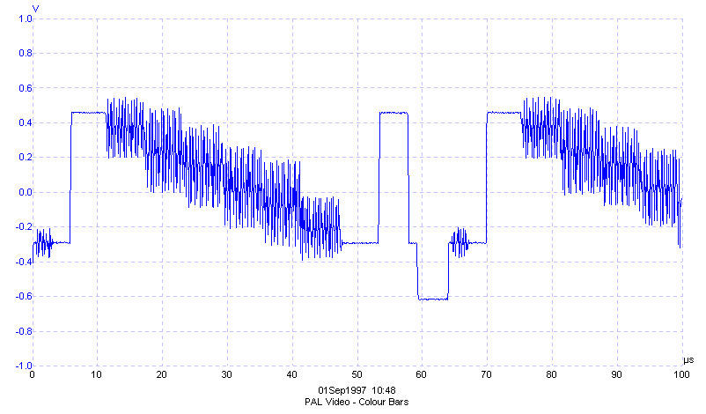
Example PAL video waveforms captured using an ADC-200/50

Slide 6
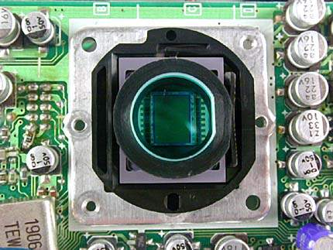
The Cmos Video Imager
CCD
500,000 to 20,000,000 Pixels

Slide 7
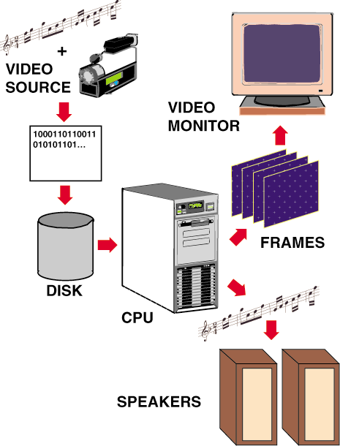
Producing Digital Video
Video capture
Editing
Playback
Notes:
2

Slide 8
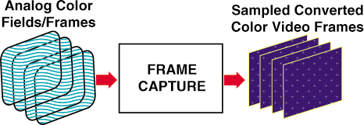
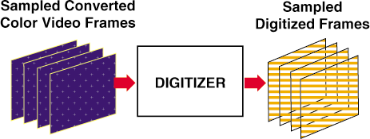
Converting the Video Frame to Bits
Think of Video Frames as individual Images, stacked front to back
110001100011111100000011100001100000011111000000000001111111111000000000

Slide 9
DVD – Digital Versatile Disk
Up to 133 minutes of medium resolution video, with 720 dots of horizontal resolution X 480 dots of vertical resolution (The video compression ratio is typically 40:1 using MPEG-2 compression.)
Soundtrack presented in up to eight languages using 5.1 channel Dolby digital surround sound
4.7Gb of storage total per disk

Slide 10
Blu-Ray High Definition DVD
10 times the capacity of std DVD
Higher resolution:
  Up to 1920X1080 dots of resolution
Up to 50GB of storage!
Uses a blue laser as opposed to a red one (shorter wavelength)
The current high def standard

Slide 11
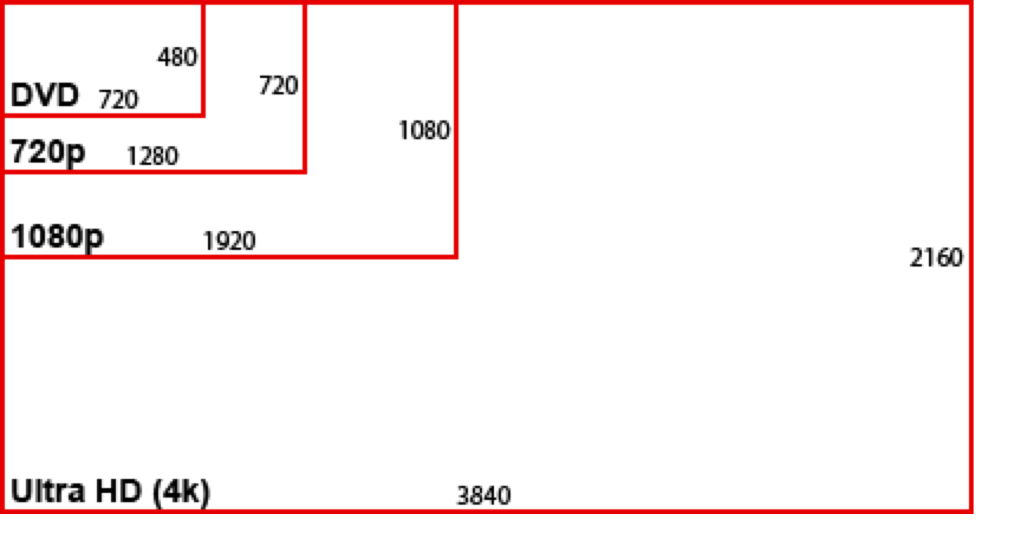
Video Aspect Ratios

Slide 12
Advantages and Disadvantages of Digital Video
Advantages
  Scalable to different playback systems
  Random access to frames
  Easy to Edit
  More playback options
  Potential for interactivity
Disadvantages
  High playback and storage requirements
    ( Who Cares!!)
Notes:
3

Slide 13
But, there is soooo much data!
If we didn’t have a way to efficiently compress all of the information in the video frames, we would quickly run out of cost effective storage capacity for consumer applications.
Thus the need for
Compression/Decompression

Slide 14
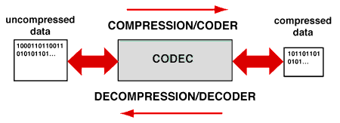
Digital Compression Concepts
Compression techniques are used to replace a file with another that is smaller
Decompression techniques expands the compressed file to recover the original data -- either exactly or in facsimile
A pair of compression/decompression techniques that work together is called a codec for short
Notes:
2

Slide 15
Redundancy
Data compression is possible because most messages (images, etc.) are redundant, and they can theoretically be reconstructed from a smaller set of bits.

Slide 16
Types of Data Compression
We can divide up data-compression techniques in many different ways:
Lossy as opposed to lossless compression
Syntactic as opposed to semantic compression.

Slide 17
Assumptions
One way to look at data compression techniques is to ask what fact about the world they assume.
Syntactic techniques make very broad assumptions, semantic techniques can depend on very specific ones.

Slide 18
Run Length Encoding (RLE)
Achieves modest savings with a Syntactic method
Based on the assumption that redundancy is is present in certain repetitions of ASCII characters or numbers
ABBCCDDDDDDDDDEEFGGGGG becomes
ABBCCD#9EEFG#5

Slide 19
Huffman Coding
One of the most basic lossless syntactic techniques is Huffman coding.
It assumes that some portions of a file (or image) will be more common than other portions.
It then uses variable length coding to code common things in fewer bits than less common things.

Slide 20
An Example of Huffman Encoding
1
0
0
0
1
0
0
1
1
e
a
1
blank
i
o
t
u
h
the = 01111001000

Slide 21
Ziv Lempel (Welsh) Coding
Ziv Lempel coding assumes that sequences that occurred earlier in the message are likely to occur again, and we can save space by “remembering” them.
Every time we encounter a sequence that occurred earlier, we simply note the position and length of the sequence.
This is also a lossless compression.

Slide 22
Image Compression
The basic assumption of image compression is that pixel intensity values do not change much between neighboring pixels.
So record, say, the center pixel, and work out in a spiral. For each new pixel, just record the difference between it and the previous one.

Slide 23
JPEG
JPEG is set of lossy image compression standards.
JPEG combines a lossy scheme much like the one we just described, and then further compresses the data using a lossless scheme. If we have a long string of 0’s (no change) this could be represented by a pointer back to a previous such string or the use of Run Length Encoding
JPEG results in some loss of detail due to averaging as well as slight discoloration

Slide 24
Video Compression:
Coping with Large Files
Video Compression is an encoding process that filters the original file in several successive stages
Without powerful compression we would NOT be able to produce CDs, DVDs, or Video Downloads over the Internet
Notes:
4

Slide 25
Types of Codecs
Codecs that upon decompression always reproduce the original file exactly are called lossless codecs
Codecs that reproduce only an approximation of the original file upon decompression are called lossy codecs
Codecs that take approximately the same amount of time to compress and decompress a file are referred to as symmetric codecs
By contrast, codecs that feature simple fast decompression but significantly slower compression are called asymmetric codecs
Notes:
3

Slide 26
Codec Methods
Syntactic encoding methods attempt to reduce the redundancy of symbolic patterns in a file without any regard to the type of information represented
Semantic methods consider special properties of the type of information represented to reduce nonessential information in a file
Hybrid methods combine both syntactic and semantic methods
Notes:
5

Slide 27
Compressing Video
Video compression employs both spatial and temporal compression techniques
  spatial techniques compress individual frames
  temporal methods compress data in frames over time
QuickTime and AVI (Audio Video Interleaved) are two popular (and incompatible with each other) compression formats used on PCs
Notes:
8

Slide 28
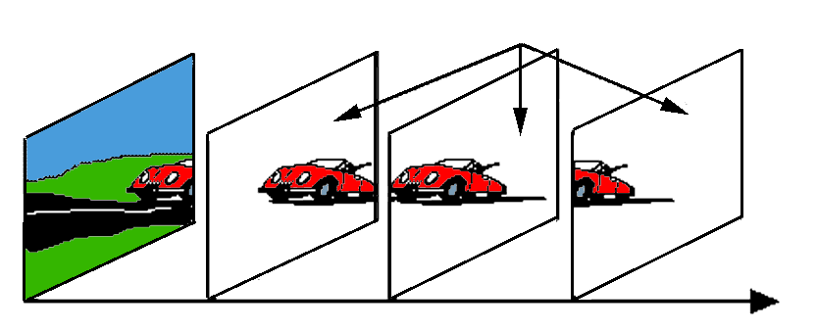
Temporal Compression in Video
Lossy strategies for eliminating redundancy of information between frames employ temporal compression -- referred to as interframe compression
Sequence of frames are considered together
  key frames
  difference frames
Notes:
10

Slide 29
Other Brute Force Methods for Reducing Demands
Frame rate adjustment
  slow it from 30 to 24 fps
Lower resolution on individual frames
  sometimes hard to notice by average viewer
Notes:
5

Slide 30
MPEG 2- The Mother of all Video Compression!….so far
Uses : Temporal and Spatial Redundancy
Basically it predicts what subsequent frames of video are going to be based on previous and future frames
It encodes that knowledge such that only one out of 12 frames has a complete set of digital binary information….the others have a combo of binary and vector information
40:1 Compression Ratio…..makes DVDs possible

Slide 31

Millionaire!!!!

Slide 32
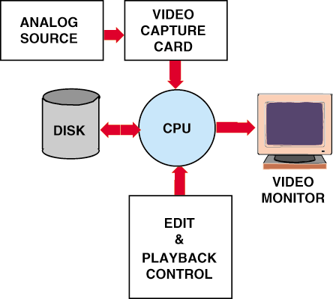
The Desktop Video System
Basic Components
Analog Source
Video Capture Card
CPU
Secondary Storage
Monitor
Edit and Playback Control
Notes:
6

Slide 33
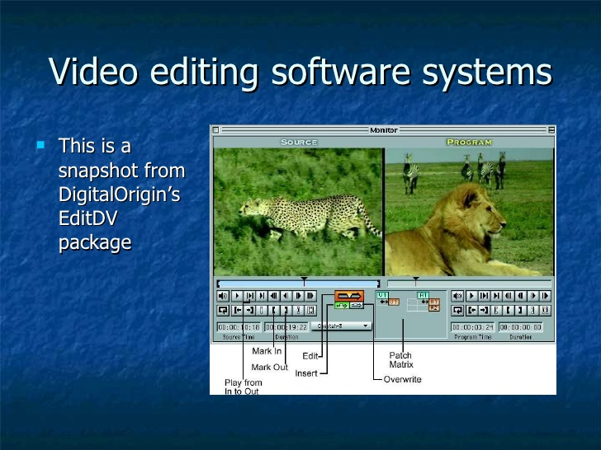

Slide 34
Editing Digital Video
Clip Logging
Assembling
Transitions
  dissolves
  wipes, etc.
Rotoscoping
  Frame Editing (Digital Effects)
Compositing
  keying
  titling
Notes:
9

Slide 35

Compositing…..First we have a Mountain

Slide 36
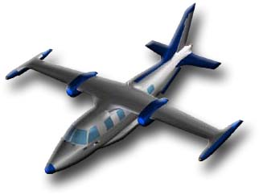
Plane

Slide 37

Mountain and Plane…..Together !!

Slide 38
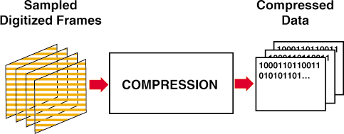
Digital Video
The Entire Process Illustrated
Notes:
8

Slide 39
Video Resolution
Standard definition video was typically delivered at 440 X 320 or 720 X 480 depending upon whether it was broadcasted, stored on VHS videotape or standard DVD
High definition video is delivered at:
1280 × 720 pixels
Or 1920 × 1080 pixels
3-5 fold increase in pixel resolution…lot’s more data…
How is it possible that we can afford to transmit this over cable, satellite and over the air given this drastic increase in resolution

Slide 40
Digital Cinema
Has replaced traditional film in all major movie theatres
Movies are shipped in encrypted memory packs or downloaded to the theatres
Ensures that every viewing is at the same level of quality
Prevents counterfeiting

Slide 41
So What does Digital Video make possible?
Anyone can produce, direct, shoot, edit and publish a hi-def video
Portability
Self publishing over the net
Video on Demand
  Downloading
  Streaming
  Purchasing
And it gets cheaper every day!

Slide 42
Summary
Digital video is:
  scalable
  allows unlimited editing
  has interactive potential
Digital video can be produced with desktop systems
Flexible editing and playback options are major advantages
Storage requirement is biggest challenge
  But, Remember Moore’s Law !!

Slide 43
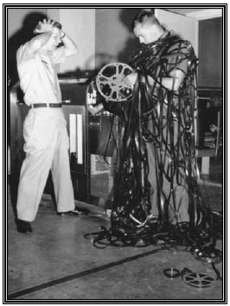
Do Not Try This Unsupervised
Don’t Be Afraid of the Technology
Take the Plunge!

Slide 44




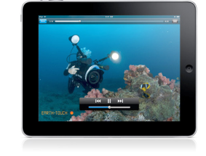
Digital Video 101
Digital Video Workflow
Step 1:
Produce a Great Video
Step 2:
Encode Files
Step 3:
Store
Files
Step 4:
Deliver a Great Video to Any Device

Slide 45
Questions?

