Slide 1
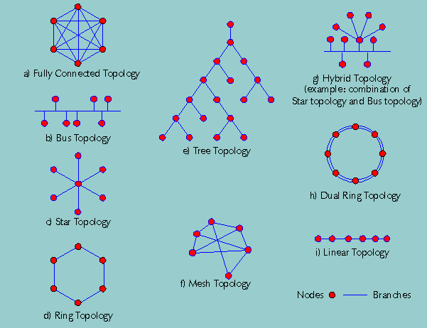
Data Network Basics

Slide 2
What is a Data Communications Network?
It is an infrastructure that contains connection nodes and transmission pathways which allow the reliable exchange of data between connected parties

Slide 3
Underlying Trends in Networks Today
The industry has evolved from a multitude of proprietary standards to the wholesale adoption of widely accepted standards
This has resulted in the ability of practically anyone to connect to the large public networks available without having to engage in special engineering
It has dramatically reduced the overall cost of deploying and operating networks

Slide 4
Shannon’s Data Communciation Model -- Six Components
An information source generates a message
A transmitter encodes the message as a signal
The signal is transmitted over a communications channel -- a medium that bridges the distance between the transmitter and the receiver
A source of noise is usually present in the communication channel -- this is a random element that modifies the encoded signal in unpredictable ways
The receiver extracts a signal from the communications channel and converts it back into the form of a message
The destination receives the message

Slide 5
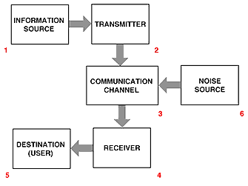
Shannon’s Model Illustrated
The six components of a data communications system:

Slide 6
Transmitting and Receiving using Modems
In data communications, data may be transmitted as either analog or digital (discrete) signals
Analog signals are composed of waves
  repeating waveforms are modulated (altered) to encode information
Digital data must be translated into modulated analog signals for transmission and the signal must be translated back into digital data at the receiver
Special devices called modems (modulate/demodulate) are used to perform these translations

Slide 7
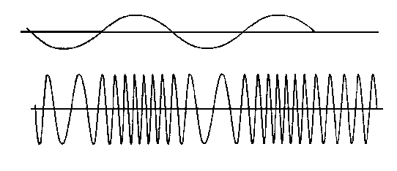
Modem Functionality
MODEM
1001
MODM
MODEM
1001

Slide 8
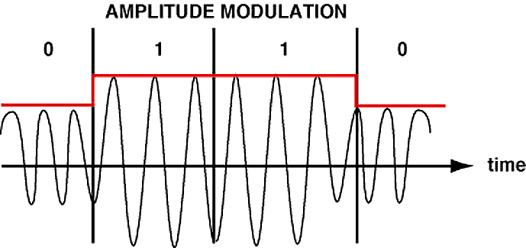
Translating Digital Data using amplitude modulation

Slide 9
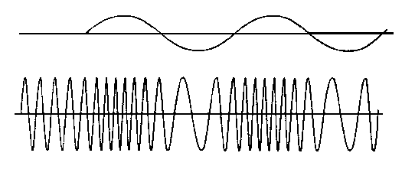
Frequency Modulation
Copyright Gr Knott 1999
0 0 0 0 1 1 1 1 1 space 0 1 1 1 1 10 space
The diagram shows how the carrier varies in frequency corresponding to the data being transmitted

Slide 10
Noise
In the transmission of information errors are thought of as noise.
The term comes from the days of radio, where the transmission errors literally resulted in a noisy radio broadcast.
Noise is viewed as a (typically) random process.

Slide 11
Error Detection
A very simple error detection mechanism is the checksum.
Each byte of information (thought it could be a larger size) has included in it a checksum bit. This is 1 if the number of ones in the rest of the byte is odd (or even, depending on the convention)
Checksum
1 0 0 1 0 1 1 0

Slide 12
Encoding Information
We encode analog information into digital for four reasons:
We need to represent it somehow in binary
We may need to compress the message size.
We may need to protect privacy and security.
We may need to detect (and possibly correct) error caused by noise

Slide 13
Channel Properties
Bandwidth - how much information can travel through it in a given amount of time. We often measure this in megahertz, but more intuitively we use bits/second.
Latency, how long does it take to get from one end to another.
Signal to noise ratio (SNR). The ratio of signal to noise expressed in decibels

Slide 14
Properties of Networks
Distance (geographical size)
Media (what carries the messages)
Signal (how is the information passed through the media).
Switching (handling many users )
Topology (the physical configuration of the network)

Slide 15
Distance
A local area network (or LAN) is typically confined to a single organization spread over a distance that can be easily walked.
A wide area network (or WAN) is typically serving multiple entities, and is spread much farther.
An internet is a network that includes multiple LANs and WANs

Slide 16
Media
We distinguish between bounded media (Often called Terrestrial) and wireless media..
Typical bounded media include
Twisted pair wire (about 10 megabits/sec)
Coaxial cable (about 50 megabits/sec)
FiberOptics (about 10 gigabit/sec)
Wireless media include:
Radio
Infared
Laser

Slide 17
Switching
One needs to switch between the messages of various users. Two basic method types:
Circuit switching - a connection is established between users until the message is complete. Your voice telephone works on this principle
Packet switching - messages are broken up into packets and multiple messages and packets are being carried at the same time over different paths

Slide 18
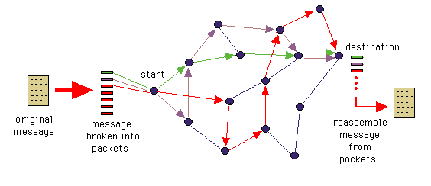
Packet Switching Example

Slide 19
Millionaire Quiz Show!

Slide 20
Local and Wide Area Networks

Slide 21
Uses of LANs
Wide-area networks are primarily used for communication. Local-area networks are also used for communication as well as resource sharing, including:
Printers
Computing and Web servers
File servers

Slide 22
LAN Topology
The topology of a LAN is the way the computers are connected together. There are several common configurations:
Star
Bus
Ring

Slide 23
Network Topologies

Slide 24
Ethernet Switching
Ethernets use bus or ring topologies.
To send a message, wait for an idle moment and send it.
All machines constantly listen to the net for messages addressed to them.
If someone else picks the same moment to send we have packet collision.

Slide 25
Packet Collision
Should packet collision occurs, both parties must re-send.
But they must choose the moment randomly, or else they will re-collide.
Packet collision limits the number of messages that can be send on ethernet LANs and determines the variable latency experienced by the users

Slide 26
Ethernet Bus
Router
Server
100 Mbps
Clients

Slide 27
Complicated LANs
LANs tend to grow. The Brown computer science LAN now has about 250 machines attached to it.
To handle this sort of traffic (and reduce the number of collisions) the LAN has been broken up into several sub-LANs.
Sub-LANs can be connected by switches and routers.

Slide 28
Switches and Routers
Both bridges and routers allow messages to pass between one sub-LAN and another.
A bridge simply notes if the recipient of the message is in the other LAN, and if so, allows the message to cross over.
A router is used when there is more than one way to route the messag and must be used to access the internet WAN

Slide 29
Interconnected Lans
Server
Router
Internet
switch
Server
Router
Clients
(PCs)

Slide 30
Symmetry
Symmetric Networks are those where the data in both directions is more or less the same.
Asymmetric networks are characterized by a large difference between data in one direction vs. the other……Web Traffic, File Transfers(FTPs), etc.

Slide 31
LANs and WANs
Lan- Local Area network…a network with a limited geography such as the Brown campus
Wan – Wide Area network….a network with no geographical limit…often interconnected with Lans – such as IBM’s global network (Intranet) or the public Internet

Slide 32
Intranets
An Intranet is a closed network that has group of defined users
  (Intra-organizational)
Intranets exist for businesses, universities, trade organizations, etc.
Most Intranets are also connected to the Internet

Slide 33
Network Nodes
Nodes are a location on a network where there is an aggregation of connections
Internet nodes are also those places where many smaller networks are actually connected to the Internet

Slide 34
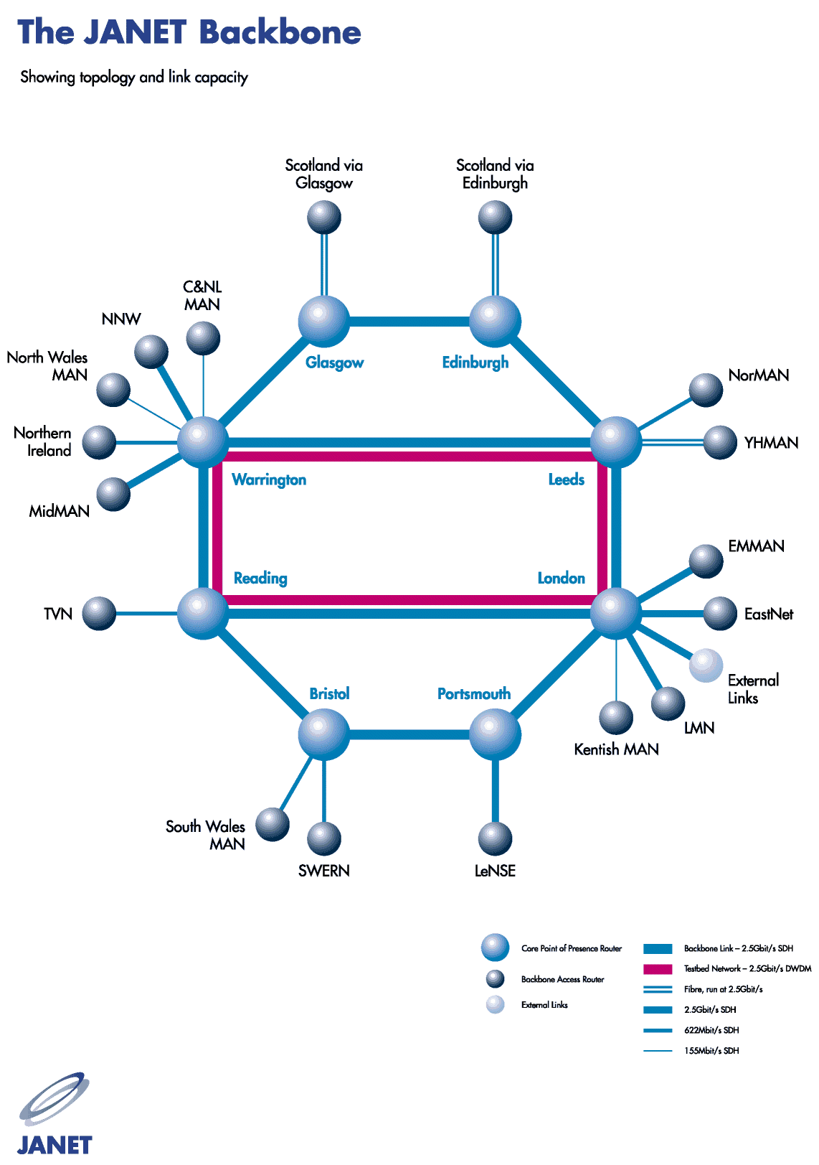

Slide 35
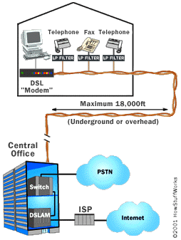
Digital Subscriber Loop - DSL
Allows high speed data to share the same wires as regular voice telephone service.
Developed for consumer internet access as an alternative to dialup

Slide 36
Voice and Video over IP (VOIP)
VoIP is a technology that allows telephone calls to be made over computer networks like the Internet. VoIP converts analog voice signals into digital data packets and supports real-time, two-way transmission of conversations using the Internet Protocol (IP)
Skype, Vonage, Ooma, Facetime etc:

Slide 37
Wireless Media
Infrared is good between fixed locations. It is also not bothered by noise.
Lasers are also excellent point to point systems with limited range
Radio frequency networks are more flexible and allow the participants to be mobile and move while they communicate

Slide 38
Wireless Networks
Radio data networks are the fastest growing type of network technology today.
This model is much like the terrestrial LANs we know and love except that it is total portable and works without cables and wall jacks!

Slide 39
Some Common types of Data Wireless
WiFi (802.11b/g) High speed wireless with range up to 200 feet or so. Speeds up to 54mbps
BlueTooth – Personal Area Network with range of up to 30 feet
GPRS/3G/4G – Wide area data network used in conjunction with cellular telephone services
WiMax – Emerging technology which provides long distance (up to 30 miles) functionality of WiFi
VSAT – Small antenna satellite technology used for high speed data communication over very large distances

Slide 40
Mobile Wireless Networks aka…Cell Phones
Originally invented by Motorola in cooperation with AT&T in early 1970’s
Huge increase in usage as a result of the rapid adoption of cellphones worldwide (> 2.0 Billion subscribers and growing at double digit rates)
Two dominant cellphone technologies
  GSM (Global system for mobile communications) (80%)
  CDMA (Code Division Multiple Access) (20%)
Both technologies incorporate data along with voice and messaging
The cellphone system would not be possible without very sophisticated computing systems to enable it

Slide 41

The Original Cellphone –
Motorola Dynatac 8000X
Cost $100 Million to Develop
First phones cost over $4K !!
½ hour talk time
10 Hours to charge
Weighed almost 4 pounds

Slide 42
Cell phone history trivia
In 1978 AT&T commissioned Mackenzie research to project the market for cell phones in the U.S.
Mackenzie estimated that the total market by the year 2000 would be 1 million units
Today there are over 200 million cellphone subscribers in the U.S. alone and still growing
Mackenzie’s research did not anticipate the precipitous drop in handset cost which would make cell phones popular with consumers as opposed to businesses alone

Slide 43
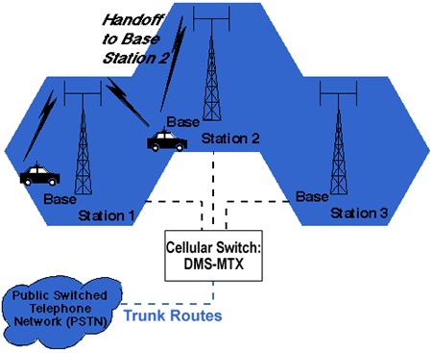
Cell phone topology

Slide 44

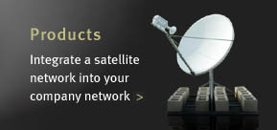
Satellite VSATs
Satellite in Geo Stationary orbit
VSAT dish <1 meter diameter

Slide 45
Questions??

