Slide 1
Artificial Intelligence
Computers that think?

Slide 2
What is AI?
It is the science and engineering of making intelligent machines, especially intelligent computer programs.
Artificial Intelligence is the study of the computations that make it possible to perceive, reason and act.

Slide 3
Artificial Intelligence
Artificial intelligence is concerned with understanding the nature of intelligence through the creation of computer programs which control machines.
It is normally divided up into various sub-disciplines such as vision, language, planning, motion, etc.

Slide 4
Artificial Intelligence
Artificial Intelligence becomes a formal branch of Computer Science around 1956
AI has its own computer programming languages LISP, which developed in 1957, is STILL in use today, along with others
Every major computer technology company has a considerable investment in AI research

Slide 5
The Mind-Body Problem
The major philosophical issue related to AI in computer science is the mind-body problem -- how the mind relates to the body as espoused by Rene Descartes

Slide 6
Mental Life
People (and presumably some animals) have a mental life.
Consider the question “what would it be like to be a bat?”
Mental life is made up of sensations (color, pain, smells, touch,etc.), emotions and thoughts etc.

Slide 7
The Mind Body Paradox
1 - Bodies are physical.
2 - Minds are not physical.
3 - Minds and bodies interact.
4 - The physical and non-physical can't interact.
Any three of this propositions are compatible but all four together are not….

Slide 8
Cartesian Dualism
Cartesian dualism as espoused by Rene Descartes claims that mental activity is governed by different laws, and is made up of different stuff than purely physical activity.
The major problem with this theory for science is that nobody has every seen such stuff, or observed such laws.

Slide 9
Physicalism
Physicalism contends that mental activity and physical brain activity are the same thing.

Slide 10
Here is Where Computers Enter the Picture.
Computers today to some degree make physicalism seem less plausible.
“What is it like to be an Apple iBook?”
Presumably our answer would be “not much”.
Would our answer change if the computer were talking to us?

Slide 11
Can Computers Think?
Not yet…but who knows what the future holds in store?
Either way there are important philosophical ramifications.

Slide 12
The “Chinese Room” Problem
Imagine a person sitting in a room, and who does not understand Chinese.
This person is given a manual on how to respond to all possible sequences of Chinese symbols.
To the outside world, the person in the room seems to understand Chinese, but does not.
The same should be said about computers.

Slide 13
Just Wait for Our Intuitions to Change!
Many things that we currently take for granted at one time seemed very implausible.
Computation and logic can be carried out in the absence of consciousness.

Slide 14
The Promise of AI
Some Machines that “Think”, or at least give the appearance that they do….
Robots
Expert Systems
Automation
Natural Language Processors

Slide 15
Results To Date
Software that analyzes other systems and software
Software that “learns” and never forgets
Very reliable robotic systems at decreasing cost
Problem Solvers
  Computer Chess

Slide 16
Some Areas and Applications of AI Research
Game Theory
Speech and Language Recognition
Machine Vision
Expert Systems (Learning)
Robotics
Heuristic Classification (what should I do?)

Slide 17
Machine (Computer) Vision
Computer vision is concerned with reconstructing the objects and their placement in a scene from one or more arrays of light intensities generated by these objects.
It is a very complicated problem.
That we and other animals do it so effortlessly speaks highly of evolution.

Slide 18
Line Detection
Early vision (things that are done early in the vision process) is generally concerned with line detection.
Lines are places where there is a sharp change in light intensities.
Noise often complicates things, so it is necessary to smooth the observed light intensities.

Slide 19
Three Causes of Lines
Line caused by reflectance change.
Line caused by object orientation change.
W
Line caused by object boundary.

Slide 20
Early Vision and It’s Uses
So far we have been talking about early vision: line detection, stereo, texture.
Some tasks require not much more than this, e.g. driving a car on a highway.

Slide 21
Tesla Autopilot
Creepy and Wonderful !https://www.youtube.com/watch?v=3yCAZWdqX_Y

Slide 22
Object Recognition
More advanced machine vision is concerned with object recognition.
Problem involve how to represent object shapes and sizes, how to map such representations when an object is seen at different angles

Slide 23
Some Applications for Object Recognition
Manufacturing Quality Control
Medical Research
Navigation over terrain (Guidance systems)
Facial Analyis (Security Systems)

Slide 24
Machine Learning
Machine learning is the creation of new hypotheses by computers (or at least hypotheses new to the computer).
Today most machine learning programs use statistical techniques, and there is, in general, a great cross fertilization between Statistics and Artificial Intelligence.

Slide 25
Planning
Planning is deciding what action to take next.
Within AI planning problems are generally thought of as coming in two varieties: planning with and without complete information.

Slide 26
Game Playing
One standard planning problem is game playing.
Games like chess are examples of planning with complete information since one knows the exact state of the game board, and nothing else affects the play of the game

Slide 27
Game Trees with known rules
My possible first moves.
Initial state of the board
State after move 1
State after move 2
My opponents possible moves.
State after move 2 followed by my opponents move 1

Slide 28
Using the Game Tree
In principle one can decide on a move by considering all possible responses to responses …
In practice one cannot carry this out to the end of the game..
So one carries it out as far as one can….

Slide 29
Chess Playing
Many of the worlds best chess players are computers.
A computer (IBM’s Deep Blue) beat the Gary Kasparov, the world champion in 1997 in a one on one tournament using the tree technique..

Slide 30
Pretending the Information is Perfect
In many cases one needs to plan without perfect information, scheduling a factory floor, airport terminal gates, transportation of supplies.
If things break down, or don’t arrive, analyze the result and re-plan.

Slide 31
Planning Under Uncertainty
Most of the time, however, the future is very uncertain.
Should one send an airplane to pick up people if you are not sure where the people are, if the airplane will make it, or if they really want to be picked up?

Slide 32
Utility Theory
A standard tool for reasoning in such situations is utility theory.
Actions have costs, and possible outcomes with certain probabilities. Do the action for which the sum of P(outcome)*Utility of outcome - cost is the greatest.

Slide 33
Speech Recognition and Natural Language Programs
Very difficult problem
Recognizing words and simple phrases vs. complex thoughts and syntax
Cultural nuance and Context
Pattern recognition on different speech patterns and accents
Used by the “Turing test” as the ultimate test of computer intelligence

Slide 34
The Loebner Prize ($100K)
Awarded each year to the computer program that best responds to a team of human questioners and best mimics another human being in what is called the “Turing Test”
Turing asked the question, “ If a computer could be made to think, how would we tell?”…have a conversation with it…..?

Slide 35
Chat bots
A Chat bot is a program that attempts to simulate typed conversation, with the aim of at least temporarily fooling a human into thinking they were talking to another person.
Chat bots are lightweight Natural Language Programs.

Slide 36
Chat bot Speech Demo
“Mitsuku”
winner of the Loebner Prize
in 2013

Slide 37
Heuristics
For a given set of circumstances, what should be done?
What information can be used as input into the decision process?
What weight should be given to different pieces of data?
example: approving a credit card purchase

Slide 38
Robotics
The ultimate exercise in planning and action is in the area of robotics.
The current state of robotics is fairly primitive. Our sensors typically do not tell us much about the environment with much certainty, and our effectors do not work all that well either.

Slide 39
Robotic Sensors
Infared
Lasers
Temperature
Humidity
Liquid
Micro Switches

Slide 40
A practical robotic example
Self driving cars!
https://www.youtube.com/watch?v=TsaES--OTzM

Slide 41
IBM’s Artificial Brain
IBM has just unveiled its Blue Gene Artificial Brain.
Has the computing power of a cat’s brain but is only 1/83rd as fast as a human brain
Consists of 147,000 interconncted processors and consumes 1,000,000 watts of power and has 150,000 Gigabytes of memory!
http://www.popularmechanics.com/technology/industry/4337190.html

Slide 42
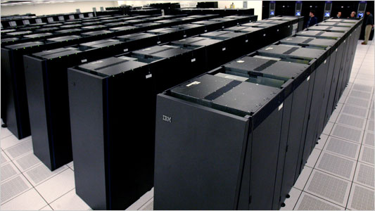
IBM Blue Gene

Slide 43
IBM Watson
http://www.youtube.com/watch?v=3e22ufcqfTs

Slide 44
Self Awareness
Can machines be made Self-Aware?
Implies that at some point they might not need further programming….they do it themselves….just like a new born infant does from the time it is born!
The machines could then decide whether or not they like us…and if they should keep us around!

Slide 45
Self Awareness in Popular Culture
Science Fiction from Asimov, Phillip Dick, Arthur Clarke, Brian Aldiss and others…
  Robots
  Malevolent Computers
  Artificial Worlds
  Androids and Replicants
  Self Aware Machines the enslave mankind

Slide 46
Asimov’s Robotics Laws
Over-riding Law: A robot may not injure humanity, or, through inaction, allow humanity to come to harm.
Law One: A robot may not injure a human being, or, through inaction, allow a human being to come to harm, unless this would violate a higher order law.
Law Two: A robot must obey orders given it by human beings, except where such orders would conflict with a higher order law.
Law Three: A robot must protect its own existence as long as such protection does not conflict with a higher order law.
-Isaac Asimov

Slide 47
Given the uncanny accuracy that science fiction has for predicting the future…who knows?…

Slide 48
Some examples of AI in popular culture

Slide 49
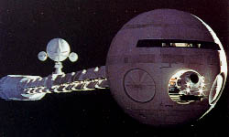
2001 Space Odyssey…controlled by HAL
(Heuristic Algorithm)

Slide 50
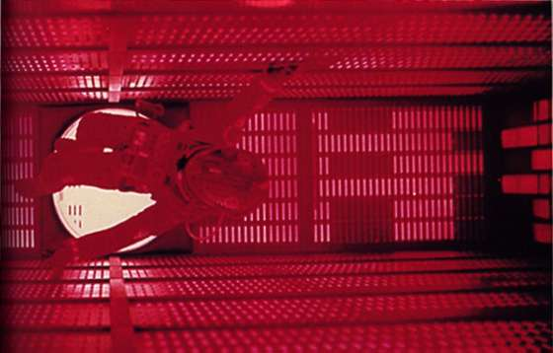
Walking Inside Hal’s Brain…to pull the plug!!

Slide 51
Hal 2001 Space Odyssey Dialogue and Video
http://www.youtube.com/watch?v=dSIKBliboIo

Slide 52
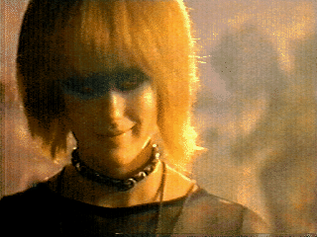
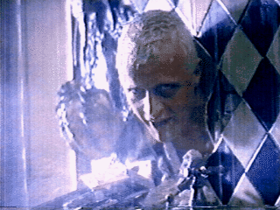

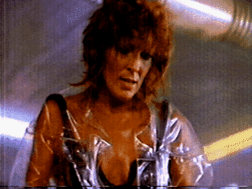

Blade runner and Replicants

Slide 53
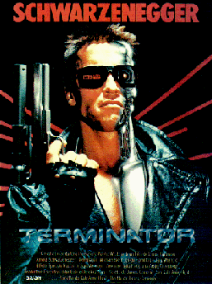

Slide 54
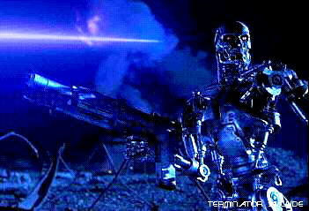
A Machine that no longer appreciates its maker!!!

Slide 55
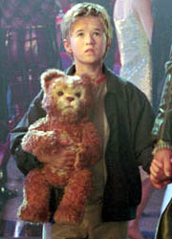
Artificial Child with Smart Toy in “AI”
(Can a machine experience “Love”)

Slide 56
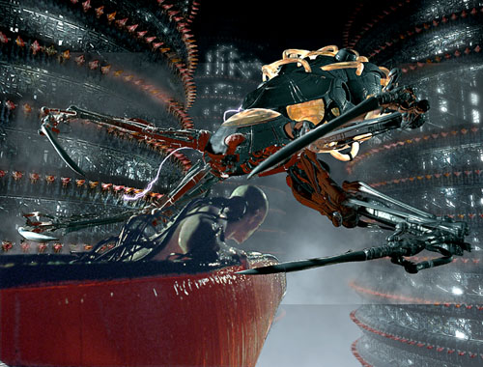
Machine breeding humans for use as “battery” power in “The Matrix”

Slide 57
So, as you can see…self aware machines can be our friends!!!

Slide 58
"I have no hesitation in thinking
that a machine can be just as intelligent and
just as real as a person, in principle."
Professor Rodney Brooks, Director, MIT Artificial Intelligence Lab

