Slide 1
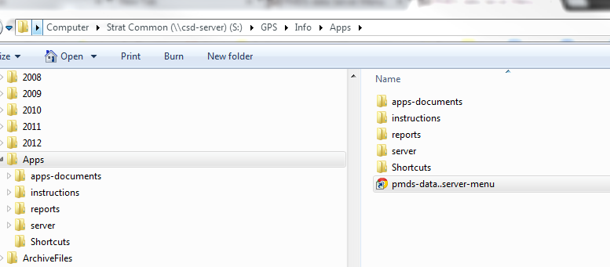
How to get a shortcut to the PMDSDATA Menu
Method 1:
1.
Go to this folder in s: drive.
S:\GPS\info\apps
2.
Drag this shortcut to your desktop

Slide 2
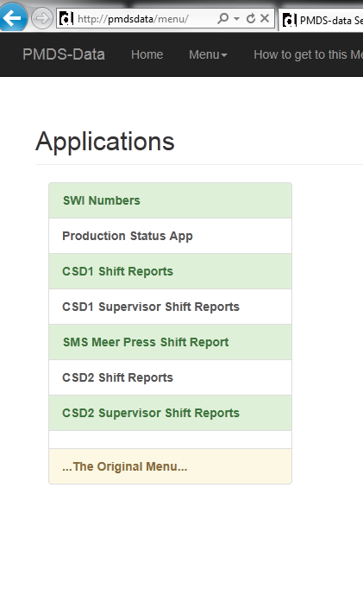
Menu
Method 2:
Type:
pmds-data.stackpole.ca
Or
pmdsdata/
Or
pmds-data/
in your browser address bar.
You can also type
10.4.1.245/menu
In the browser address bar.
You can also go to:
S:\gps\info\apps\
There is a short cut there called.
pmds-data..server-menu

