Slide 1
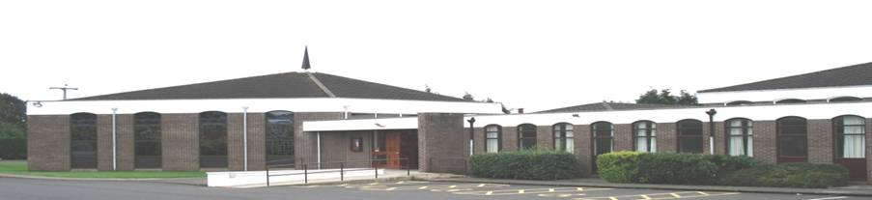

Welcome!
Sunday 6th August 2017
Holiday Bible Club / Inspire Service 2017
Rev Colin McDowell
High Street

Slide 2


Slide 3
Come on and celebrate

Slide 4
Come on and celebrate His gift of love, We will celebrate The Son of God who loved us And gave us life.

Slide 5
We’ll shout Your praise, O King, You give us joy nothing else can bring, We’ll give to You our offering In celebration praise.

Slide 6
Come on and celebrate, celebrate Celebrate and sing; Celebrate and sing to the King.

Slide 7
Come on and celebrate, celebrate Celebrate and sing; Celebrate and sing to the King.

Slide 8
Come on and celebrate His gift of love, We will celebrate The Son of God who loved us And gave us life.

Slide 9
We’ll shout Your praise, O King, You give us joy nothing else can bring, We’ll give to You our offering In celebration praise.

Slide 10
Come on and celebrate, celebrate Celebrate and sing; Celebrate and sing to the King.

Slide 11
Come on and celebrate, celebrate Celebrate and sing; Celebrate and sing to the King.
CCLI 128675

Slide 13


Slide 15
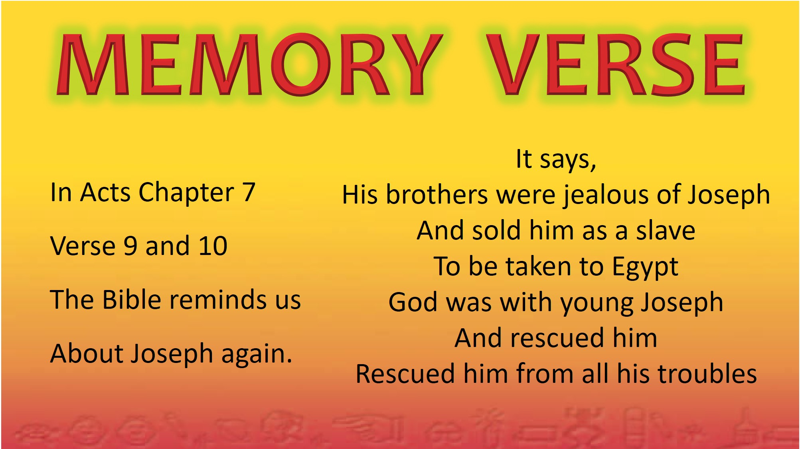

Slide 16


Slide 18
God’s love is the best love

Slide 19
God’s love is the best love That the world has ever ever known Deeper than the ocean it’s the love that God above has shown

Slide 20
Higher than the sun and moon and stars Further than from earth to planet mars Gods love is the best love

Slide 21
That the world has ever ever Could ever ever Will ever ever know.

Slide 22
God’s ways are the best ways That the world has ever ever seen Jesus came from heaven Gave up everything to set us free .

Slide 23
Never sinned in word or thought or deed Yet died on the cross for you and me God’s ways are the best ways

Slide 24
That the world has ever ever Could ever ever Will ever ever know.

Slide 25
God’s word is the best word That the world has ever ever known Better than the best books Is the Bible that the Lord has given

Slide 26
Read it everyday and learn from it Let God guide you with his perfect truth God’s word is the best word

Slide 27
That the world has ever ever Could ever ever Will ever ever know.
CCLI 128675

Slide 33
All over the world

Slide 34
All over the world the Spirit is moving All over the world as the prophet said it would be

Slide 35
All over the world there's a mighty revelation Of the glory of the Lord, as the waters cover the sea

Slide 36
All over His church God's Spirit is moving All over His church as the prophet said it would be

Slide 37
All over His church there's a mighty revelation Of the glory of the Lord, as the waters cover the sea

Slide 38
Right here in this place the Spirit is moving Right here in this place as the prophet said it would be

Slide 39
Right here in this place there's a mighty revelation Of the glory of the Lord, as the waters cover the sea
CCLI 128675

Slide 41

Genesis 50:15-21
Reader: Rev Colin McDowell
Page 57

Slide 43
Lord the light of your love is shining

Slide 44
Lord, the light of your love is shining, In the midst of the darkness, shining;

Slide 45
Jesus, light of the world, shine upon us; Set us free by the truth you now bring us Shine on me, shine on me.

Slide 46
Shine, Jesus, shine, Fill this land with the Father's glory; Blaze, Spirit, blaze, Set our hearts on fire.

Slide 47
Flow, river, flow, Flood the nations with grace and mercy; Send forth your word, Lord, and let there be light!

Slide 48
Lord, I come to your awesome presence, From the shadows into your radiance;

Slide 49
By the blood I may enter your brightness, Search me, try me, consume all my darkness. Shine on me, shine on me.

Slide 50
Shine, Jesus, shine, Fill this land with the Father's glory; Blaze, Spirit, blaze, Set our hearts on fire.

Slide 51
Flow, river, flow, Flood the nations with grace and mercy; Send forth your word, Lord, and let there be light!

Slide 52
As we gaze on your kingly brightness So our faces display your likeness.

Slide 53
Ever changing from glory to glory, Mirrored here may our lives tell your story. Shine on me, shine on me.

Slide 54
Shine, Jesus, shine, Fill this land with the Father's glory; Blaze, Spirit, blaze, Set our hearts on fire.

Slide 55
Flow, river, flow, Flood the nations with grace and mercy; Send forth your word, Lord, and let there be light!
CCLI 128675

Slide 57

Fancy a CUPPA
and a CHAT after Church??
Don’t be rushing away!...
...Teas and coffees served in the hall after the service...
...Everyone welcome!

