Slide 1
NETWORKS and MATRIX COMPUTATIONS
CS 59000-NMC
David F. Gleich
T-Th 10:30-11:45
CIVL 2123
Course Teaser
17 August 2011

Slide 2


Images copyright by their respective owners.

Slide 3
We like books …

Slide 4
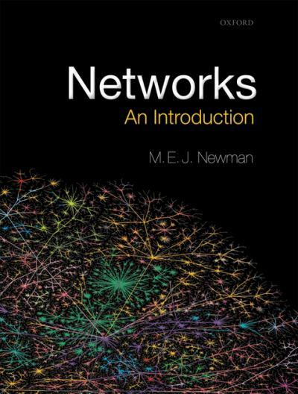
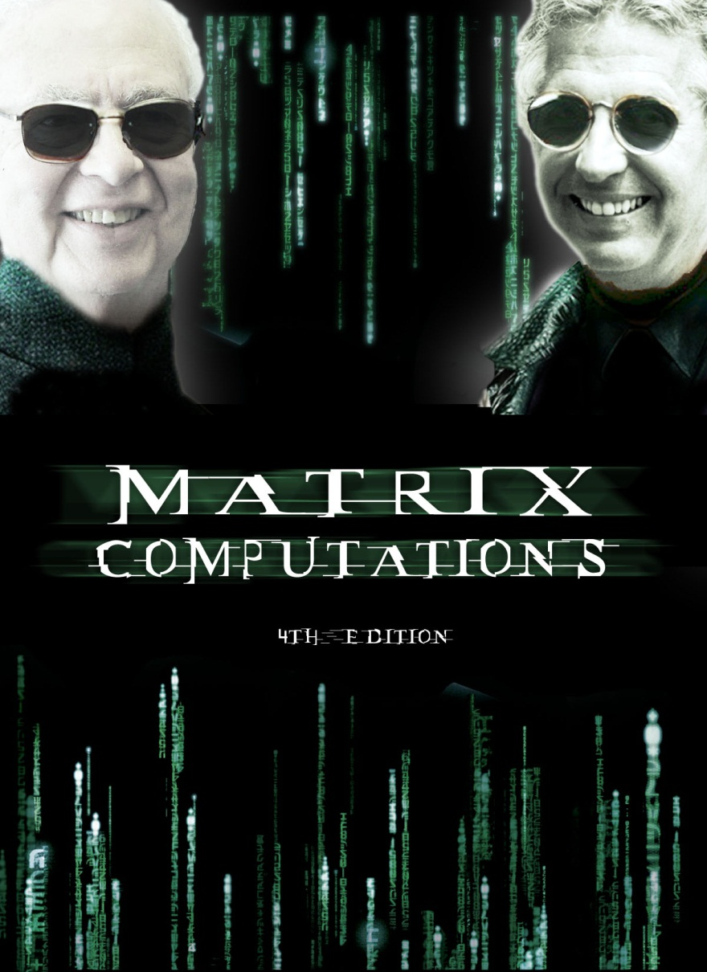
Gene H. Golub
Charles van Loan
Networks cover copyright by Oxford Press

Slide 5
NETWORKS and MATRIX COMPUTATIONS
Why looking at networks of data as a matrix is a powerful and successful paradigm.

Slide 6
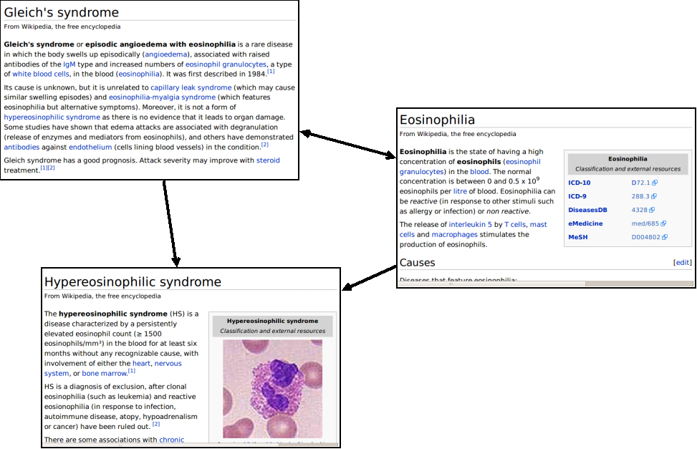
Web graph

Slide 7

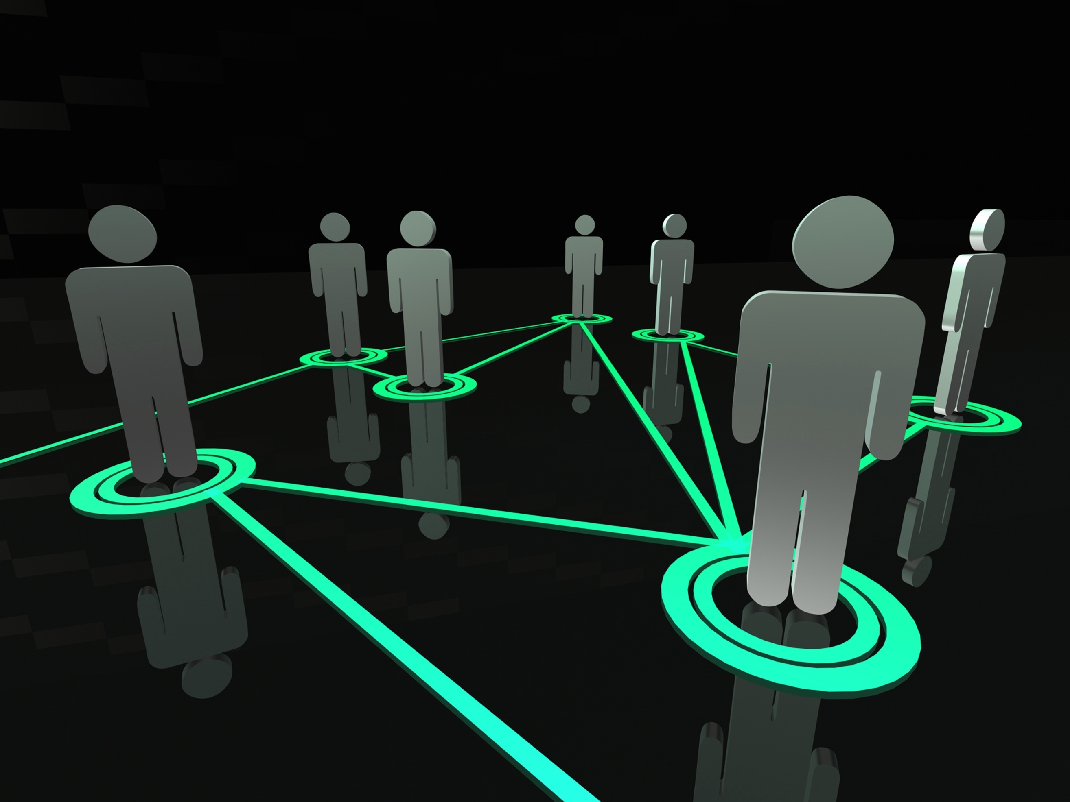


Slide 8
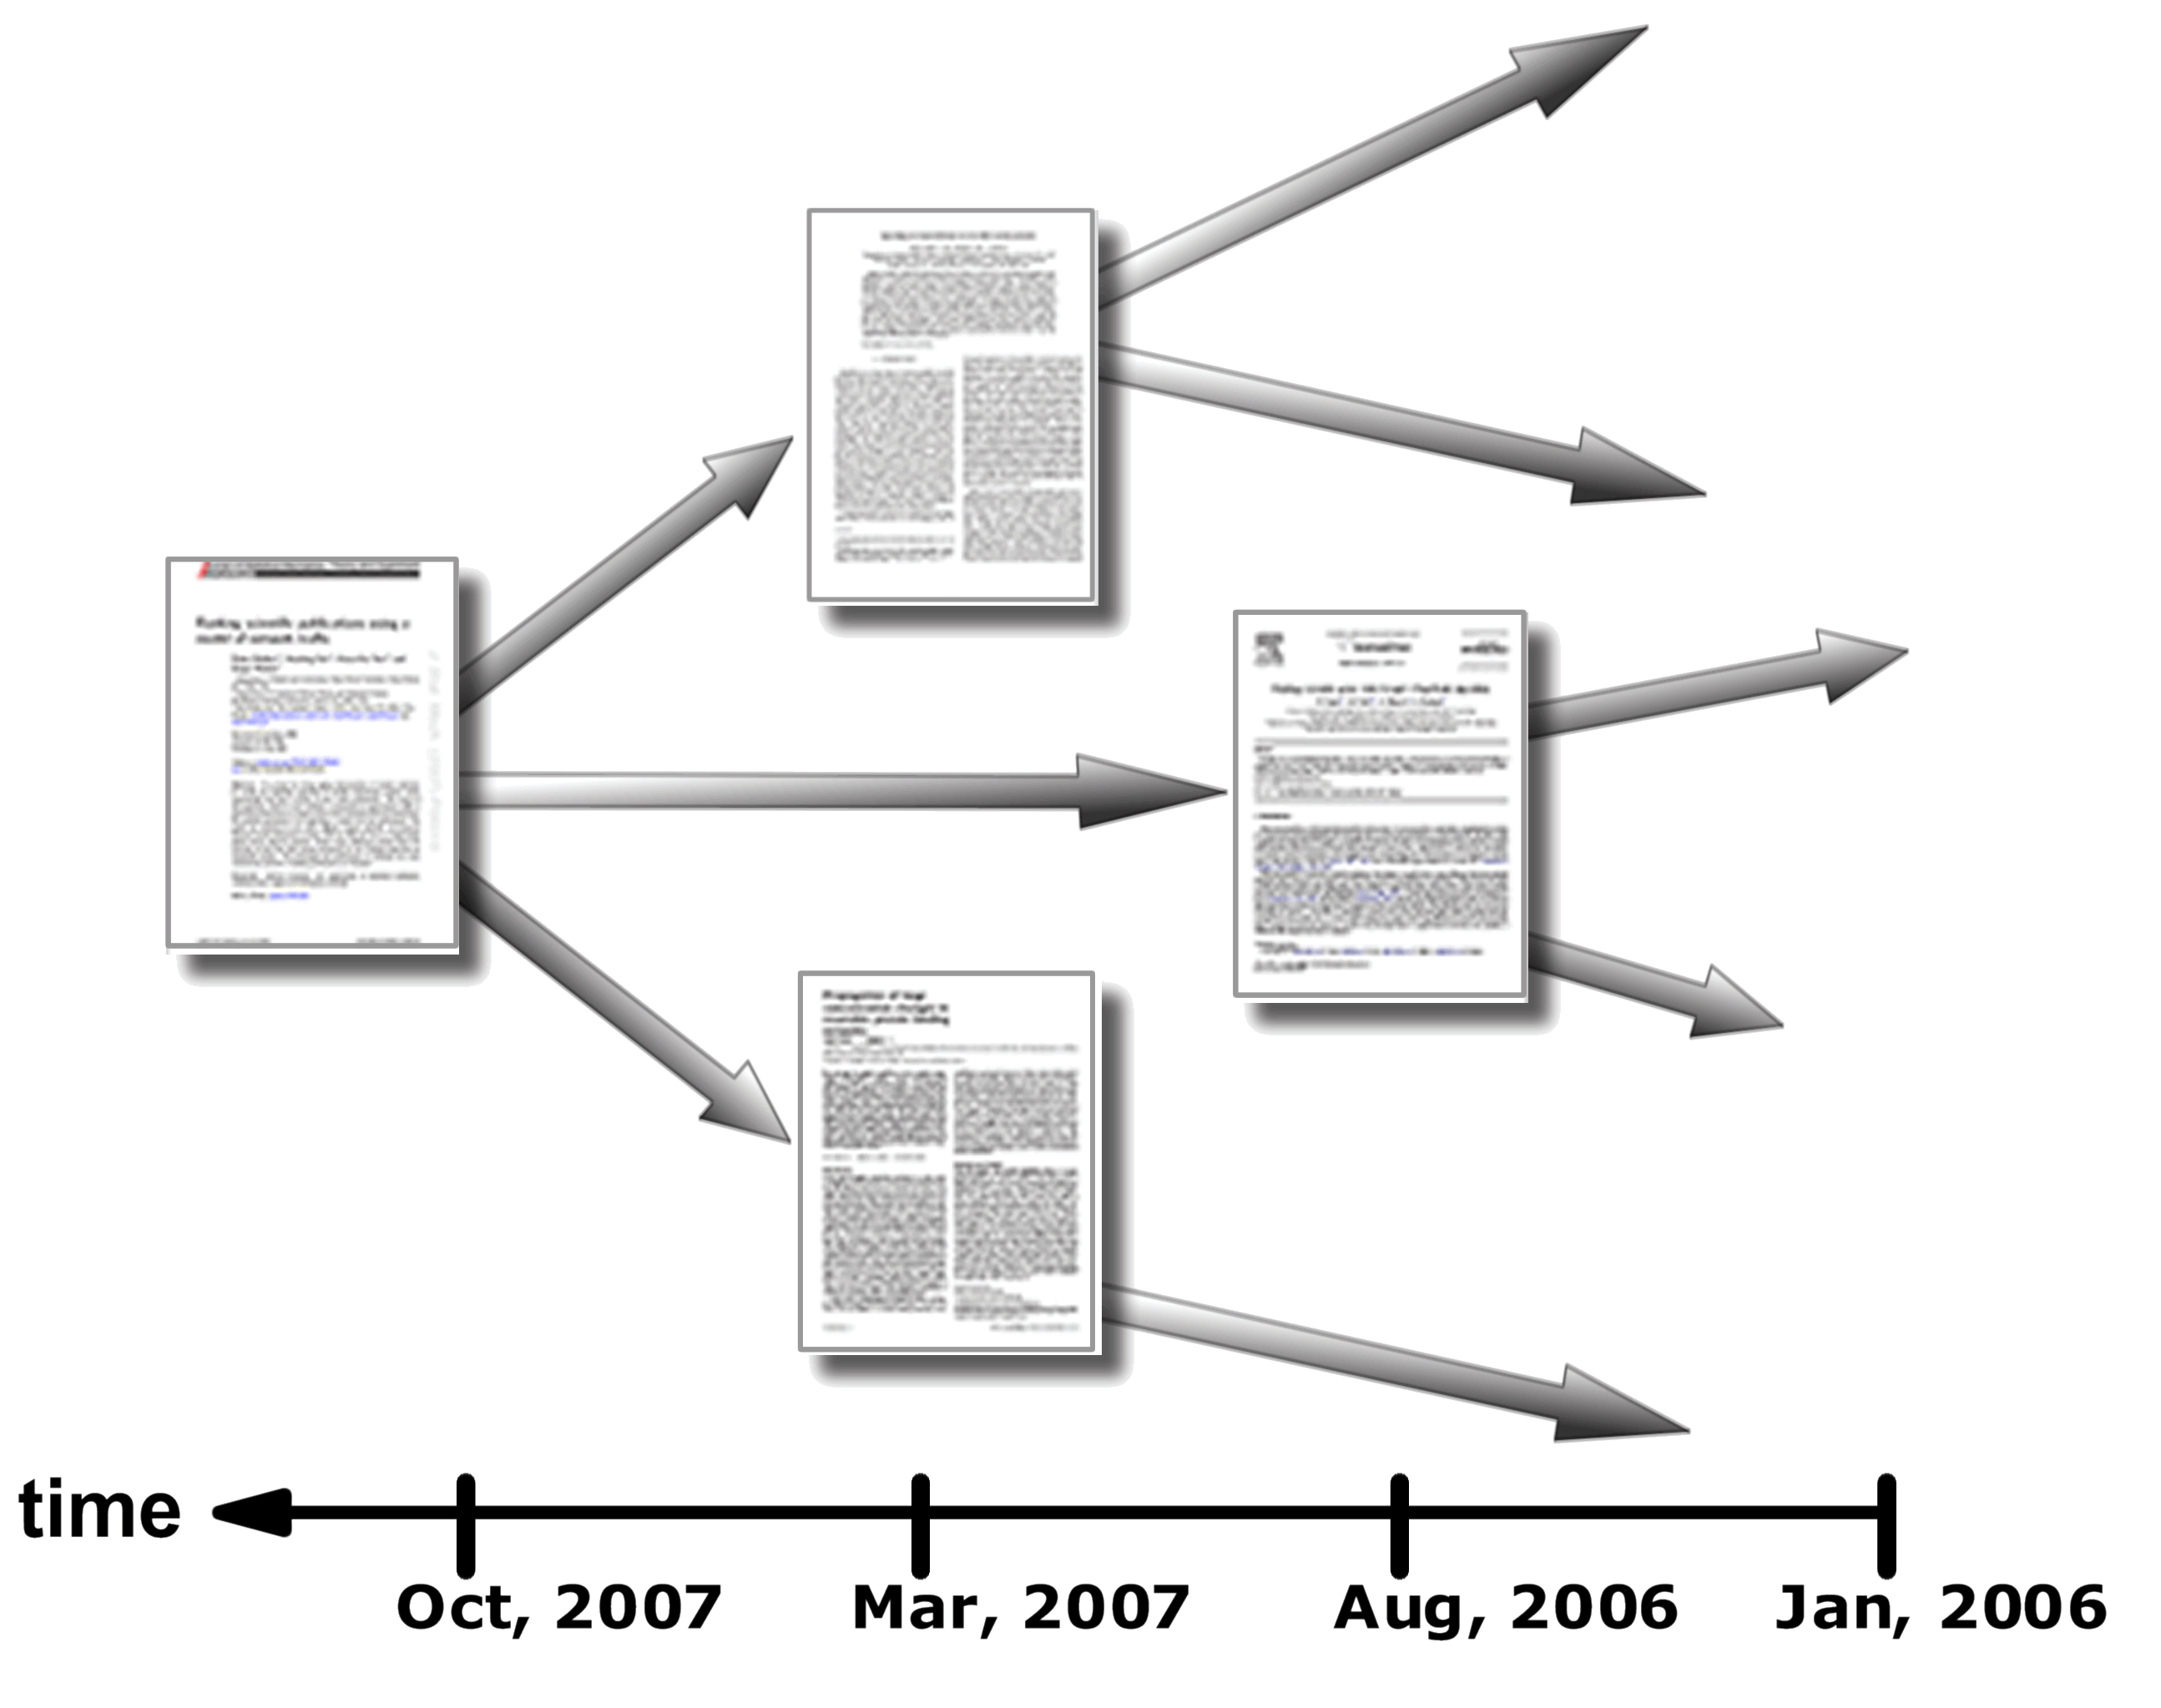
Citation network
http://www.cmth.bnl.gov/~maslov/citerank/HowItWorks.php

Slide 9
<Insert your favorite network here>

Slide 10
TOPICS
Notes:
The first point I’d like to make is that networks are everywhere. I’m guessing that this isn’t a

Slide 11
BASICS
How to state network problems as matrix problems.
Matrices over a semi-ring and how this yields instant parallel algorithms!
Relationships with MapReduce computations.

Slide 13

TROPICAL semi-rings
http://www.ultimatebeachviews.com/wallpaper/Tropical-010/

Slide 14
MARKOV CHAIN theory
Random walks on networks
Perron Frobenius theory
State space classification
How to “solve” a large linear system with a random walk.
How to “solve” Markov chain problems on compressed graphs

Slide 15
PAGERANK
Deep dive into one particular application. Is it a Markov chain or a linear system?
How to compute it, FAST.
How to manipulate PageRank.

Slide 16
Just PageRank?

Slide 17
SimRank
BlockRank
TrustRank
ObjectRank
HostRank
Random walk with restart
GeneRank
DiffusionRank
IsoRank
ItemRank
ProteinRank
SocialPageRank
FoodRank
FutureRank
TwitterRank

Slide 18
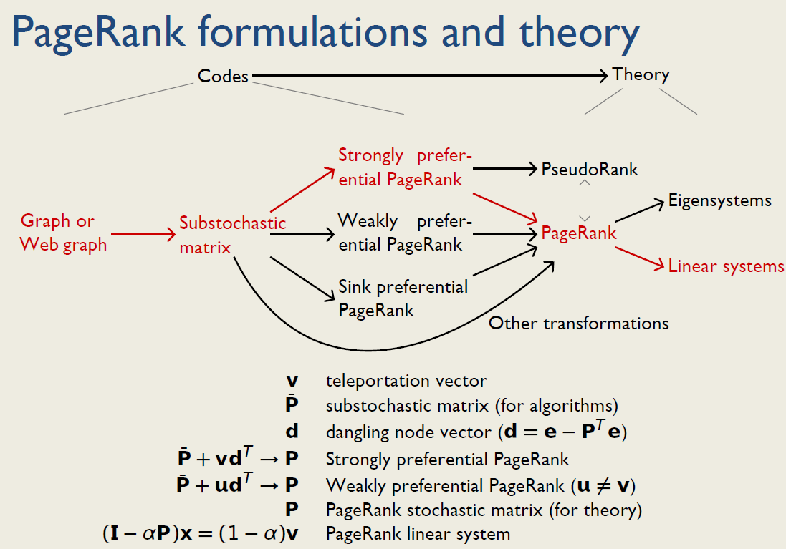

Slide 19
SPECTRAL GRAPH theory
The Fiedler vector, the Laplacian matrix and graph cuts
Semi-definite approximation problems and properties
Local partitioning
How to split a graph without even seeing it all!

Slide 20
QUITE A BIT MORE
Higher order graph analysis with tensors.
Network alignment
Affine eigenvectors and centrality
SVD graph analysis.
Matrix based graph models.

Slide 21
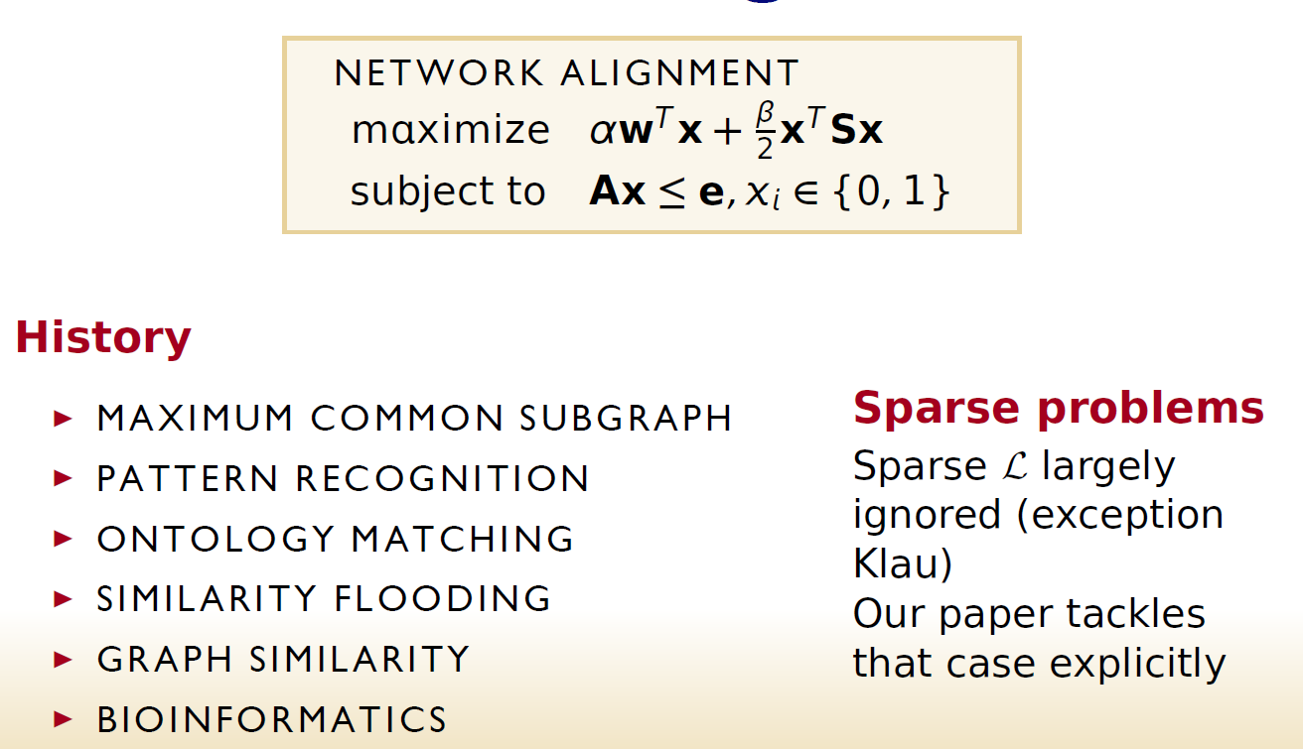

Slide 22
<Insert your favorite application/topic/area here>

Slide 23
THE WORK
Notes:
The first point I’d like to make is that networks are everywhere. I’m guessing that this isn’t a

Slide 24
BIG ITEM one
A project.
A proposal
A paper
A presentation

Slide 25
BIG ITEM two
A lecture.
Take a paper and present it to the class using the matrix paradigm.
OR
Present a paper that uses the matrix paradigm.

Slide 26
OTHER WORK
Survey
Homework (2-4?)
Quizzes
Writing

Slide 27
Quizzes?
Taken/Missed These are for me, not you.

Slide 28
QUESTIONS?
www.cs.purdue.edu/homes/dgleich/nmcomp
Notes:
The first point I’d like to make is that networks are everywhere. I’m guessing that this isn’t a

