Slide 1
Keyword Programming in Java
Greg Little and Robert C. Miller
MIT CSAIL
This work was supported in part by the National Science Foundation under award number IIS-0447800,
and by Quanta Computer as part of the TParty project.

Slide 2
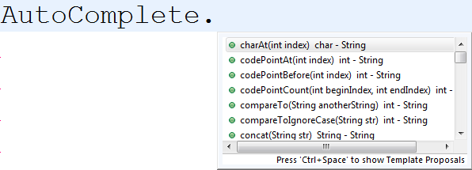
Keyword Programming

Slide 3
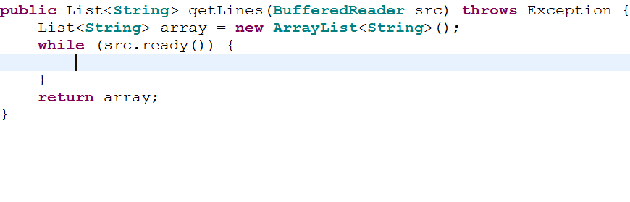
Problem
src
array
cursor
read a line from src,
and add it to array

Slide 4
AutoComplete
read a line from src,
and add it to array

Slide 5
AutoComplete
read a line from src,
and add it to array

Slide 6
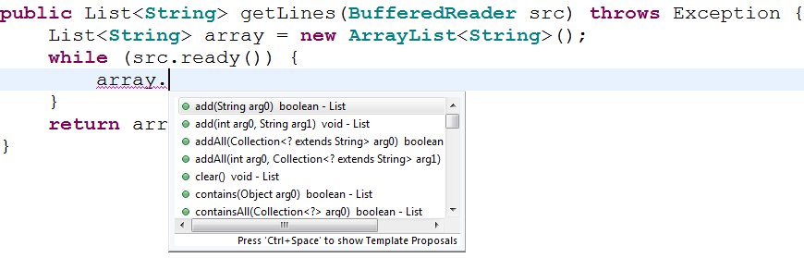
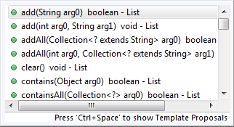
AutoComplete
read a line from src,
and add it to array

Slide 7
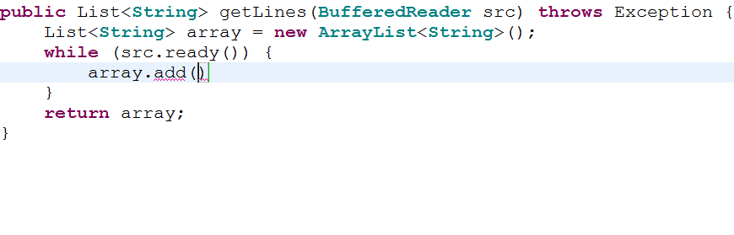
AutoComplete
read a line from src,
and add it to array

Slide 8
AutoComplete
read a line from src,
and add it to array

Slide 9
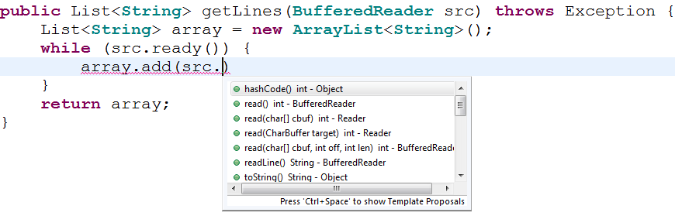
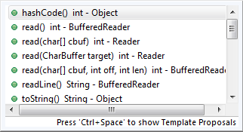
AutoComplete
read a line from src,
and add it to array

Slide 10
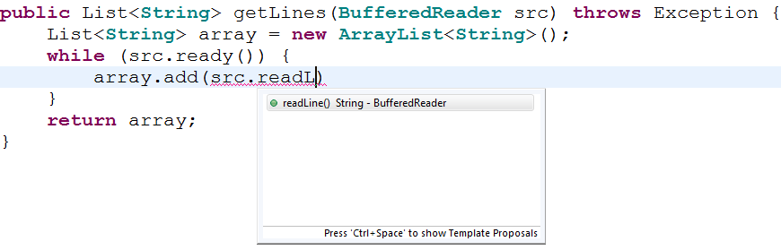
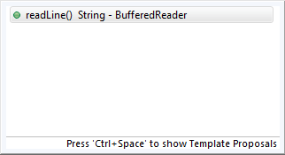
AutoComplete
read a line from src,
and add it to array

Slide 11
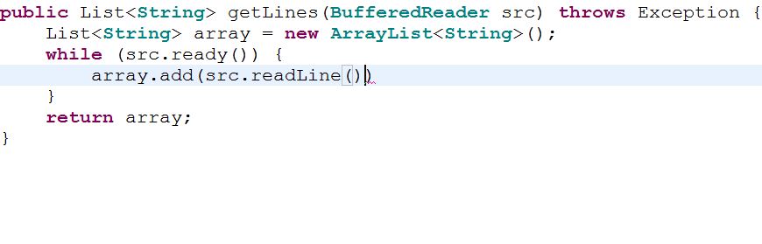
AutoComplete
read a line from src,
and add it to array

Slide 12

Keyword Programming
read a line from src,
and add it to array

Slide 13
Keyword Programming
read a line from src,
and add it to array

Slide 14
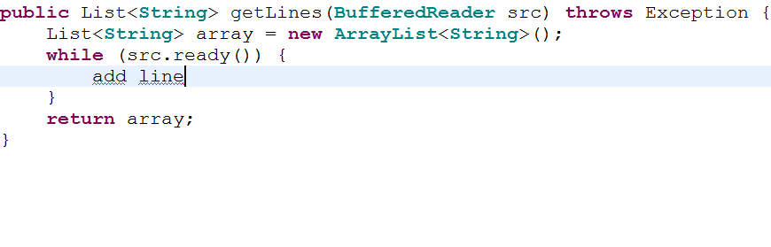
Keyword Programming
read a line from src,
and add it to array

Slide 15
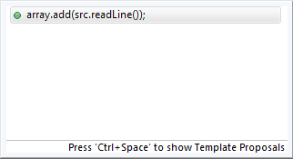
Keyword Programming
read a line from src,
and add it to array

Slide 16

Keyword Programming
read a line from src,
and add it to array

Slide 17
Related Work
AutoComplete
  syntactically valid prefix
Jungloids [Mandelin et al PLDI ’05]
XSnippet [Sahavechaphan et al OOPSLA ’06]
  input and output types
Keyword Programming
  keywords from expression

Slide 18
Motivation

Slide 19
Overview
Algorithm
Evaluation

Slide 20
Algorithm
array.add(src.readLine());

Slide 21
Algorithm
array.add(src.readLine);
array readLine
src

Slide 22
Algorithm
array.add(src.readLine);
array readLine
src
List<String>
String
BufferedReader

Slide 23
Algorithm
boolean
add
List<String>, String
List<String>
String
array
readLine
BufferedReader
BufferedReader
src

Slide 24
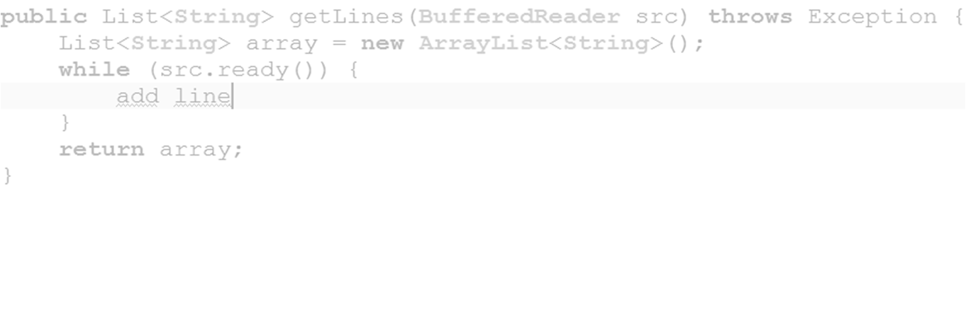
Algorithm
Function
boolean
add
List<String>, String
List<String>
String
array
readLine
BufferedReader
BufferedReader
src

Slide 25
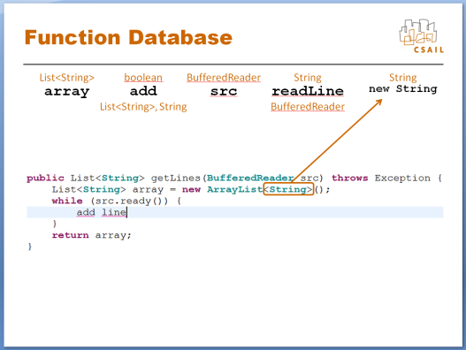
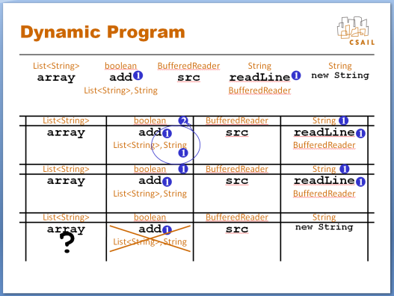
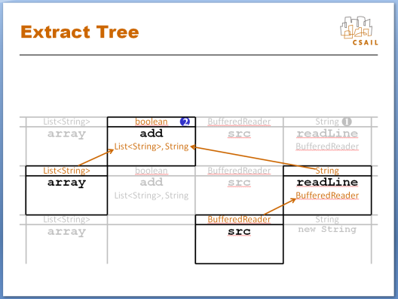
Algorithm
Function Database
Dynamic Program
Extract Tree

Slide 26
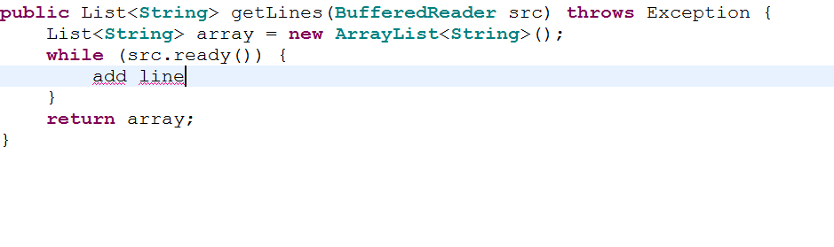
Function Database
List<String>
array

Slide 27
Function Database
List<String>
boolean
array
add
List<String>, String

Slide 28
Function Database
List<String>
boolean
BufferedReader
array
add
src
List<String>, String

Slide 29
List Functions
List<String>
boolean
BufferedReader
String
array
add
src
readLine
List<String>, String
BufferedReader

Slide 30
Function Database
List<String>
boolean
BufferedReader
String
String
array
add
src
readLine
new String
List<String>, String
BufferedReader

Slide 31

Score Functions
List<String>
boolean
BufferedReader
String
String
array
add
src
readLine
new String
List<String>, String
BufferedReader

Slide 32
Score Functions
List<String>
boolean
BufferedReader
String
String
array
add
src
readLine
new String
List<String>, String
BufferedReader
add line

Slide 33
Score Functions
List<String>
boolean
BufferedReader
String
String
array
add
src
readLine
1
new String
List<String>, String
BufferedReader
add line

Slide 34
Score Functions
List<String>
boolean
BufferedReader
String
String
array
add
readLine
1
src
1
new String
List<String>, String
BufferedReader
add line

Slide 35
Dynamic Program
List<String>
boolean
BufferedReader
String
String
array
add
readLine
1
src
1
new String
List<String>, String
BufferedReader
List<String>
boolean
2
BufferedReader
String
1
array
add
src
readLine
1
1
List<String>, String
BufferedReader
1
List<String>
boolean
1
BufferedReader
String
1
array
add
src
readLine
1
1
List<String>, String
BufferedReader
List<String>
boolean
BufferedReader
String
array
?
add
src
new String
1
List<String>, String

Slide 36
Extract Tree
List<String>
boolean
2
BufferedReader
String
1
array
add
src
readLine
List<String>, String
BufferedReader
List<String>
boolean
BufferedReader
String
array
add
src
readLine
List<String>, String
BufferedReader
List<String>
BufferedReader
String
array
src
new String

Slide 37
Extract Tree
List<String>
boolean
2
BufferedReader
String
1
array
add
src
readLine
List<String>, String
BufferedReader
List<String>
boolean
BufferedReader
String
array
add
src
readLine
List<String>, String
BufferedReader
List<String>
BufferedReader
String
array
src
new String

Slide 38
Extract Tree
List<String>
boolean
2
BufferedReader
String
1
array
add
src
readLine
List<String>, String
BufferedReader
List<String>
boolean
BufferedReader
String
array
add
src
readLine
List<String>, String
BufferedReader
List<String>
BufferedReader
String
array
src
new String

Slide 39
Extract Tree
List<String>
boolean
2
BufferedReader
String
1
array
add
src
readLine
List<String>, String
BufferedReader
List<String>
boolean
BufferedReader
String
array
add
src
readLine
List<String>, String
BufferedReader
List<String>
BufferedReader
String
array
src
new String

Slide 40
Extract Tree
boolean
add
List<String>, String
List<String>
String
array
readLine
BufferedReader
BufferedReader
src

Slide 41
Render as Java
array.add(src.readLine())
boolean
add
List<String>, String
List<String>
String
array
readLine
BufferedReader
BufferedReader
src

Slide 42
More Complex
.Math.max(x, y)..........
Keep best n functions per box
.Math.max(x, x)..........
max x y .
3
Discourage double counting

Slide 43
Evaluation
Artificial Corpus
sense of speed in real projects
sense of accuracy in wide variety of contexts
User Study
sense of accuracy on real inputs
sense for how real inputs look

Slide 44


Artificial Corpus
Azureus | 340 | kloc
Buddi | 28 | kloc
CAROL | 18 | kloc
Dnsjava | 17 | kloc
Jakarta CC | 10 | kloc
jEdit | 125 | kloc
jMemorize | 15 | kloc
Jmol | 88 | kloc
JRuby | 72 | kloc
Radeox | 71 | kloc
RSSOwl | 71 | kloc
Sphinx | 67 | kloc
TV-Browser | 120 | kloc
Zimbra | 256 | kloc
multiple open source repositories
Popular
Could Compile

Slide 45
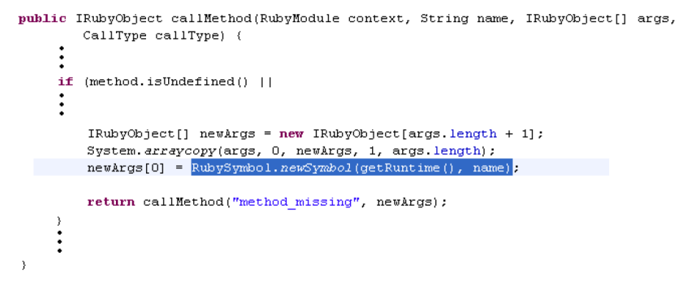
Artificial Corpus
Azureus | 340 | kloc
Buddi | 28 | kloc
CAROL | 18 | kloc
Dnsjava | 17 | kloc
Jakarta CC | 10 | kloc
jEdit | 125 | kloc
jMemorize | 15 | kloc
Jmol | 88 | kloc
JRuby | 72 | kloc
Radeox | 71 | kloc
RSSOwl | 71 | kloc
Sphinx | 67 | kloc
TV-Browser | 120 | kloc
Zimbra | 256 | kloc

Slide 46
Artificial Corpus
RubySymbol.newSymbol(getRuntime(), name)

Slide 47
Artificial Corpus
RubySymbol.newSymbol(getRuntime(), name)
RubySymbol newSymbol getRuntime name

Slide 48
Artificial Corpus
RubySymbol.newSymbol(getRuntime(), name)
RubySymbol newSymbol getRuntime name
Ruby Symbol new Symbol get Runtime name

Slide 49
Artificial Corpus
RubySymbol.newSymbol(getRuntime(), name)
RubySymbol newSymbol getRuntime name
Ruby Symbol new Symbol get Runtime name
ruby symbol new symbol get runtime name

Slide 50
Artificial Corpus
RubySymbol.newSymbol(getRuntime(), name)
RubySymbol newSymbol getRuntime name
Ruby Symbol new Symbol get Runtime name
ruby symbol new symbol get runtime name
name runtime get symbol symbol ruby new

Slide 51
Artificial Corpus
RubySymbol.newSymbol(getRuntime(), name)
name runtime get symbol symbol ruby new

Slide 52
Artificial Corpus
RubySymbol.newSymbol(getRuntime(), name)
name runtime get symbol symbol ruby new
Algorithm

Slide 53
Artificial Corpus
RubySymbol.newSymbol(getRuntime(), name)
name runtime get symbol symbol ruby new
Algorithm

Slide 54

Artificial Corpus
RubySymbol.newSymbol(getRuntime(), name)
Record:
- match?
how long?
how many keywords?
name runtime get symbol symbol ruby new
Algorithm

Slide 55
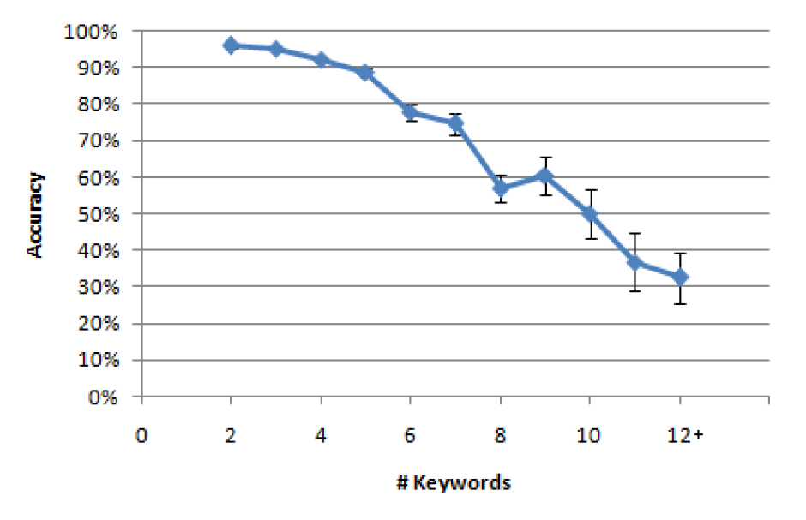

Results
overall 91%

Slide 56
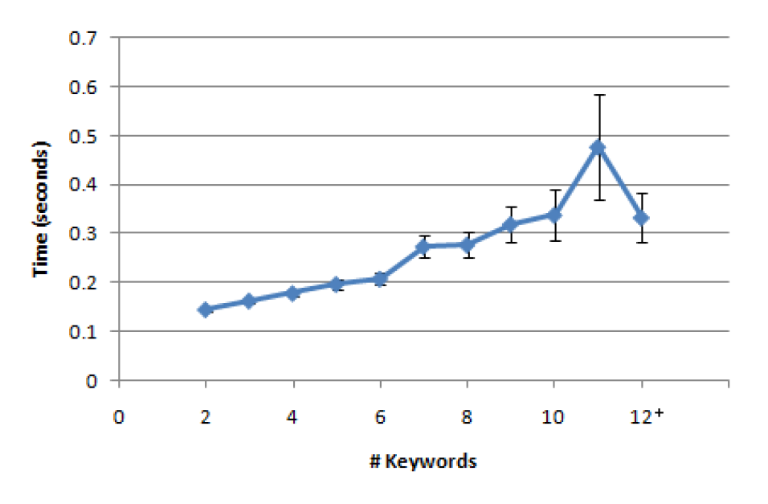

Results
under 500ms

Slide 57
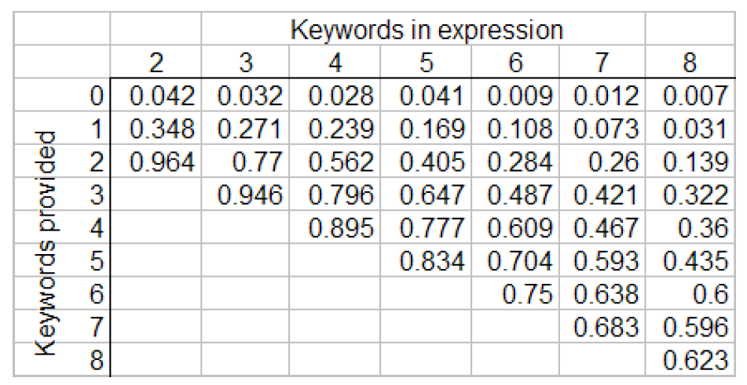
Results

Slide 58
Results

Slide 59
User Study
solicited experienced Java programmers (from college mailing lists)
motivated with money—chance to win $20
web based study
good data for 49 participants
ages: 18 - 74
about 70% students
3 females

Slide 60
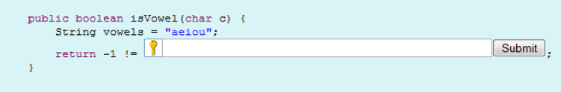
User Study

Slide 61



User Study

Slide 62
Results
Correct
Incorrect
as-is
vowels.indexOf(c)
vowels.index(c)
vowels.index(c)
vowels.isIn(c)
vowels.charAt(c)
Algorithm
index of c in vowels
check vowels for c, return neg -1 if c is in vowels
vowels.indexOf(c,Integer.SIZE))
vowels search c
search
c

Slide 63

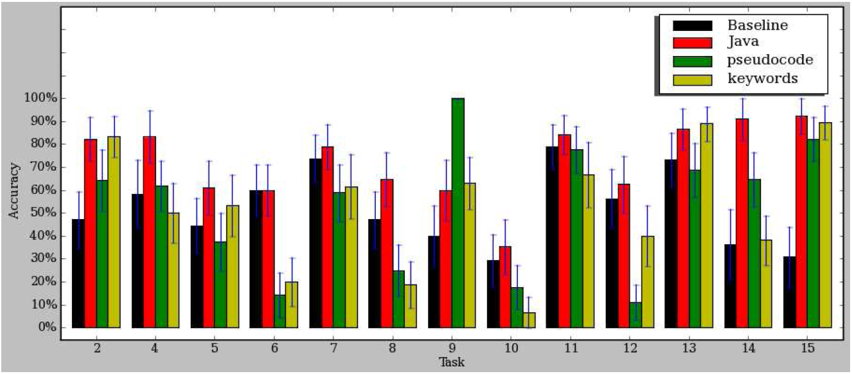


Results
as-is
Algorithm

Slide 64
Results
java
key/pseudo
using
as
-
is
using algorithm

Slide 65
Results
java
key/pseudo
using
as
-
is
53%
using algorithm
71%
53%

Slide 66
Future Work
a priori word weights
print name of f
want
becomes
System.out.print(f.getName())
Integer.valueOf(f.getName())
of
f
name
1
print
f
name
1
1
1
1
1
3
3

Slide 67
Future Work
a priori function weights
println f name
want
becomes
System.out.println(f.getName())
System.err.println(f.getName())
println
f
name
1
println
f
name
1
1
1
1
1
3
3

Slide 68
Future Work
spell correction
lowercase
toLowerCase
synonyms
add vs append

Slide 69
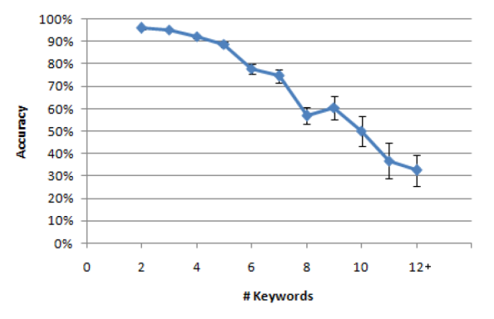

Conclusion
array.add(src.readLine());

Slide 70
Backup Slides

Slide 71
E-mail
glittle@gmail.com

Slide 72
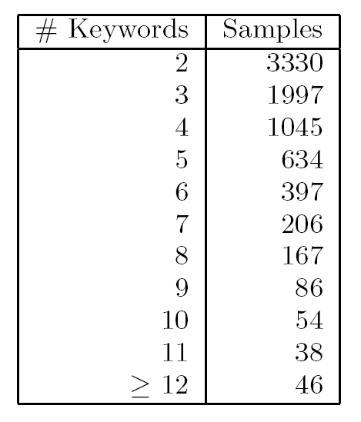

Slide 73
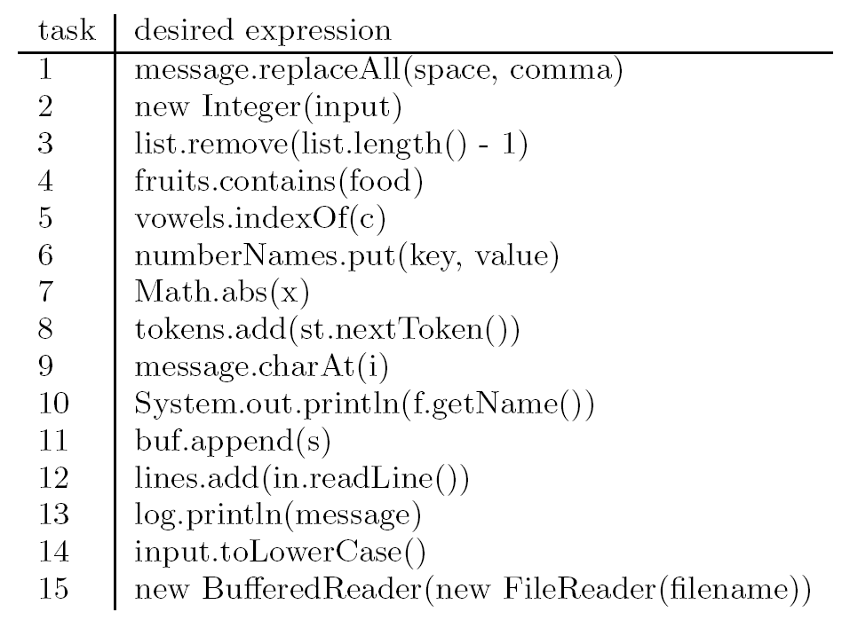

Slide 74
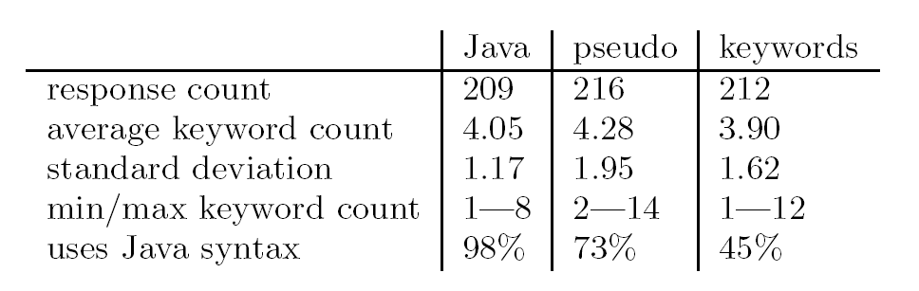

Slide 75
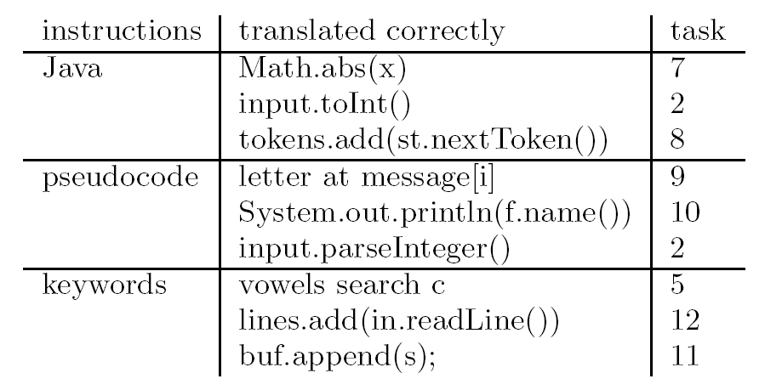

Slide 76
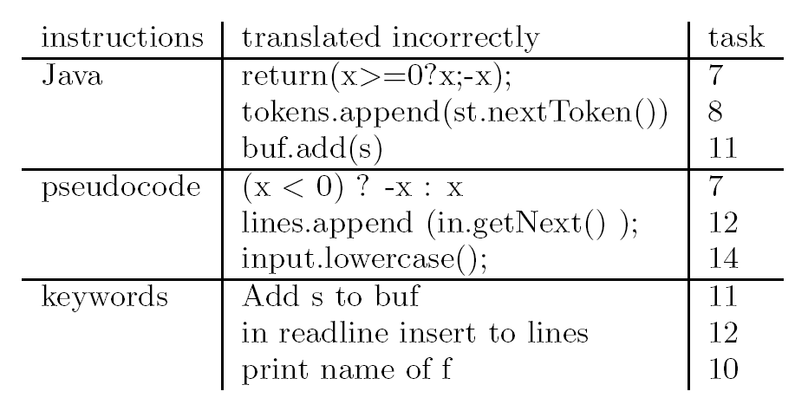

Slide 78
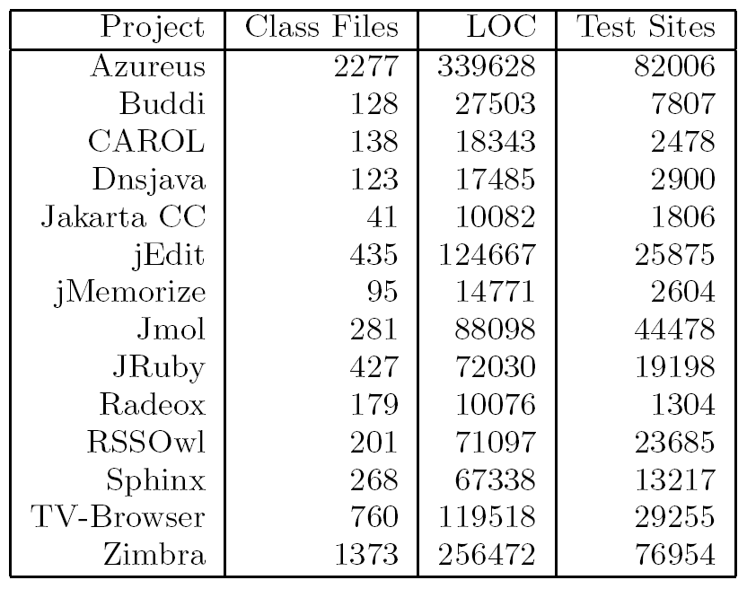

Slide 79
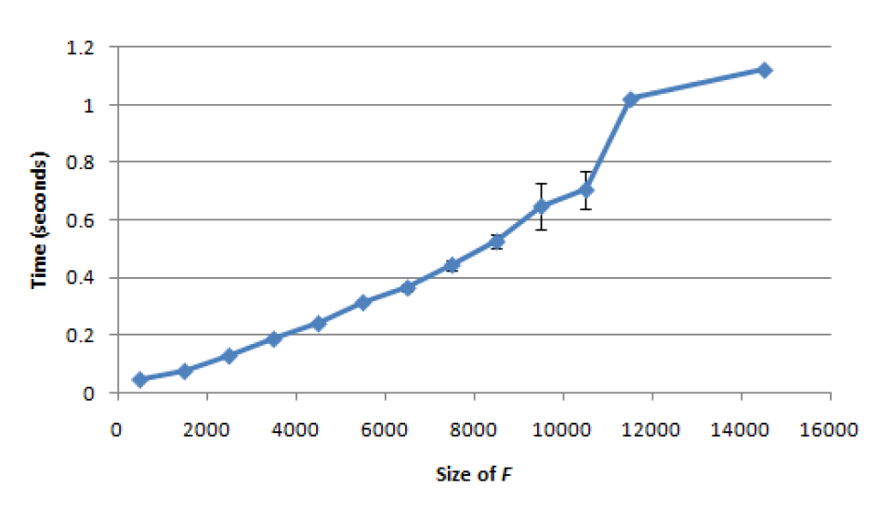

Slide 80
