Slide 1
BANKING DATABASE SYSTEM

Slide 2
INTRODUCTION
The aim of this project is to maintain the customer information in a banking system.
Banking is one of the most synchronized systems in the world. In this project, a customer can create an account in the bank and keep track of personal information such as balance.
Both bank and customer can view bank details and customer details.
A database named [BankingDatabaseSystem] has been created.

Slide 3
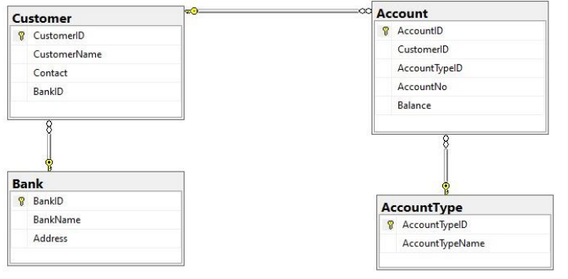
DATABASE DIAGRAM
One - Many Relation
One - Many Relation
One - One Relation

Slide 4
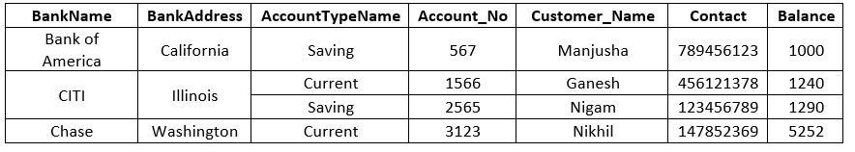
NORMALIZATION
The process of eliminating duplicate data from the tables and maintain integrity is known as ‘normalization.’

Slide 5
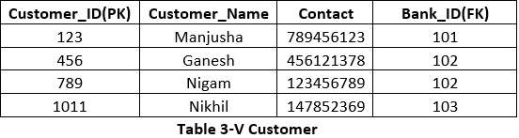
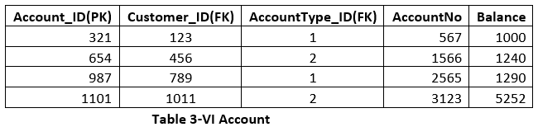
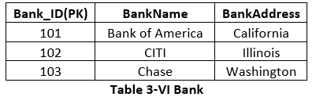
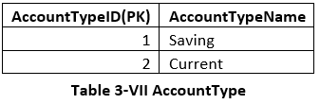
AFTER 3RD NORMAL FORM

Slide 6
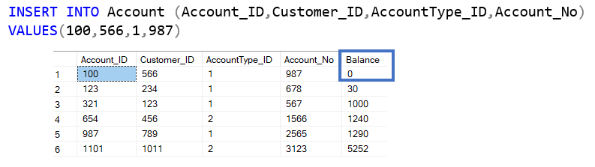
CONSTRAINTS
Constraints limit the type of data that goes into a table. They also provide accuracy and reliability of the data.
Default Constraint: Added default constraint df_balance which by default contains balance as 0 when no balance is entered.
Foreign Key
Default Constraints
Primary Key
[dbo].[Account]:

Slide 7
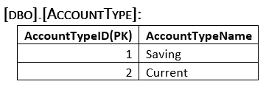
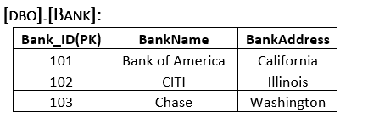
Primary key
Primary key
[dbo].[AccountType]:
[dbo].[Bank]:

Slide 8
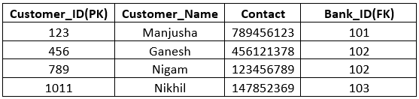
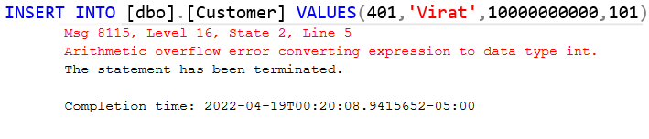
Check Constraint: A check constraint named Ck_PhValidation has been created to check the contact range from 100000000 to 999999999
Primary Key
Foreign Key
Check constraint

Slide 9
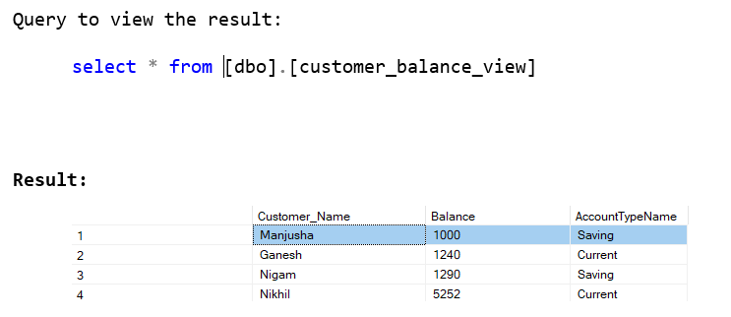
VIEWS
View is a logical structure of the table which can obtain the data from another table.
customer_balance_view has been created which results the customer’s name, balance, the type of account.

Slide 10
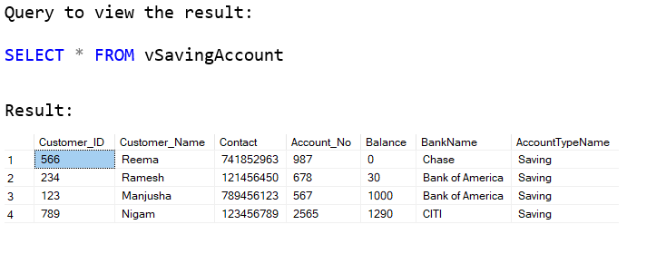
vSavingAccount view gives the customer details and account details of savings account

Slide 11
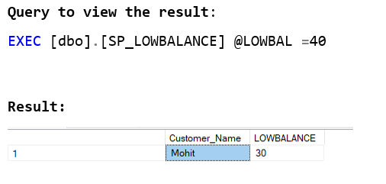
STORED PROCEDURES
Stored procedure is a collection of statements and logics that can be stored on the database. They can be re-used and they hide the queries to improve performance.
A stored procedure named SP_LOWBALANCE has been created which fetches customer name and balance when the balance is below 40.

Slide 12
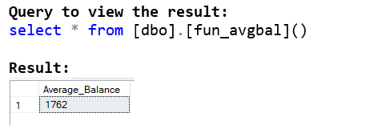
FUNCTIONS
A function is a set of SQL statements that perform a specific task. It takes inputs as parameters and returns a value.
Here a function named [dbo].[fun_avgbal]() has been created. It gives the average balance in a banking database as output.

Slide 13
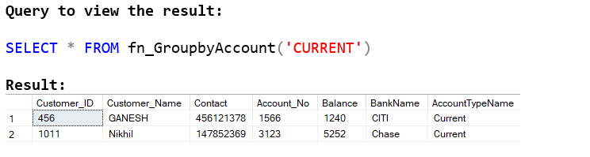
A function named fn_GroupbyAccount() has been created. Where it takes either ‘savings’ or ‘current’ as a parameter and displays customer details of those accounts

Slide 14
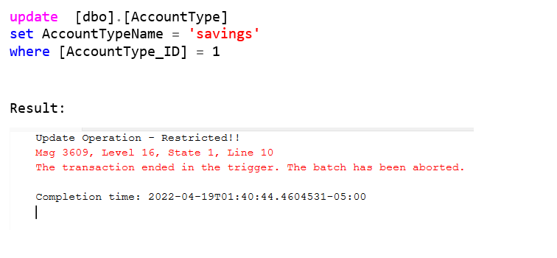
TRIGGERS
The SQL statements that are executed in response when an event is occurred in the database. The maintain the data integrity.
A trigger name Trg_UpdateRestricted has been created which doesnot let the update operation.
Triggered statement

Slide 15
THANK YOU

