Slide 1

BOOK RENTAL DETAILS
CPSC 6576 Database Design Admin SQL
Project Presentation

Slide 2
INTRODUCTION
The main objective of this project is to design and implement database of students’ details and books they rent.
This Data model is designed using database diagrams.
This project contains key constraints, entity integrity, referential integrity constraints that are implemented on tables.
The SQL objects that are created are views, stored procedures, functions, and triggers.

Slide 3

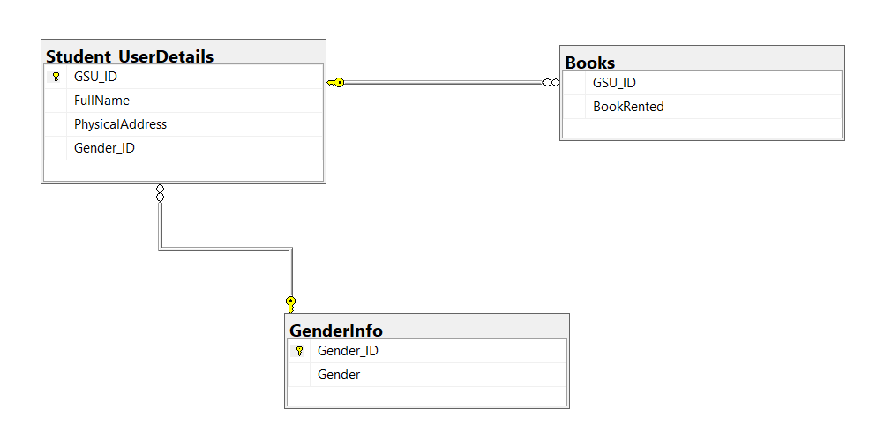
DATABASE DIAGRAM
The above Entity Relation - Diagram has 3 entities. Such as Student_UserDetails, Books, GenderInfo.
Relationship between Student_UserDetails and Books.
The two entities Student_UserDetails and Books share one to many relationships.
Relationship between Student_UserDetails and GenderInfo.
The two entities Student_UserDetails and GenderInfo share one to many relationships.

Slide 4
NORMALISATION
FullName | PhysicalAddress | BookRented | Gender
Joe Root | 1st street, Park Forest | Pride and Prejudice | Male
Ariel Chappel | 3rd Ave, Richton Park | The Alchemist | Female
Tia Star | 5th street, Chicago Heights | Gone Girl | Female
Marcus Warne | 7th street, Oak Forest | The Song of Achilles | Male
Keri Cook | 9th street, Tinley Park | The Fault in Our Stars | Prefer Not to Say
Normalization is the process of removing redundant data.
The table describes the unnormalized data.
Unnormalized Data

Slide 5
AFTER 3RD NORMAL FORM
GSU_ID | FullName | PhysicalAddress | Gender_ID
1001 | Joe Root | 1st street, Park Forest | 1
1002 | Ariel Chappel | 3rd Ave, Richton Park | 2
1003 | Tia Star | 5th street, Chicago Heights | 2
1004 | Marcus Warne | 7th street, Oak Forest | 1
1005 | Keri Cook | 9th street, Tinley Park | 3
Table 1: Student_UserDetails

Slide 6
GSU_ID | BookRented
1001 | Pride and Prejudice
1001 | Gone Girl
1002 | The Alchemist
1002 | The Fault in Our Stars
1003 | Gone Girl
1003 | The Alchemist
1004 | The Song of Achilles
1005 | The Fault in Our Stars
Gender_ID | Gender
1 | Male
2 | Female
3 | Prefer Not to Say
Table 3: Gender Details
Table 2: Book

Slide 7
CONSTRAINTS
GSU_ID | FullName | PhysicalAddress | Gender_ID
1001 | Joe Root | 1st street, Park Forest | 1
1002 | Ariel Chappel | 3rd Ave, Richton Park | 2
1003 | Tia Star | 5th street, Chicago Heights | 2
1004 | Marcus Warne | 7th street, Oak Forest | 1
1005 | Keri Cook | 9th street, Tinley Park | 3
Constraints specify rules for data in a table. Primary keys, foreign keys, check constraints, and not null are few important constraints.
Table 1: Student_UserDetails

Slide 8
Gender_ID | Gender
1 | Male
2 | Female
3 | Prefer Not to Say
GSU_ID | BookRented
1001 | Pride and Prejudice
1001 | Gone Girl
1002 | The Alchemist
1002 | The Fault in Our Stars
1003 | Gone Girl
1003 | The Alchemist
1004 | The Song of Achilles
1005 | The Fault in Our Stars
Table 2: Gender Details
Table 3: Books

Slide 9
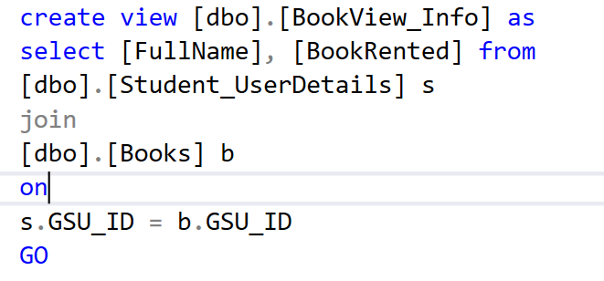
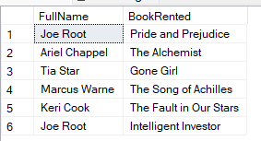
VIEWS
A view is a virtual table based on the result set of an SQL statement.
In this project, two views have been created.
They are [dbo].[BookView_Info] and [dbo].[GenderView_Info].
View 1: [dbo].[BookView_Info]
Output of BookView_Info

Slide 10
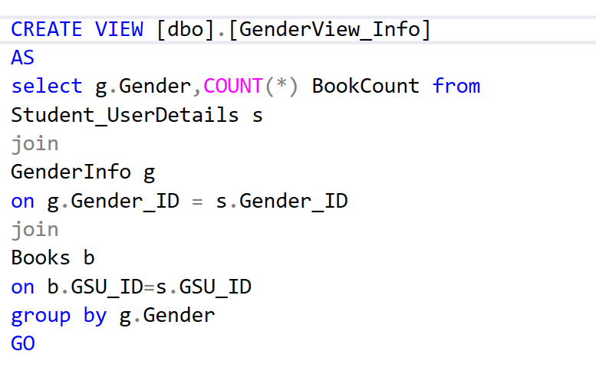

Output of [dbo].[GenderView_Info]
View 2: [dbo].[GenderView_Info]

Slide 11
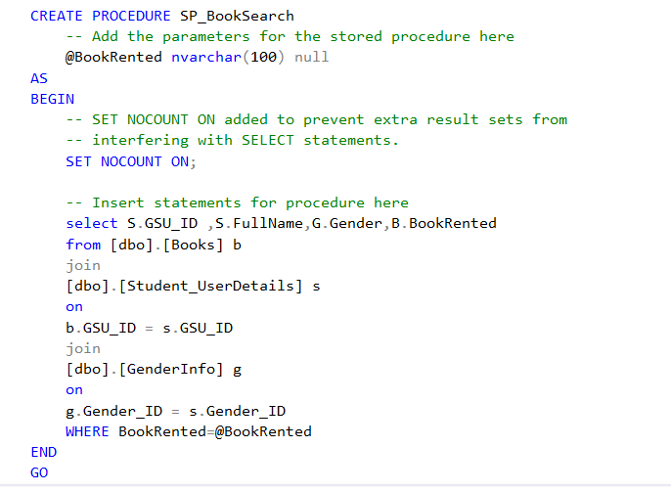
STORED PROCEDURES
A stored procedure is an SQL code, which can be reused any number of times.
Stored Procedure 1: [dbo].[SP_BookSearch]

Slide 12
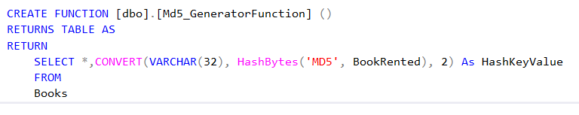
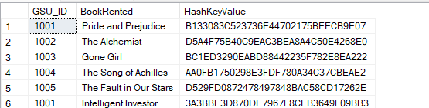
FUNCTIONS
To use sql code repeatedly, function can be used.
In this project, one function named [dbo].[Md5_GeneratorFunction] has been created.
[dbo].[Md5_GeneratorFunction]
Output of Md5_GeneratorFunction

Slide 13
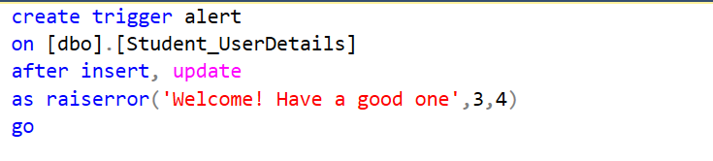
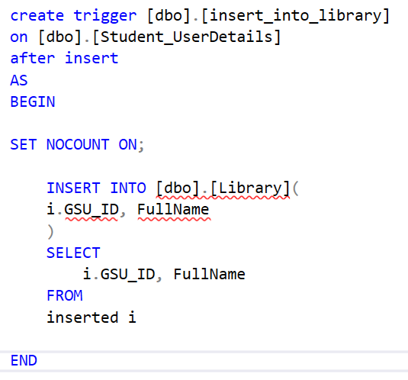
TRIGGERS
Trigger 1: [dbo].[alert]
A trigger is a special type of stored procedure that automatically runs when an event occurs in the database server.
Triggers fire when any valid event fires.
Trigger 2: [insert_into_library]

Slide 14
Thank you

