Slide 1
Presentations
Will Doyle

Slide 2
The Basic Structure
Tell me what you’re going to say
Say what you have to say
Tell me what you told me

Slide 3
Outlining a Talk
Start with your conclusions:
What’s the problem and who cares?
What did you find out?
What does your finding mean?
Go back over each part in more detail
Conclude with the conclusions (again)‏

Slide 4
P-G-P
Particular: Begin with something concrete and familiar
General: Expand out to be more broad
Particular: Relate the broader thought back to another familiar example

Slide 5
Powerpoint: The Root of All Evil?
What powerpoint is good for:
Images: pictures, charts, graphs
Organizing thoughts
Key words and concepts
What powerpoint is bad at:
Extensive reading (use a handout)‏
Tables with more than 10 numbers

Slide 6
The Triple Threat
The triple threat is the term for a presentation where the presenter hands out a copy of the slides, projects the slides onto a screen, and then proceeds to read the slides. The overall effect is to place the entire room, including the presenter, into a kind of trance. Do not ever engage in the triple threat.

Slide 7
Information to Ink ratio
Information is whatever is being transmitted to the audience
Ink is the amount of design used to convey that information
The ratio should be LARGE, if there’s more ink than information, there’s a problem.

Slide 8
Examples of Poor Information to Ink Ratios
Transitions from slide to slide
Animation that does not aid in understanding
Graphics that don’t convey much information:

Slide 9
Here’s more text than anyone could ever read
As states decrease funding to higher education, the burden is increasingly passed on to students in the form of higher tuition. Webber (2017) finds that when states decrease funding per student by $1000, students pay $257 more annually on average. This trend has accelerated since the Great Recession. Prior to 2000, the pass-through rate was 10.3 percent, but it has since increased to 31.8 percent.
States budgets use higher education as a “balance wheel,” increasing appropriations in prosperous economies, but disproportionately decreasing appropriations during economic downturns (Hovey 1999). Delaney and Doyle’s (2011) research supports this model using state level data from 1985 to 2004. Compared to other budget categories, higher education is subject to larger cuts and gains. The balance wheel pattern is indicative of volatility, but this volatility follows a discernable, patterned relationship with economic conditions.
Few studies have measured the volatility of state appropriations to higher education. Lacy, et al. (2017) explain the state-level political characteristics that make funding more or less volatile. Using a two-way fixed effects model, they regress volatility of appropriations to higher education on governor appointed SHEEO and SHEEO recommended budget. Results indicate that appropriations are more volatile when the governor appoints the SHEEO and when the SHEEO does not recommend the budget. Other factors that significantly increased volatile appropriations to higher education include partisan change in gubernatorial control, state higher education appropriations per capita, and median household income. Legislative professionalism and divided partisan control of state government were associated with lower levels of volatility. They also find that volatility in appropriations increases during the budget cycle after state revenues experience volatility. This study does not take into account institutional factors that may influence volatility, though it does find that increased enrollment decreased volatility. Our study differs from the Lacy et al. (2017) study by focusing on institutions as the unit of analysis, and specifically emphasizing the role of volatility in other economic conditions as the source.
Li (2017) finds that higher education appropriations exhibit a pattern of punctuated equilibrium, meaning there are periods of stasis punctuated by large budget cuts or increases. While measuring punctuated equilibrium is conceptually different from volatility, budget punctuations are instances of volatility. Using an event history analysis, the predictors of large state budget cuts (greater than 14%) to higher education were: changes in the unemployment rate, changes in tax revenue, a unified Democratic or Republican government, interest group density, and the existence of a merit aid program.

Slide 10
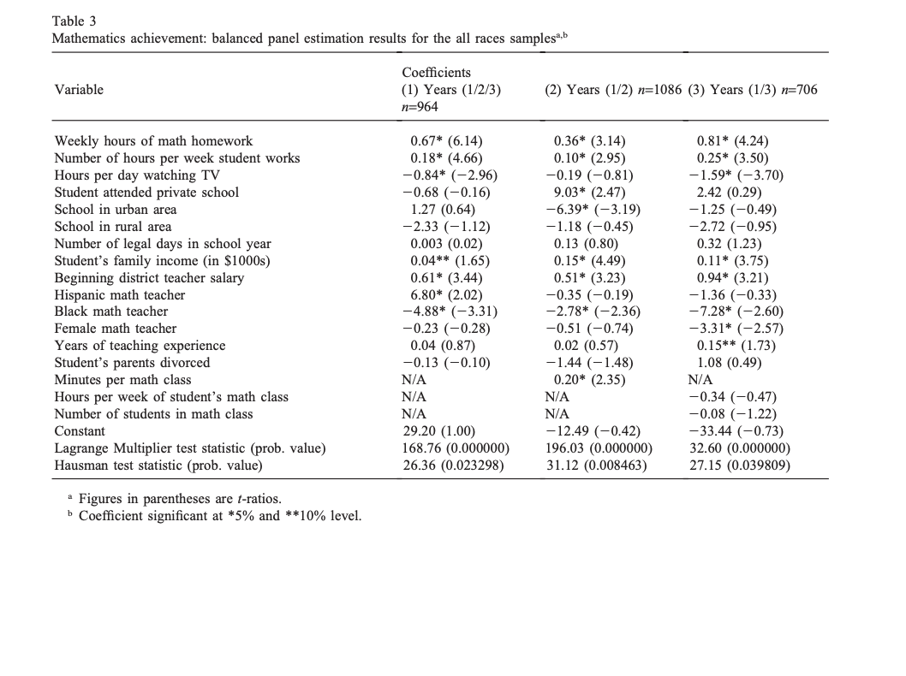
Here’s a Table That You Can’t Read

Slide 11
Here’s Another Table That You Can’t Read
Rank, mean volatility | State | Mean Log Volatility | Rank, trend volatility | State | Mean Log Volatility | Rank, trend & enrollment volatility | State | Mean Log Volatility
1 | NV | 0.59 | 1 | FL | 0.49 | 1 | KS | 0.28
2 | NM | 0.51 | 2 | ND | 0.48 | 2 | IL | 0.27
3 | AZ | 0.48 | 3 | GA | 0.45 | 3 | MN | 0.26
4 | WY | 0.47 | 4 | NV | 0.36 | 4 | GA | 0.26
5 | KS | 0.45 | 5 | UT | 0.34 | 5 | MA | 0.23
6 | CT | 0.44 | 6 | MI | 0.29 | 6 | FL | 0.23
7 | IL | 0.44 | 7 | OH | 0.29 | 7 | WV | 0.23
8 | MS | 0.44 | 8 | MN | 0.28 | 8 | SC | 0.22
9 | UT | 0.43 | 9 | WI | 0.27 | 9 | MI | 0.22
10 | TX | 0.42 | 10 | IL | 0.26 | 10 | LA | 0.22
11 | NC | 0.42 | 11 | WA | 0.26 | 11 | MO | 0.21
12 | AR | 0.42 | 12 | OK | 0.25 | 12 | UT | 0.21
13 | DE | 0.41 | 13 | WV | 0.24 | 13 | TX | 0.2
14 | MD | 0.41 | 14 | KS | 0.24 | 14 | CA | 0.2
15 | MN | 0.41 | 15 | LA | 0.22 | 15 | NV | 0.2
16 | NE | 0.4 | 16 | CA | 0.22 | 16 | OH | 0.2
17 | CA | 0.4 | 17 | TX | 0.21 | 17 | WI | 0.19
18 | MA | 0.38 | 18 | MA | 0.21 | 18 | OR | 0.19
19 | GA | 0.37 | 19 | SC | 0.21 | 19 | MS | 0.19
20 | IA | 0.36 | 20 | MS | 0.19 | 20 | AL | 0.19
21 | ID | 0.36 | 21 | HI | 0.19 | 21 | NM | 0.19
22 | FL | 0.35 | 22 | DE | 0.18 | 22 | HI | 0.18
23 | VA | 0.34 | 23 | NH | 0.17 | 23 | NH | 0.17
24 | AL | 0.34 | 24 | IN | 0.17 | 24 | OK | 0.17
25 | ND | 0.34 | 25 | NM | 0.17 | 25 | NJ | 0.17
26 | NH | 0.33 | 26 | VA | 0.16 | 26 | IN | 0.17
27 | MO | 0.33 | 27 | OR | 0.16 | 27 | DE | 0.16
28 | WV | 0.33 | 28 | AZ | 0.16 | 28 | ND | 0.16
29 | OK | 0.33 | 29 | AL | 0.15 | 29 | VA | 0.16
30 | MI | 0.32 | 30 | TN | 0.15 | 30 | SD | 0.15
31 | NY | 0.31 | 31 | AR | 0.15 | 31 | WA | 0.15
32 | WI | 0.31 | 32 | NY | 0.15 | 32 | AZ | 0.15
33 | OH | 0.31 | 33 | MO | 0.14 | 33 | RI | 0.15
34 | TN | 0.31 | 34 | NJ | 0.14 | 34 | AR | 0.15
35 | IN | 0.31 | 35 | ID | 0.14 | 35 | IA | 0.15
36 | WA | 0.3 | 36 | NC | 0.14 | 36 | WY | 0.15
37 | LA | 0.29 | 37 | PA | 0.13 | 37 | TN | 0.15
38 | SD | 0.28 | 38 | WY | 0.13 | 38 | NY | 0.14
39 | ME | 0.28 | 39 | CT | 0.12 | 39 | NC | 0.14
40 | HI | 0.27 | 40 | RI | 0.12 | 40 | CT | 0.14
41 | MT | 0.27 | 41 | IA | 0.12 | 41 | NE | 0.13
42 | OR | 0.27 | 42 | KY | 0.12 | 42 | ID | 0.13
43 | VT | 0.27 | 43 | MT | 0.11 | 43 | MD | 0.13
44 | NJ | 0.26 | 44 | MD | 0.11 | 44 | MT | 0.13
45 | PA | 0.25 | 45 | NE | 0.1 | 45 | PA | 0.13
46 | KY | 0.25 | 46 | VT | 0.09 | 46 | KY | 0.12
47 | SC | 0.24 | 47 | ME | 0.09 | 47 | VT | 0.11
48 | RI | 0.19 | 48 | SD | 0.07 | 48 | ME | 0.09

Slide 12
Logistics
Be early
Know the technology you plan to use
Practice, practice beforehand
Talk slowly (but talk!)
Be prepared to adapt: talking is the only sure thing
Plan to finish early

