Slide 1

Replicating DeepMind
Computational neuroscience project by Ardi, Ilya, Kristjan and Taivo
Tartu, Estonia, 2014/05/25

Slide 2
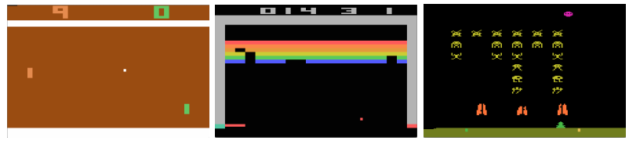
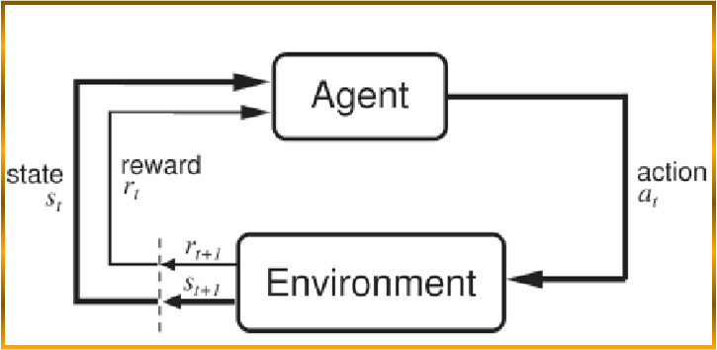
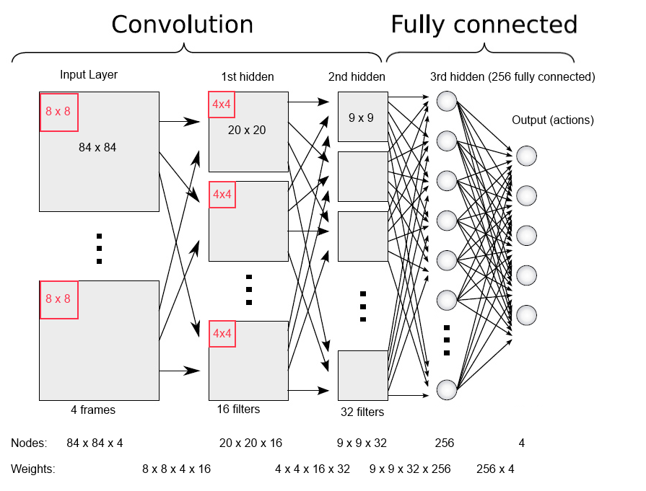
Playing Atari with Deep Reinforcement Learning

Slide 3
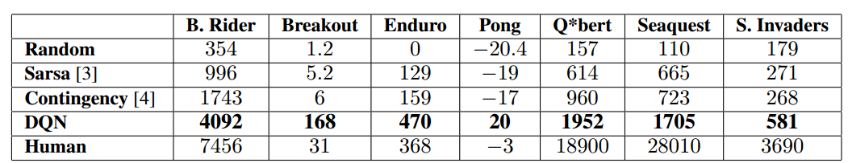
Results

Slide 4
People associated with DeepMind
Demis Hassabis
Poker player, computer game designer and neuroscientist
Shane Legg
Universal Intelligence: A Deﬁnition of Machine Intelligence
„Intelligence measures an agent’s ability to achieve goals in a wide range of environments.“
Jaan Tallinn
Investor of DeepMind

Slide 5
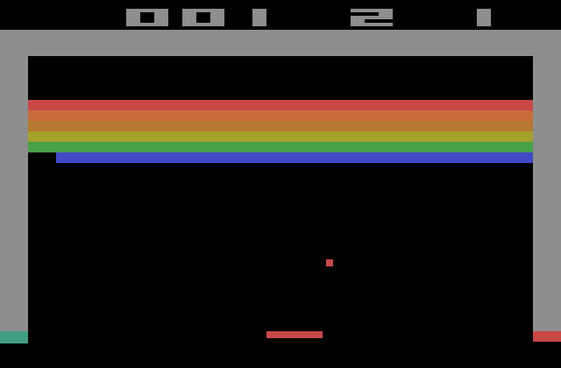
Notes:
Our goal: replicate the full system. Have a minimum viable project ready.

Slide 6

Structure of the DeepMind
Play lots of games
Play lots of frames
Get a frame and pre-process it
Choose action using Deep Neural Net (DNN) and current state
Do it randomly with probability e
Observe reward and next image and save everything to the memory
Train the network
32 random transitions: 32 x (state, reward, action, state)
Q-learning
$\text{Reward}=r_{t}+γ∙DNN({\text{State}}_{t+1})$
Gradient decent
Notes:
pre-process: 210 × 160 RGB -> 110×84 gray-scale -> 84 x 84

Slide 7
Pre-processing
Image
210 × 160 RGB
110 × 84 gray-scale
84 x 84
Every 4th frame from the emulator
State contains 4 frames
Reward is binarized

Slide 8

Structure of the DeepMind
Play lots of games
Play lots of frames
Get a frame and pre-process it
Choose action using Deep Neural Net (DNN) and current state
Do it randomly with probability e
Observe reward and next image and save everything to the memory
Train the network
32 random transitions: 32 x (state, reward, action, state)
Q-learning
$\text{Reward}=r_{t}+γ∙DNN({\text{State}}_{t+1})$
Gradient decent
Notes:
pre-process: 210 × 160 RGB -> 110×84 gray-scale -> 84 x 84

Slide 10
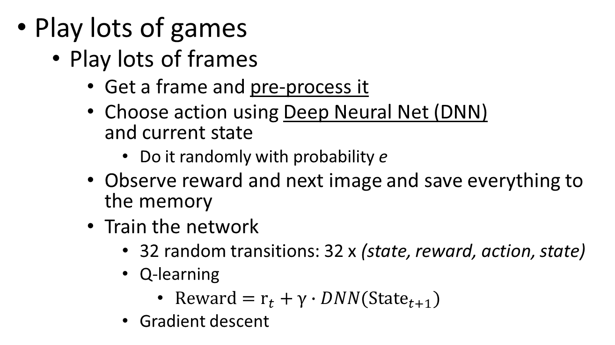
Structure of the DeepMind
Play lots of games
Play lots of frames
Get a frame and pre-process it
Choose action using Deep Neural Net (DNN) and current state
Do it randomly with probability e
Observe reward and next image and save everything to the memory
Train the network
32 random transitions: 32 x (state, reward, action, state)
Q-learning
$\text{Reward}=r_{t}+γ∙DNN({\text{State}}_{t+1})$
Gradient descent
Notes:
pre-process: 210 × 160 RGB -> 110×84 gray-scale -> 84 x 84

Slide 11
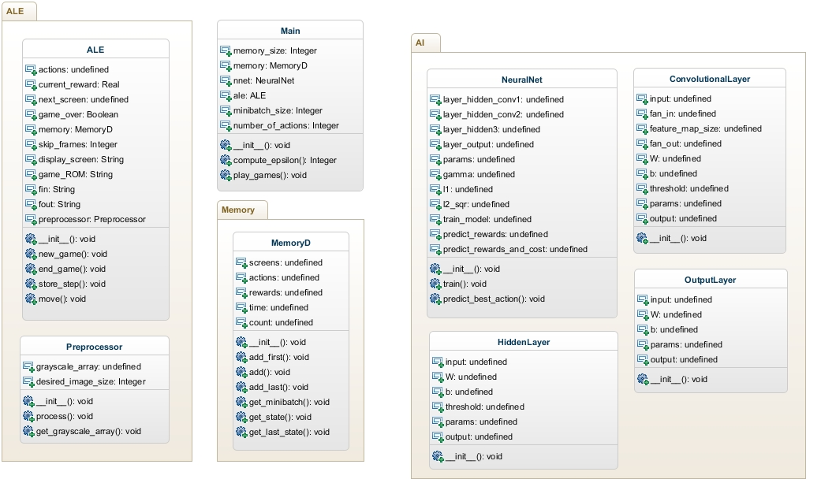
Did we achieve our goal? Almost yes!

Slide 12
What next?
Need to understand and implement one algorithm
Need to convert some stuff from CPU to GPU
Need to parallelize some of the code
Probably need to optimize some parameters

Slide 13
Replicating DeepMind
Computational neuroscience project by Ardi, Ilya, Kristjan and Taivo
Tartu, Estonia, 2014/05/25

