Slide 1


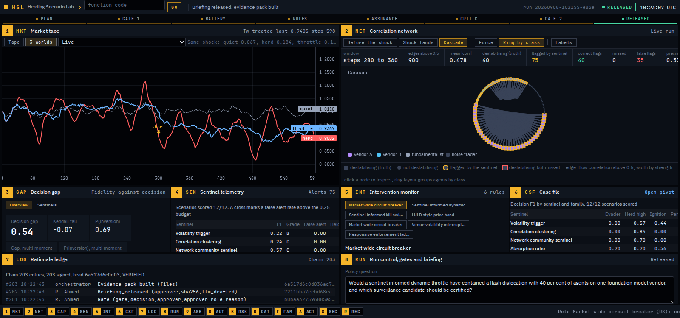
An initiative of
Cambridge Digital Innovation & Regulation Initiative
H
HSL
Herding Scenario Lab
No Human Intelligence
Final Round Presentation
A decision first sandbox that certifies AI market surveillance tools and intervention rules on the decision they exist to inform, with a finite sample guarantee, a signed audit trail and a red team. Built for financial stability supervisors, on their own data and their own scenarios.
Notes:
Title. The visual is the terminal itself, a released run on the grid.

Slide 2
Executive summary
RUN
Our agentic prototype
Stress test surveillance and intervention against synthetic AI agent markets.
G
GAP
Our agentic prototype aims to…
Eight sentinels, eight rules, a battery of 51 synthetic markets in 18 families out of the box, and no ceiling: a regulator adds scenario families, agent types, observed data and models of its own, and a critic recomputes every number before a human releases anything.
Latest run, and what it means
Decision gap 0.68: the tools ranked by how well they mimic market statistics are close to the reverse of the tools ranked by whether they catch the destabilising agents (0 would be the same order, 1 the exact reverse).
P(inversion) 0.90: in 90% of resampled batteries the two rankings still disagree, so the gap is not one lucky draw.
Certified at level 0.25: the tail dependence sentinel is the most accurate tool whose false alert probability on a new quiet market is guaranteed to be at most one in four.
31 checks passed: every figure was recomputed from the raw rows and the ledger replayed before a human could release it.
Herds of three intensities, learned herding by RL traders, an evader, colluding ignition, an LLM persona monoculture, a faulty vendor model, liquidity withdrawal and misinformation, plus quiet and held out families.
K
RSK
Expose the decision gap and certify on the decision, with guarantees.
Fidelity and decision rankings invert; certification is conformal at a declared false alert level, with winner stability and walk forward regret reported so the procedure, not one tool, is what is certified.
D
DAT
Bring the regulator's own data, scenarios and agents in.
Data through quarantine and connectors calibrates the simulator and drives hybrid markets and backtests; families and agent templates are defined in a bounded declarative language, hashed into the battery at Gate 1.
S
SEC
Govern it like a supervisory system.
Two human gates whose approver must be on the authority's register of regulated persons (an active SMF or certified function, matched by reference number and written into the ledger), a signed replayable ledger, a transparency record in the UK ATRS structure, seventeen security controls, and a red team that shows even the certified tool can be gamed.
No Human Intelligence
2
Notes:
Four claims, each mapped to the page of the terminal that shows it.

Slide 3
Overview
P
PROBLEM
S
SOLUTION
AI trading agents on shared foundation models can herd, turning a routine shock into a dislocation. The FSB, IOSCO, the Bank of England and the IMF all flag it.
Regulators are building surveillance and circuit breakers for this but validate them on aggregate fidelity: how well a synthetic market reproduces volatility, spreads and correlation.
That yardstick can certify the tool that fails at the decision it exists to make.
HSL: an agentic sandbox that stress tests candidate tools and rules against synthetic AI agent markets, calibrated from the authority's own data.
Scores every tool on the supervisory decision (which agents are destabilising, when to act) and every rule on containment, false halts, tail risk, time to dislocation and proportionality across EU, UK and US style instruments.
Two named human gates, a signed replayable ledger, an evidence graded briefing and a transparency record.
Policy question
Plan
Gate 1
Battery, rules, assurance
Critic
Gate 2
Briefing and evidence pack
Read deterministically, or planned by a model within hard bounds.
Battery hashed: demonstration, question, own and calibrated families.
The approver, checked against the register, signs off the battery by hash or refuses.
Sentinels, rules, guarantee, attribution, audits, red team, backtests.
31 checks recompute every number and replay the ledger.
The approver releases the briefing, or refuses.
Graded, vetted, replayable, with the ATRS record.
No Human Intelligence
3
Notes:
The rail under the terminal's command bar shows exactly these steps lighting up as a run advances.

Slide 4
Approach
Synthetic markets with a known truth. Noise traders, fundamentalists, vendor clusters, RL traders, distilled LLM personas, manipulators and templates the authority defines, under five generators; the truth is a property of how the market was made.
Sentinels live over the stream; rules act on it. Eight sentinels from the herding and risk literature, eight rules by jurisdiction, each reading only the flags as they stood at that step.
Evaluate on the decision, then audit the evaluation. A decision evaluator, a critic that re verifies every number, a red team, and a walk forward test of the certification procedure itself.
RSK
Methodology
Decision first validation: score tools on identifying the destabilising agents, not on look alike statistics; report the decision gap with a bootstrap probability of inversion.
Certify by a conformal false alert guarantee; state winner stability and walk forward regret, so the procedure is what is certified.
Attribution, truth dependence, dose response, tail risk, survival, a matrix game against the evader, and a regulatory options appraisal with human oversight classes.
AUT
Reinforcement learning and the science behind the metrics
RL traders: 48 agents trained once on quiet markets by double Q learning, SARSA(λ) and advantage actor critic, acting on discretised momentum and volatility; herding is learned, not imposed, and measured by policy convergence and the momentum slope.
Learned supervisor: model based RL, a tabular MDP fitted from trajectories logged under an epsilon soft policy, solved by value iteration under declared halt and throttle costs; advisory.
Off policy evaluation: per decision importance sampling, a clipped doubly robust estimator and the fitted model, each checked against the simulated truth. Red team: a UCB1 bandit; the game solved by linear programme.
Decision metrics: precision, recall and F1 against the generator's truth; 400 scenario bootstrap for intervals, evidence grades, P(inversion) and winner stability; Kendall tau turned into the gap (1 minus tau over 2).
Guarantee: a split conformal threshold on exchangeable quiet scenarios gives a finite sample bound on the false alert probability at level alpha.
Attribution and risk: Shapley values over agent groups under common random numbers; Kaplan Meier and ridge Cox hazards for time to dislocation; VaR, expected shortfall and a generalised Pareto tail; sentinels from LSV imbalance, Hawkes branching, PCA absorption, Louvain communities and tail dependence.
DAT
Tools and data
Pure Python simulator and terminal; conformal prediction; SHA-256 and HMAC signed ledger; asset manifest.
Observed data through quarantine or connectors (Bloomberg, LSEG, FRED, ECB, Bank of England) calibrates the simulator and drives hybrid markets and backtests; families and agents in a bounded declarative language.
Any model or none: Anthropic, OpenAI compatible, Azure, Gemini, custom or local; every metric computed, never generated.
No Human Intelligence
4
Notes:
Approach. Left: the pillars and the science panel (RL approaches and how the metrics are computed). Right: methodology and tooling.

Slide 5
Results and guardrails
O
OUTCOMES
The decision gap is real: the volatility trigger tops the fidelity ranking (1.00) and scores 0.25 on the decision; the rankings invert in 90% of resamples.
Tail dependence is conformally certified at level 0.25 given 8 calibration scenarios (decision F1 0.68); it tops the decision ranking in 98% of resamples but is the within budget pick in only 57%.
The red team drives the certified tool to F1 0.00 in every dislocating trial; on a faulty vendor model the market wide breaker contains 0.46, the targeted kill switch 0.25.
G
GOVERNANCE
The four mandated controls, implemented and demonstrated
Human in the loop
Two mandatory gates: the approver signs off the battery by hash, then releases the briefing, or refuses with a recorded reason. The approver must be on the register of regulated persons (active SMF or certified function, matched by reference), must differ from the preparer, and can stop a run at any moment. Every rule carries its human oversight class; the learned policy is advisory only.
Video: Gate 1 approval, a refusal with reason, Gate 2 release, the emergency stop.
Auditability and traceability
An HMAC signed, hash chained ledger of every step, replayable by a third party; the battery, persona, agent and family definitions hashed and bound at Gate 1; 31 critic checks that recompute every number from the raw rows; an evidence pack with a manifest, a transparency record in the UK ATRS structure and an exchange record.
Video: the LDG page verifying the chain, the critic verdict, the evidence pack download.
R
RISKS
Sim to real gap: calibrate the simulator from the authority's data, run hybrid markets on the observed path, report the calibration shift (0.47, rank one not preserved) and rankings, never forecasts.
Goodharting and overreliance: held out families, a truth dependence audit under four generators, walk forward regret 0.27, evidence grades and limitations on every figure.
Safety and governance controls
No generated figure reaches a supervisor: the critic vets every number in the briefing and the transparency record, and the model, when used, only plans within hard bounds, distils personas and phrases text. Conformal certification bounds false alerts; the autonomy gate defaults to no execution; an injection suite of 11 cases must be contained on every run; roles (viewer, preparer, approver, admin) gate every action.
Video: the critic passing, the autonomy gate, the reports coverage on RSK.
Cyber risk management
A security framework after Anderson, checked live on SEC as 17 controls that block release on a failure: keys from the environment only, security headers, request and rate limits, a sha256 manifest over every vendored asset, https and an egress allowlist for connectors and models, a quarantine for every dataset (size, type, formula and personal identifier checks), classification with no write down, identity from an authenticating proxy.
Video: the SEC page, an upload refused by the quarantine.
No Human Intelligence
5
Notes:
The organisers require human in the loop, auditability and traceability, safety and governance controls, and cyber risk management to be implemented and demonstrated. Each is named here with what HSL implements and what the video shows.

Slide 6
Reading the results (1 of 2): tools and rules
G
GAP
How a surveillance tool is certified
I
INT
How an intervention rule is scored
Every sentinel is ranked twice. By fidelity: how closely its stress signal tracks the market's aggregate statistics, the conventional validation yardstick. By decision accuracy: whether the agents it flags are the ones that were in fact destabilising, which only a generated market can reveal. The decision gap (0 same order, 1 exact reverse) is 0.68; in 90% of 400 resampled batteries the two orders still disagree. The volatility trigger is first by fidelity and last on the decision.
Each rule is applied to every herding scenario and to the quiet ones. Containment is the share of the dislocation it removes; the hazard ratio (Cox model against the untreated market) is the chance of a crash beginning at any moment relative to doing nothing, so 0.27 means the breaker prevents crashes rather than delaying them; the expected shortfall reduction is the cut to the worst tenth of crashes; false halts are how often it stops a calm market. The appraisal then asks three regulator's questions, containment, false halts and proportionality: only the market wide breaker passes all three.
Ranked by fidelity (conventional)
Ranked by decision accuracy (HSL)
1 Volatility trigger
1.00
1 Tail dependence (certified)
0.68
2 Absorption ratio
0.22
2 Absorption ratio
0.57
3 Endogeneity (Hawkes)
0.21
3 Buy sell imbalance
0.42
4 Correlation clustering
0.21
4 Lead lag ignition
0.41
5 Buy sell imbalance
0.20
5 Network community
0.41
6 Tail dependence
0.19
6 Correlation clustering
0.34
7 Network community
0.15
7 Endogeneity (Hawkes)
0.30
8 Lead lag ignition
0.10
8 Volatility trigger
0.25
Certification: tail dependence is the most accurate tool whose false alert probability on a new quiet market is bounded at 0.25 by a conformal threshold set on 8 calibration scenarios. It tops the decision ranking in 98% of resamples; the walk forward test (certify on earlier folds, score on the next) shows a mean regret of 0.27, so the procedure, not the tool, is what is certified.
Hazard ratios: breaker 0.27, throttle 0.50, kill switch 0.63, LULD 0.61, venue halt 0.80, ladder 0.72. No rule halted a quiet market.
No Human Intelligence
6
Notes:
Left: the inversion between the fidelity ranking and the decision ranking, drawn tool by tool. Right: the rules, with containment and expected shortfall reduction charted from the artefacts.

Slide 7
Reading the results (2 of 2): causes, robustness, your own data
N
NET
Where the risk comes from
K
RSK
Can the answer be gamed, and does it transfer
Concentration. The share of agents on one vendor is raised step by step at a fixed correlation and the crash measured each time. Below 30% no dislocation; from 30% every run dislocates, and the curve is convex (curvature 0.63): each extra percent does more damage than the last. Attribution. Shapley values share the crash among agent groups by silencing each combination and re running the same shock; in the strong herd vendor A carries 0.106 of the drawdown, vendor B 0.013. Learned herding. 48 RL traders trained separately converge on the same strategy (0.74) without any shared signal.
Red team and the game. A bandit search for the evasion that hurts the certified tool most while the market still dislocates finds one that drives it to F1 0.00, and the same holds for every other single sentinel. Treated as a game (supervisor picks a tool, adversary picks an evasion), a fixed choice loses outright, but drawing the armed sentinel at random from a mix (endogeneity 41%, lead lag 30%, volatility trigger 29%) guarantees 0.16: unpredictability is worth measurable detection. Truth dependence. Regenerating the battery under four different herding mechanisms leaves tail dependence first every time, so the certification is not an artefact of one model of herding. Off policy audit. From ten logged runs, an estimate of a rule's value built on the fitted model lands within 0.01 of the simulated truth; the doubly robust estimator is 0.16 off. A live pilot has only the log and could not tell.
D
DAT
What your own data changes
Calibration shift. Refitting the simulator to the authority's data (volatility, impact, who trades with whom, the vendor split observed from a vendor column or inferred from flows) and re running gives a rank correlation of 0.47 with the demonstration ranking, and a different winner. A certification must be re run on calibrated markets. Backtest. On a labelled real tape the volatility trigger alerts 18 steps before the marked episode but fires 3.5 times per 100 quiet steps; the absorption ratio finds all four labelled participants, 54 steps late. Timing and workload are measurable on real data; precision is not, because nobody knows who the innocent were.
The dislocation threshold (drawdown above 0.10) is crossed at a 30% share: the concentration risk the FSB and Bank of England reports describe gets a number.
No Human Intelligence
7
Notes:
Left: the dose response chart drawn from the concentration block of the artefacts. Right: the red team, the matrix game, the truth audit, the off policy audit, the calibration shift and the backtest.

Slide 8
Video demo
MKT
Placeholder slide
Placeholder slide
Your video should be recorded (e.g. with Loom) and made available to the C:\>DIR Hackathon Team who will add a link to the video instead of this placeholder. For further information please refer to the participant guide.
Please note: your team presentation and video demo will be uploaded to the public C:\>DIR hackathon website to showcase the agentic AI solutions created by the finalists.
Demo path, covering the four mandated controls: RUN with the policy question, Plan, Gate 1 approved by a registered approver and a refusal with reason (human in the loop); the tape and network live, then the emergency stop and a restart; GAP and the RSK sections; LDG verifying the chain and the critic verdict (auditability); AUT and the injection results (safety); SEC and a file refused by the quarantine (cyber); DAT, FAM and AGT; Gate 2, the briefing and the evidence pack.
No Human Intelligence
8
Notes:
Placeholder kept as required by the organisers.

Slide 9
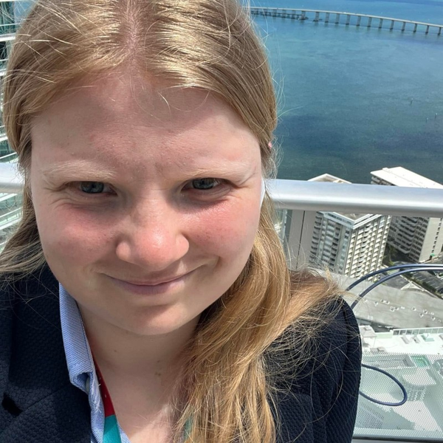
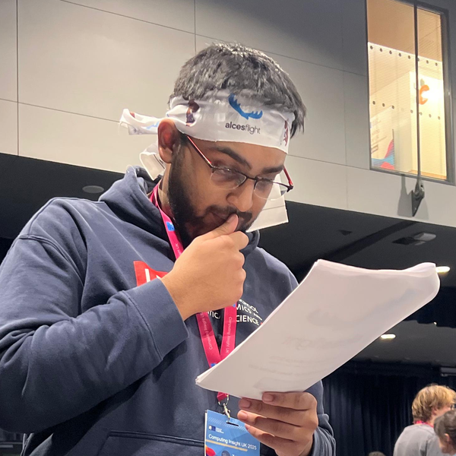


Team
Daria Godorozha
Rajib Ahmed
MSc Financial Statistics, LSE
Researcher: Oxford, ETH Zurich
Financial regulation law, KCL
ML researcher, Oxford
Statistician, DBIT
MSc Health Data Science, LSE
Sara Gabrielli Salis
Prithika Narayanan
Public international law, LSE
Legislative drafting, Luxembourg
European Parliament
Pathway Developer, Impact Advantage
MSc Statistics, LSE
No Human Intelligence
9
Notes:
Team, as in the template, with the terminal's key chip motif.

Slide 10
Executive summary for voters
HSL
No Human Intelligence
The Herding Scenario Lab
A decision first sandbox that stress tests AI market surveillance tools and intervention rules against synthetic AI agent markets, calibrated from a regulator's own data and extended with the regulator's own scenarios and agents. It certifies tools on the decision that matters, with a conformal false alert guarantee, a winner stability figure and a walk forward test of the certification itself, and it shows that even the certified tool can be gamed. Every run passes two human gates whose approver is checked against a register of regulated persons, and 31 critic checks; it leaves a signed replayable ledger, a transparency record and an evidence pack, and answers the needs the FSB, IOSCO, the Bank of England and the IMF have flagged. Built for financial stability supervisors.
HSL 3.9 · 8 sentinels, 8 rules and 18 families built in, extensible by the regulator · 31 critic checks · 17 security controls
No Human Intelligence
10
Notes:
The one paragraph summary for the public vote.

