Slide 1

Note: The data and information in this document is reflective of a hypothetical situation and client. This document is to be used for KPMG Virtual Internship purposes only.
Sprocket Central Pty Ltd
Data analytics approach
[Division Name] - [Engagement Manager], [Senior Consultant], [Junior Consultant]

Slide 2
Note: The data and information in this document is reflective of a hypothetical situation and client. This document is to be used for KPMG Virtual Internship purposes only.
Agenda
Introduction
Data Exploration
Model Development
Interpretation

Slide 3
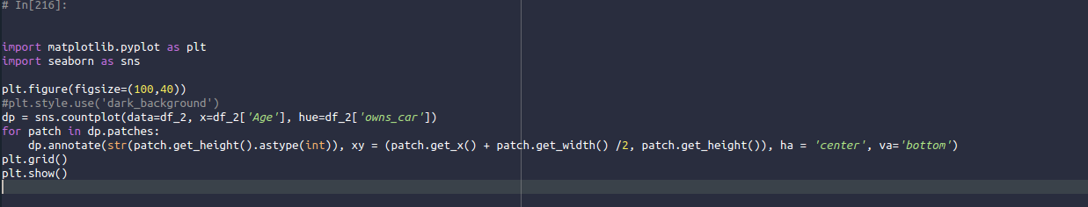
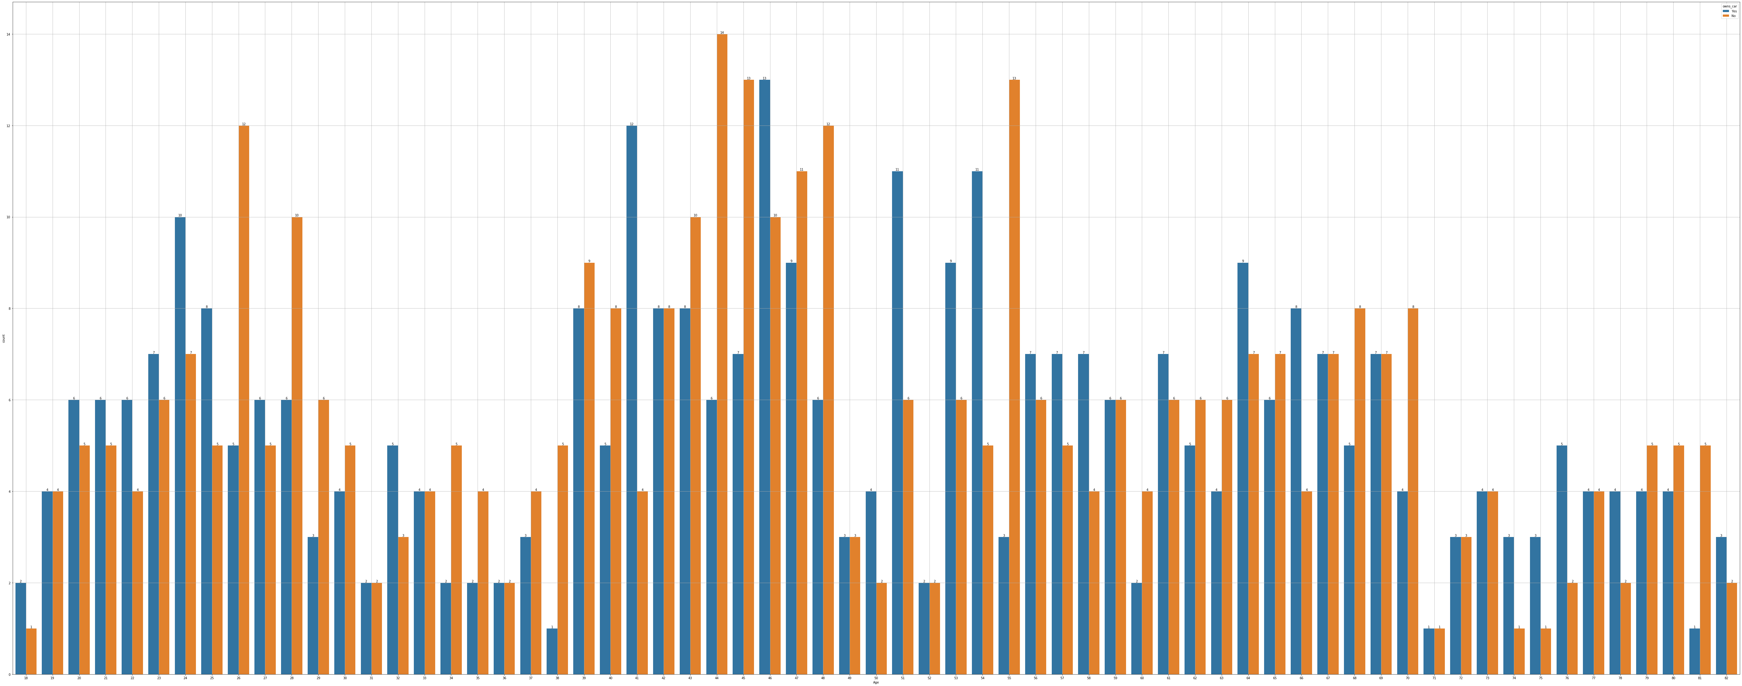
Note: The data and information in this document is reflective of a hypothetical situation and client. This document is to be used for KPMG Virtual Internship purposes only.
Introduction
ANALYSIS OF “NEWCUSTOMERLIST”
As per the Gender, You can observe how many persons owned a car in Australia.
gender owns_car
Female No 185
Yes 184
Male No 181
Yes 165

Slide 4
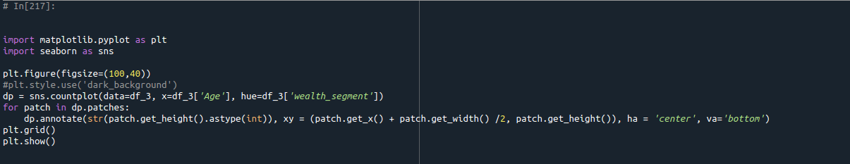
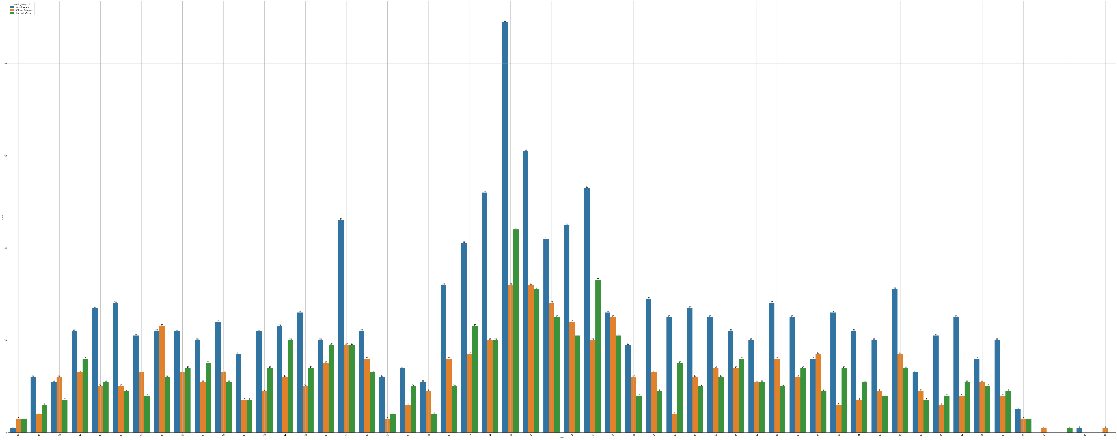
Note: The data and information in this document is reflective of a hypothetical situation and client. This document is to be used for KPMG Virtual Internship purposes only.
Data Exploration
ANALYSIS OF “CUSTOMERDEMOGRAPHIC SHEET”
As per the Gender, You can observe what is the wealth segment of a person.
gender wealth_segment
Female Affluent Customer 316
High Net Worth 359
Mass Customer 693
Male Affluent Customer 340
High Net Worth 315
Mass Customer 607
Name: wealth_segment, dtype: int64

