Slide 1
All About CSS
Basics of CSS.
Saurabh Singh(24 Jan 2026)

Slide 2
Get started with CSS basics: selectors, properties, and where to write styles.

Slide 3
CSS basics
Topics to be covered
What is CSS?
Where to Write CSS
CSS Syntax Basics
CSS Selectors (Very Important)
Common CSS Properties (Starter Set)
How CSS is Applied (Cascade Rule)

Slide 4
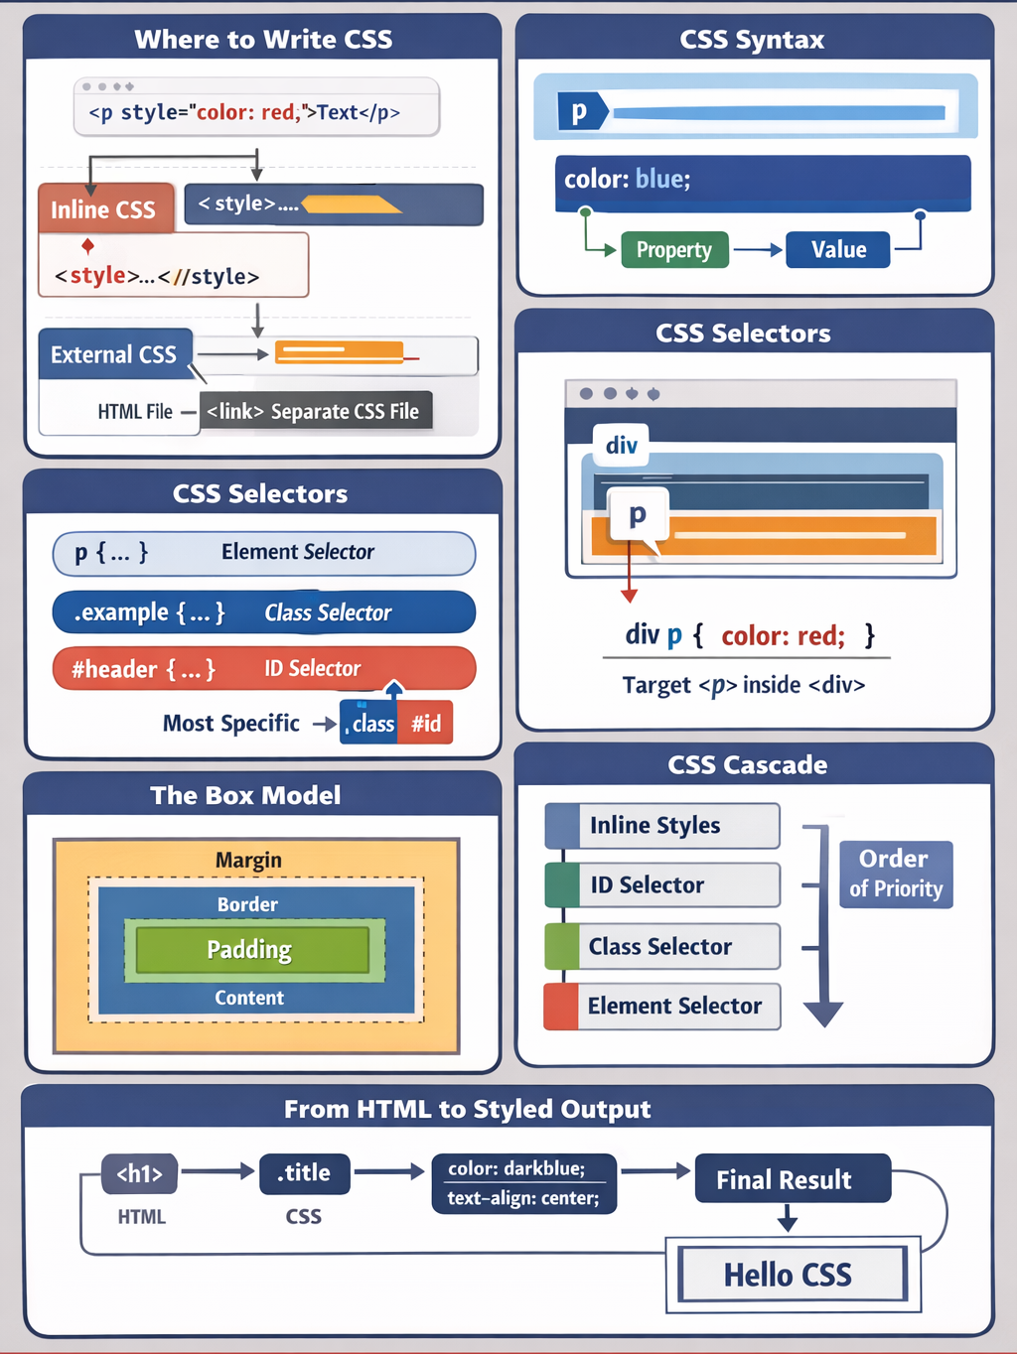

Slide 5
What is CSS?
CSS (Cascading Style Sheets) controls how HTML elements look on the page—colors, spacing, layout, fonts, and responsiveness.
HTML = structure
CSS = appearance

Slide 6
Where to use CSS
Inline CSS (not recommended for real projects)
Written directly inside an HTML tag.
<p style="color: red; font-size: 18px;">Hello World</p>
Pros: Quick testing
Cons
  Hard to maintain
  No reuse
  Avoid in production

Slide 7
Where to use CSS
Internal CSS (inside <style> tag)
Written in the <head> of an HTML file.
<head>
<style>
p {
color: blue;
font-size: 16px;
}
</style>
</head>
Use case
  Small pages
  Prototypes

Slide 8
Where to use CSS
External CSS (best practice)
Written in a separate .css file
index.html
<link rel="stylesheet" href="styles.css">
style.css
p {
color: green;
font-size: 16px;
}
Why
  Clean separation
  Reusable
  Scales well
  Used in all real projects

Slide 9
CSS Syntax Basics
Css has three parts
selector {
property: value;
}
Example
h1 {
color: purple;
text-align: center;
}

Slide 10
CSS Selectors (Very Important)
Element Selector
Selectors decide which HTML elements get styled.
Element Selector targets all element of a type
css
p {
color: black;
}
Targets
<p>All paragraphs</p>

Slide 11
CSS Selectors (Very Important)
Class Selector
Starts with a ‘.’
css
.card {
border: 1px solid gray;
padding: 16px;
}
HTML
<div class="card">Content</div>
You can reuse classes many times

Slide 12
CSS Selectors (Very Important)
ID Selector
Starts with #
css
#header {
background-color: light blue;
}
HTML
<div id=“header"></div>
Use IDs sparingly

Slide 13
CSS Selectors (Very Important)
Group Selector
Apply same style to multiple selectors
css
h1, h2, h3 {
font-family: Arial;
}

Slide 14
CSS Selectors (Very Important)
Descendant Selector
Targets elements inside another element.
css
div p {
color: red;
}
Means: all <p> inside <div>

Slide 15
Common CSS Properties
Text
css
color
font-size
font-family
font-weight
text-align
Example
p {
color: #333;
font-size: 14px;
}

Slide 16
Common CSS Properties
Box Model(Very Important)
css
margin
padding
border
width
height
Example
.box {
width: 200px;
padding: 16px;
margin: 10px;
border: 1px solid black;
}

Slide 17
Common CSS Properties
Background
css
background-color
background-image
background-size

Slide 18
How CSS is Applied(Cascade Rule)
Priority Order
  Inline CSS (highest)
  Internal CSS
  External CSS (lowest)
More specific selectors override generic ones
css
<p class="text">Blue wins</p>
html
<p class="text">Blue wins</p>

Slide 19
Understand CSS specificity and selector hierarchy for predictable styling

Slide 20
Understand CSS specificity and selector hierarchy for predictable styling
Topics to be covered
What Is CSS Specificity?
The Specificity Hierarchy (From Lowest to Highest)
How Specificity Is Calculated
Selector Hierarchy in Practice
The Cascade: When Specificity Is Equal
!important: Use with caution
Common specificity Pitfalls
Best Practices for Predictable Styling

Slide 21
What Is CSS Specificity?
CSS specificity is the rule system browsers use to decide which CSS declaration wins when multiple rules target the same element.
More specific selectors override less specific ones.
Specificity prevents ambiguity in styling and is a core part of the CSS Cascade (along with source order and importance).

Slide 22
The Specificity Hierarchy (From Lowest to Highest)
Priority | Selector Type | Examples
1 (Lowest) | Universal selector | *
2 | Element (type) selectors | div, p, h1
3 | Class selectors, attributes, pseudo-classes | .card, [type="text"], :hover
4 | ID selectors | #header, #main
5 (Highest) | Inline styles | style="color:red"
Absolute override | !important | color:red !important

Slide 23
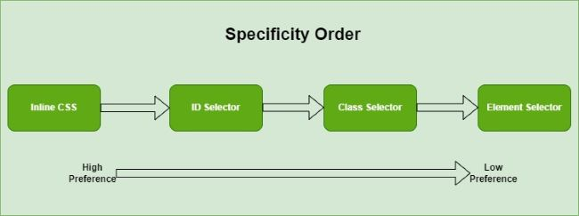

Slide 24
How Specificity Is Calculated
Specificity is calculated as a 4-part score:
(a, b, c, d) {a = Inline styles, b = Number of IDs, c = Number of classes, attributes, pseudo-classes, d = Number of elements, pseudo-elements}
Examples
Browsers compare specificity left to right, just like numbers.
Selector | Specificity
p | (0,0,0,1)
.box p | (0,0,1,1)
#app .box p | (0,1,1,1)
style="color:red" | (1,0,0,0)

Slide 25
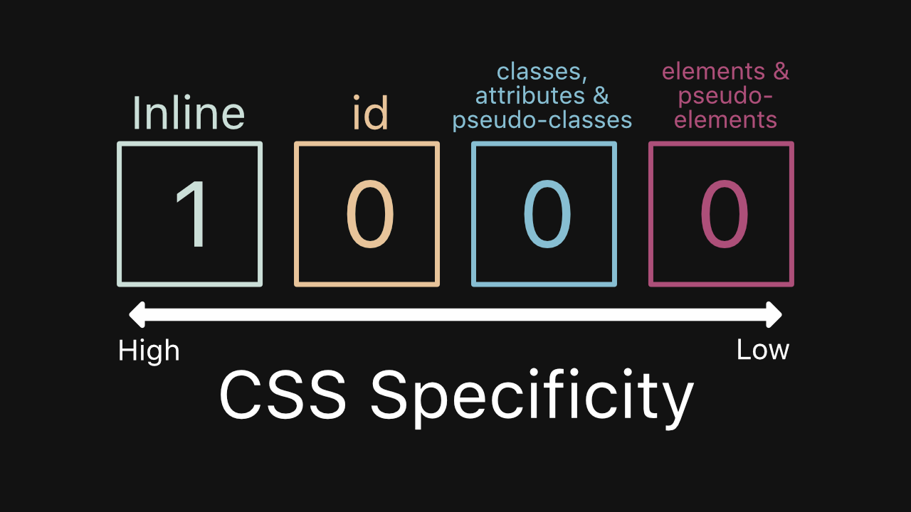

Slide 26
Selector Hierarchy in Practice
css
p {
color: blue;
}
.text {
color: green;
}
#content p {
color: red;
}
Result
Paragraph inside #content → red
Why?
#content p → (0,1,0,1)
.text → (0,0,1,0)
p → (0,0,0,1)

Slide 27
The Cascade: When Specificity Is Equal
If specificity scores are identical, CSS uses source order.
css
.button {
background: blue;
}
.button {
background: black;
}
Result: black (last rule wins)

Slide 28
!important: Use With Caution
Overrides all specificity rules
Makes debugging and maintenance difficult
Should be avoided except for:
  Utility overrides
  Third-party CSS fixes
css
.button {
background: blue !important;
}

Slide 29
Common Specificity Pitfalls
Overly specific selectors
css
div.container ul.menu li a span {
color: red;
}
Hard to override later
Mixing IDs with classes
css
#header .title { }
Locks styling unnecessarily
Fighting CSS with !important
Often indicates poor selector design.

Slide 30
Best Practices for Predictable Styling
Use classes as your primary styling hook
css
.card { }
.card-title { }
.card--highlighted { }
Keep selectors shallow
css
.card-title { } /* good */
.card .content .title { } /* risky */

Slide 31
Best Practices for Predictable Styling
Avoid IDs for styling
  IDs are best for JavaScript and anchors
  Classes scale better
Adopt a naming convention
  BEM (block__element—modifier)
  Utility-first (Tailwind-style)
  Component-scoped CSS

Slide 32
Position elements using static, relative, absolute, fixed, and sticky

Slide 33
Position elements using static, relative, absolute, fixed, and sticky
Topics to be covered
position: static (Default behavior)
position: relative
position: absolute
position: fixed
position: sticky

Slide 34
position: static(default behaviour)
What it means
This is the default position for all HTML elements.
Elements follow the normal document flow (top to bottom, left to right).
top, right, bottom, left, and z-index do not work.

Slide 35
position: static(default behaviour)
Key characteristic
No overlap control
No manual positioning
Layout is predictable
Example:
css
.box {
position: static;
}
Use static when you want standard layout behavior with no positioning logic.

Slide 36
position: relative
What it means
Element stays in normal flow
You can offset it relative to its original position
The original space is still reserved

Slide 37
position: relative
Key characteristics
Can use top, left, etc.
Does not affect surrounding layout
Often used as a reference parent for absolute elements
Example
css
.box {
position: relative;
top: 10px;
left: 20px;
}

Slide 38
position: relative
Common use
Minor nudges
Creating a positioning context for absolute children

Slide 39
position: absolute
What it means
Removed from normal document flow
Positioned relative to the nearest positioned ancestor
If none exists, it positions relative to the viewport

Slide 40
position: absolute
Key characteristics
Surrounding elements ignore it
Precise placement
Requires a reference parent (relative, absolute, or fixed)
Example
css
.parent {
position: relative;
}
.child {
position: absolute;
top: 0;
right: 0;
}

Slide 41
position: absolute
Common use
Dropdowns
Tooltips
Modals (inside containers)

Slide 42
position: fixed
What it means
Removed from document flow
Positioned relative to the viewport
Does not move on scroll

Slide 43
position: fixed
Key characteristics
Always stays visible
Independent of parent containers
Example
css
.navbar {
position: fixed;
top: 0;
width: 100%;
}

Slide 44
position: fixed
Common use
Fixed headers
Floating action buttons
Chat widgets

Slide 45
position: sticky
What it means
Hybrid of relative and fixed
Behaves as relative until a scroll threshold
Then sticks like fixed within its parent

Slide 46
position: sticky
Key characteristics
Requires top, left, etc.
Works only within parent boundaries
Parent must not have overflow: hidden
Example
css
.header {
position: sticky;
top: 0;
}

Slide 47
position: sticky
Key characteristics
Section headers
Sticky table rows
Sidebar navigation

Slide 48
Position | In Flow | Relative To | Scrolls | Typical Use Case
static | Yes | Normal flow | Yes | Default layout
relative | Yes | Itself | Yes | Offset / parent
absolute | No | Nearest positioned parent | Yes | Overlays
fixed | No | Viewport | No | Persistent UI
sticky | Yes → No | Parent + viewport logic | Partial | Smart headers

Slide 49
Rule of thumb
Normal layout → static
Small adjustments → relative
Overlay inside a container → absolute
Always visible UI → fixed
Scroll-aware UI → sticky

Slide 50
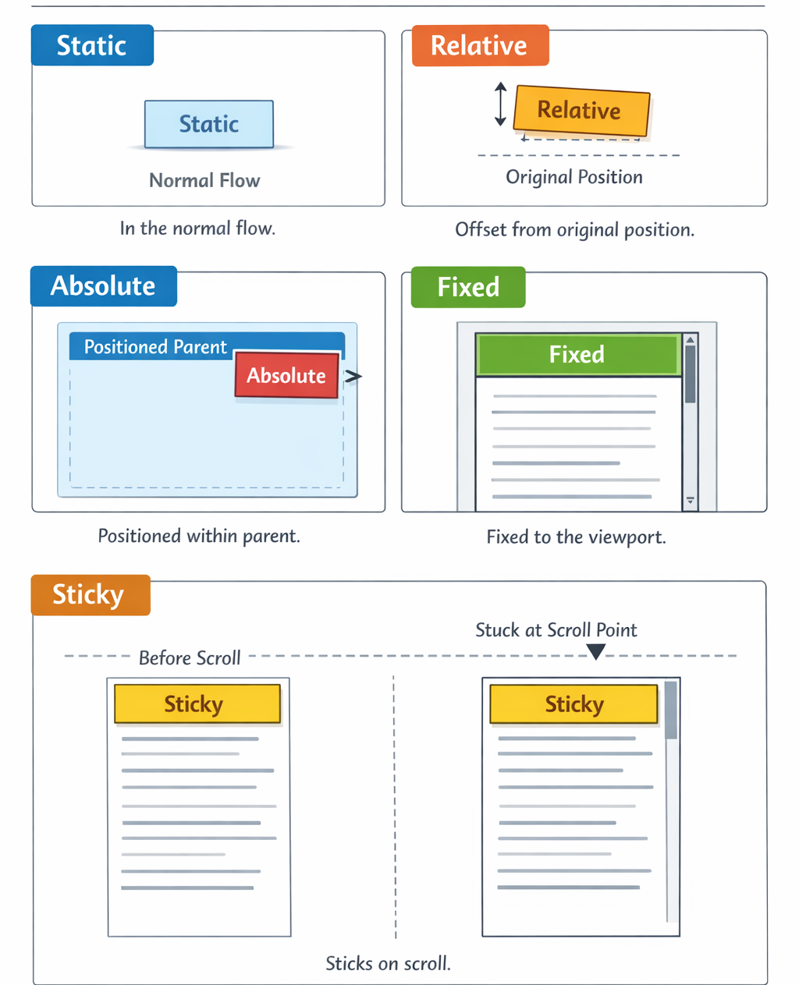

Slide 51
Use Flexbox core properties (justify-content, align-items, flex-wrap, gap) to design

Slide 52
Designing Layouts Using Flexbox Core Properties
Flexbox (Flexible Box Layout)
Flexbox stands for Flexible Box Layout
It is a one-dimensional CSS layout system
Used to arrange elements in:
  A row (horizontal), or
  A column (vertical)
Designed to:
  Distribute space efficiently
  Align items easily
  Build responsive layouts
Layout adapts automatically to different screen sizes

Slide 53
Designing Layouts Using Flexbox Core Properties
Flexbox Layout Model
Flexbox follows a parent–child model
The parent element becomes the flex container
All direct children become flex items
Layout behavior is controlled only by the parent

Slide 54
Designing Layouts Using Flexbox Core Properties
Flex Container
Flexbox is enabled using:
display: flex;
Effects of display: flex:
Children align in a row by default
Items become flexible in size
Parent controls alignment and spacing

Slide 55
Designing Layouts Using Flexbox Core Properties
Flexbox Axes(Main Axis and Cross Axis)
Main Axis
  Primary direction of layout
  Default direction: left to right
  Controlled by:
  justify-content

Slide 56
Designing Layouts Using Flexbox Core Properties
Flexbox Axes(Main Axis and Cross Axis)
Cross Axis
  Direction perpendicular to main axis
  Default direction: top to bottom
  Controlled by:
  align-items

Slide 57
justify-content
Controls alignment along the main axis
Affects horizontal spacing (default)
Common Values:
  Flex-start
  items align at the start
  center
  Items align at the center
  flex-end
  Items align at the end
  space-between
  Equal space between items, none at edges
  space-around
  Equal space around items
  space-evenly
  Equal space between items and edges

Slide 58
align-items
Controls alignment along the cross axis
Affects vertical alignment (default)
Common Values:
  stretch (default)
  Items stretch to fill container height
  flex-start
  Items align to the top
  center
  Items align vertically in the center
  flex-end
  Items align to the bottom
  baseline
  Items align based on text baseline

Slide 59
flex-wrap
Controls whether items stay on one line or wrap
Values:
  nowrap (default)
  All items stay on one line
  wrap
  Items move to the next line if needed
  wrap-reverse
  Items wrap in reverse order
  Used to create responsive layouts

Slide 60
Gap
Defines space between flex items
Applies evenly in all directions
Works with wrapping layouts
Key Points
  No spacing at container edges
  Replaces margins between items
  Ensures consistent spacing

Slide 61
Combined Flexbox Layout Example
.container {
display: flex;
justify-content: space-between;
align-items: center;
flex-wrap: wrap;
gap: 16px;
}
Resulting Behavior:
  Items spread evenly across the row
  Items are vertically centered
  Items wrap to new rows on smaller screens
  Spacing remains consistent

Slide 62
Responsive Layout Behavior
Large screens
  Items appear in one row
Medium screens
  Items wrap into multiple rows
Small screens
  Items stack vertically
Achieved without media queries

Slide 63
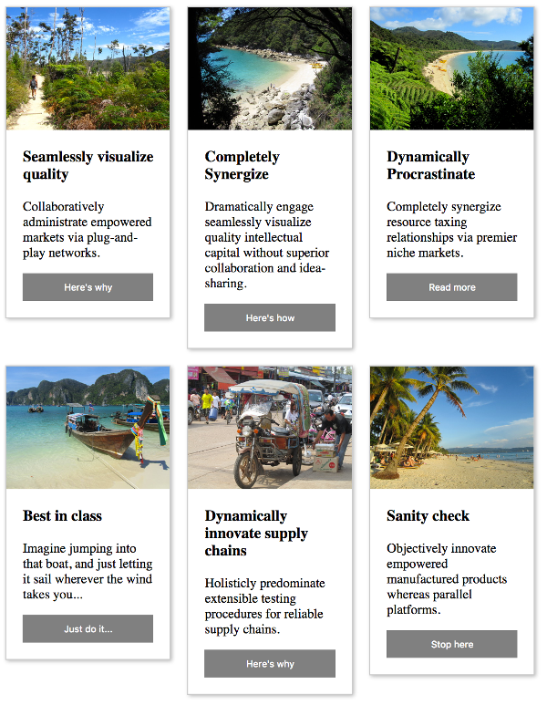

Slide 64
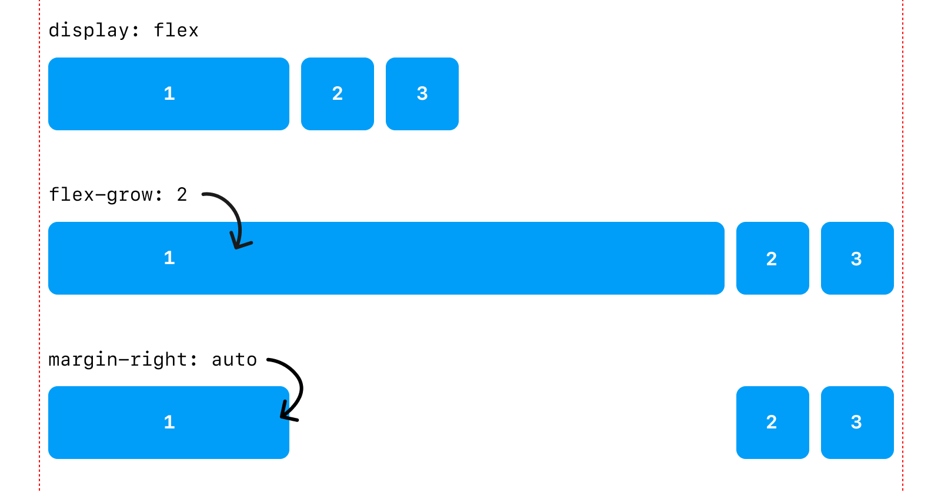

Slide 65
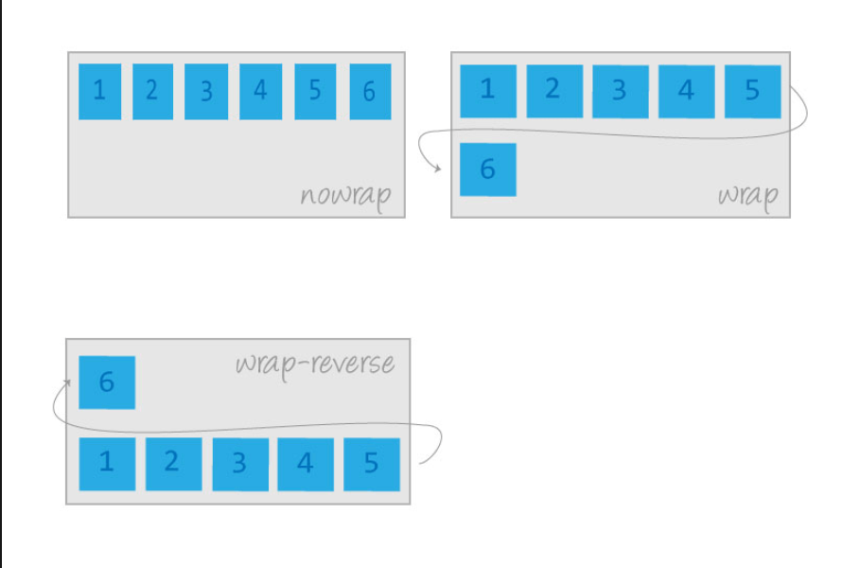

Slide 66
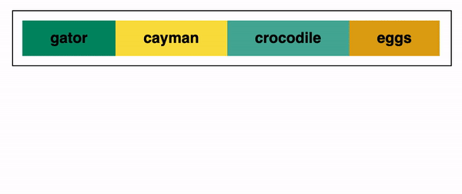

Slide 67
Core Properties Summary
justify-content
→ Controls main-axis spacing
align-items
→ Controls cross-axis alignment
flex-wrap
→ Controls line wrapping
gap
→ Controls spacing between items
One line summary:Flexbox is a one-dimensional layout system that arranges items in a row or column and provides flexible alignment, spacing, and responsive behavior using parent-controlled properties.

Slide 68
Build common UI patterns: navbars, cards, split screens with Flexbox.

Slide 69
Navbar (horizontal alignment)
Syntax:
.navbar {
display: flex;
justify-content: space-between;
align-items: center;
}
Pattern Meaning:
  display: flex → enables Flexbox
  justify-content: space-between → left items + right items
  align-items: center → vertical centering

Slide 70
Navbar Groups (logo + links)
Syntax:
.nav-left {
display: flex;
gap: 16px;
}
Pattern Meaning:
  Groups items horizontally
  gap controls spacing (preferred over margins)

Slide 71
Card (vertical layout)
Syntax:
.card {
display: flex;
flex-direction: column;
}
Pattern Meaning
  Stack card sections top → bottom
  Default for most UI cards

Slide 72
Card Footer Pushed to Bottom
Syntax:
.card-footer {
margin-top: auto;
}
Pattern Meaning
  Pushes footer to the bottom
  Uses Flexbox’s free space

Slide 73
Card Grid (responsive rows)
Syntax:
.card-grid {
display: flex;
flex-wrap: wrap;
gap: 16px;
}
.card {
flex: 1 1 250px;
}
Pattern Meaning
  flex-wrap: wrap → multiple rows
  flex: grow shrink base-width

Slide 74
Split Screen (sidebar + content)
Syntax:
.split {
display: flex;
}
Sidebar (fixed width)
.sidebar {
flex: 0 0 260px;
}
Main Content (fill space)
.main {
flex: 1;
}
Pattern Meaning:
  Sidebar stays fixed
  Main expands automatically

Slide 75
Centering (most common interview pattern)
Syntax:
.centre {
display: flex;
justify-content: centre;
align-items: centre;
}
Pattern Meaning:
  Perfect horizontal + vertical centering

Slide 76
Equal Height Columns
Syntax:
.container {
display: flex;
}
Pattern Meaning:
  Flex items automatically stretch to same height

Slide 77
Reverse Layout (row / column)
Syntax:
.container {
display: flex;
flex-direction: row-reverse;
}
container {
display: flex;
flex-direction: column-reverse;
}

Slide 78
Mobile Stack (responsive switch)
Syntax:
@media (max-width: 768px) {
.container {
flex-direction: column;
}
}
One-Line Mental Model (very important)
display:flex → direction → alignment → spacing → responsiveness

Slide 79
Interview-Style Summary Table
Use Case | Key Syntax
Navbar | justify-content: space-between
Card | flex-direction: column
Footer bottom | margin-top: auto
Grid | flex-wrap: wrap
Sidebar | flex: 0 0 width
Main | flex: 1
Center | justify-content + align-items

Slide 80
Learn CSS Grid concepts: rows, columns, track sizing, and grid templates.

Slide 81
CSS Grid
CSS Grid is ideal for two-dimensional layouts. I define rows and columns using ‘grid-template’, control sizing with ‘fr’ and ‘minmax’, and structure layouts cleanly using grid areas
Enable CSS Grid
Syntax
.container {
display: grid;
}
Meaning:
  Activates two-dimensional layout
  Controls rows and columns together (unlike Flexbox)

Slide 82
Define Columns
Syntax
.container {
grid-template-columns: 200px 1fr 100px;
}
Meaning:
  Creates 3 columns
  Fixed → flexible → fixed

Slide 83
Define Rows
Syntax
.container {
grid-template-rows: 60px auto 100px;
}
Meaning:
  Creates 3 rows
  Header → content → footer style layout

Slide 84
Track Sizing Units (Very Important)
Example:
grid-template-columns: 1fr 2fr;
Second column is twice as wide
Common Units
Unit | Meaning
px | Fixed size
% | Relative to container
fr | Fraction of available space
auto | Based on content
min-content | Smallest content size
max-content | Largest content size

Slide 85
Repeat Function (Clean & Scalable)
Syntax:
grid-template-columns: repeat(3, 1fr);
Meaning
  Creates 3 equal columns
  Cleaner than writing 1fr 1fr 1fr

Slide 86
Gap Between Rows & Columns
Syntax:
.container {
gap: 16px;
}
or
row-gap: 10px;
column-gap: 20px;
Meaning
  Space between grid cells
  Preferred over margins

Slide 87
Grid Template (Rows + Columns Together)
Syntax:
.container {
grid-template:
"header header" 60px
"sidebar main" 1fr
"footer footer" 80px
/ 250px 1fr;
}
Meaning
  Defines layout + size in one block
  Very readable and interview-friendly

Slide 88
Grid Areas (Naming Sections)
Container:
.container {
display: grid;
grid-template-areas:
"nav nav"
"side main"
"footer footer";
}
Items
.nav { grid-area: nav; }
.side { grid-area: side; }
.main { grid-area: main; }
.footer { grid-area: footer; }
Meaning
  Layout becomes semantic
  Excellent for dashboards and pages

Slide 89
Auto-Fill vs Auto-Fit (Frequently Asked)
Syntax:
grid-template-columns: repeat(auto-fit, minmax(250px, 1fr));
auto-fill
Keeps empty columns
auto-fit
Collapses unused columns

Slide 90
Minimum & Maximum Track Size
Syntax:
grid-template-columns: minmax(200px, 1fr);
Meaning
  Column never smaller than 200px
  Grows when space is available

Slide 91
Requirement | Syntax
Enable grid | display: grid
Define columns | grid-template-columns
Define rows | grid-template-rows
Equal columns | repeat(n, 1fr)
Flexible sizing | fr
Responsive grid | auto-fit + minmax()
Spacing | gap
Page layout | grid-template-areas
Fixed + fluid | px + fr
Min/max control | minmax()

Slide 92
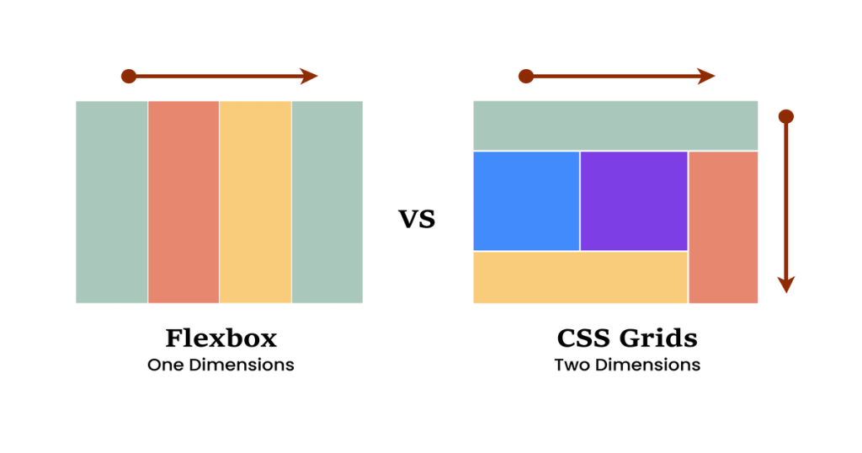

Slide 93
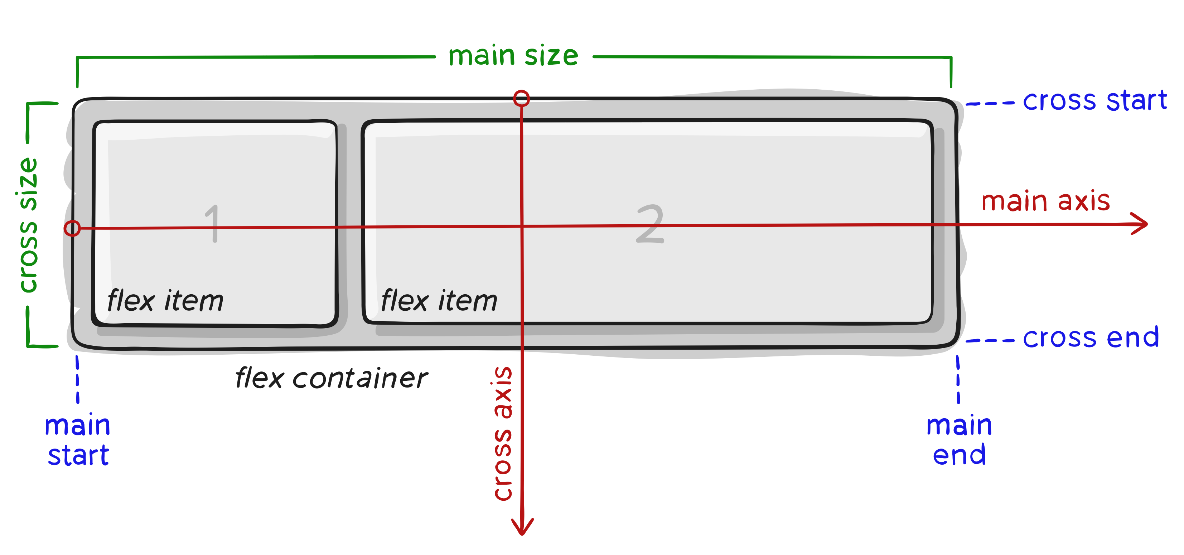

Slide 94
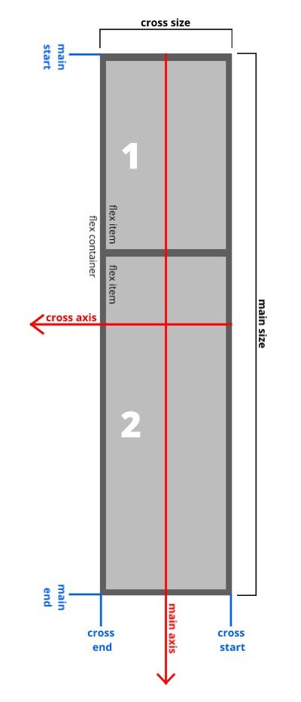

Slide 95
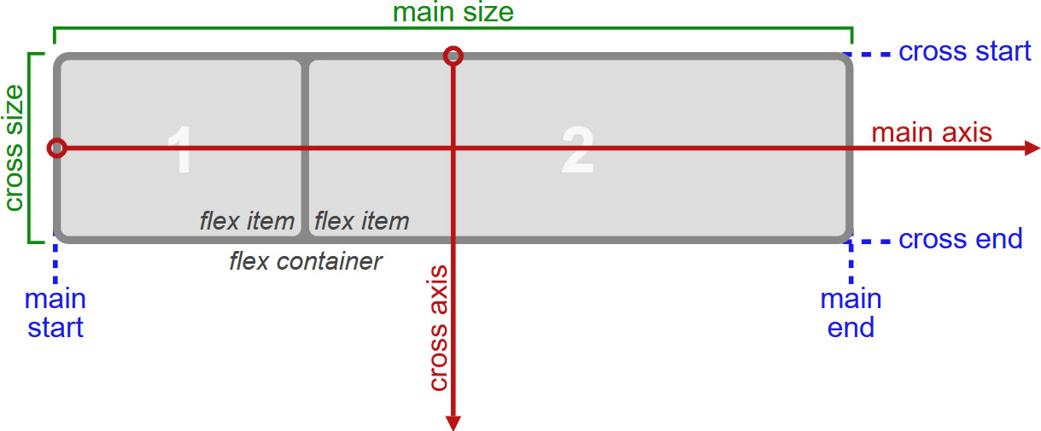

Slide 96
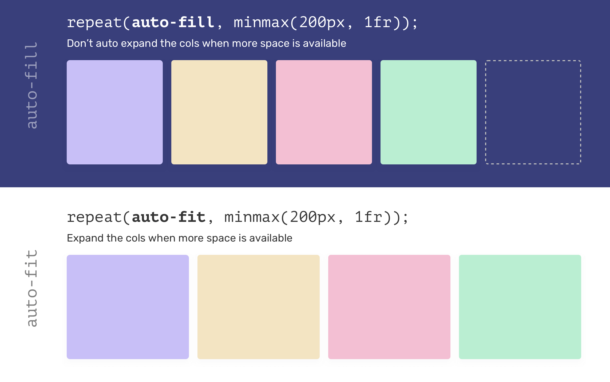

Slide 97
Apply media queries and custom breakpoints for responsive layouts.

Slide 98
What Does “Applying Media Queries” Really Mean?
Applying media queries does not mean writing CSS for different devices which means actively adapting layout behavior when environmental constraints change.
Those constraints include:
  Available horizontal space
  Vertical space
  Interaction comfort
  Readability
  Visual hierarchy
Media queries are the decision layer of responsive design.

Slide 99
What Is a Breakpoint (Conceptually)?
A breakpoint is a point of layout instability.
It exists where:
  Content stops fitting naturally
  Alignment breaks
  Text becomes cramped
  Interaction targets become uncomfortable
Breakpoints are content-driven, not device-driven

Slide 100
Why Custom Breakpoints Are Necessary?
Predefined breakpoints (Bootstrap, Tailwind):
  Assume generic content
  Ignore text length, language, data density
Custom breakpoints::
  Respond to your layout
  Preserve usability
  Reduce hacks
That means 980px is your breakpoint, not 1024px.

Slide 101
Media Queries as Layout Strategy Switches
Think of media queries as layout strategy toggles, not styling tweaks.
This is structural adaptation, not cosmetic change.
At breakpoints, layouts usually switch between:
Before Breakpoint | After Breakpoint
Horizontal → | Vertical
Multi-column → | Fewer columns
Persistent menu → | Collapsible menu
Dense UI → | Spacious UI

Slide 102
Mobile-First vs Desktop-First (Theory)
Mobile-First (Modern Standard)
  Default: least space
  Enhancements added as space increases
  Forces prioritization
  Conceptually:
    Design for constraint first, then progressively enhance.”

Slide 103
Mobile-First vs Desktop-First (Theory)
Desktop-First
  Starts with abundance
  Removes features later
  Often leads to fragile designs
  Mobile-first is preferred because it aligns with progressive enhancement.

Slide 104
Breakpoints Are About Human Factors
Breakpoints exist to protect:
  Readability (line length, spacing)
  Scanability (visual grouping)
  Touch accuracy
  Cognitive load
They are a UX decision, not a CSS decision.

