Slide 1
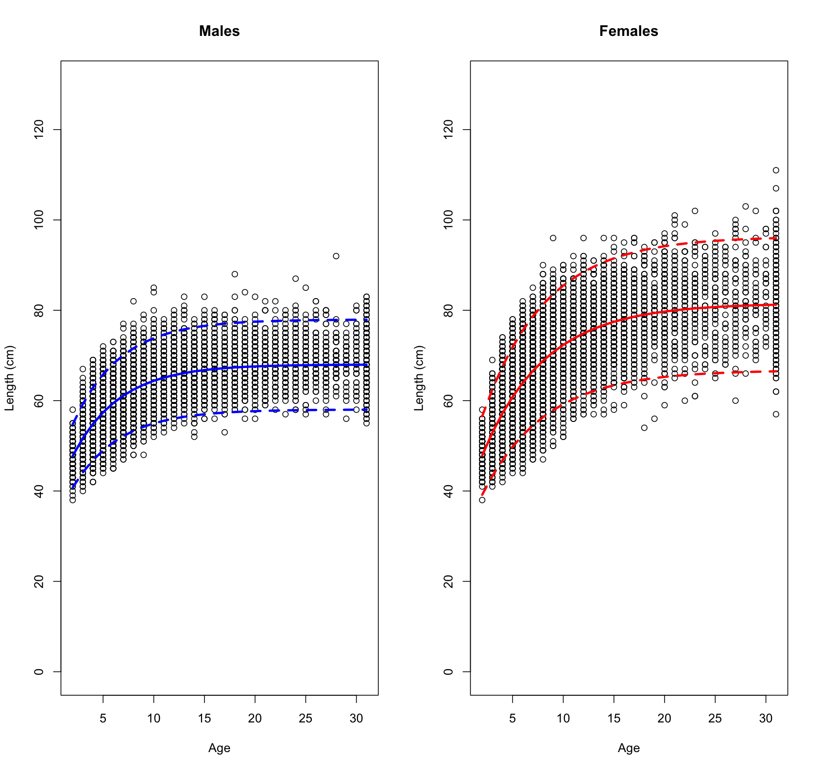
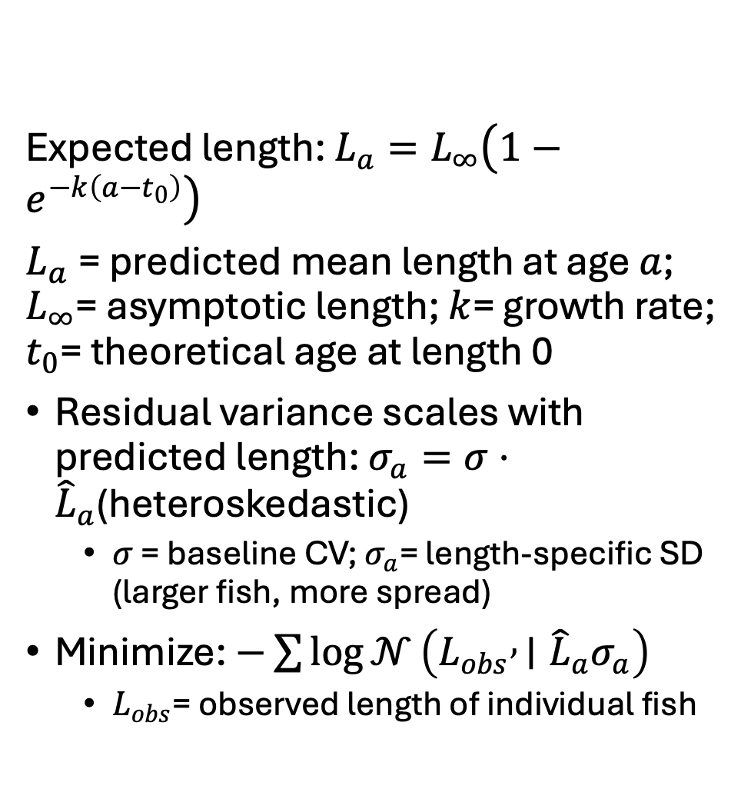
Length-at-age estimation
Expected length: $L_{a}=L_{∞}\left(1−e^{−k\left(a−t_{0}\right)}\right)$
$L_{a}$​= predicted mean length at age $a$; $L_{∞}$= asymptotic length; $k$= growth rate; $t_{0}$= theoretical age at length 0
Residual variance scales with predicted length: $σ_{a}=σ⋅{\hat{L}}_{a}$(heteroskedastic)
$σ$ = baseline CV; $σ_{a}$= length-specific SD (larger fish, more spread)
Minimize: $−\sum{log}{𝒩}\left(L_{obs} , ∣{\hat{L}}_{a}σ_{a}\right)$
$L_{obs}$= observed length of individual fish

Slide 2
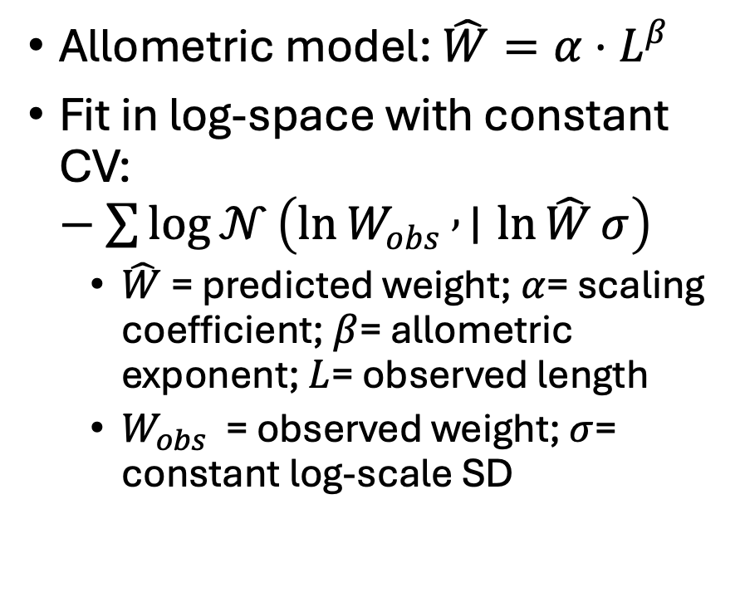
Length-weight estimation
Allometric model: $\hat{W}=α⋅L^{β}$
Fit in log-space with constant CV: $−\sum{log}{𝒩}\left(\ln{W_{obs}} , ∣\ln{\hat{W}}σ\right)$
$\hat{W}$= predicted weight; $α$= scaling coefficient; $β$= allometric exponent; $L$= observed length
$W_{obs}$​ = observed weight; $σ$= constant log-scale SD

Slide 3

Weight-at-age estimation
Composed from VBGF + LW: $W_{a}=α⋅{\hat{L}}_{a}^{β}$
$W_{a}$ = predicted weight at age $a$, composed from VBGF + LW
Asymptotic weight: $W_{∞}=α⋅L_{∞}^{β}$
$W_{∞}$= asymptotic weight

Slide 4
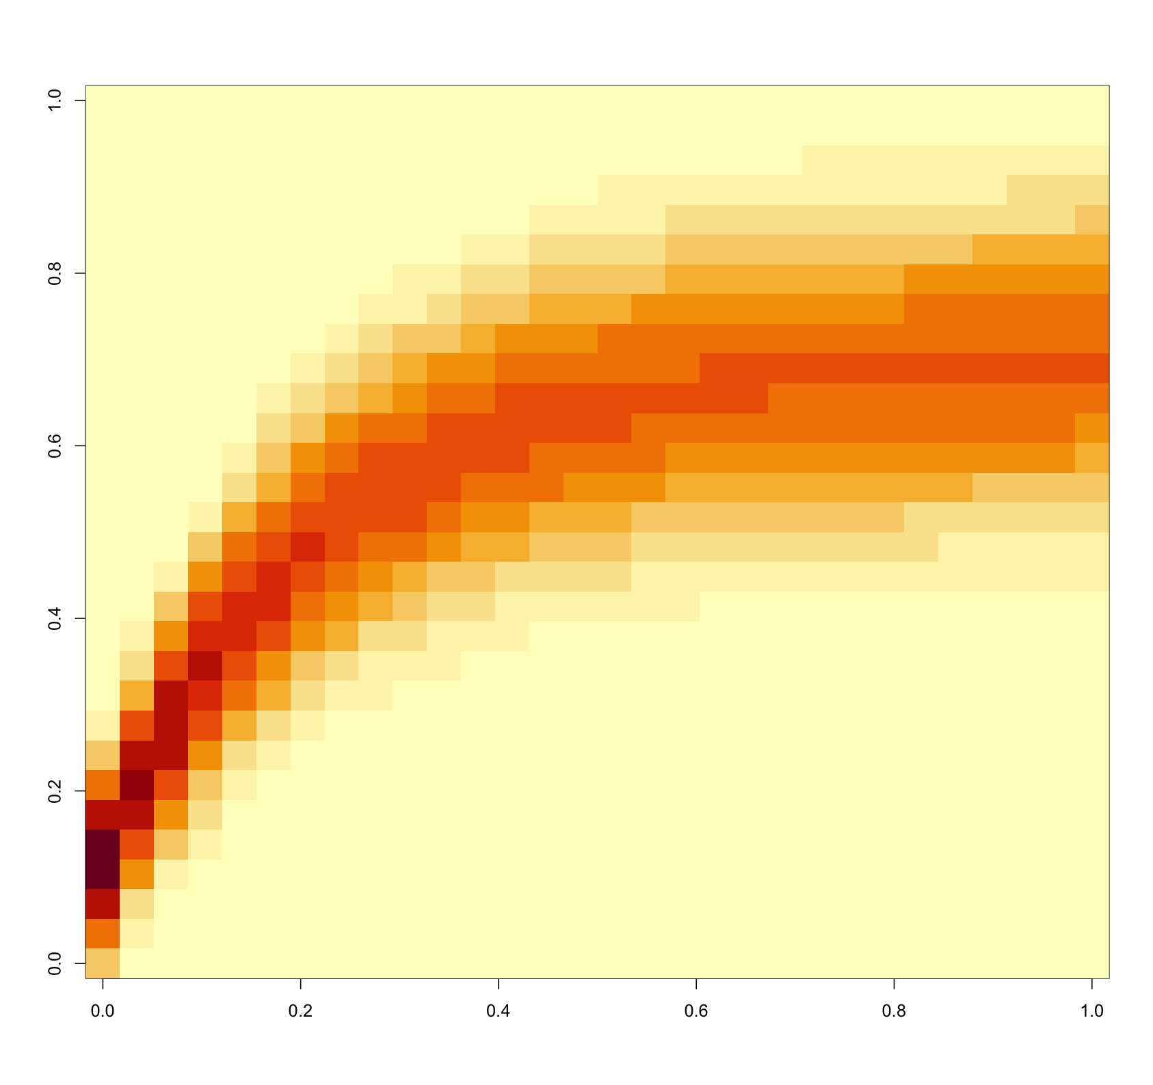
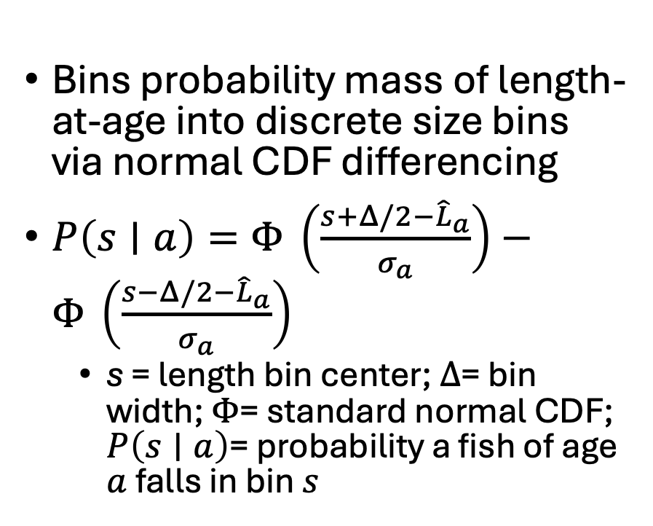
Size-age transition matrix
Bins probability mass of length-at-age into discrete size bins via normal CDF differencing
$P\left(s∣a\right)=Φ\text{ ⁣}\left(\frac{s+Δ/2−{\hat{L}}_{a}}{σ_{a}}\right)−Φ\text{ ⁣}\left(\frac{s−Δ/2−{\hat{L}}_{a}}{σ_{a}}\right)$
s = length bin center; $Δ$= bin width; $Φ$= standard normal CDF; $P\left(s∣a\right)$= probability a fish of age $a$falls in bin $s$

