Slide 1
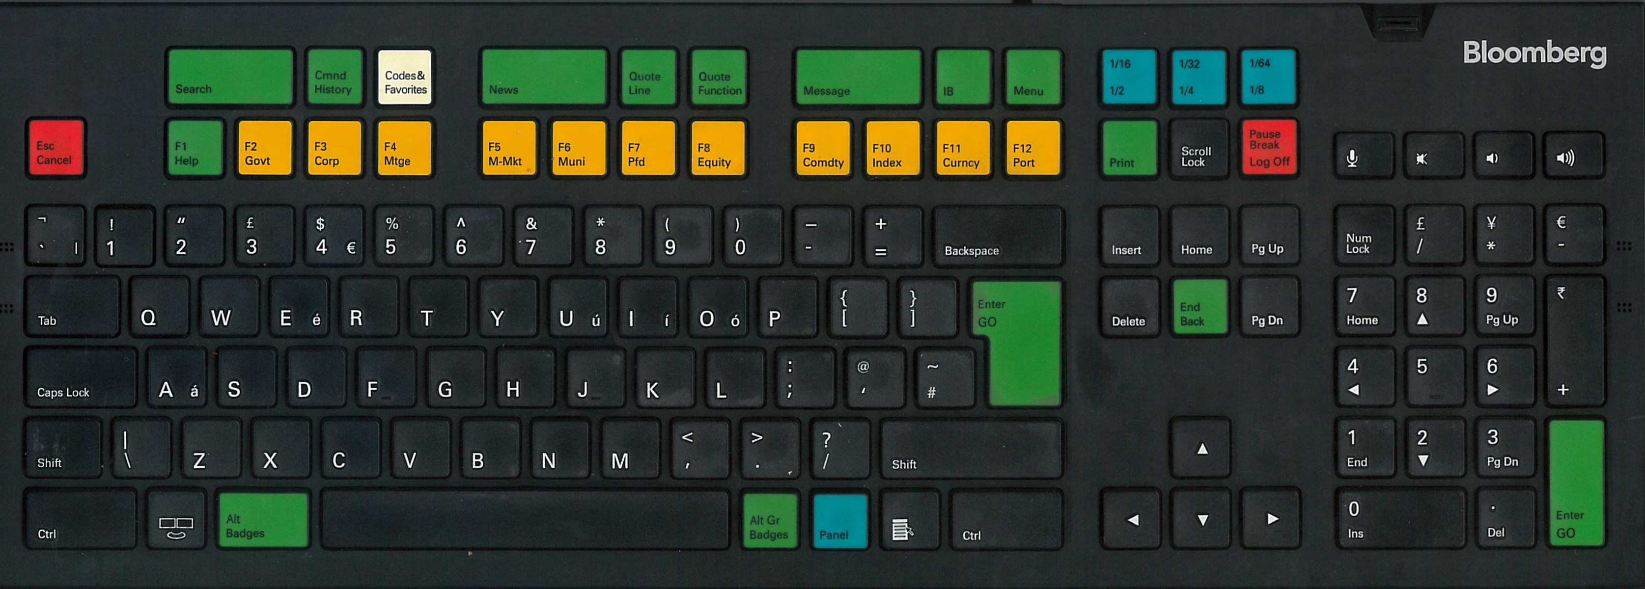

Slide 3


Slide 4
Mr. ADSK

Slide 5
Mr. ADSK
(Mister Analytics Desk)

Slide 6
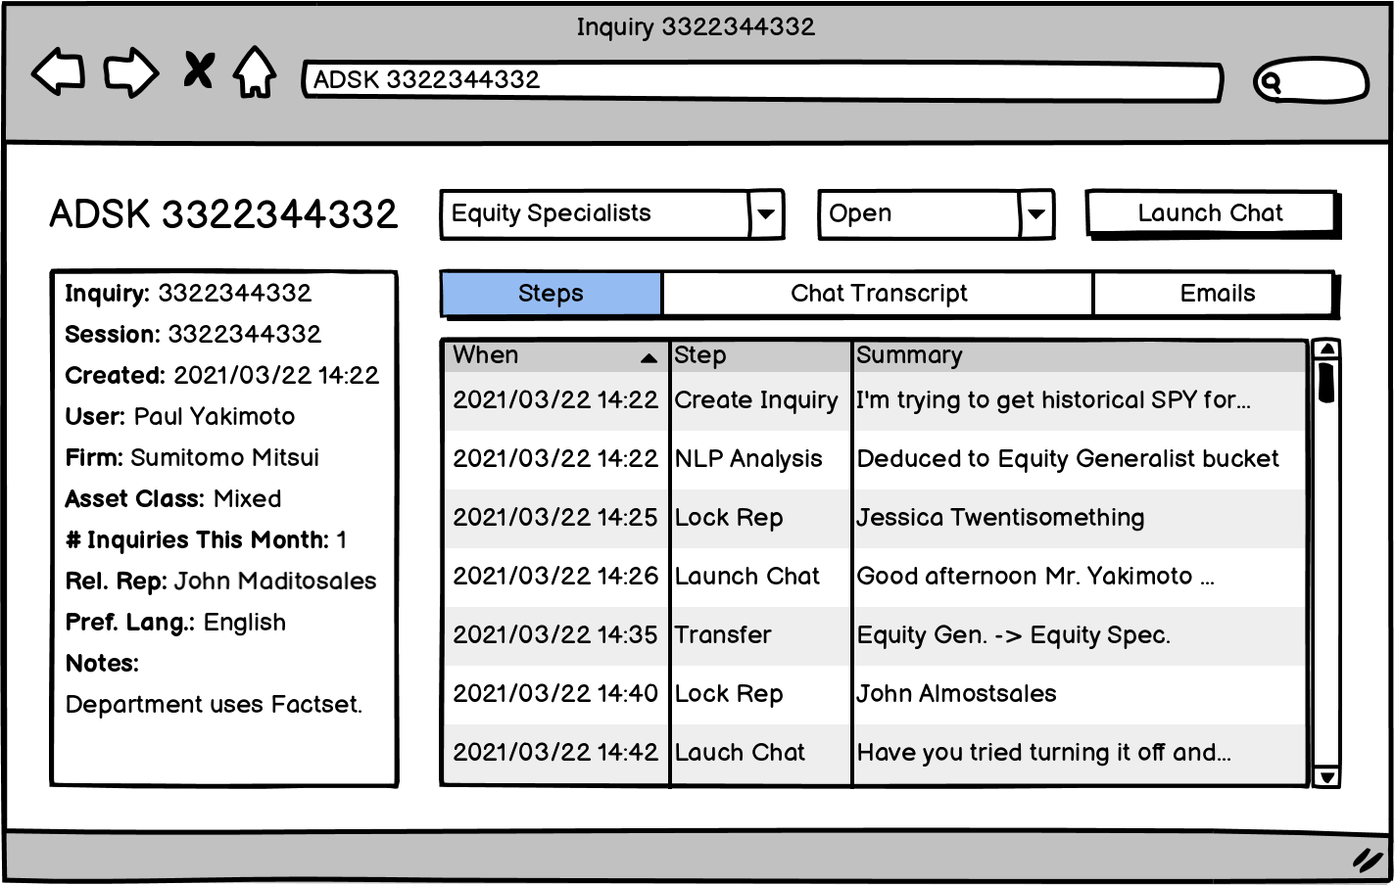

Slide 8
Problems to Solve
Current listing of steps does not update “live.”
Loading inquiries having many steps time out.
Loading queries the database every time.

Slide 9





Windows
Internal Systems Servers
ADSK
Services
SQL Server
UI
.NET SOAP Services
RPC
Multicast
Live Data
General Purpose Servers
ADSK Gateway
RPC
Multicast
Live Data
stepd
ADSK State Server

Slide 10
Windows
Internal Systems Servers
ADSK
Services
SQL Server
UI
.NET SOAP Services
RPC
Multicast
Live Data
General Purpose Servers
ADSK Gateway
RPC
Multicast
Live Data
stepd
ADSK State Server

Slide 11
Windows
Internal Systems Servers
ADSK
Services
SQL Server
UI
.NET SOAP Services
RPC
Multicast
Live Data
General Purpose Servers
ADSK Gateway
RPC
Multicast
Live Data
stepd
ADSK State Server

Slide 12
Windows
Internal Systems Servers
ADSK
Services
SQL Server
UI
.NET SOAP Services
RPC
Multicast
Live Data
General Purpose Servers
ADSK Gateway
RPC
Multicast
Live Data
stepd
ADSK State Server

Slide 13
Windows
Internal Systems Servers
ADSK
Services
SQL Server
UI
.NET SOAP Services
RPC
Multicast
Live Data
General Purpose Servers
ADSK Gateway
RPC
Multicast
Live Data
stepd
ADSK State Server

Slide 14
Windows
Internal Systems Servers
ADSK
Services
SQL Server
UI
.NET SOAP Services
RPC
Multicast
Live Data
General Purpose Servers
ADSK Gateway
RPC
Multicast
Live Data
stepd
ADSK State Server

Slide 15
Windows
Internal Systems Servers
ADSK
Services
SQL Server
UI
.NET SOAP Services
RPC
Multicast
Live Data
General Purpose Servers
ADSK Gateway
RPC
Multicast
Live Data
stepd
ADSK State Server

Slide 16
Windows
Internal Systems Servers
ADSK
Services
SQL Server
UI
.NET SOAP Services
RPC
Multicast
Live Data
General Purpose Servers
ADSK Gateway
RPC
Multicast
Live Data
stepd
ADSK State Server

Slide 17
Windows
Internal Systems Servers
ADSK
Services
SQL Server
UI
.NET SOAP Services
RPC
Multicast
Live Data
General Purpose Servers
ADSK Gateway
RPC
Multicast
Live Data
stepd
ADSK State Server

Slide 18
Windows
Internal Systems Servers
ADSK
Services
SQL Server
UI
.NET SOAP Services
RPC
Multicast
Live Data
General Purpose Servers
ADSK Gateway
RPC
Multicast
Live Data
stepd
ADSK State Server

Slide 19
Windows
Internal Systems Servers
ADSK
Services
SQL Server
UI
.NET SOAP Services
RPC
Multicast
Live Data
General Purpose Servers
ADSK Gateway
RPC
Multicast
Live Data
stepd
ADSK State Server

Slide 20
Windows
Internal Systems Servers
ADSK
Services
SQL Server
UI
.NET SOAP Services
RPC
Multicast
Live Data
General Purpose Servers
ADSK Gateway
RPC
Multicast
Live Data
stepd
ADSK State Server

Slide 21
Windows
Internal Systems Servers
ADSK
Services
SQL Server
UI
.NET SOAP Services
RPC
Multicast
Live Data
General Purpose Servers
ADSK Gateway
RPC
Multicast
Live Data
stepd
ADSK State Server

Slide 22
Windows
Internal Systems Servers
ADSK
Services
SQL Server
UI
.NET SOAP Services
RPC
Multicast
Live Data
General Purpose Servers
ADSK Gateway
RPC
Multicast
Live Data
stepd
ADSK State Server

Slide 23
Windows
Internal Systems Servers
ADSK
Services
SQL Server
UI
.NET SOAP Services
RPC
Multicast
Live Data
General Purpose Servers
ADSK Gateway
RPC
Multicast
Live Data
stepd
ADSK State Server

Slide 24
Windows
Internal Systems Servers
ADSK
Services
SQL Server
UI
.NET SOAP Services
RPC
Multicast
Live Data
General Purpose Servers
ADSK Gateway
RPC
Multicast
Live Data
stepd
ADSK State Server

Slide 25
Windows
Internal Systems Servers
ADSK
Services
SQL Server
UI
.NET SOAP Services
RPC
Multicast
Live Data
General Purpose Servers
ADSK Gateway
RPC
Multicast
Live Data
stepd
ADSK State Server

Slide 26
stepd

Slide 27
Events
Live data subscription / recapitulation
Live data unsubscribe
Multicast event
Multicast broker connect / disconnect
Live Data broker connection / disconnect
RPC request
Command pipe command (e.g. “exit”)
Database results available

Slide 28
Events
Live data subscription / recapitulation
Live data unsubscribe
Multicast event
Multicast broker connect / disconnect
Live Data broker connection / disconnect
RPC request
Command pipe command (e.g. “exit”)
Database results available

Slide 29

Actors

Slide 30
Actors
Actor X

Slide 31

Actors
Actor X

Slide 32
Actors
Actor Y
Actor X

Slide 33
Actors
Actor Y
Actor X

Slide 34
Actors
Actor Y
Actor X

Slide 35

Actors
class Message { /* ... */ }; // type-erased
class Address { /* ... */ }; // opaque
class Actor {
protected:
...

Slide 36
Actors
class Message { /* ... */ }; // type-erased
class Address { /* ... */ }; // opaque
class Actor {
protected:
template <typename Derived, typename RealMsg>
void registerHandler(void (Derived::*handler)(const RealMsg&));
...

Slide 37
Actors
class Message { /* ... */ }; // type-erased
class Address { /* ... */ }; // opaque
class Actor {
protected:
template <typename Derived, typename RealMsg>
void registerHandler(void (Derived::*handler)(const RealMsg&));
template <typename ActorImpl, typename... Args>
Address create(Args&&... args);
...

Slide 38
Actors
class Message { /* ... */ }; // type-erased
class Address { /* ... */ }; // opaque
class Actor {
protected:
template <typename Derived, typename RealMsg>
void registerHandler(void (Derived::*handler)(const RealMsg&));
template <typename ActorImpl, typename... Args>
Address create(Args&&... args);
void send(const Address&, const Message&);
...

Slide 39
Actors
class Message { /* ... */ }; // type-erased
class Address { /* ... */ }; // opaque
class Actor {
protected:
template <typename Derived, typename RealMsg>
void registerHandler(void (Derived::*handler)(const RealMsg&));
template <typename ActorImpl, typename... Args>
Address create(Args&&... args);
void send(const Address&, const Message&);
void destroyMe();
};

Slide 40
Actors Lifetime
Time

Slide 41
Actor Lifetime
{ }
constructor
Time

Slide 42

Actor Lifetime
{ }
{ }
message
handler
constructor
Time

Slide 43
Actor Lifetime
{ }
{ }
{ }
message
handler
constructor
destructor
Time

Slide 44
Actor Runtime – MultiQueueThreadPool

Slide 45

Actor Runtime – MultiQueueThreadPool

Slide 46


Actor Runtime – MultiQueueThreadPool

Slide 47
Actor Runtime – MultiQueueThreadPool

Slide 48
stepd Events
Live data subscription / recapitulation
Live data unsubscribe
Multicast event
Multicast broker connect / disconnect
Live Data broker connection / disconnect
RPC request
Command pipe command (e.g. “exit”)
Database results available

Slide 49
stepd Actors

Slide 50
stepd Actors
Application

Slide 51
stepd Actors
Application
RPC
Command
Shell

Slide 52
stepd Actors
Multicast
Session
Live Data
Session
Application
RPC
Command
Shell

Slide 53
stepd Actors
Inquiry Manager
Multicast
Session
Live Data
Session
Application
RPC
Command
Shell

Slide 54
stepd Actors
Event
Scheduler
Inquiry Manager
Multicast
Session
Live Data
Session
Application
RPC
Command
Shell

Slide 55
stepd Actors
Inquiry
Event
Scheduler
Inquiry Manager
Multicast
Session
Live Data
Session
Application
RPC
Command
Shell

Slide 56
stepd Actors
Inquiry
Event
Scheduler
Step Loader
Inquiry Manager
Multicast
Session
Live Data
Session
Application
RPC
Command
Shell

Slide 57
stepd Actors
Inquiry
Event
Scheduler
Step Loader
Inquiry Manager
Multicast
Session
Live Data
Session
Application
RPC
Command
Shell

Slide 58
stepd Actors
Inquiry
Event
Scheduler
Step Loader
Inquiry Manager
Multicast
Session
Live Data
Session
Application
RPC
Command
Shell

Slide 59
stepd Actors
Inquiry
Event
Scheduler
Step Loader
Inquiry Manager
Multicast
Session
Live Data
Session
Application
RPC
Command
Shell

Slide 60
stepd Actors
Inquiry
Event
Scheduler
Step Loader
Inquiry Manager
Multicast
Session
Live Data
Session
Application
RPC
Command
Shell

Slide 61
stepd Actors
Inquiry
Event
Scheduler
Step Loader
Inquiry Manager
Multicast
Session
Live Data
Session
Application
RPC
Command
Shell

Slide 62
stepd Actors
Inquiry
Event
Scheduler
Step Loader
Inquiry Manager
Multicast
Session
Live Data
Session
Application
RPC
Command
Shell

Slide 63
stepd

Slide 64
Problems to Solve
Current listing of steps does not update “live.”
Loading inquiries having many steps time out.
Loading queries the database every time.

Slide 65
Problems to Solve
Current listing of steps does not update “live.”
Loading inquiries having many steps time out.
Loading queries the database every time.

Slide 66
Problems to Solve
Current listing of steps does not update “live.”
Loading inquiries having many steps time out.
Loading queries the database every time.

Slide 67
Problems to Solve
Current listing of steps does not update “live.”
Loading inquiries having many steps time out.
Loading queries the database every time.

Slide 69


