Slide 1





















cppcon 2017
Attended eighteen talks
Saw twenty-one speakers

Slide 2

cppcon 2017
Some were boring

Slide 3
cppcon 2017
Here are the talks I liked

Slide 4


From security to performance to GPU programming: exploring modern allocators
Sergey Zubkov
Allocators allow you to do magic in legacy situations
Memory pools can prevent fragmentation

Slide 5
dynamic_cast From Scratch
Arthur O'Dwyer
Inheritance is cuckoo bananas
Informative talk. Takeaway:
If you want to understand your objects, use neither multiple nor virtual inheritance

Slide 6


Using Functional Programming Patterns to build a clean and simple HTTP routing API
Jeremy Demeule, Quentin Duval
Use expression templates to define declarative domain specific languages in your API
auto router = RequestRouter(
GET(Uri("stocks")/"current" / Int("id")), LastPrice(),
GET(Uri("stocks")/Ticker("ticker")), History(),
GET(Uri("status")/Regex("(exchange|ticker)[0 - 9]+"), Status());
cout << typeid(router).name() << ‘\n’; // something insane

Slide 7

Agent based class design,
C++ with a robot glue gun
Odin Holmes
Odin is a C++ wizard
I don’t understand what Odin is doing
Something about assembling capabilities of electronic components at compile time in a modular fashion
Statically defined user interfaces!

Slide 8

Meta: Thoughts on generative C++
(define-syntax define-record-type
(syntax-rules ()
((define-record-type type
(constructor constructor-tag ...)
predicate
(field-tag accessor . more) ...)
(begin
(define type
(make-record-type 'type '(field-tag ...)))
(define constructor
(record-constructor type '(constructor-tag ...)))
(define predicate
(record-predicate type))
(define-record-field type field-tag accessor . more)
...))))
Herb Sutter
Proposed an idea of what “meta-classes” might look like
I’m not turning C++ into Lisp, I promise!
I’m just simplifying what we already do, honest!

Slide 9
Reader-Writer Lock versus Mutex –
Understanding a Lost Bet
Jeffrey Mendelsohn
Just use a mutex
Always label your axes
Measure benchmarks in isolation

Slide 10
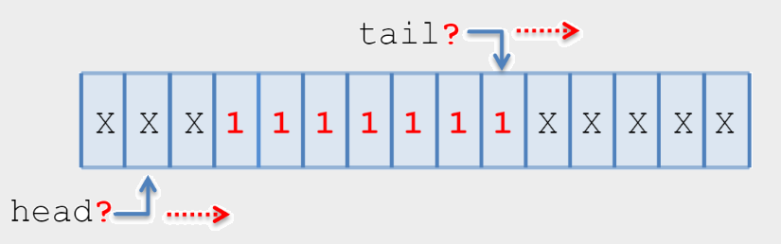
An Interesting Lock-free Queue –
Part 2 of N
Tony Van Eerd
Lock-free queues are interesting
Subtle
Fun to think about
You should never use one

Slide 11



Objects, Lifetimes, and References
oh my: the C++ Object Model, and Why it Matters to You
Nicole Mazzuca
Rebind reference members when assigning to object
Value/object relationship
Object
Value

Slide 12

So, you inherited a large code base...
David Sankel
How to improve BAS
Migration paths
Mnemonics, automated refactoring

Slide 13
Going Nowhere Faster
Chandler Carruth
X86 code is compiled (in the chip) into microcode
Microcode is pipelined, scheduled, reordered
Code does not do what you think

Slide 14
Unbolting the Compiler's Lid: What Has My Compiler Done for Me Lately?
Matt Godbolt
godbolt.org is cool
Matt is cool
The -O3 optimization setting is cool

Slide 15
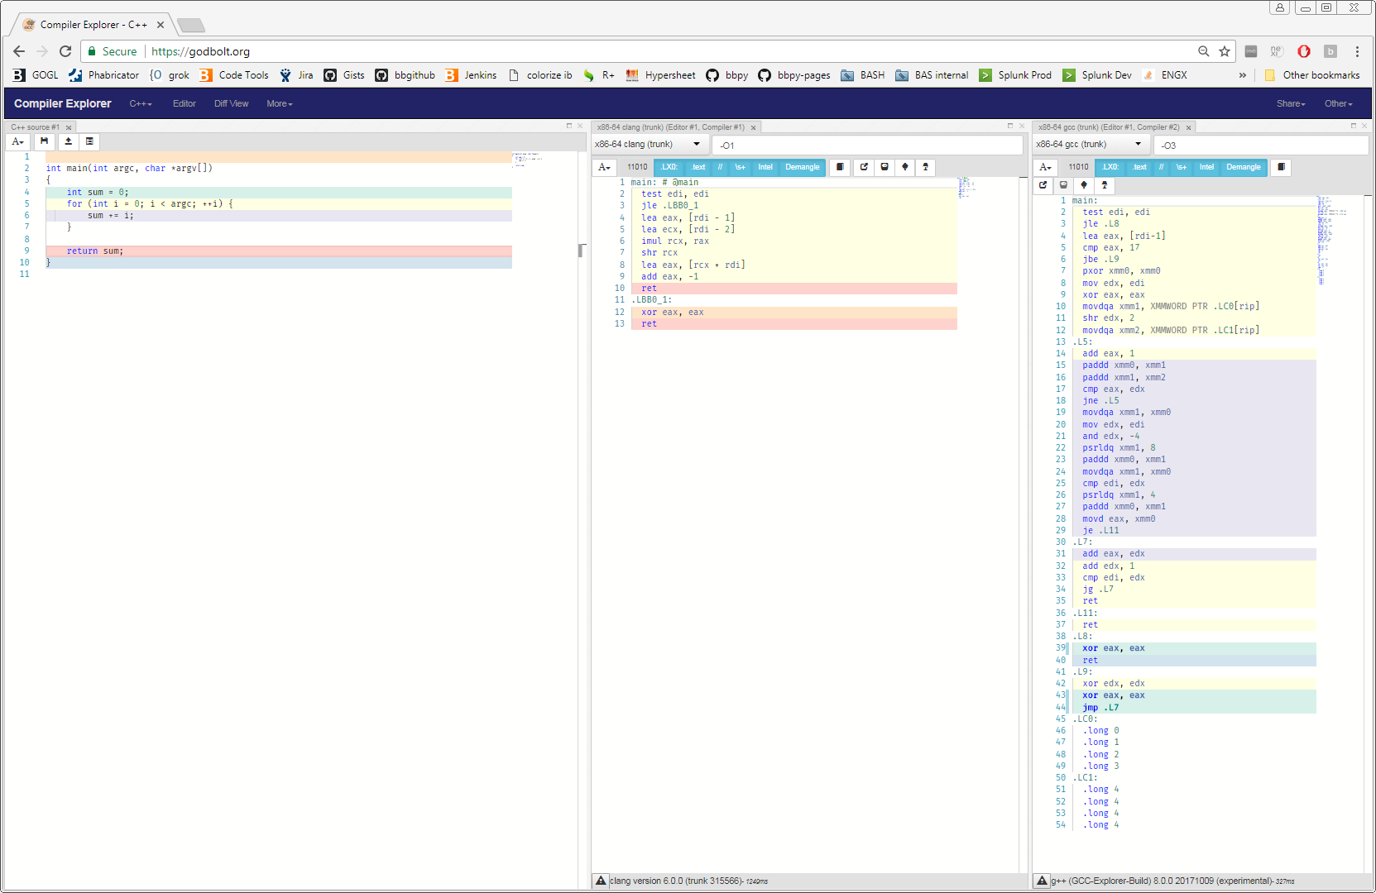
Unbolting the Compiler's Lid: What Has My Compiler Done for Me Lately?

Slide 16
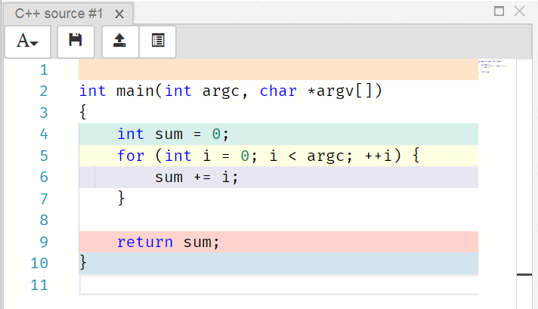
Unbolting the Compiler's Lid: What Has My Compiler Done for Me Lately?

Slide 17
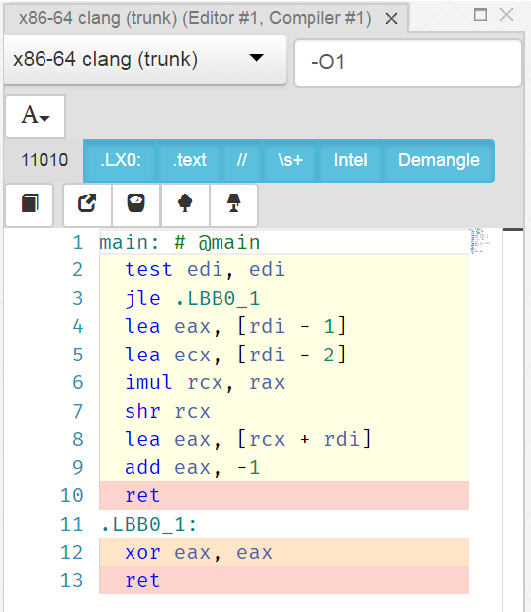
Unbolting the Compiler's Lid: What Has My Compiler Done for Me Lately?

Slide 18
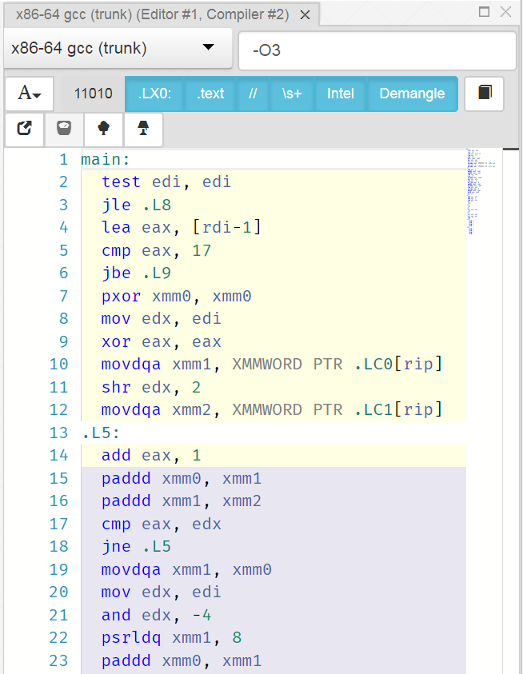
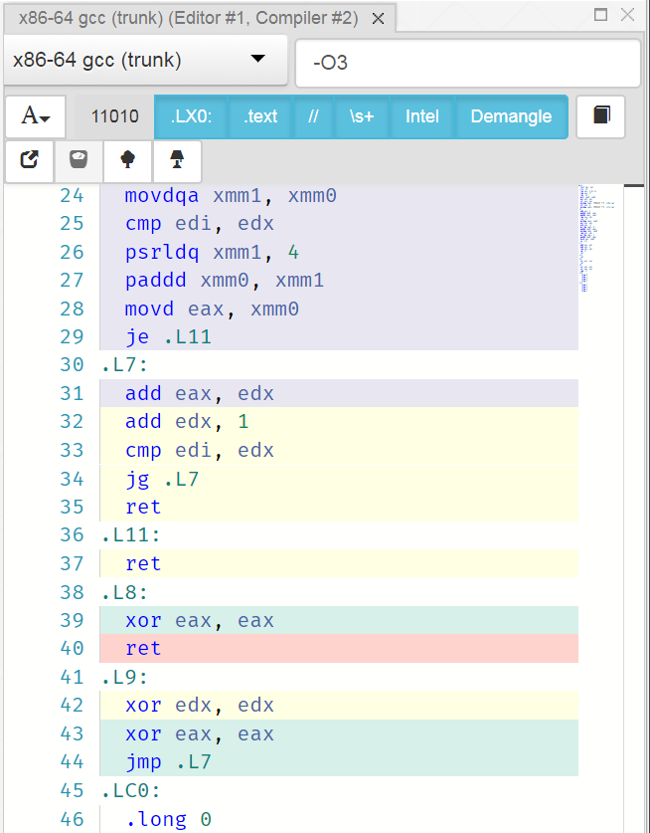
Unbolting the Compiler's Lid: What Has My Compiler Done for Me Lately?

Slide 19
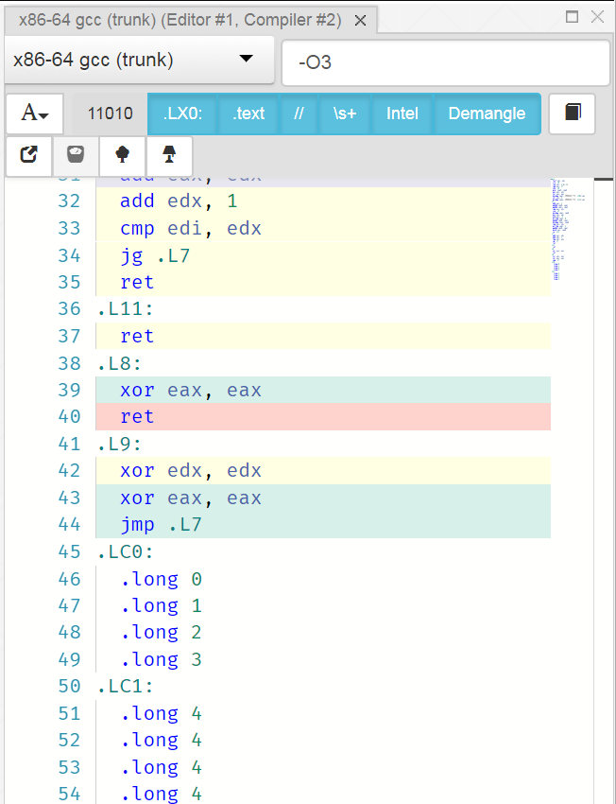
Unbolting the Compiler's Lid: What Has My Compiler Done for Me Lately?

Slide 20
cppcon 2017
That’s it for the talks I liked

Slide 21
Overall Impression of the Conference
Reflection/generation as language features
  What we’re going towards is hygienic macros
  But not, since C++ isn’t (and shouldn’t be) homoiconic
Meta-programming to build domain-tailored APIs
  Templates, SFINAE, constexpr, traits, constexpr if…
Make everything go faster
  Measurement is assumed but how often overlooked?
Concurrency still treated as a niche
  No more free lunch, blah blah, co-routines, blah blah

Slide 22
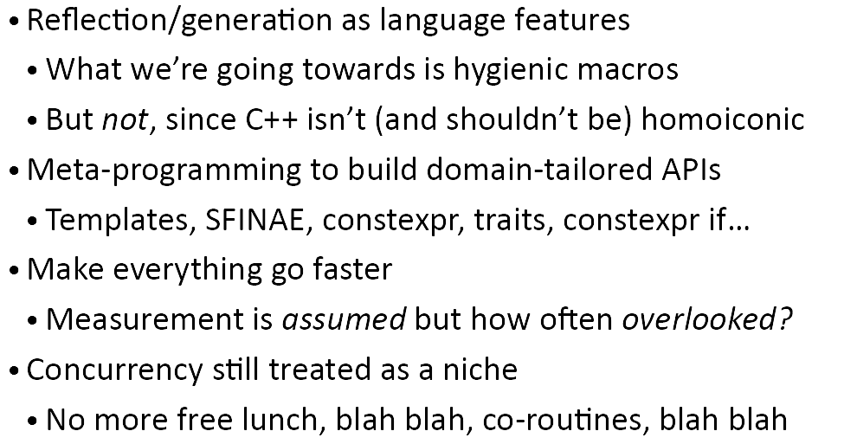
Overall Impression of the Conference

Slide 23


Slide 24
#define

Slide 25
I aspire to a more perfect enum

Slide 26
enum Color { e_RED, e_GREEN, e_PURPLE };
Color favorite = e_PURPLE;
cout << "I like " << favorite;
Color boring = Color::e_RED;
“I like 2”
“Error: WTF is Color::e_RED?”

Slide 27
enum class Color { e_RED, e_GREEN, e_PURPLE };
Color favorite = Color::e_PURPLE;
cout << "I like " << favorite;
“I like 2”

Slide 28
struct Color {
enum Value { e_RED, e_GREEN, e_PURPLE };
};
Color favorite = Color::e_PURPLE;
Color::Value best = Color::e_PURPLE;
cout << "I like " << best;
Error: No conversion
“I like 2”

Slide 29
Part One
bas_codegen.pl

Slide 30
/home/dgoffred/git/bas-codegen ! $ \
> git ls-files '*.*' | \
> sed 's/.*\.\([^.]\+\)$/\1/' | \
> sort | \
> uniq -c | \
> sort -r
90 pm
58 t
57 mk
57 mem
57 dep
57 cap
52 xml
19 opts
18 gitignore
10 xsd
10 sh
10 cpp
8 dd
6 pl
6 h
6 d
5 sundev1
5 defs
2 md
1 pod
1 ini
1 depends

Slide 31
/home/dgoffred/git/bas-codegen ! $ cat \
> <(git ls-files '*.pl') \
> <(git ls-files '*.pm') \
> <(git ls-files '*.t') | \
> xargs wc -l | \
> tail -1
68761 total

Slide 32
<?xml version="1.0" encoding="UTF-8"?>
<xs:schema
xmlns:xs="http://www.w3.org/2001/XMLSchema"
xmlns:bdem="http://bloomberg.com/schemas/bdem">
<xs:simpleType name="Color">
<xs:restriction base="xs:string">
<xs:enumeration value="RED" bdem:id="0" />
<xs:enumeration value="GREEN" bdem:id="1" />
<xs:enumeration value="PURPLE" bdem:id="2" />
</xs:restriction>
</xs:simpleType>
</xs:schema>

Slide 33
bas-codegen XSD

Slide 34
Basic Application Services XSD

Slide 35
Basic Application Services XML Schema Definition

Slide 36
Basic Application Services Extensible Markup Language Schema Definition

Slide 37
Basic Application Services Extensible Markup Language Schema Definition
Language

Slide 38
Bloomberg Application Services Extensible Markup Language Schema Definition
Language

Slide 39
BAS Application Services Extensible Markup Language Schema Definition
Language

Slide 40
BAS Application Services Application Services Extensible Markup Language Schema Definition
Language

Slide 41
BAS Application Services Application Services Application Services Extensible Markup Language Schema Definition
Language

Slide 42
BAS Application Services Application Services Application Services Application Services Extensible Markup Language Schema Definition
Language

Slide 43
BAS Application Services Application Services Application Services Application Services Application Services Extensible Markup Language Schema Definition
Language

Slide 44
BAS Application Services Application Services Application Services Application Services Application Services Application Services Extensible Markup Language Schema Definition
Language

Slide 45
BAS Application Services Application Services Application Services Application Services Application Services Application Services Application Services Extensible Markup Language Schema Definition
Language

Slide 46
BAS Application Services Application Services Application Services Application Services Application Services Application Services Application Services Application Services Extensible Markup Language Schema Definition
Language

Slide 47
BAS Application Services Application Services Application Services Application Services Application Services Application Services Application Services Application Services Application Services Extensible Markup Language Schema Definition
Language

Slide 48
BAS Application Services Application Services Application Services Application Services Application Services Application Services Application Services Application Services Application Services Application Services Extensible Markup Language Schema Definition
Language

Slide 49
BAS Application Services Application Services Application Services Application Services Application Services Application Services Application Services Application Services Application Services Application Services Application Services Extensible Markup Language Schema Definition
Language

Slide 50
BAS Application Services Application Services Application Services Application Services Application Services Application Services Application Services Application Services Application Services Application Services Application Services Application Services Extensible Markup Language Schema Definition
Language

Slide 51
BAS Application Services Application Services Application Services Application Services Application Services Application Services Application Services Application Services Application Services Application Services Application Services Application Services Application Services Extensible Markup Language Schema Definition
Language

Slide 52
BAS Application Services Application Services Application Services Application Services Application Services Application Services Application Services Application Services Application Services Application Services Application Services Application Services Application Services Application Services Extensible Markup Language Schema Definition
Language

Slide 53
BAS Application Services Application Services Application Services Application Services Application Services Application Services Application Services Application Services Application Services Application Services Application Services Application Services Application Services Application Services Application Services Extensible Markup Language Schema Definition
Language

Slide 54
BAS Application Services Application Services Application Services Application Services Application Services Application Services Application Services Application Services Application Services Application Services Application Services Application Services Application Services Application Services Application Services Application Services Extensible Markup Language Schema Definition
Language

Slide 55
BAS Application Services Application Services Application Services Application Services Application Services Application Services Application Services Application Services Application Services Application Services Application Services Application Services Application Services Application Services Application Services Application Services Application Services Extensible Markup Language Schema Definition
Language

Slide 56
BAS Application Services Application Services Application Services Application Services Application Services Application Services Application Services Application Services Application Services Application Services Application Services Application Services Application Services Application Services Application Services Application Services Application Services Application Services Extensible Markup Language Schema Definition
Language

Slide 57
BAS Application Services Application Services Application Services Application Services Application Services Application Services Application Services Application Services Application Services Application Services Application Services Application Services Application Services Application Services Application Services Application Services Application Services Application Services Application Services Extensible Markup Language Schema Definition
Language

Slide 58
BAS Application Services Application Services Application Services Application Services Application Services Application Services Application Services Application Services Application Services Application Services Application Services Application Services Application Services Application Services Application Services Application Services Application Services Application Services Application Services Application Services Extensible Markup Language Schema Definition
Language

Slide 59
BAS Application Services Application Services Application Services Application Services Application Services Application Services Application Services Application Services Application Services Application Services Application Services Application Services Application Services Application Services Application Services Application Services Application Services Application Services Application Services Application Services Application Services Extensible Markup Language Schema Definition
Language

Slide 60
BAS Application Services Application Services Application Services Application Services Application Services Application Services Application Services Application Services Application Services Application Services Application Services Application Services Application Services Application Services Application Services Application Services Application Services Application Services Application Services Application Services Application Services Application Services Extensible Markup Language Schema Definition
Language

Slide 61
BAS Application Services Application Services Application Services Application Services Application Services Application Services Application Services Application Services Application Services Application Services Application Services Application Services Application Services Application Services Application Services Application Services Application Services Application Services Application Services Application Services Application Services Application Services Application Services Extensible Markup Language Schema Definition
Language

Slide 62
BAS Application Services Application Services Application Services Application Services Application Services Application Services Application Services Application Services Application Services Application Services Application Services Application Services Application Services Application Services Application Services Application Services Application Services Application Services Application Services Application Services Application Services Application Services Application Services Application Services Extensible Markup Language Schema Definition
Language

Slide 63
BAS Application Services Application Services Application Services Application Services Application Services Application Services Application Services Application Services Application Services Application Services Application Services Application Services Application Services Application Services Application Services Application Services Application Services Application Services Application Services Application Services Application Services Application Services Application Services Application Services Application Services Application Services Application Services Application Services Application Services Application Services Application Services Application Services Application Services Application Services Application Services Application Services Application Services Application Services Application Services Application Services Application Services Application Services Application Services Application Services Application Services Application Services Application Services Application Services Application Services Application Services Application Services Application Services Application Services Application Services Application Services Application Services Application Services Application Services Application Services Application Services Application Services Application Services Application Services Application Services Application Services Application Services Application Services Application Services Application Services Application Services Application Services Application Services Application Services Application Services Application Services Application Services Application Services Application Services Application Services Application Services Application Services Application Services Application Services Application Services Application Services Application Services Application Services Application Services Application Services Application Services Application Services Application Services Application Services Application Services Application Services Application Services Application Services Application Services Application Services Application Services Application Services Application Services Application Services Application Services Application Services Application Services Application Services Application Services Application Services Application Services Application Services Application Services Application Services Application Services Application Services Application Services Application Services Application Services Application Services Application Services Application Services Application Services Application Services Application Services Application Services Application Services Application Services Application Services Application Services Application Services Application Services Application Services Application Services Application Services Application Services Application Services Application Services Application Services Application Services Application Services Application Services Application Services Application Services Application Services Application Services Application Services Application Services Application Services Application Services Application Services Application Services Application Services Application Services Application Services Application Services Application Services Application Services Application Services Application Services Application Services Application Services Application Services Application Services Application Services Application Services Application Services Application Services Application Services Application Services Application Services Application Services Application Services Application Services Application Services Application Services Application Services Application Services Application Services Application Services Application Services Application Services Application Services Application Services Application Services Application Services Application Services Application Services Application Services Application Services Application Services Application Services Application Services Application Services Application Services Application Services Application Services Application Services Application Services Application Services Application Services Application Services Application Services Application Services Application Services Application Services Application Services Application Services Application Services Application Services Application Services Application Services Application Services Application Services Application Services Application Services Application Services Application Services Application Services Application Services Application Services Application Services Application Services Application Services Application Services Application Services Application Services Application Services Application Services Application Services Application Services Application Services Application Services Application Services Application Services Application Services Application Services Application Services Application Services Application Services Application Services Application Services Application Services Application Services Application Services Application Services Application Services Application Services Application Services Application Services Application Services Application Services Application Services Application Services Application Services Application Services Application Services Application Services Application Services Application Services Application Services Application Services Application Services Application Services Application Services Application Services Application Services Application Services Application Services Application Services Application Services Application Services Application Services Application Services Application Services Application Services Application Services Application Services Application Services Application Services Application Services Application Services Application Services Application Services Application Services Application Services Application Services Application Services Application Services Application Services Application Services Application Services Application Services Application Services Application Services Application Services Application Services Application Services Application Services Application Services Application Services Application Services Application Services Application Services Application Services Application Services Application Services Application Services Application Services Application Services Application Services Application Services Application Services Application Services Application Services Application Services Application Services Application Services Application Services Application Services Application Services Application Services Application Services Application Services Application Services Application Services Application Services Application Services Application Services Application Services Application Services Application Services Application Services Application Services Application Services Application Services Application Services Application Services Application Services Application Services Application Services Application Services Application Services Application Services Application Services Application Services Application Services Application Services Application Services Application Services Application Services Application Services Application Services Application Services Application Services Application Services Application Services Application Services Application Services Application Services Application Services Application Services Application Services Application Services Application Services Application Services Application Services Application Services Application Services Application Services Application Services Application Services Application Services Application Services Application Services Application Services Application Services Application Services Application Services Application Services Application Services Application Services Application Services Application Services Application Services Application Services Application Services Application Services Application Services Application Services Application Services Application Services Application Services Application Services Application Services Application Services Application Services Application Services Application Services Application Services Application Services Application Services Application Services Application Services Application Services Application Services Application Services Application Services Application Services Application Services Application Services Application Services Application Services Application Services Application Services Application Services Application Services Application Services Application Services Application Services Application Services Application Services Application Services Application Services Application Services Application Services Application Services Application Services Application Services Application Services Application Services Application Services Application Services Application Services Application Services Application Services Application Services Application Services Application Services Application Services Application Services Application Services Application Services Application Services Application Services Application Services Application Services Application Services Application Services Application Services Application Services Application Services Application Services Application Services Application Services Application Services Application Services Application Services Application Services Application Services Application Services Application Services Application Services Application Services Application Services Application Services Application Services Application Services Application Services Application Services Application Services Application Services Application Services Application Services Application Services Application Services Application Services Application Services Application Services Application Services Application Services Application Services Application Services Application Services Application Services Application Services Application Services Application Services Application Services Application Services Application Services Application Services Application Services Application Services Application Services Application Services Application Services Application Services Application Services Application Services Application Services Application Services Application Services Extensible Markup Language Schema Definition
Language

Slide 64
BAS Application Services Application Services Application Services Application Services Application Services Application Services Application Services Application Services Application Services Application Services Application Services Application Services Application Services Application Services Application Services Application Services Application Services Application Services Application Services Application Services Application Services Application Services Application Services Application Services Application Services Application Services Application Services Application Services Application Services Application Services Application Services Application Services Application Services Application Services Application Services Application Services Application Services Application Services Application Services Application Services Application Services Application Services Application Services Application Services Application Services Application Services Application Services Application Services Application Services Application Services Application Services Application Services Application Services Application Services Application Services Application Services Application Services Application Services Application Services Application Services Application Services Application Services Application Services Application Services Application Services Application Services Application Services Application Services Application Services Application Services Application Services Application Services Application Services Application Services Application Services Application Services Application Services Application Services Application Services Application Services Application Services Application Services Application Services Application Services Application Services Application Services Application Services Application Services Application Services Application Services Application Services Application Services Application Services Application Services Application Services Application Services Application Services Application Services Application Services Application Services Application Services Application Services Application Services Application Services Application Services Application Services Application Services Application Services Application Services Application Services Application Services Application Services Application Services Application Services Application Services Application Services Application Services Application Services Application Services Application Services Application Services Application Services Application Services Application Services Application Services Application Services Application Services Application Services Application Services Application Services Application Services Application Services Application Services Application Services Application Services Application Services Application Services Application Services Application Services Application Services Application Services Application Services Application Services Application Services Application Services Application Services Application Services Application Services Application Services Application Services Application Services Application Services Application Services Application Services Application Services Application Services Application Services Application Services Application Services Application Services Application Services Application Services Application Services Application Services Application Services Application Services Application Services Application Services Application Services Application Services Application Services Application Services Application Services Application Services Application Services Application Services Application Services Application Services Application Services Application Services Application Services Application Services Application Services Application Services Application Services Application Services Application Services Application Services Application Services Application Services Application Services Application Services Application Services Application Services Application Services Application Services Application Services Application Services Application Services Application Services Application Services Application Services Application Services Application Services Application Services Application Services Application Services Application Services Application Services Application Services Application Services Application Services Application Services Application Services Application Services Application Services Application Services Application Services Application Services Application Services Application Services Application Services Application Services Application Services Application Services Application Services Application Services Application Services Application Services Application Services Application Services Application Services Application Services Application Services Application Services Application Services Application Services Application Services Application Services Application Services Application Services Application Services Application Services Application Services Application Services Application Services Application Services Application Services Application Services Application Services Application Services Application Services Application Services Application Services Application Services Application Services Application Services Application Services Application Services Application Services Application Services Application Services Application Services Application Services Application Services Application Services Application Services Application Services Application Services Application Services Application Services Application Services Application Services Application Services Application Services Application Services Application Services Application Services Application Services Application Services Application Services Application Services Application Services Application Services Application Services Application Services Application Services Application Services Application Services Application Services Application Services Application Services Application Services Application Services Application Services Application Services Application Services Application Services Application Services Application Services Application Services Application Services Application Services Application Services Application Services Application Services Application Services Application Services Application Services Application Services Application Services Application Services Application Services Application Services Application Services Application Services Application Services Application Services Application Services Application Services Application Services Application Services Application Services Application Services Application Services Application Services Application Services Application Services Application Services Application Services Application Services Application Services Application Services Application Services Application Services Application Services Application Services Application Services Application Services Application Services Application Services Application Services Application Services Application Services Application Services Application Services Application Services Application Services Application Services Application Services Application Services Application Services Application Services Application Services Application Services Application Services Application Services Application Services Application Services Application Services Application Services Application Services Application Services Application Services Application Services Application Services Application Services Application Services Application Services Application Services Application Services Application Services Application Services Application Services Application Services Application Services Application Services Application Services Application Services Application Services Application Services Application Services Application Services Application Services Application Services Application Services Application Services Application Services Application Services Application Services Application Services Application Services Application Services Application Services Application Services Application Services Application Services Application Services Application Services Application Services Application Services Application Services Application Services Application Services Application Services Application Services Application Services Application Services Application Services Application Services Application Services Application Services Application Services Application Services Application Services Application Services Application Services Application Services Application Services Application Services Application Services Application Services Application Services Application Services Application Services Application Services Application Services Application Services Application Services Application Services Application Services Application Services Application Services Application Services Application Services Application Services Application Services Application Services Application Services Application Services Application Services Application Services Application Services Application Services Application Services Application Services Application Services Application Services Application Services Application Services Application Services Application Services Application Services Application Services Application Services Application Services Application Services Application Services Application Services Application Services Application Services Application Services Application Services Application Services Application Services Application Services Application Services Application Services Application Services Application Services Application Services Application Services Application Services Application Services Application Services Application Services Application Services Application Services Application Services Application Services Application Services Application Services Application Services Application Services Application Services Application Services Application Services Application Services Application Services Application Services Application Services Application Services Application Services Application Services Application Services Application Services Application Services Application Services Application Services Application Services Application Services Application Services Extensible Markup Language Schema Definition
Language

Slide 65
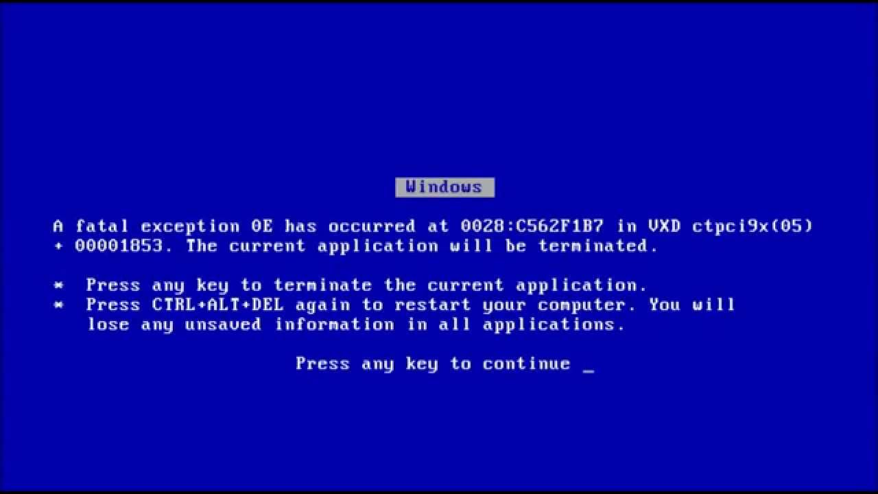

Slide 66
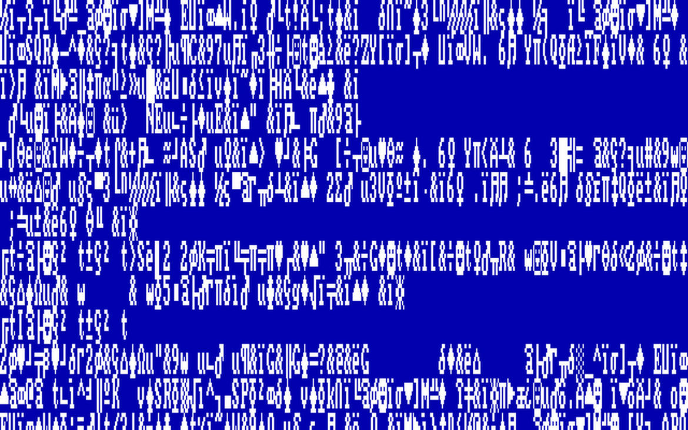

Slide 67


Slide 70


Slide 71
<?xml version="1.0" encoding="UTF-8"?>
<xs:schema
xmlns:xs="http://www.w3.org/2001/XMLSchema"
xmlns:bdem="http://bloomberg.com/schemas/bdem">
<xs:simpleType name="Color">
<xs:restriction base="xs:string">
<xs:enumeration value="RED" bdem:id="0" />
<xs:enumeration value="GREEN" bdem:id="1" />
<xs:enumeration value="PURPLE" bdem:id="2" />
</xs:restriction>
</xs:simpleType>
</xs:schema>

Slide 72
<?xml version="1.0" encoding="UTF-8"?>
<xs:schema
xmlns:xs="http://www.w3.org/2001/XMLSchema"
xmlns:bdem="http://bloomberg.com/schemas/bdem">
<xs:simpleType name="Color">
<xs:restriction base="xs:string">
<xs:enumeration value="RED" bdem:id="0" />
<xs:enumeration value="GREEN" bdem:id="1" />
<xs:enumeration value="PURPLE" bdem:id="2" />
</xs:restriction>
</xs:simpleType>
</xs:schema>

Slide 73
<?xml version="1.0" encoding="UTF-8"?>
<xs:schema
xmlns:xs="http://www.w3.org/2001/XMLSchema"
xmlns:bdem="http://bloomberg.com/schemas/bdem">
<xs:simpleType name="Color">
<xs:restriction base="xs:string">
<xs:enumeration value="RED" bdem:id="0" />
<xs:enumeration value="GREEN" bdem:id="1" />
<xs:enumeration value="PURPLE" bdem:id="2" />
</xs:restriction>
</xs:simpleType>
</xs:schema>

Slide 74
<?xml version="1.0" encoding="UTF-8"?>
<xs:schema
xmlns:xs="http://www.w3.org/2001/XMLSchema"
xmlns:bdem="http://bloomberg.com/schemas/bdem">
<xs:simpleType name="Color">
<xs:restriction base="xs:string">
<xs:enumeration value="RED" bdem:id="0" />
<xs:enumeration value="GREEN" bdem:id="1" />
<xs:enumeration value="PURPLE" bdem:id="2" />
</xs:restriction>
</xs:simpleType>
</xs:schema>

Slide 75
<?xml version="1.0" encoding="UTF-8"?>
<xs:schema
xmlns:xs="http://www.w3.org/2001/XMLSchema"
xmlns:bdem="http://bloomberg.com/schemas/bdem">
<xs:simpleType name="Color">
<xs:restriction base="xs:string">
<xs:enumeration value="RED" bdem:id="0" />
<xs:enumeration value="GREEN" bdem:id="1" />
<xs:enumeration value="PURPLE" bdem:id="2" />
</xs:restriction>
</xs:simpleType>
</xs:schema>

Slide 76
$ bas_codegen.pl \
> --mode msg \
> --msgExpand \
> --noAggregateConversion \
> --noExternalization \
> --package msgs \
> color.xsd
The schema is valid
Generating ./msgs_color.cpp
Generating ./msgs_color.h

Slide 77
$ wc -l msgs_color.{h,cpp}
167 msgs_color.h
119 msgs_color.cpp
286 total

Slide 78
$ less msgs_color.{h,cpp}
// msgs_color.h *DO NOT EDIT* @generated -*-C++-*-
#ifndef INCLUDED_MSGS_COLOR
#define INCLUDED_MSGS_COLOR
#ifndef INCLUDED_BDES_IDENT
#include <bdes_ident.h>
#endif
BDES_IDENT_RCSID(msgs_color_h, "$Id$ $CSID$")
BDES_IDENT_PRAGMA_ONCE
//@PURPOSE: Provide value-semantic attribute classes
//
//@AUTHOR: David GOFFREDO (dgoffredo@bloomberg.net)
#ifndef INCLUDED_BSLALG_TYPETRAITS
#include <bslalg_typetraits.h>
#endif
#ifndef INCLUDED_BDEAT_ATTRIBUTEINFO
#include <bdeat_attributeinfo.h>
#endif
#ifndef INCLUDED_BDEAT_ENUMERATORINFO
#include <bdeat_enumeratorinfo.h>
#endif

Slide 79
$ less msgs_color.{h,cpp}
#ifndef INCLUDED_BDEAT_TYPETRAITS
#include <bdeat_typetraits.h>
#endif
#ifndef INCLUDED_BSLS_ASSERT
#include <bsls_assert.h>
#endif
#ifndef INCLUDED_BSL_IOSFWD
#include <bsl_iosfwd.h>
#endif
#ifndef INCLUDED_BSL_OSTREAM
#include <bsl_ostream.h>
#endif
#ifndef INCLUDED_BSL_STRING
#include <bsl_string.h>
#endif

Slide 80
$ less msgs_color.{h,cpp}
namespace BloombergLP {
namespace msgs {
// ===========
// class Color
// ===========
struct Color {
public:
// TYPES
enum Value {
RED = 0
, GREEN = 1
, PURPLE = 2
};
enum {
NUM_ENUMERATORS = 3
};
// CONSTANTS
static const char CLASS_NAME[];
static const bdeat_EnumeratorInfo ENUMERATOR_INFO_ARRAY[];

Slide 81
$ less msgs_color.{h,cpp}
// CLASS METHODS
static const char *toString(Value value);
// Return the string representation exactly matching the enumerator
// name corresponding to the specified enumeration 'value'.
static int fromString(Value *result,
const char *string,
int stringLength);
// Load into the specified 'result' the enumerator matching the
// specified 'string' of the specified 'stringLength'. Return 0 on
// success, and a non-zero value with no effect on 'result' otherwise
// (i.e., 'string' does not match any enumerator).
static int fromString(Value *result,
const bsl::string& string);
// Load into the specified 'result' the enumerator matching the
// specified 'string'. Return 0 on success, and a non-zero value with
// no effect on 'result' otherwise (i.e., 'string' does not match any
// enumerator).
static int fromInt(Value *result, int number);
// Load into the specified 'result' the enumerator matching the
// specified 'number'. Return 0 on success, and a non-zero value with
// no effect on 'result' otherwise (i.e., 'number' does not match any
// enumerator).

Slide 82
$ less msgs_color.{h,cpp}
static bsl::ostream& print(bsl::ostream& stream, Value value);
// Write to the specified 'stream' the string representation of
// the specified enumeration 'value'. Return a reference to
// the modifiable 'stream'.
};
// FREE OPERATORS
inline
bsl::ostream& operator<<(bsl::ostream& stream, Color::Value rhs);
// Format the specified 'rhs' to the specified output 'stream' and
// return a reference to the modifiable 'stream'.
} // close package namespace
// TRAITS
BDEAT_DECL_ENUMERATION_TRAITS(msgs::Color)
// ============================================================================
// INLINE FUNCTION DEFINITIONS
// ============================================================================

Slide 83
$ less msgs_color.{h,cpp}
namespace msgs {
// -----------
// class Color
// -----------
// CLASS METHODS
inline
int Color::fromString(Value *result, const bsl::string& string)
{
return fromString(result,
string.c_str(),
static_cast<int>(string.length()));
}
inline
bsl::ostream& Color::print(bsl::ostream& stream,
Color::Value value)
{
return stream << toString(value);
}
} // close package namespace

Slide 84
$ less msgs_color.{h,cpp}
// FREE FUNCTIONS
inline
bsl::ostream& msgs::operator<<(
bsl::ostream& stream,
msgs::Color::Value rhs)
{
return msgs::Color::print(stream, rhs);
}
} // close enterprise namespace
#endif
// GENERATED BY BLP_BAS_CODEGEN_3.8.26 Fri Oct 13 21:00:46 2017
// USING bas_codegen.pl --mode msg --msgExpand –noAggregateConversion --noExternalization --package msgs generated.xsd
// ----------------------------------------------------------------------------
// NOTICE:
// Copyright (C) Bloomberg L.P., 2017
// All Rights Reserved.
// Property of Bloomberg L.P. (BLP)
// This software is made available solely pursuant to the
// terms of a BLP license agreement which governs its use.
// ------------------------------ END-OF-FILE ---------------------------------

Slide 85
$ less msgs_color.{h,cpp}
// msgs_color.cpp *DO NOT EDIT* @generated -*-C++-*-
#include <bdes_ident.h>
BDES_IDENT_RCSID(msgs_color_cpp,"$Id$ $CSID$")
#include <msgs_color.h>
#include <bdeat_formattingmode.h>
#include <bdeat_valuetypefunctions.h>
#include <bdeu_print.h>
#include <bdeu_printmethods.h>
#include <bdeu_string.h>
#include <bdlb_print.h>
#include <bslim_printer.h>
#include <bsls_assert.h>
#include <bsl_iomanip.h>
#include <bsl_limits.h>
#include <bsl_ostream.h>
namespace BloombergLP {
namespace msgs {

Slide 86
$ less msgs_color.{h,cpp}
// -----------
// class Color
// -----------
// CONSTANTS
const char Color::CLASS_NAME[] = "Color";
const bdeat_EnumeratorInfo Color::ENUMERATOR_INFO_ARRAY[] = {
{
Color::RED,
"RED",
sizeof("RED") - 1,
""
},
{
Color::GREEN,
"GREEN",
sizeof("GREEN") - 1,
""
},
{
Color::PURPLE,
"PURPLE",
sizeof("PURPLE") - 1,
""
}
};

Slide 87
$ less msgs_color.{h,cpp}
// CLASS METHODS
int Color::fromInt(Color::Value *result, int number)
{
switch (number) {
case Color::RED:
case Color::GREEN:
case Color::PURPLE:
*result = (Color::Value)number;
return 0;
default:
return -1;
}
}

Slide 88
$ less msgs_color.{h,cpp}
int Color::fromString(
Color::Value *result,
const char *string,
int stringLength)
{
for (int i = 0; i < 3; ++i) {
const bdeat_EnumeratorInfo& enumeratorInfo =
Color::ENUMERATOR_INFO_ARRAY[i];
if (stringLength == enumeratorInfo.d_nameLength
&& 0 == bsl::memcmp(enumeratorInfo.d_name_p, string, stringLength))
{
*result = (Color::Value)enumeratorInfo.d_value;
return 0;
}
}
return -1;
}

Slide 89
$ less msgs_color.{h,cpp}
const char *Color::toString(Color::Value value)
{
switch (value) {
case RED: {
return "RED";
} break;
case GREEN: {
return "GREEN";
} break;
case PURPLE: {
return "PURPLE";
} break;
}
BSLS_ASSERT(!"invalid enumerator");
return 0;
}
} // close package namespace
} // close enterprise namespace

Slide 90
$ less msgs_color.{h,cpp}
// GENERATED BY BLP_BAS_CODEGEN_3.8.26 Fri Oct 13 21:00:46 2017
// USING bas_codegen.pl --mode msg --msgExpand --noAggregateConversion --package msgs generated.xsd
// ----------------------------------------------------------------------------
// NOTICE:
// Copyright (C) Bloomberg L.P., 2017
// All Rights Reserved.
// Property of Bloomberg L.P. (BLP)
// This software is made available solely pursuant to the
// terms of a BLP license agreement which governs its use.
// ------------------------------ END-OF-FILE ---------------------------------

Slide 91
#include <msgs_color.h>
Color::Value favorite = Color::PURPLE;
cout << "I like " << favorite;
“I like PURPLE”

Slide 92
Color favorite;
cin >> favorite;
if (!cin) {
cerr << "That's not a color.";
return 1;
}
if (favorite == Color::e_PURPLE) {
cout << "Good choice.";
}
else {
cout << favorite << " is in poor taste.";
}
// ... insert magic here ...
“RED is in poor taste”

Slide 93
bslmc::enumeration Color { RED, GREEN, PURPLE };
Color favorite;
cin >> favorite;
if (!cin) {
cerr << "That's not a color.";
return 1;
}
if (favorite == Color::e_PURPLE) {
cout << "Good choice.";
}
else {
cout << favorite << " is in poor taste.";
}
“RED is in poor taste”

Slide 94
DEFINE_ENUM(Color, RED, GREEN, PURPLE);
Color favorite;
cin >> favorite;
if (!cin) {
cerr << "That's not a color.";
return 1;
}
if (favorite == Color::e_PURPLE) {
cout << "Good choice.";
}
else {
cout << favorite << " is in poor taste.";
}
“RED is in poor taste”

Slide 95
Part Two
DEFINE_ENUM(NAME, ...);
Journey to the Center of the C++

Slide 96
When I type this:
DEFINE_ENUM(Color, RED, GREEN, PURPLE);

Slide 97
I want it to expand to this:
class Color {
public:
enum Value { e_RED, e_GREEN, e_PURPLE };
enum { k_NUM_VALUES = 3 };
static const StringRef(&names())[k_NUM_VALUES] // { ... }
private:
Value d_value;
public:
Color() // { .. }
Color(Value) // { ... }
operator Value() const // { ... }
StringRef toString() const // { ... }
friend ostream& operator<<(ostream&, const Color&) // { ... }
int fromString(const StringRef&) // { ... }
friend ostream& operator>>(ostream&, Color&) // { ... }
};
constants with the e_

Slide 98
where the strings are in the names() like this:
static const StringRef(&names())[k_NUM_VALUES]
{
static const StringRef(*dataPtr)[k_NUM_VALUES] = 0;
BSLMT_ONCE_DO
{
static const StringRef data[] = {
"RED", "GREEN", "PURPLE"
};
dataPtr = &data;
}
return *dataPtr;
}
each of the arguments “quoted”

Slide 99


Slide 100
Say you want to overload a macro on arity, so that:
MY_MACRO(arg1);
MY_MACRO(arg1, arg2);
MY_MACRO(arg1, arg2, arg3);
invoke three totally different macro definitions.
Can that be done?

Slide 101
YES
but you’re not going to like it

Slide 102
A macro that expands to how many arguments were passed to it:
NUM_ARGS(foo, bar) → 2
#define NUM_ARGS(...) // ... ?
How can such a macro be defined?

Slide 103
For any finite maximum supported arity (say, 3):
#define NUM_ARGS_HELPER(A3, A2, A1, N, ...) \
N
#define NUM_ARGS(...) \
NUM_ARGS_HELPER(__VA_ARGS__, 3, 2, 1)
Then the expansion of
NUM_ARGS(foo, bar)
is 2, because:
NUM_ARGS_HELPER(foo, bar, 3, 2, 1)
// NUM_ARGS_HELPER(A3, A2, A1, N, ...) N

Slide 104
Then you can have:
#define MY_MACRO_1(A1) "one"
#define MY_MACRO_2(A1, A2) "two"
#define MY_MACRO_3(A1, A2, A3) "three"
#define MY_MACRO_HELPER_(N, ...) \
MY_MACRO_##N(__VA_ARGS__)
#define MY_MACRO_HELPER(N, ...) \
MY_MACRO_HELPER_(N, __VA_ARGS__)
#define MY_MACRO(...) \
MY_MACRO_HELPER(NUM_ARGS(__VA_ARGS__), \
__VA_ARGS__)

Slide 105
and so
cout << MY_MACRO(foo, bar);
expands to
cout << "two";

Slide 106


Slide 107
For our enumeration class, we need to turn this
RED, GREEN, PURPLE
into this
e_RED, e_GREEN, e_PURPLE
and also into this
"RED", "GREEN", "PURPLE"

Slide 108
We can use token pasting for the enum literals:
#define ENUMIFY(X) e_ ## X
and we can use token stringification for the strings:
#define QUOTE(X) #X
except due to the order of operations we need helpers:
#define ENUMIFY_(X) e_ ## X
#define ENUMIFY(X) ENUMIFY_(X)
#define QUOTE_(X) #X
#define QUOTE(X) QUOTE_(X)

Slide 109
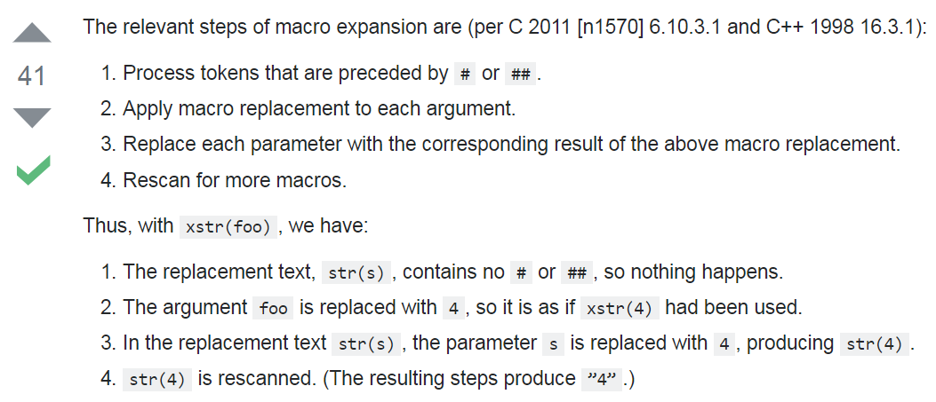
That’s because of the way the pre-processor works:
#define ENUMIFY(X) e_ ## X
and we can use token stringification for the strings:
#define QUOTE(X) #X
except due to the order of operations we need helpers:
#define ENUMIFY_(X) e_ ## X
#define ENUMIFY(X) ENUMIFY_(X)
#define QUOTE_(X) #X
#define QUOTE(X) QUOTE_(X)
https://stackoverflow.com/a/16990634

Slide 110
So now, for example, this:
cout << QUOTE(RED) << ENUMIFY(RED);
expands to:
cout << "RED" << e_RED;

Slide 111
GREAT
now how do we operate on lists of arguments?

Slide 112
To avoid repeating ourselves, let’s write MAP:
#define MAP(MACRO, LIST) // ?
so, for example, these invocations:
MAP(QUOTE, (foo, bar, baz))
MAP(ENUMIFY, (foo, bar, baz))
would expand to these expressions:
"foo", "bar", "baz"
e_foo, e_bar, e_baz

Slide 113
The idea is to use this algorithm:
(define (map func items)
(prepend (func (first items))
(map func (rest items))))
except we don’t have recursion in the pre-processor,
so we’ll have to write a macro for each arity n:
(define (map_{n} func items)
(prepend (func (first items))
(map_{n-1} func (rest items))))

Slide 114
Here’s how it looks in the pre-processor:
#define EXPAND(X) X
#define REST(X, ...) (__VA_ARGS__)
#define FIRST(X, ...) (X)
#define MAP_3(MACRO, LIST) \
EXPAND(MACRO FIRST LIST) \
, MAP_2(MACRO, REST LIST)

Slide 115
Let’s do an example looking at only the first part:
MAP_3(QUOTE, (killer, macro, stuff))
EXPAND(QUOTE FIRST (killer, macro, stuff))
EXPAND(QUOTE (killer))
EXPAND("killer")
"killer"
and then the rest of the definition gives us:
"killer", MAP_2(QUOTE, (macro, stuff))

Slide 116
Now combine that with the NUM_ARGS trick,
and you’ve got a multi-arity MAP macro:
#define MAP__(N, MACRO, LIST) \
MAP_##N(MACRO, LIST)
#define MAP_(N, MACRO, LIST) \
MAP__(N, MACRO, LIST)
#define MAP(MACRO, LIST) \
MAP_(NUM_ARGS LIST, MACRO, LIST)

Slide 117
TADA
now how do we apply this to DEFINE_ENUM?

Slide 118
#define DEFINE_ENUM(NAME, ...) \
\
class NAME { \ public: \
enum Value { MAP(ENUMIFY, (__VA_ARGS__)) }; \
\
enum { k_NUM_VALUES = NUM_ARGS(__VA_ARGS__) }; \
\
static const StringRef(&names())[k_NUM_VALUES] \
\
...

Slide 119
static const StringRef(&names())[k_NUM_VALUES] \
{ \
static const StringRef(*Ptr)[k_NUM_VALUES] = 0; \
\
BSLMT_ONCE_DO \
{ \
static const StringRef data[] = { \
MAP(QUOTE, (__VA_ARGS__)) \
}; \
Ptr = &data; \
} \
\
return *Ptr; \
}

Slide 120


Slide 121
Now this is working code:
DEFINE_ENUM(Color, RED, GREEN, PURPLE);
Color favorite;
cin >> favorite;
if (!cin) {
cerr << "That's not a color.";
return 1;
}
if (favorite == Color::e_PURPLE) {
cout << "Good choice.";
}
else {
cout << favorite << " is in poor taste.";
}

Slide 122
And the macro can appear where generated code cannot:
class Session {
public:
// PUBLIC TYPES
DEFINE_ENUM(Rcode,
SUCCESS,
BAD_ADDRESS,
DISCONNECT,
BAD_MESSAGE,
TIMEOUT);
// MANIPULATORS
Rcode open(...);
};

Slide 123
But there’s still something missing...
static bsl::ostream& print(bsl::ostream& stream, Value value);
// Write to the specified 'stream' the string representation of
// the specified enumeration 'value'. Return a reference to
// the modifiable 'stream'.
};
// FREE OPERATORS
inline
bsl::ostream& operator<<(bsl::ostream& stream, Color::Value rhs);
// Format the specified 'rhs' to the specified output 'stream' and
// return a reference to the modifiable 'stream'.
} // close package namespace
// TRAITS
BDEAT_DECL_ENUMERATION_TRAITS(msgs::Color)
Remember this?

Slide 124
Part Three
Codecs
Getting bdlat to work with DEFINE_ENUM

Slide 125
I want to be able to write this:
DEFINE_ENUM(Color, RED, GREEN, PURPLE);
istringstream input(
"[\"RED\",\"GREEN\",\"PURPLE\"]");
vector<Color> colors;
baljsn::Decoder().decode(input, &colors);
ostringstream output;
baljsn::Encoder().encode(output, colors);
assert(output.str() == input.str());

Slide 126


Slide 127
bdlat enumerations
A type Enum is a bdlat enumeration if:
overloads of the bdlat_enumfunctions exist for Enum and are accessible via argument dependent lookup, and
the IsEnumeration trait is specialized for Enum in the bdlat_EnumFunctions namespace.

Slide 128
bdlat enumerations
These are the functions to overload:
int bdlat_enumFromInt(Enum *result,
int number);
int bdlat_enumFromString(Enum *result,
const char *string,
int stringLength);
void bdlat_enumToInt(int *result,
const Enum& value);
void bdlat_enumToString(string *result,
const Enum& value);

Slide 129
bdlat enumerations
This trait is to be specialized for TYPE=Enum:
namespace BloombergLP {
namespace bdlat_EnumFunctions {
template <typename TYPE>
struct IsEnumeration;
}}

Slide 130
bdlat enumerations
Like this:
namespace BloombergLP {
namespace bdlat_EnumFunctions {
template <>
struct IsEnumeration<Enum>
{
enum { VALUE = 1 };
};
}}

Slide 131
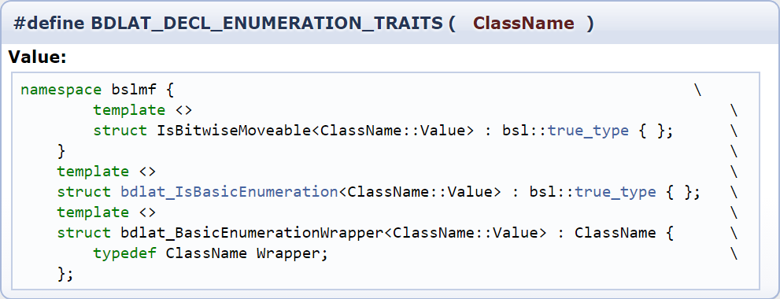
bdlat enumerations
This is how bas_codegen.pl handles the trait:
There’s that macro from the generated code

Slide 132
bdlat enumerations
But bas_codegen.pl can pick its namespace
and DEFINE_ENUM cannot,
so we’ll have to do something else.

Slide 133
bdlat enumerations
Let’s go back to the functions
int bdlat_enumFromInt(Enum *result,
int number);
int bdlat_enumFromString(Enum *result,
const char *string,
int stringLength);
void bdlat_enumToInt(int *result,
const Enum& value);
void bdlat_enumToString(string *result,
const Enum& value);

Slide 134
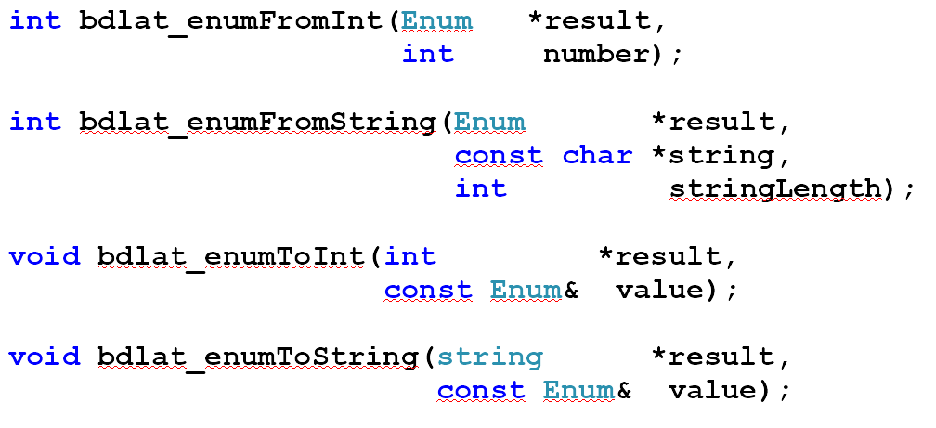
bdlat enumerations
We can’t include these in the macro,
because they could end up in a class scope.
Instead, how do we define these functions
for all types created by DEFINE_ENUM?

Slide 135
INHERITANCE
let’s try it

Slide 136
bdlat enumerations
Say each class created by DEFINE_ENUM
had a common base class EnumBase:
#define DEFINE_ENUM(NAME, ...) \
class NAME : public EnumBase { \
...

Slide 137
bdlat enumerations
Then we could generally define these functions:
int bdlat_enumFromInt(EnumBase *result,
int number);
int bdlat_enumFromString(EnumBase *result,
const char *string,
int stringLength);
void bdlat_enumToInt(int *result,
const EnumBase& value);
void bdlat_enumToString(string *result,
const EnumBase& value);

Slide 138
bdlat enumerations
and...
the functions would know nothing about the actual enumerations

Slide 139


Slide 140
bdlat enumerations
The base class needs knowledge of the derived class
Can it be done?

Slide 141
The Curiously Recurring Template Pattern
let’s try it

Slide 142
bdlat enumerations
Each class Enum created by DEFINE_ENUM
has a common base class EnumBase<Enum>:
#define DEFINE_ENUM(NAME, ...) \
class NAME : public EnumBase<NAME> { \
...

Slide 143
bdlat enumerations
Then we could generally define these functions:
template <typename ENUM>
int bdlat_enumFromInt(EnumBase<ENUM> *result,
int number);
...

Slide 144
bdlat enumerations
Then we could generally define these functions:
template <typename ENUM>
int bdlat_enumFromInt(EnumBase<ENUM> *result,
int number)
{
if (number < 0 || number >= ENUM::k_NUM_VALUES)
return -1;
ENUM& derived = static_cast<ENUM&>(*result);
derived = ENUM::Value(number);
return 0;
}

Slide 145
SUCCESS
Now what about that trait...

Slide 146
bdlat enumerations
How can we specialize this trait
for all classes derived from EnumBase<T>?
namespace BloombergLP {
namespace bdlat_EnumFunctions {
template <typename TYPE>
struct IsEnumeration;
}}

Slide 147
bdlat enumerations
Does the compiler accept this?
namespace BloombergLP {
namespace bdlat_EnumFunctions {
template <
typename T,
typename=enable_if<
has_enum_base<T>::value>::type>
struct IsEnumeration {
...

Slide 148
NO
Error: IsEnumeration previously defined with one template parameter, but here is defined with two

Slide 149


Slide 150
The Curiously Recurring Template Pattern
not going to work

Slide 151
bdlat enumerations
What are we going to do about this trait?
namespace BloombergLP {
namespace bdlat_EnumFunctions {
template <typename TYPE>
struct IsEnumeration;
}}

Slide 152


Slide 153
bdlat enumerations
What if each type generated by DEFINE_ENUM were an instantiation of some template, BasicEnum?
template <typename UTIL>
class BasicEnum {
typename UTIL::Value d_value;
public:
BasicEnum(typename UTIL::Value)
...
};

Slide 154
bdlat enumerations
Then we could have this:
#define DEFINE_ENUM(NAME, ...) \
class NAME ## _Util { \
... \
}; \
\
typedef BasicEnum<NAME ## _Util> NAME

Slide 155
bdlat enumerations
For example, this:
DEFINE_ENUM(Color, RED, GREEN, PURPLE);
would expand to this:
class Color_Util {
...
};
typedef BasicEnum<Color_Util> Color;

Slide 156
bdlat enumerations
Then the trait is just a partial specialization
namespace BloombergLP {
namespace bdlat_EnumFunctions {
template <typename UTIL>
struct IsEnumeration<BasicEnum<UTIL> >
{
enum { VALUE = 1 };
};
}}

Slide 157
bdlat enumerations
The functions are similar to before:
template <typename UTIL>
int bdlat_enumFromInt(BasicEnum<UTIL> *result,
int number);
...

Slide 158
bdlat enumerations
The functions are similar to before:
template <typename UTIL>
int bdlat_enumFromInt(BasicEnum<UTIL> *result,
int number);
{
if (number < 0 || number >= UTIL::k_NUM_VALUES)
return -1;
*result = typename UTIL::Value(number);
return 0;
}

Slide 159
IT WORKS

Slide 160
This is now working code:
DEFINE_ENUM(Color, RED, GREEN, PURPLE);
stringstream input(
"[\"RED\",\"GREEN\",\"PURPLE\"]");
vector<Color> colors;
baljsn::Decoder().decode(input, &colors);
ostringstream output;
baljsn::Encoder().encode(output, colors);
assert(output.str() == input.str());

Slide 161


Slide 162
We’ve created a macro
DEFINE_ENUM(Color, RED, GREEN, PURPLE);
that expands to the definition of a type that:
behaves like a built-in enum,
doesn’t export its constant values,
can be inserted into and extracted from streams,
can appear in namespace, class, or function scope,
is compatible with bdlat-based codecs,
adheres to BDE typographical conventions, and
requires no external tool or language.

Slide 163
But wouldn’t this have been easier?
bslmc::enumeration Color {
RED,
GREEN,
PURPLE
};

Slide 164
fin

