Slide 1
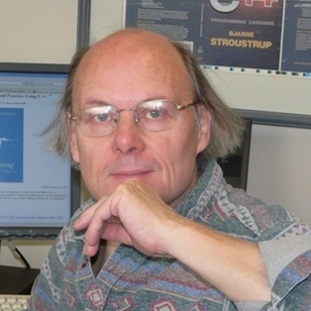

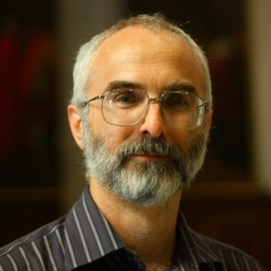

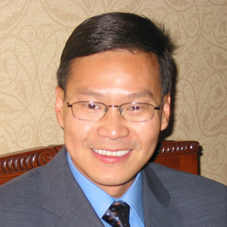









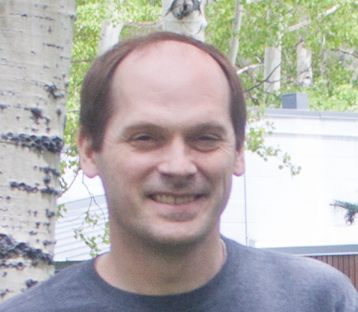


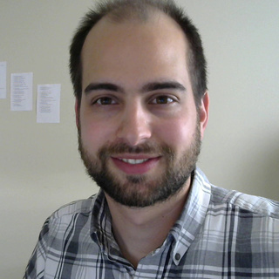


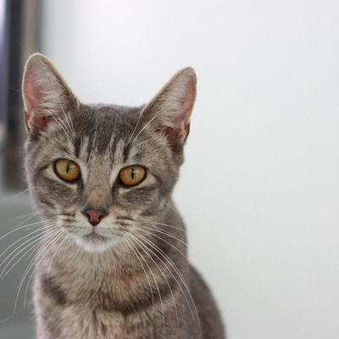
cppcon 2017
Attended eighteen talks
Saw twenty-one speakers

Slide 2

cppcon 2017
Some were boring

Slide 3
cppcon 2017
Here are the talks I liked

Slide 4


From security to performance to GPU programming: exploring modern allocators
Sergey Zubkov
Allocators allow you to do magic in legacy situations
Memory pools can prevent fragmentation

Slide 5
dynamic_cast From Scratch
Arthur O'Dwyer
Inheritance is cuckoo bananas
Informative talk. Takeaway:
If you want to understand your objects, use neither multiple nor virtual inheritance

Slide 6


Using Functional Programming Patterns to build a clean and simple HTTP routing API
Jeremy Demeule, Quentin Duval
Use expression templates to define declarative domain specific languages in your API
auto router = RequestRouter(
GET(Uri(“stocks”)/“current”/Int(“id”)), LastPrice(),
GET(Uri(“stocks”)/Ticker(“ticker”)), History(),
GET(Uri(“status”)/Regex(“(exchange|security)[0-9]+”), Status());
std::cout << typeid(router).name() << ‘\n’; // something insane

Slide 7
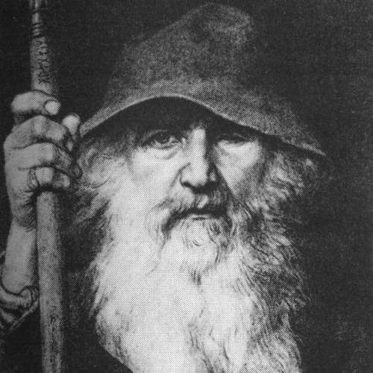
Agent based class design,
C++ with a robot glue gun
Odin Holmes
Odin is a C++ wizard
I don’t understand what Odin is doing
Something about assembling capabilities of electronic components at compile time in a modular fashion
Let the C++ compiler write your device code for you?

Slide 8

Meta: Thoughts on generative C++
(define-syntax define-record-type
(syntax-rules ()
((define-record-type type
(constructor constructor-tag ...)
predicate
(field-tag accessor . more) ...)
(begin
(define type
(make-record-type 'type '(field-tag ...)))
(define constructor
(record-constructor type '(constructor-tag ...)))
(define predicate
(record-predicate type))
(define-record-field type field-tag accessor . more)
...))))
Herb Sutter
Proposed an idea of what “meta-classes” might look like
I’m not turning C++ into Lisp, I promise!
I’m just simplifying what we already do, honest!

Slide 9
Reader-Writer Lock versus Mutex –
Understanding a Lost Bet
Jeffrey Mendelsohn
Just use a mutex
Always label your axes
Measure benchmarks in isolation

Slide 10
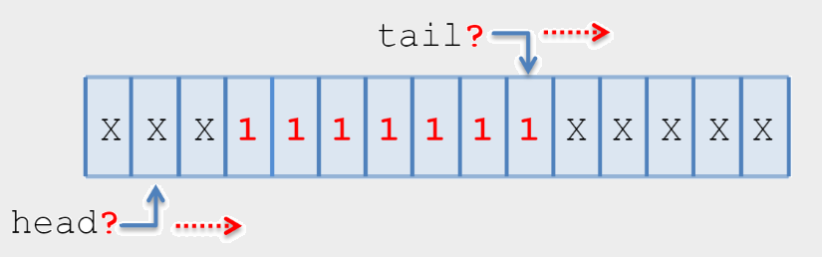
An Interesting Lock-free Queue –
Part 2 of N
Tony Van Eerd
Lock-free queues are interesting
Subtle
Fun to think about
You should never use one

Slide 11



Objects, Lifetimes, and References
oh my: the C++ Object Model, and Why it Matters to You
Nicole Mazzuca
Rebind reference members when assigning to object
Value/object relationship
Object
Value

Slide 12

So, you inherited a large code base...
David Sankel
How to improve BAS
Migration paths
Mnemonics, automated refactoring

Slide 13
template Slide Title
Author Name
The first bullet point
There might be more bullet points
And there might even be a bullet point whose text is so long that it wraps to the next line

